Slide 1
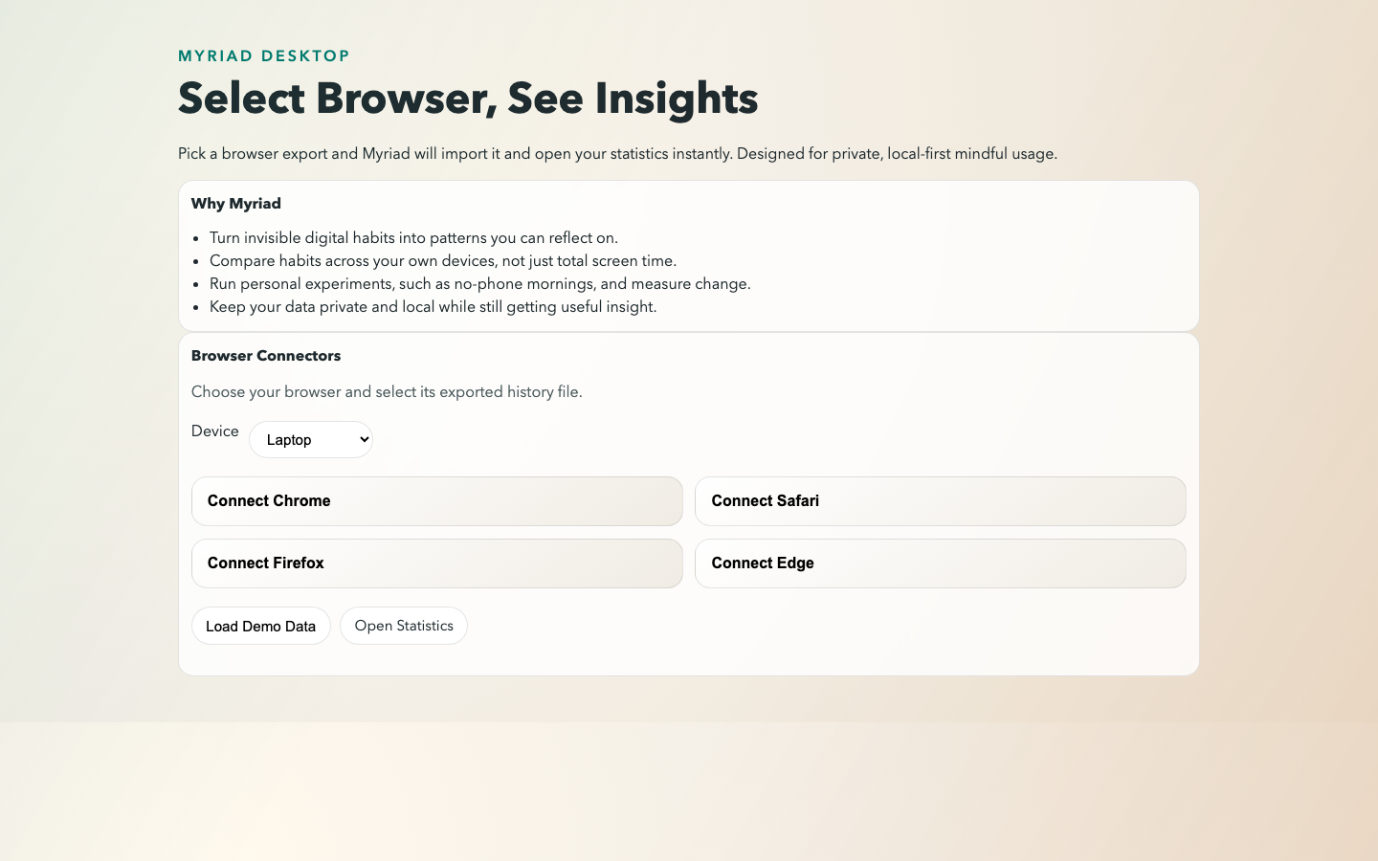
MYRIAD
A local-first, privacy-preserving
mindful habit tracker
Desktop app that imports activity exports and turns them into private insights — without default cloud upload.
Author: Said Osman (k2376552)
Programme: BSc Computer Science
Artefact: Electron + Express + SQLite
Demo deck based on the dissertation and app screenshots.
Notes:
[Sources] - User-provided dissertation screenshots (Myriad Dissertation | Said Osman | k2376552) and extracted images. - GitHub repository: https://github.com/JakkuAzzo/Myriad [/Sources]

Slide 2
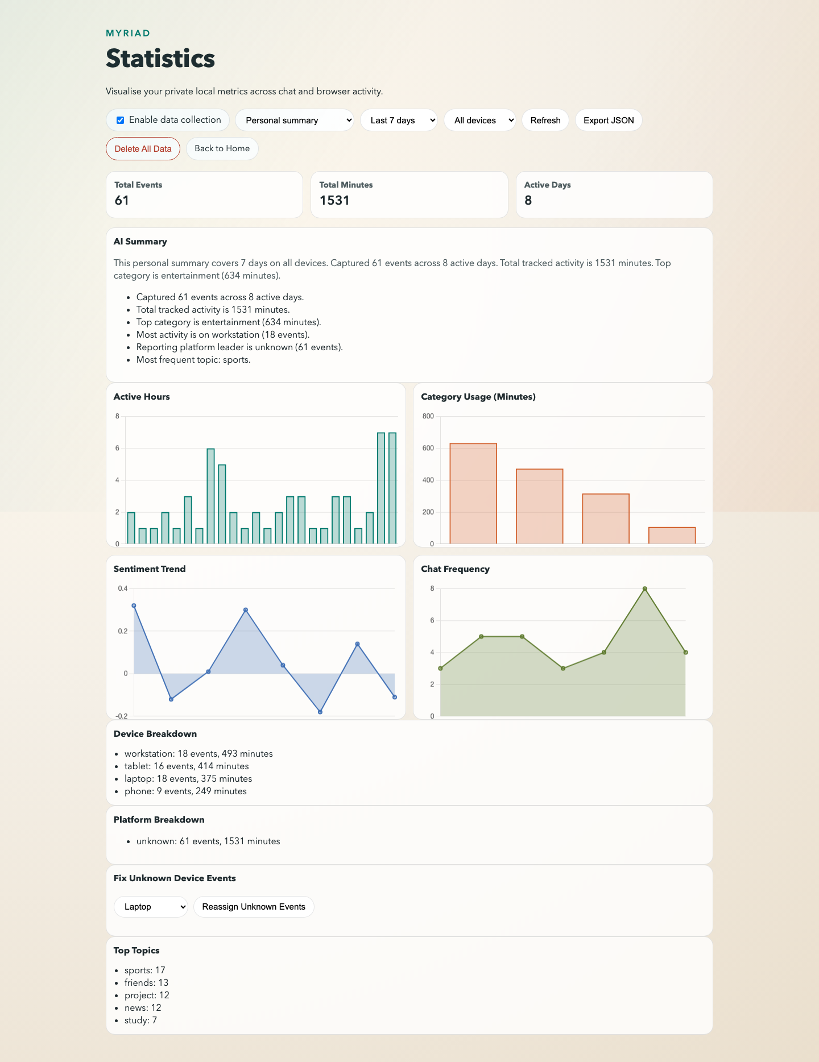
Problem → Myriad approach
Why this exists
Many wellbeing / self-tracking tools default to cloud-centric data collection.
Behavioural metadata can still be sensitive (patterns, routines, social rhythms).
Users want insight **without** surrendering raw data by default.
Myriad: local-first by design
Ingest user-controlled exports (e.g., browser history).
Compute aggregates and trends locally.
Offer controls: consent toggle, export, and delete.
Optional narrative summary with confidence cues.
Dashboard view (local statistics + AI summary)
Myriad • App overview
Notes:
[Sources] - User-provided dissertation screenshots and narrative description. [/Sources]

Slide 3
User flow (how a user gets value)
1) Select an export → 2) Import locally → 3) See insights
01
Select browser
02
Import & transform
03
Explore insights
Pick a browser export file
(e.g., Chrome/Safari/Firefox).
Connector parsing + normalisation
+ privacy transformations.
Open Statistics dashboard
+ optional AI summary.
Myriad • User flow
Notes:
[Sources] - User-provided dissertation screenshots and process description. [/Sources]

Slide 4
Dashboard tour (what you can see and control)
Key controls
Consent toggle (collect / pause)
Time window + device filters
Export JSON
Delete all data
AI summary + highlights
What you get
Totals + active days
Active hours patterns
Category usage
Sentiment trend
Chat frequency + topics
Myriad • Dashboard
Notes:
[Sources] - User-provided dissertation screenshots. [/Sources]

Slide 5
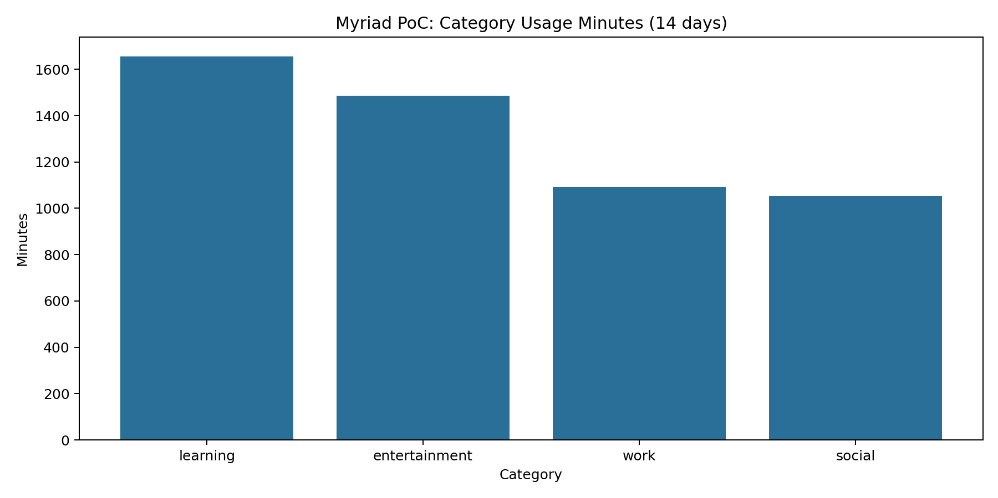
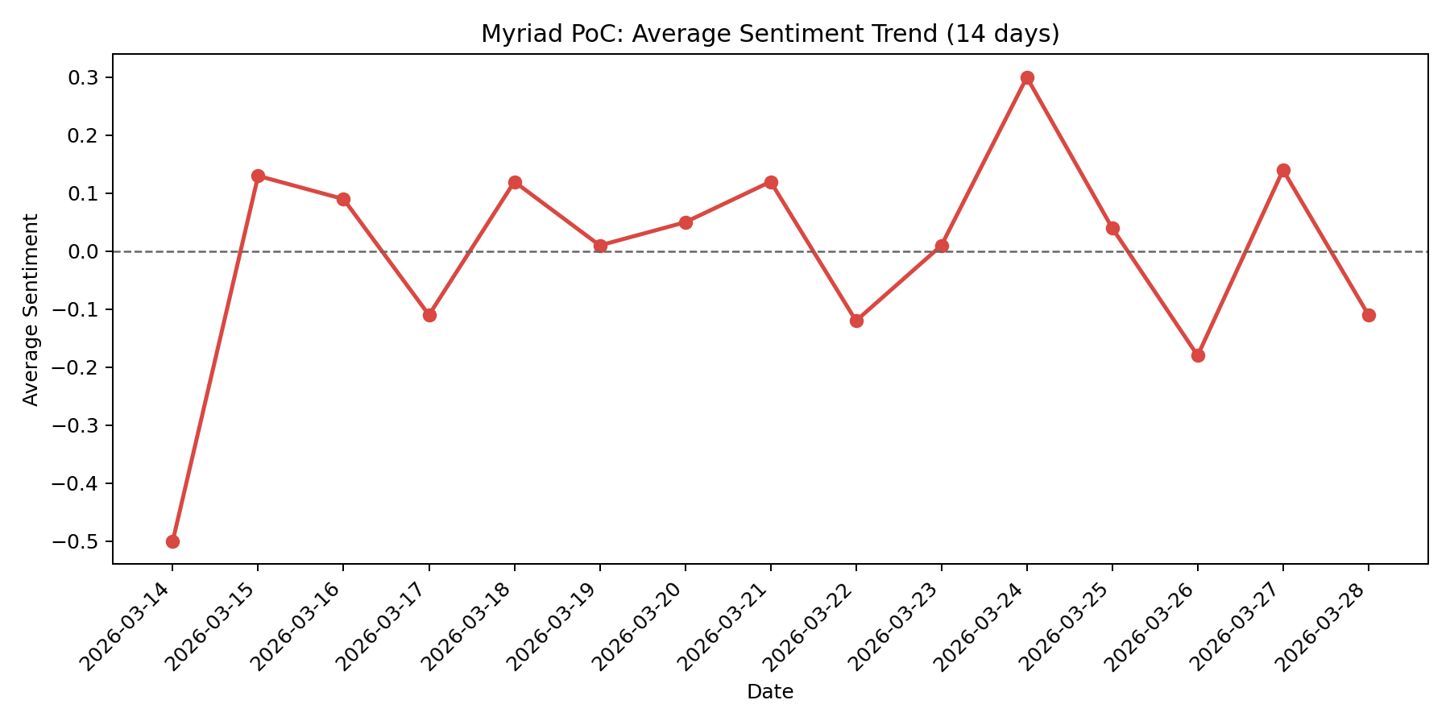
Example insights (from local analytics)
Two quick examples: category usage + sentiment trend
Category usage (minutes)
Average sentiment trend
Myriad • Analytics outputs
Notes:
[Sources] - User-provided dissertation charts (category usage, sentiment trend). [/Sources]

Slide 6
Privacy posture (controls that build trust)
Designed for privacy by default
Local processing pipeline
Local-first persistence (no mandatory cloud).
Consent-gated ingestion (collect / pause).
Identifier transformation (pseudonymisation) before storage.
Export and deletion controls for user autonomy.
Confidence cues on narrative summaries to reduce over-trust.
Import export file
(browser/chat)
Validate + normalise
(schema bounds)
Transform identifiers
(salted hash)
Store locally
(SQLite)
Compute insights
+ optional narrative
Myriad • Privacy by design
Notes:
[Sources] - User-provided dissertation (requirements table, privacy controls, consent/export/delete, confidence cues). [/Sources]

Slide 7
Implementation (tech stack + components)
Core components
Stack snapshot
Electron desktop UI
Local Express API (auth, ingestion, summaries)
SQLite persistence (single-file local DB)
Connector modules (imports)
Analytics + optional narrative summary module
Automated test suite (API + control integrity)
Node.js
Express
Electron
SQLite
Supertest
Optional ONNX
Component view
Electron UI
Local Express API
SQLite
Analytics + Summary
Everything runs locally; the UI talks to a local API which stores and summarises data.
Myriad • Implementation
Notes:
[Sources] - User-provided dissertation (technology stack, component mapping, realisation chapter). [/Sources]

Slide 8
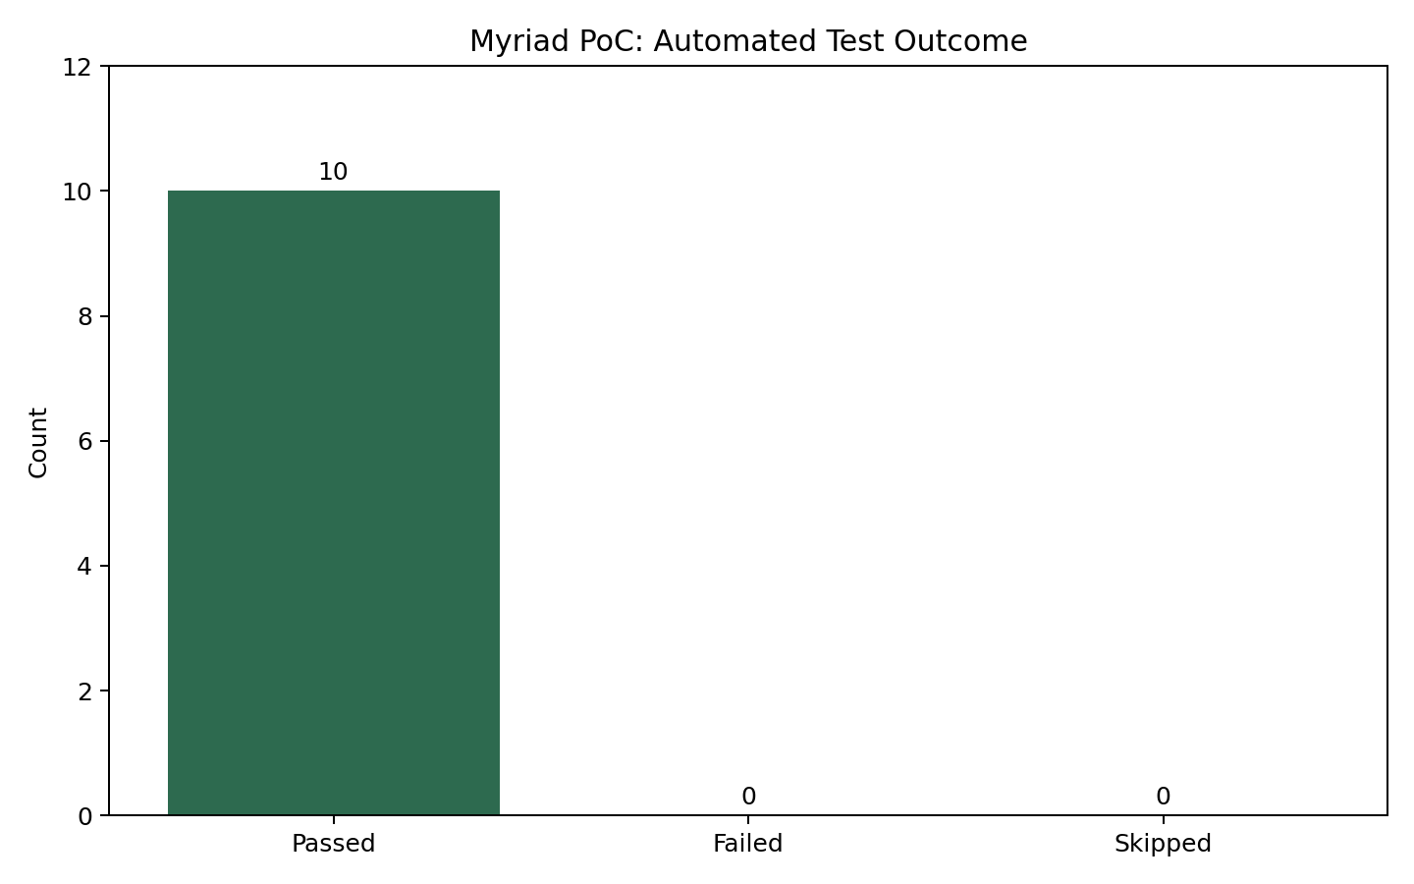
Validation (usability + system testing)
What was validated
Automated test outcome
Usability tasks T1–T4 mapped to requirements.
System tests for auth, ingestion, transformation, summaries, export/delete.
Controls validated: consent gating + per-user isolation.
Operational notes: packaging/dependency drift risks documented.
Key outcomes (snapshot)
• Automated tests: 10 passed, 0 failed
• Usability: strongest improvements needed in ingestion guidance + terminology
• Next: broader accessibility/usability validation + release-hardening checks
Regression suite focuses on privacy-critical behaviour (consent, isolation, transformation).
Myriad • Testing
Notes:
[Sources] - User-provided dissertation (Validation chapter, task-to-requirement mapping, automated test snapshot). [/Sources]

Slide 9
Roadmap / next steps
What’s next (if this becomes a product)
Priority improvements focus on trust, resilience, and broader real-world evaluation.
Security + privacy hardening
Product & research validation
Database encryption at rest + key management
Role-based access control (replace static admin key)
Retention windows + selective redaction policies
End-to-end encrypted sync across trusted devices
Broader usability + accessibility testing
More connectors + clearer ingestion guidance
Benchmark analytics latency on larger datasets
Threat modelling (STRIDE/LINDDUN) + mitigation traceability
Myriad • Roadmap
Notes:
[Sources] - User-provided dissertation (Future work and risk discussion; testing implications). [/Sources]

