Slide 1
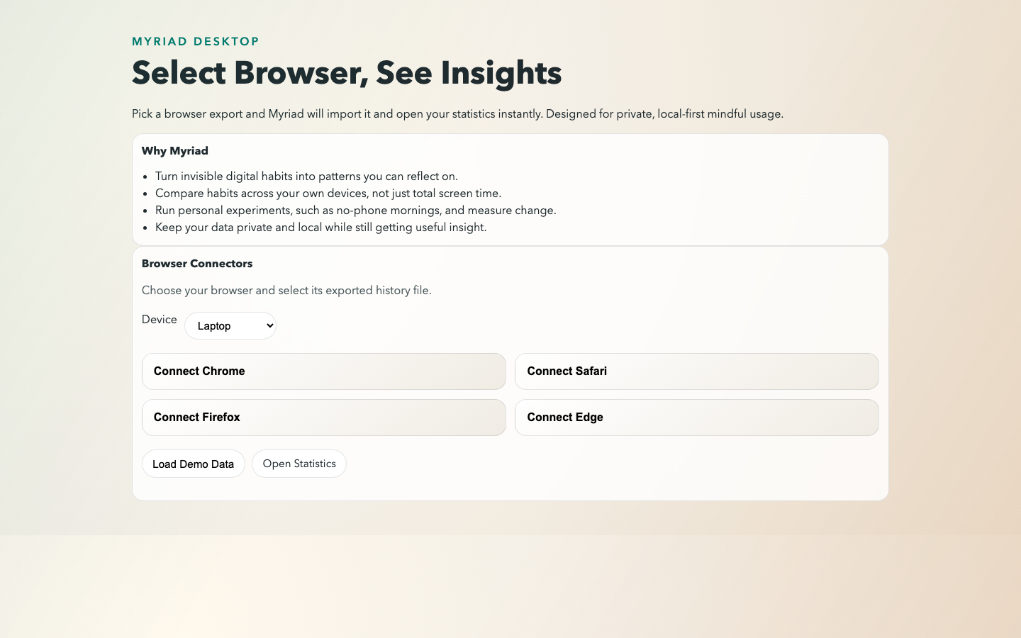
Myriad
Privacy-first mindful habit tracking across desktop and iOS
Final Year Project Presentation
Said Osman
Local-first analytics, behavior change, adaptive relapse prevention
Home dashboard screenshot
Myriad
16 Apr 2026

Slide 2
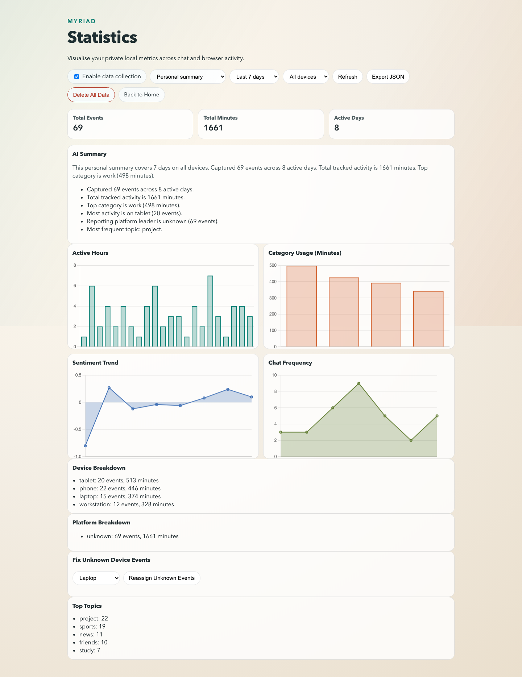
Problem, Aim, and Architecture
Usage drifts without timely feedback or practical intervention.
Myriad turns local event history into behavior-change plans.
Core stack: Electron, Express, SQLite, and browser/chat import connectors.
No external analytics backend is required for the MVP.
Stats / intervention view
Myriad
16 Apr 2026

Slide 3
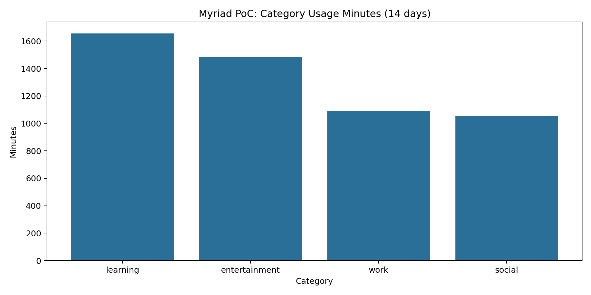
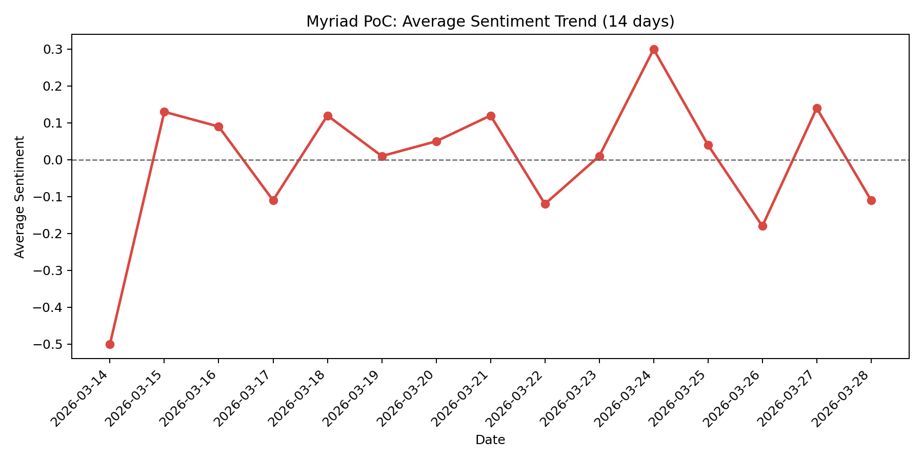
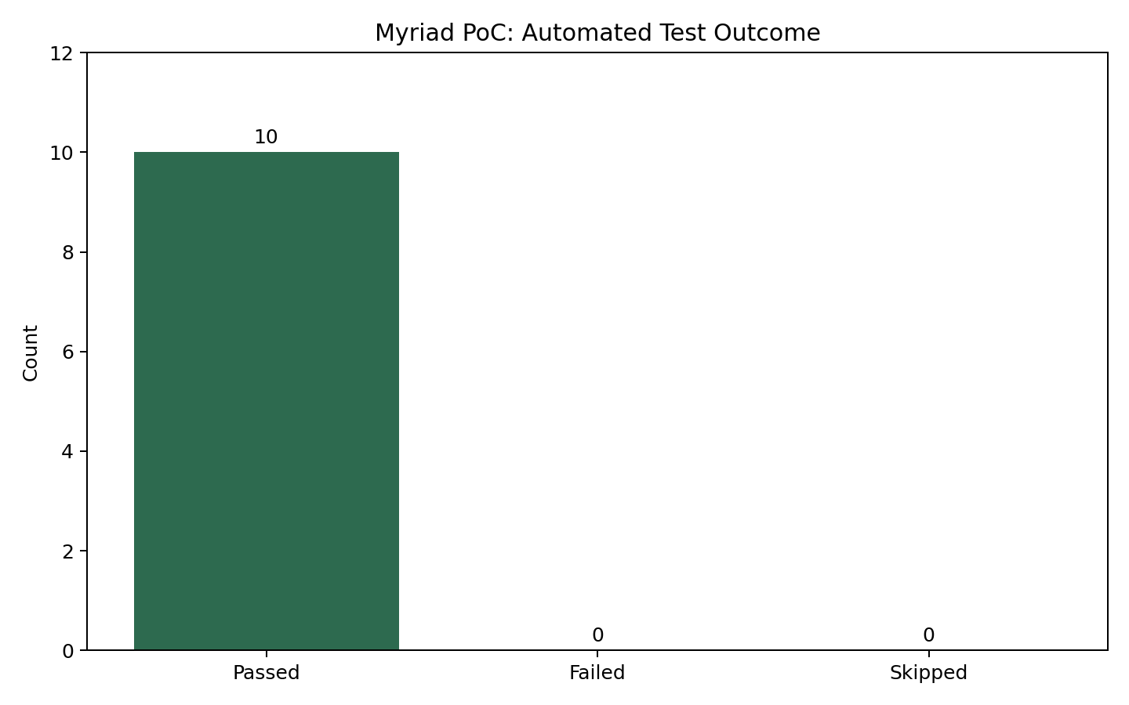
App Screenshots
Home and import flow
Stats and interventions
Category usage chart
Sentiment trend
Validation outcomes
Myriad
16 Apr 2026

Slide 4
Adaptive Relapse Risk Scoring
Risk combines trend, device usage, and time-of-day patterns.
The app classifies each goal as low, moderate, high, or critical risk.
Intervention prompts intensify automatically as risk rises.
The plan endpoint exposes detailed risk diagnostics for transparency.
Pattern evidence used by the risk model
Myriad
16 Apr 2026

Slide 5
Video Walkthrough: Desktop Flow
Embedded MP4 clip from the app demo.
Covers setup, import, and visualisation flow.
Embedded video clip
Myriad
16 Apr 2026

Slide 6
Video Walkthrough: iOS Simulator
Embedded simulator clip.
Shows the restored iOS test target and device flow.
Embedded video clip
Myriad
16 Apr 2026

Slide 7
Validation and Results
Node tests: 14/14 passed.
E2E UI test: passed.
iOS build/test flow: restored and passing via test:ios.
Usability pilot: SUS 73.8/100 with positive qualitative feedback.
Evidence summary screenshot
Myriad
16 Apr 2026

Slide 8
Thank You
Questions and feedback
Artifacts, source, and media are included for reproducibility.
Myriad
16 Apr 2026

