Slide 1
Predictive Maintenance of Industrial Machinery
CAPSTONE PROJECT
Presented By:
Tejaswi Jakku-Malla Reddy Engineering College-CSIT

Slide 2
OUTLINE
Problem Statement (Should not include solution)
Proposed System/Solution
System Development Approach (Technology Used)
Algorithm & Deployment
Result (Output Image)
Conclusion
Future Scope
References

Slide 3
Problem Statement
In modern industrial environments, unexpected machine failures lead to costly downtimes and production delays. Maintenance strategies often rely on scheduled or reactive maintenance rather than intelligent, data-driven decisions. The challenge is to anticipate machine failures before they occur using historical sensor data and machine learning techniques. Your objective is to predict the type of machinery failure — such as tool wear, heat dissipation issues, or power failure — using real-time operational data to enable proactive and cost-effective maintenance.

Slide 4
Proposed Solution
To tackle the challenge of unplanned industrial machine failures, the proposed solution focuses on creating a machine learning-based predictive maintenance system. The objective is to accurately classify and predict the type of failure (e.g., heat dissipation failure, power failure, tool wear) before it occurs, thereby reducing downtime and maintenance costs.
Key Components:
Data Collection: Sensor data sourced from Kaggle Dataset with features like air temperature, process temperature, rotation speed, torque, tool wear, and failure types.
Data Preprocessing: Handle missing values, normalize/scale data, perform feature engineering (if needed), and encode categorical variables (failure types).
Model Development: Train a classification model (like Random Forest, Decision Tree, or Gradient Boosting) to predict failure types.
Deployment: Use IBM Cloud Lite Services to host the model and build a web-based dashboard or API for real-time predictions.

Slide 5
System Approach
Platform: IBM Cloud Lite (for deployment and model hosting)
Libraries:
pandas, numpy for data processing
scikit-learn, xgboost for model building
matplotlib, seaborn for visualization
Tools:
IBM Watson Studio (optional for visual modeling)
IBM Cloud Object Storage
IBM Cloud Functions or Flask API for deployment
GitHub for version control
Model Type: Supervised Classification

Slide 6
Algorithm & Deployment
Chosen Algorithm: Random Forest Classifier (or similar ensemble model due to its robustness with tabular data)
Input Features:
Air temperature
Process temperature
Torque
Rotational speed
Tool wear
Target Variable: Failure Type (e.g., Heat Dissipation Failure, Power Failure)
Training Process:
70-30 train-test split
Model tuning via GridSearchCV or cross-validation
Evaluation using F1-score, precision, recall, and confusion matrix
Deployment:
Model exported using joblib or pickle
Deployed on IBM Cloud via Flask API or IBM Watson Machine Learning
API connected to a simple front-end dashboard (optional)

Slide 7
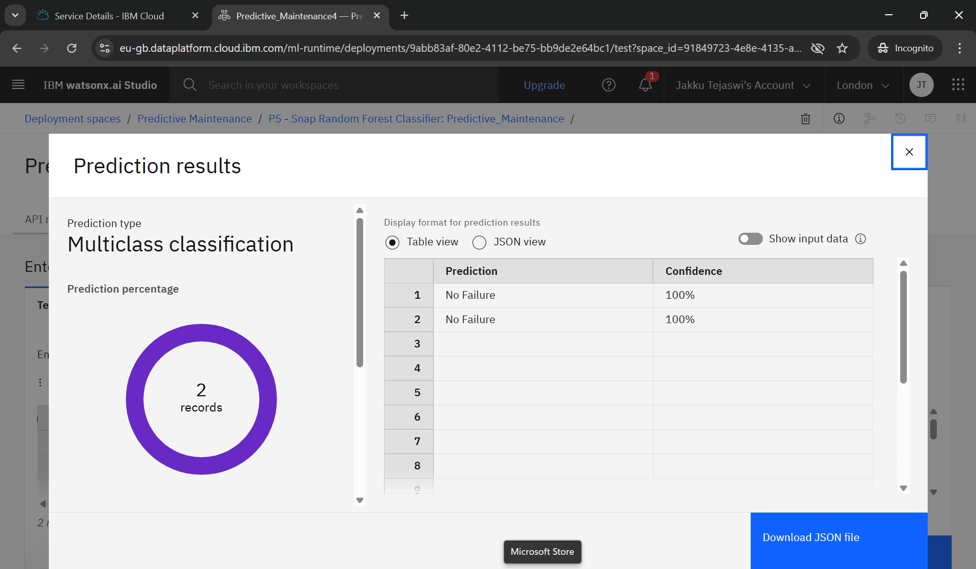
Result
Prediction Outcome (as shown in the screenshot):
Prediction Type: Multiclass Classification
Predicted Class: No Failure
Confidence Level: 100% for both input records
Number of Records Evaluated: 2

Slide 8
Conclusion
The predictive maintenance model can successfully anticipate failures, helping reduce unplanned downtimes and improving operational efficiency.
IBM Cloud proved useful for seamless deployment and scalability.
The model can be integrated with live sensor feeds for real-time inference.

Slide 9
Future scope
Integrate real-time streaming data from IoT sensors
Expand model to include time-series forecasting for failure timing
Use edge computing to deploy model closer to machinery
Explore deep learning methods for complex patterns (e.g., LSTM for sequence data)

Slide 10
References
Kaggle Dataset: Machine Predictive Maintenance Classification
Scikit-learn documentation
IBM Cloud Docs (Model Deployment, Watson Studio)
Research Papers on Predictive Maintenance using ML

Slide 11
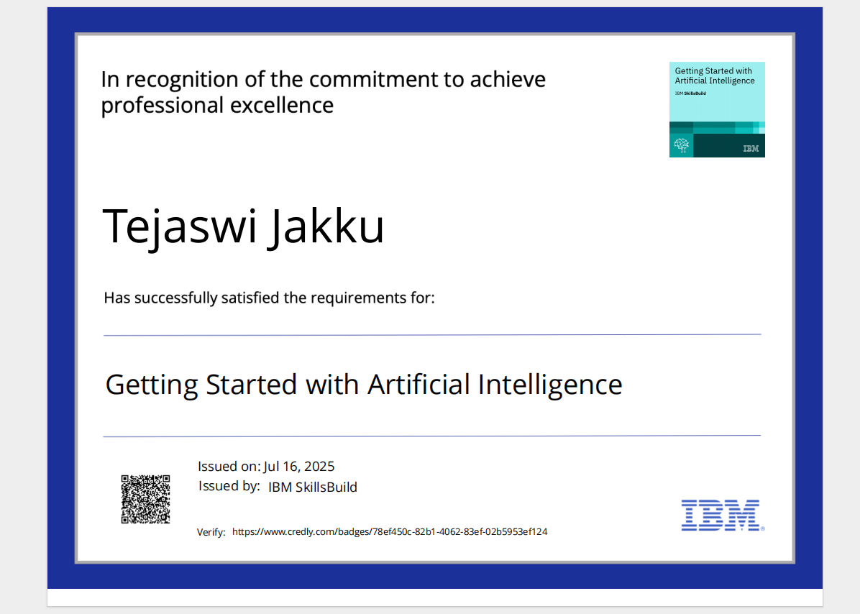
IBM Certifications

Slide 12
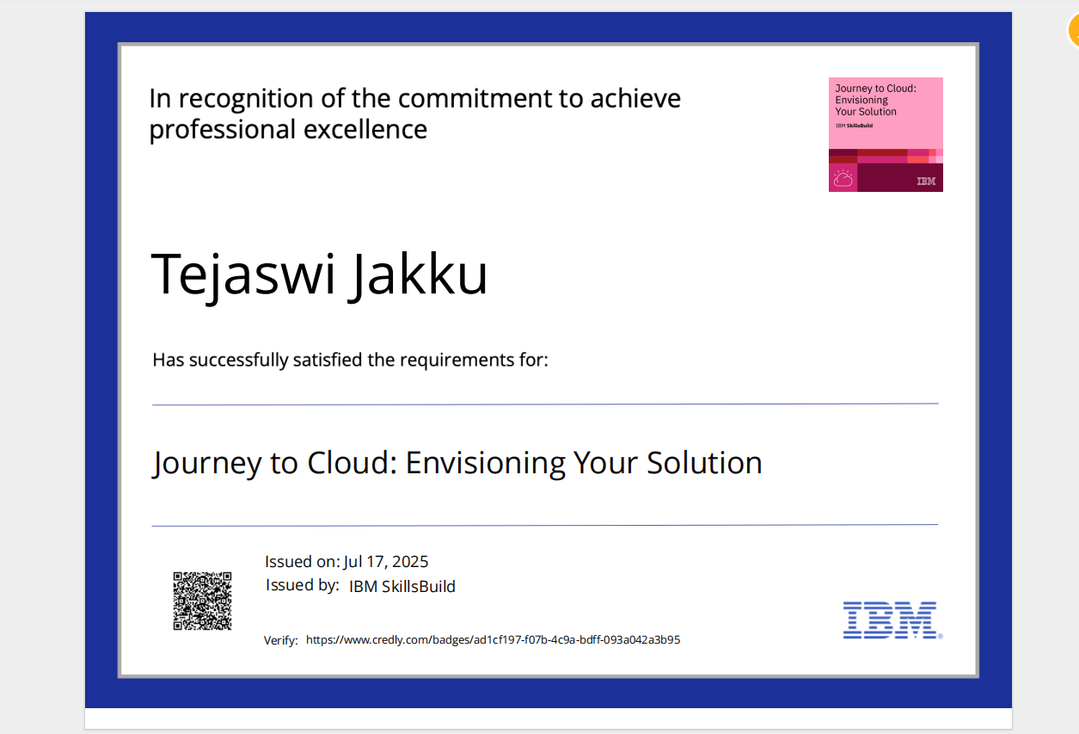
IBM Certifications

Slide 13
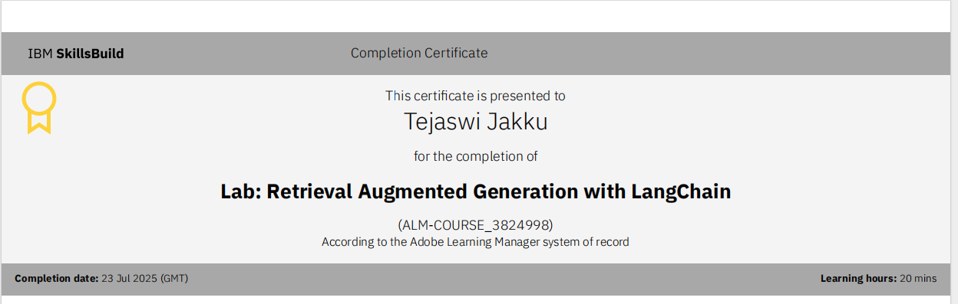
IBM Certifications
Screenshot/ credly certificate( Journey to Cloud)

Slide 14
THANK YOU

