Slide 1

Project Report: Census Exploration – Annual Business Survey (2019)
Jakob Thunen, Daniel Stein, Christopher Ng, Alysia Halverson

Slide 2
Company Summary
The Company Summary dataset includes data on the surveyed businesses, such as the number of firms within the company, the NAICS industry that the business operates in, and the company’s annual payroll. The structure of this data allows to make broad, general observations without getting too bogged down in details.

Slide 3
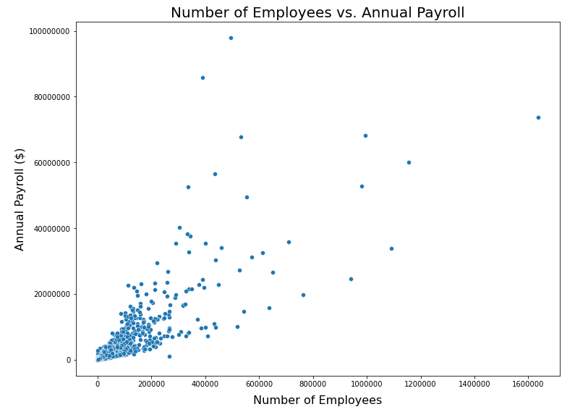
Is there any relation to a company’s number of employees and its annual payroll?

Slide 4
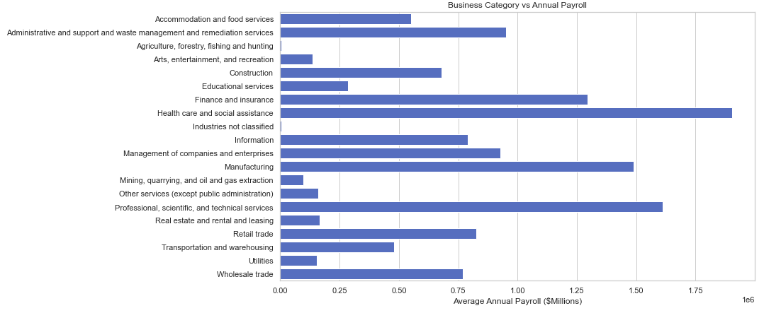
Which industries have the highest average annual payroll?

Slide 5
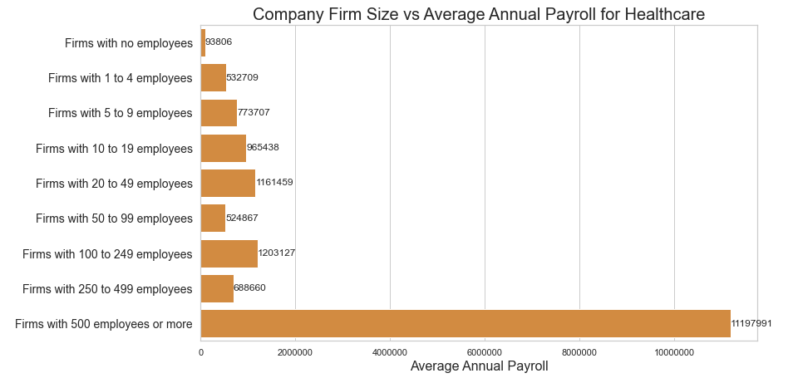
From the highest-ranking industry from the previous question, what firm sizes have the highest average annual payroll?

Slide 6
Characteristics of Business
Characteristics of Businesses provides data for respondent* employer firms by sector, gender, ethnicity, race, veteran status, years in business, employment size, and payroll for the U.S., states, and metro areas.
Initial Questions:
How many Employees classify as only Hispanic and non-Hispanic?
Does each NAIC have a similar number of employees?
Is there a relationship between the number of owners and the number of employees?
How did the total number of employees compare for Family-Owned firms by the owner’s race?
For firms that were family-owned, how did the total number of employees compare when grouping by owner-race?

Slide 7
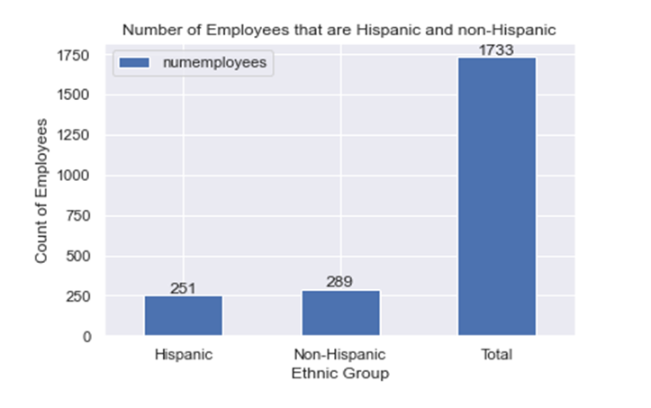
How many Employees classify as only Hispanic and non-Hispanic?
About 15% of the employees in the firms are Hispanic and about 17% of the employees identify as non-Hispanic
Warning: Equally Hispanic/non-Hispanic were not included in the charts

Slide 8
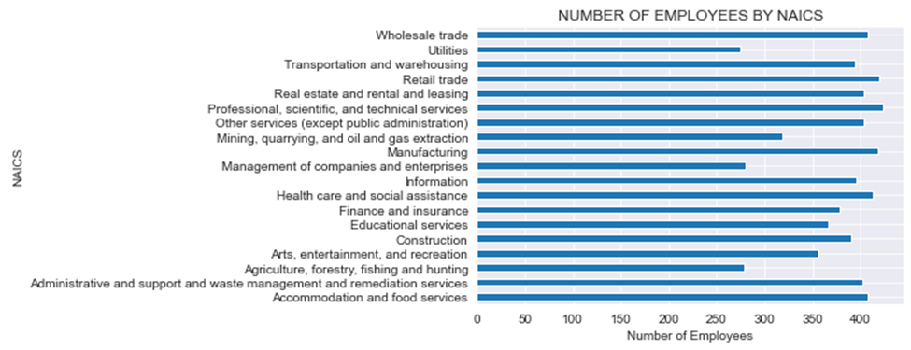
Top 3 industries with the highest number of employees are “Professional, scientific, and technological services”, “Retail trade”, and “Manufacturing”
Lowest number of people are “Utilities”, “Agriculture, forestry, fishing, and hunting”, and “Management of companies and enterprises”
Does each NAIC have a similar number of employees?
​
​

Slide 9
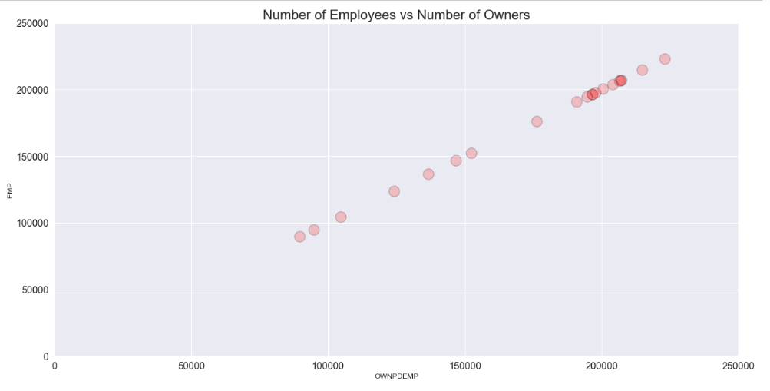
Is there a relationship between the number of owners and the number of employees?
Positive correlation between the two attributes, so as the number of employees increases the number of owners increases.
The data points look like it could be modeled by a first order linear regression model
Shows that most firms have around 200000 owners and employees

Slide 10
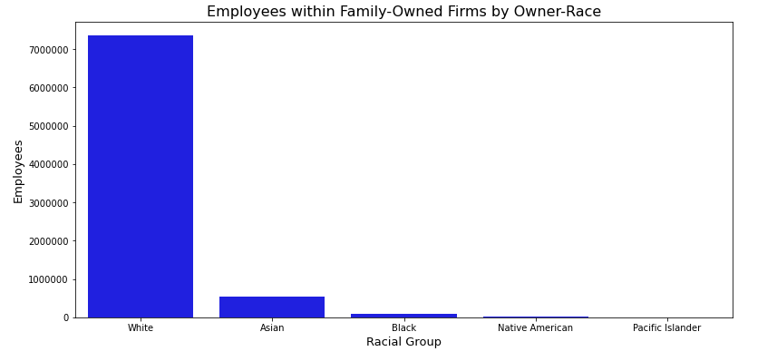
For firms that were family-owned, how do the total number of employees compare when grouping by the owner’s race?

Slide 11
Characteristics of Business Owners
Characteristics of Business Owners provides data for respondent* owners of employer firms by sector, gender, ethnicity, race, and veteran status, as well as detailed owner characteristics, for the U.S., states, and metro areas.
Initial Questions:
In the United States, which metropolitan areas had the highest spike in new business ownership in 2018?
What differences are there between total U.S.-born and foreign-born business owners as well as aggregating by race group and gender?
Are there differences among U.S. states regarding business owners and educational attainment, specifically high school graduates/GED holders versus Bachelor's degree holders?

Slide 12
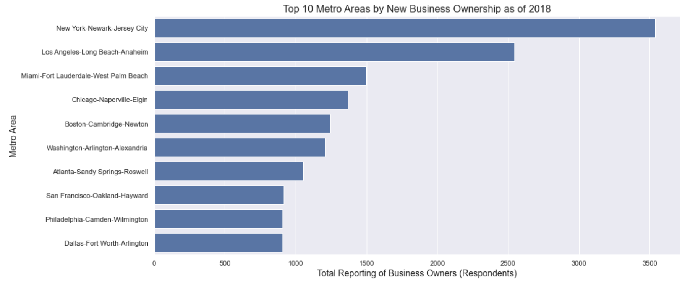
In the United States, which metropolitan areas had the highest spike in new business ownership in 2018?
- May provide information regarding metropolitan economies, accessibility to owning a new business, and overall vibrancy of urban areas.
- Important to compare these findings with previous years’ survey data and overall population data.

Slide 13
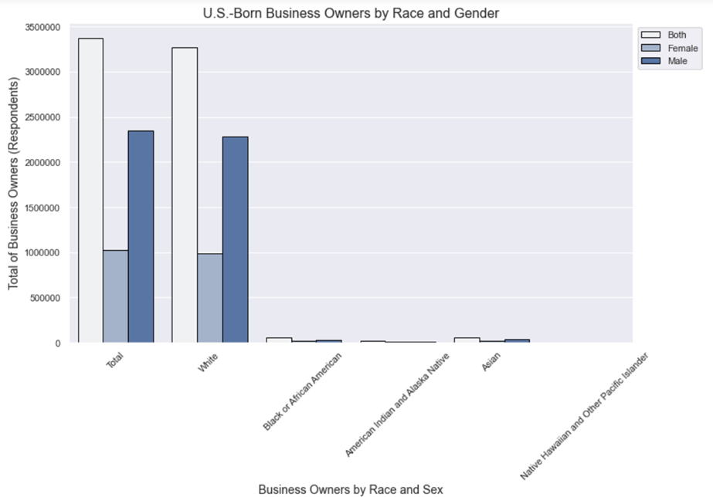
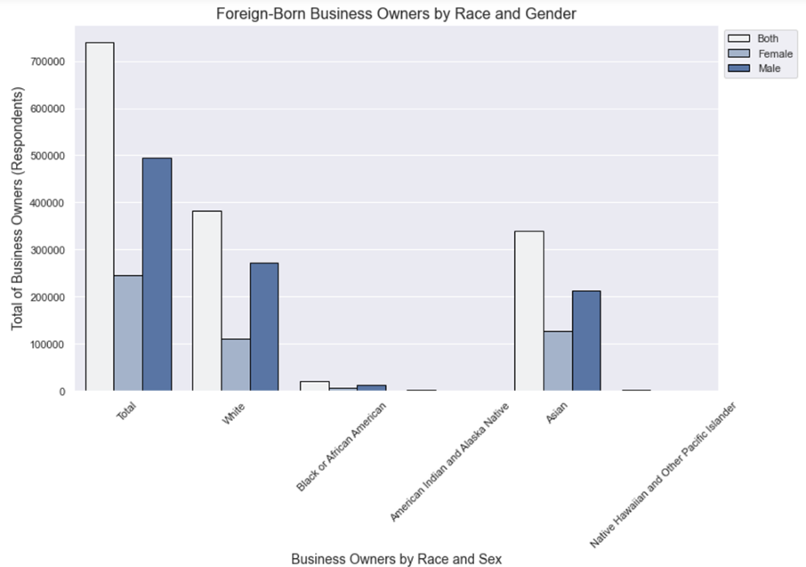
What differences are there between total U.S.-born and foreign-born business owners as well as aggregating by race group and gender?
- Could lead to improvement in policy-making and programming to ensure that there is equal opportunity for those interested in owning a business.
- Findings suggest that there is a need for an improvement in policies and programming to encourage non-White and female business ownership interest, accessibility, and opportunity.

Slide 14
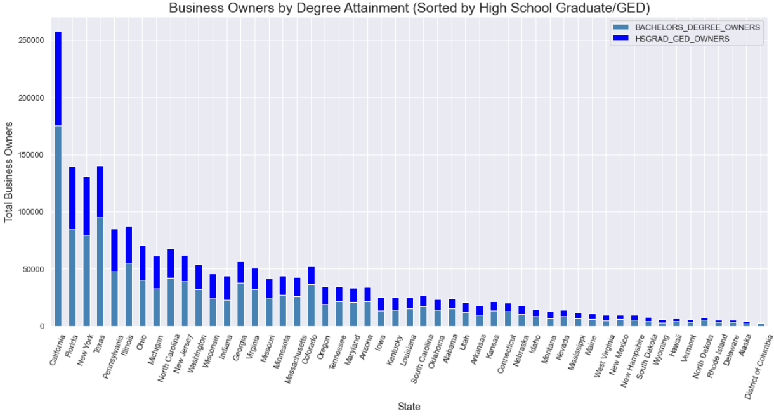

Are there differences among U.S. states regarding business owners and educational attainment, specifically high school graduates/GED holders versus Bachelor's degree holders?
- May shed light on the benefits of attaining various college degrees.
- Future research including other levels of educational attainment could provide stronger findings.
- May provide prospective business owners with information relating to their own educational attainment and the possible likelihood of acquiring business ownership based on state patterns.
Notes:
Just briefly showing visualizations, bulk of discussion will be on next slide

Slide 15
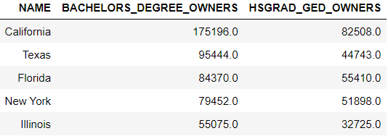
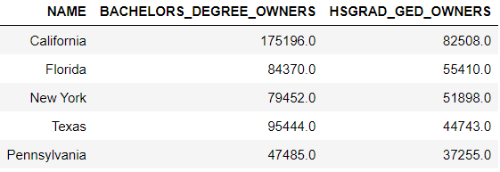
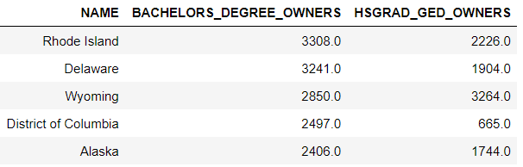
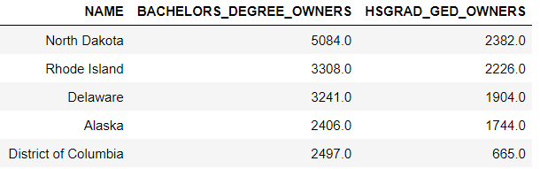
Are there differences among U.S. states regarding business owners and educational attainment, specifically high school graduates/GED holders versus Bachelor's degree holders?
Top 5 Bachelor's Degree
Top 5 HS Diploma
Bottom 5 Bachelor's Degree
Bottom 5 HS Diploma
- May shed light on the benefits of attaining various college degrees.
- Future research including other levels of educational attainment could provide stronger findings.
- May provide prospective business owners with information relating to their own educational attainment and the possible likelihood of acquiring business ownership based on state patterns.

Slide 16
Technology Characteristics of Business
The Technology Characteristics of Business API: Contains information regarding the use of technology within firms, as well as how that technology impacts business in myriad ways
In 2018 how do the average revenue of firms differ when comparing their use of Cloud-Based technology?
How do each industries’ use of Specialized-Software compare with one another?

Slide 17
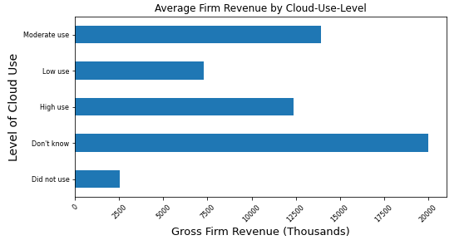
In 2018 how do the average revenue of firms differ when comparing their use of Cloud-Based technology?

Slide 18
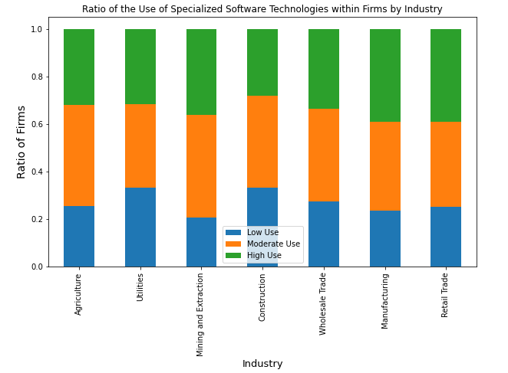
How do each industries’ use of Specialized-Software compare with one another?

