Slide 1

© CHUTTERSNAP on Unsplash
StreamShard: A Distributed Event Aggregation Engine
Jakob AI Khuzayi & Javier Herrero Delgado | Scalability Engineering | July 13, 2026
https://github.com/Jakob-al28/StreamShard

Slide 2
Architecture
SWIM gossip Membership Management
Clients / K6 Load Generator
GET /aggregates
POST /events
Gateway
Token-Buckets
Circuit Breakers
Consistent Hash Ring
Write Quorum Replication
Control Plane
Reshard Orchestration
Epoch Sequencer
Gateway
Stateless
Gateway
Stateless
Epoch sync
Replication
W=2 acks
Data Nodes
Load Shedding
Rolling Aggregates
Compaction Snapshots
Epoch Fencing
Node 0
Append-Only Log
Node 1
Append-Only Log
Node 2
Append-Only Log
SWIM gossip

Slide 3
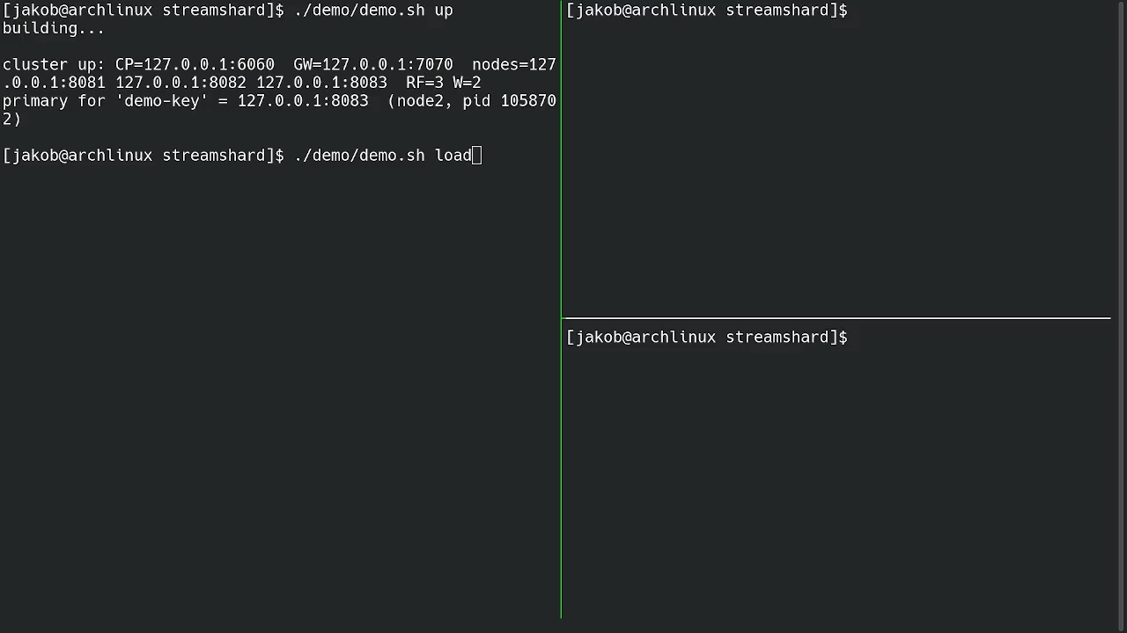
Demo: Primary Failover and Live Resharding

Slide 4
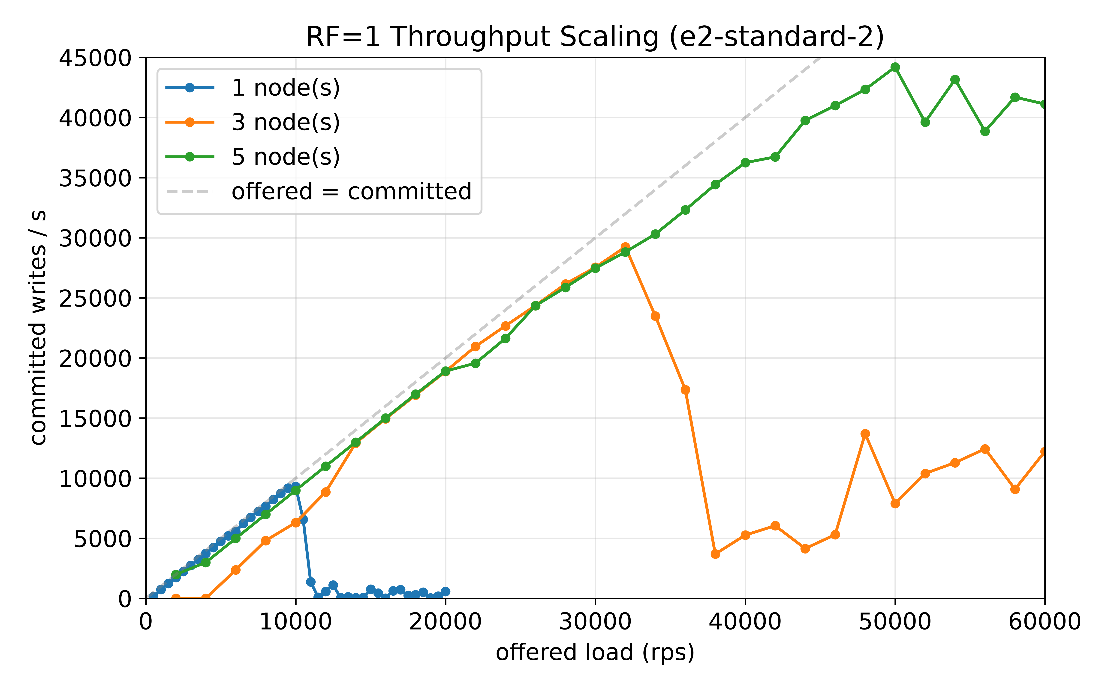
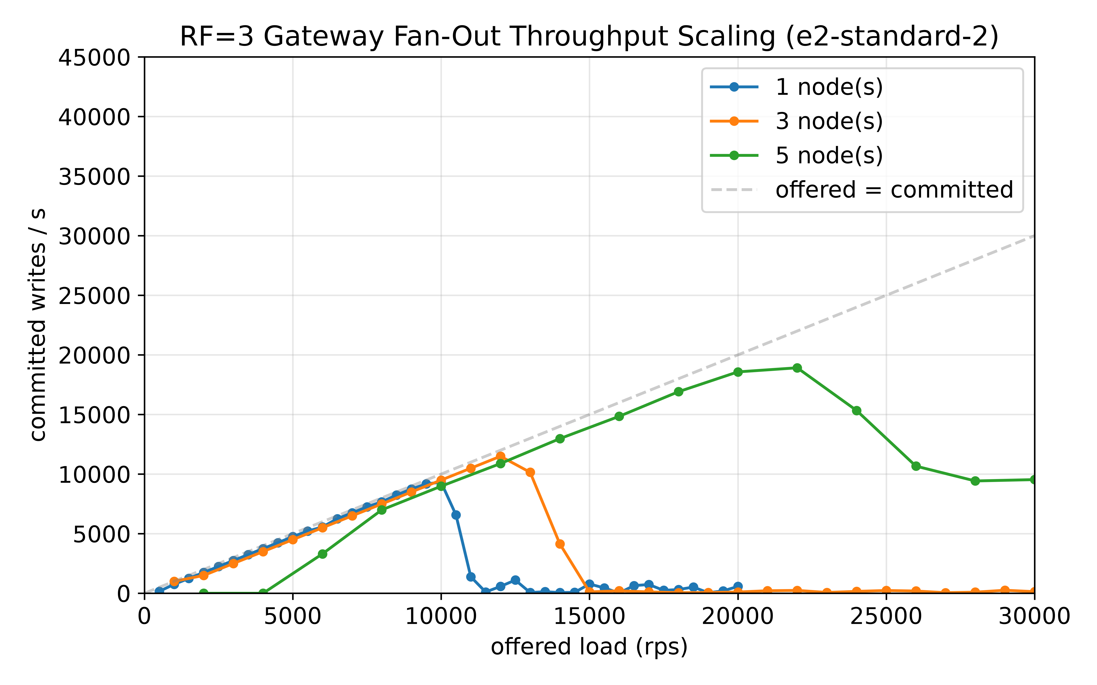
Scalability Results: The Cost of Replication
Write Quorum replication (RF=3, W=2) reduces peak throughput by ~60%
Notes:
RF1 CPU Max Values: GW: 193% Node: 114%
RF3 (gateway fan-out) CPU Max Values: GW: 143% Node: 56%
Bottleneck: See last slide
Special behavior: RF 3 is actually linearly scalable because each committed write are 3 requests so 30k / 3 = 10k expected in RF 3
RF 3 5 node shows W 2 speeds things up because 3 is written only 2 is needed (45k expected 15k result 19k)
Config Offered @ peak Committed @ peak GW at peak Node at peak
RF1 (3-node, e2std2) 32,000 29,241 189% (94% of 200%) 114% (57% of 200%)
RF3 gateway-fanout (3-node, e2std2) 12,000 11,494 70% (35% of 200%) 51% (26% of 200%)
RF3 gateway-fanout (5-node, e2std2) 22,000 18,917 181% (90% of 200%) 106% (53% of 200%)
RF3 primary-replication (3-node, e2std2) 6,000 5,587 94% (47% of 200%) 91% (46% of 200%)
RF3 primary-replication (5-node, e2std2) 12,000 8,571 105% (52% of 200%) 114% (57% of 200%)
RF3 primary-replication (3-node, e2big) 12,000 10,230 152% (38% of 400%) 193% (48% of 400%)
RF3 primary-replication (5-node, e2big) 18,000 17,154 210% (52% of 400%) 205% (51% of 400%

Slide 5
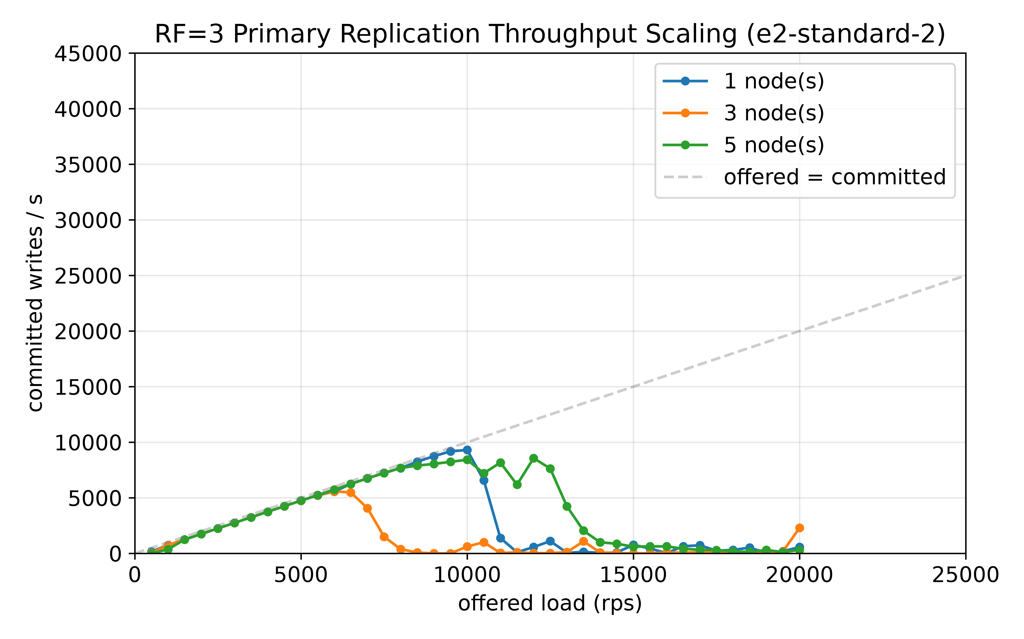
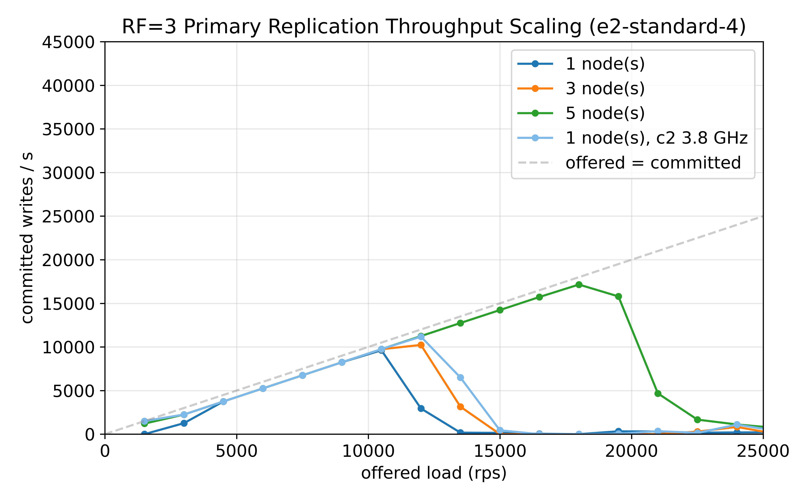
Scalability Results: Leader-Based Replication & Vertical Scaling
Primary-driven replication costs ~55% throughput vs. gateway fan-out
Core count helps parallel work, clock speed helps serial work
Notes:
RF3 (gateway fan-out) CPU Max Values: GW: 143% Node: 56%
RF3 (primary replication) CPU Max Values: GW: 157% Node: 156%
RF3 Primary Replication CPU Max Values (3-node, e2-standard-2): GW: 157% Node: 156%
RF3 Primary Replication CPU Max Values (5-node, e2-standard-2): GW: 122% Node: 145%
RF3 Primary Replication CPU Max Values (3-node, e2-standard-4): GW: 312% Node: 347%
RF3 Primary Replication CPU Max Values (5-node, e2-standard-4): GW: 322% Node: 327%

Slide 6
System Limitations & Future Work
Per-node global lock on the WAL
Serialized commits limit throughput at ~10,000 writes/s per node
Scale Up & Parallel Write:
Shard partition by key across workers
Centralized Control Plane
Single coordinator manages epochs and resharding
Replicated Control Plane
backed by a consensus store (e.g. ZooKeeper, etcd).
See the README for a full list of known limitations.
Notes:
Our vertical scaling benchmarks confirmed that write processing is heavily bottlenecked by single-core speed, which is why our future work focuses on parallel writes.

Slide 7
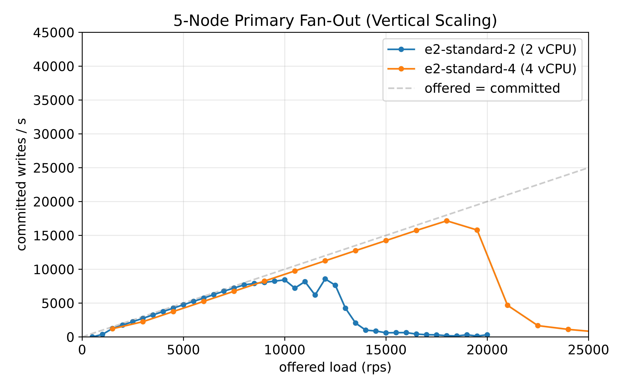
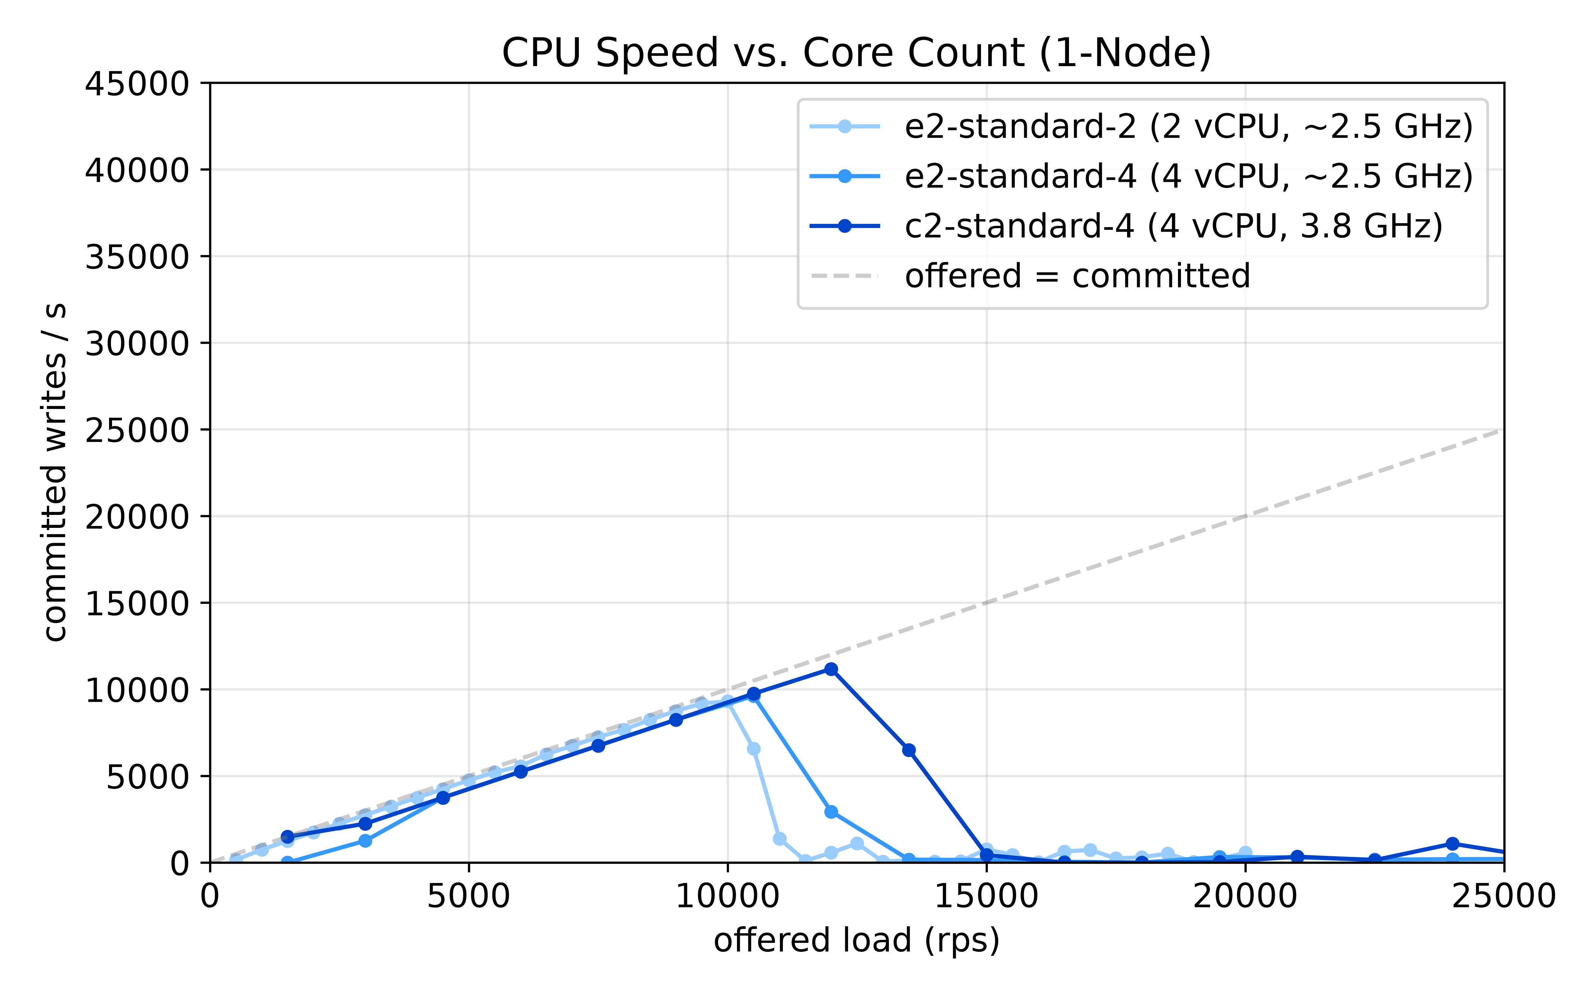
Scalability Results: Vertical Scaling
Primary fan-out benefits from more cores
Write processing benefits from faster cores
Notes:
Config Offered @ peak Committed @ peak GW at peak Node at peak
RF1 (3-node, e2std2) 32,000 29,241 189% (94% of 200%) 114% (57% of 200%)
RF3 gateway-fanout (3-node, e2std2) 12,000 11,494 70% (35% of 200%) 51% (26% of 200%)
RF3 gateway-fanout (5-node, e2std2) 22,000 18,917 181% (90% of 200%) 106% (53% of 200%)
RF3 primary-replication (3-node, e2std2) 6,000 5,587 94% (47% of 200%) 91% (46% of 200%)
RF3 primary-replication (5-node, e2std2) 12,000 8,571 105% (52% of 200%) 114% (57% of 200%)
RF3 primary-replication (3-node, e2big) 12,000 10,230 152% (38% of 400%) 193% (48% of 400%)
RF3 primary-replication (5-node, e2big) 18,000 17,154 210% (52% of 400%) 205% (51% of 400%

Slide 8
Scalability Results: Vertical Scaling
Primary fan-out benefits from more cores
Write processing benefits from faster cores
Notes:
Config Offered @ peak Committed @ peak GW at peak Node at peak
RF1 (3-node, e2std2) 32,000 29,241 189% (94% of 200%) 114% (57% of 200%)
RF3 gateway-fanout (3-node, e2std2) 12,000 11,494 70% (35% of 200%) 51% (26% of 200%)
RF3 gateway-fanout (5-node, e2std2) 22,000 18,917 181% (90% of 200%) 106% (53% of 200%)
RF3 primary-replication (3-node, e2std2) 6,000 5,587 94% (47% of 200%) 91% (46% of 200%)
RF3 primary-replication (5-node, e2std2) 12,000 8,571 105% (52% of 200%) 114% (57% of 200%)
RF3 primary-replication (3-node, e2big) 12,000 10,230 152% (38% of 400%) 193% (48% of 400%)
RF3 primary-replication (5-node, e2big) 18,000 17,154 210% (52% of 400%) 205% (51% of 400%

Slide 9
Scalability Results: Gateway vs. Primary Fan-Out
Primary-driven replication reduces throughput by ~55%
Trade-off: Complex conflict resolution & sacrifices strong consistency
Notes:
RF3 (gateway fan-out) CPU Max Values: GW: 143% Node: 56%
RF3 (primary replication) CPU Max Values: GW: 157% Node: 156%
RF3 Primary Replication CPU Max Values (3-node, e2-standard-2): GW: 157% Node: 156%
RF3 Primary Replication CPU Max Values (5-node, e2-standard-2): GW: 122% Node: 145%
RF3 Primary Replication CPU Max Values (3-node, e2-standard-4): GW: 312% Node: 347%
RF3 Primary Replication CPU Max Values (5-node, e2-standard-4): GW: 322% Node: 327%

Slide 10
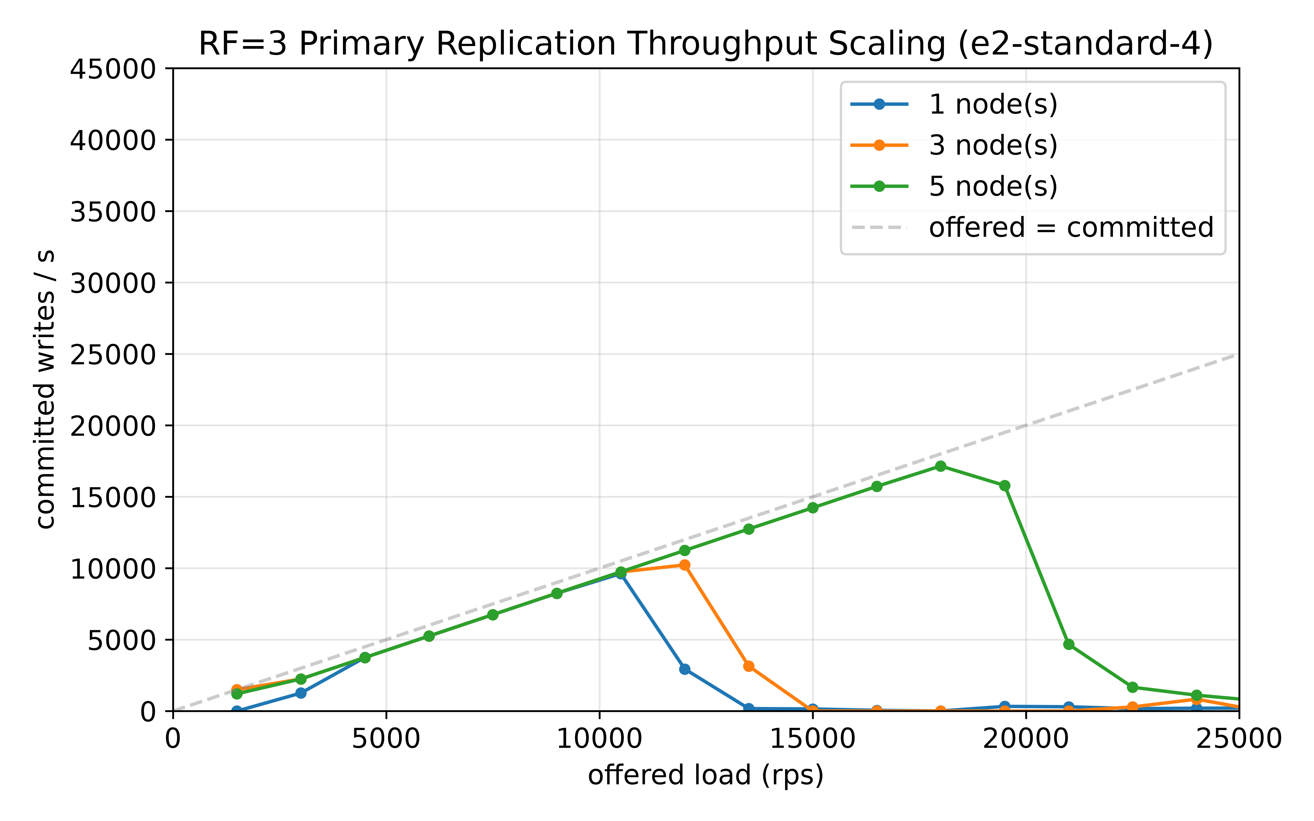
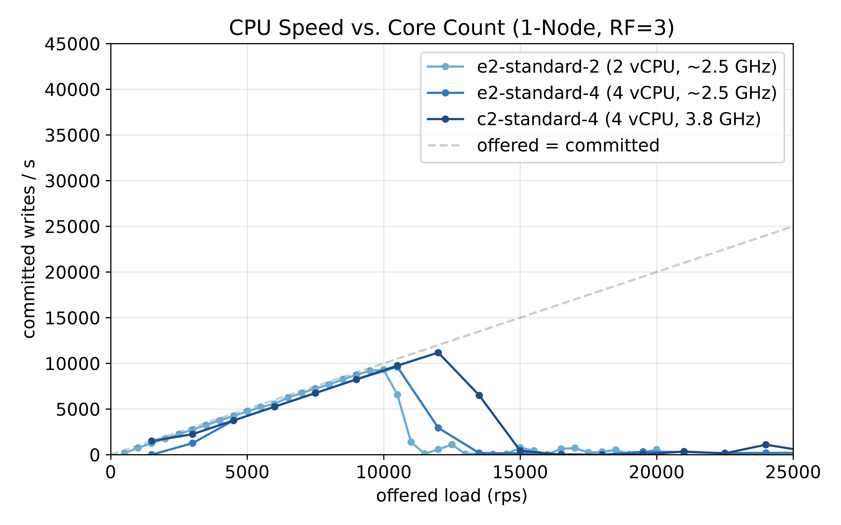
Scalability Results: Vertical Scaling
Replication benefits from more cores
Write processing benefits from faster cores

Slide 11
Overload Protection & Write Quorum Replication
Client
Client
POST /events
POST /events
W=2 ACKS
☑ Success
Token Bucket
(Gateway)
Drop Requests
Gateway
2/3 ACKS
☑ ACK
Circuit Breaker
(Gateway)
Block Failed Nodes
☑ ACK
☑ ACK
☒ Rejected
Node 1
Primary
Queue Shedding
(Node)
Reject Request (HTTP 429)
Node 0
Replica
Node 2
Replica
Forward Request

