Slide 1
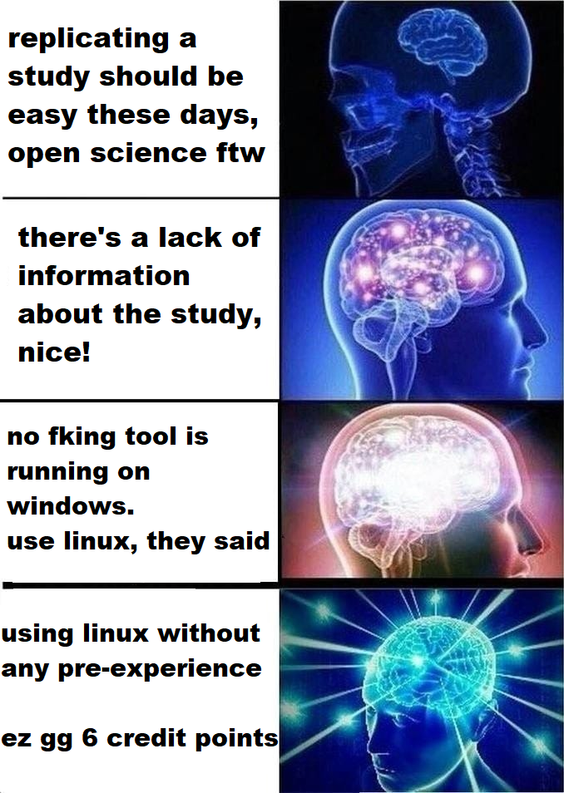

Slide 2
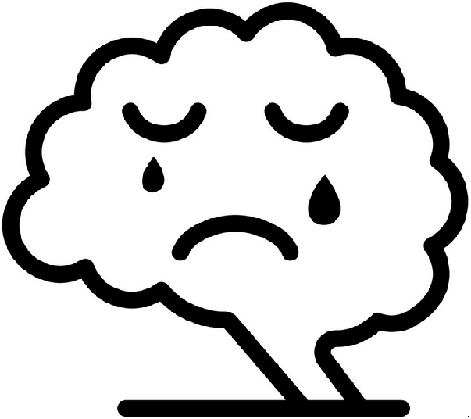
Not ready yet
Luca Grolms and Jakob Thielmann
Module: Methodological work in the neurosciences
Date: 12.08.2021

Slide 3
Overview
Study by Bezmaternykh et al. (2021)
Our replication approach
Results
Discussion
Conclusion

Slide 4
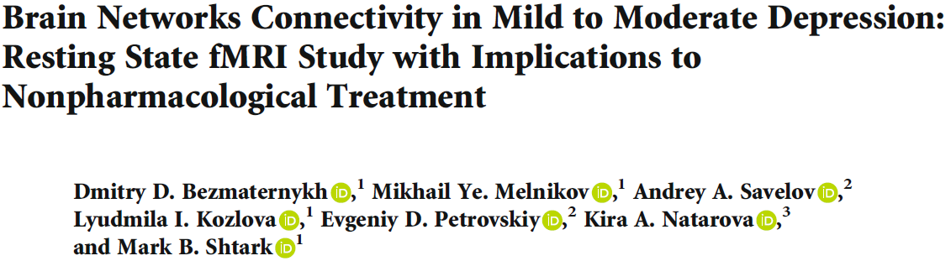
Study by Bezmaternykh et al. (2021)
72 Participants
51 patients with mild depression
21 healthy participants
resting state fMRI study

Slide 5
Methods
Preprocessing with Matlab and SPM12
- 2 participants excluded (1 because of movement, 1 because of artefacts)
GIFT 3.0.a software was used to perform spatial independent components analysis (ICA)
FNC toolbox was used to calculate temporal correlations between the dynamics of the selected components.

Slide 6
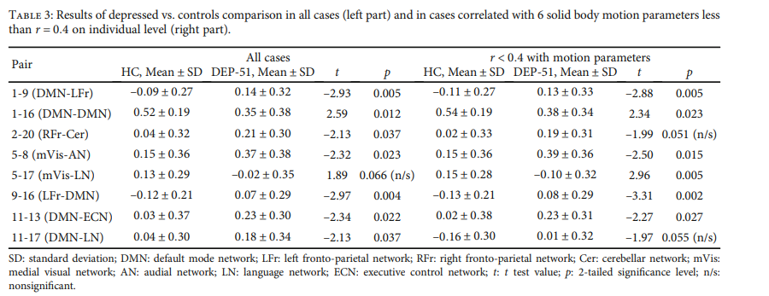
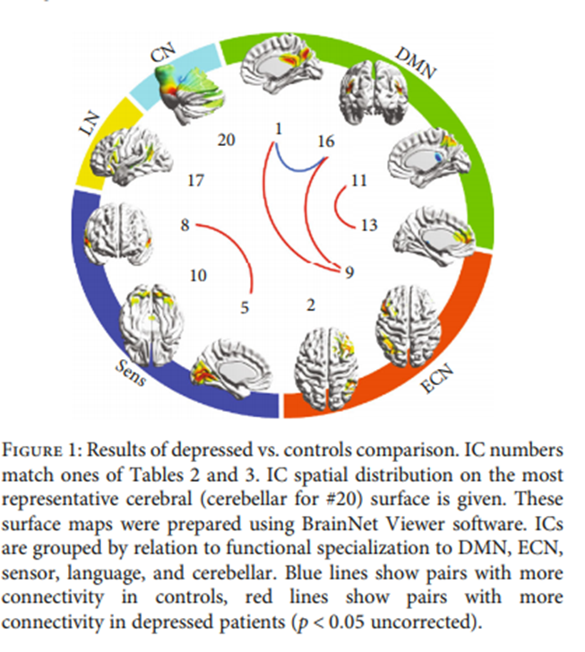
Results
In the depressed group:
decreased functional connectivity within the DMN
global increase of functional connectivity between the DMN and the ECN.
Overconnectivity of the medial visual cortex (mVis) with the audial cortex (AN) in the depressive group.

Slide 7
Hypothesis
Hypothesis 1
Functional connectivity differs between depressed patients and healthy controls.
Hypothesis 2
Replicating the methods that were made in the original study but using different analysis and preprocessing tools would lead to different results regarding the differences in functional connectivity between depressed patients and healthy controls.

Slide 8
Our methods
Quality control with mriqc and mriqception
3 subjects excluded because of too much movement or artefacts
Preprocessing with Nipype
Independent Component Analysis (ICA) with Nilearn

Slide 9
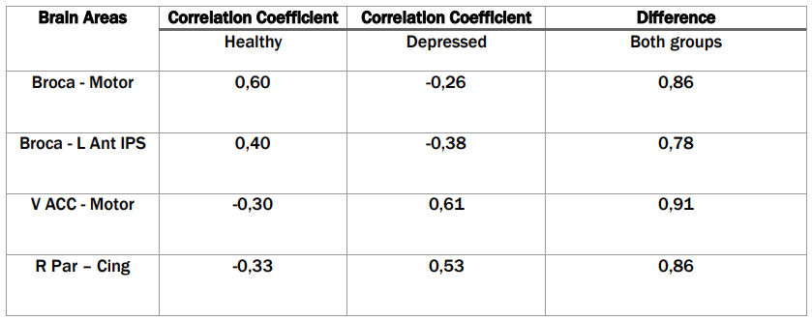
Our results – Areas with biggest difference
Motor categorized as sensorimotor network.
L Ant IPS categorized as dorsal attention network.
Cing categorized as default mode network.
V ACC categorized as salience network.
R Par categorized as default mode network.
Broca categorized as language network.

Slide 10
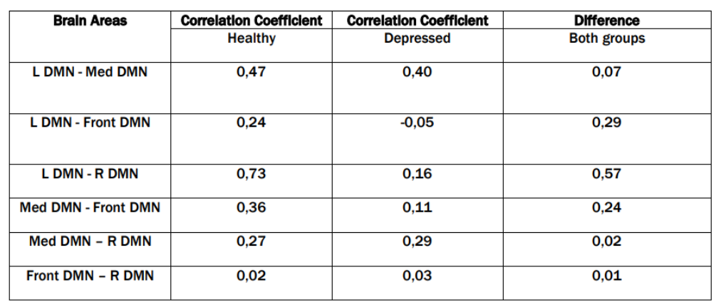
Our results

Slide 11
Discussion
Hypothesis 1 : confirmed
Differences between the two groups in connectivity
Hypothesis 2 : confirmed
Bezmaternykh et al. (2021): decreased connectivity for the depressed group within the DMN.
Our analysis: DMN connectivity (R Par – Cing) was increased in the depressed group.
Broader areas: DMN connectivity in depressed group decreased
Findings not in line with further literature (Dai et al., 2019).
Further connectivity differences were found

Slide 12
Conclusion
Functional brain connectivity differs between healthy and depressed subjects.
Can be found in this study as well as in the study by Bezmaternykh et al. (2021).
The try replicate the concrete differences with different tools, was unsuccessful.
Further connectivity differences were found
The trend that connectivity within the DMN is not increased in depressed patients as further literature would suggest (Dai et al., 2019) is confirmed.

Slide 13


Memes
For more memes check out https://jakob236.github.io/notreadyyet/Memes.html

Slide 14
References
Bezmaternykh, D. D., Melnikov, M. Y., Savelov, A. A., Kozlova, L. I., Petrovskiy, E. D., Natarova, K. A., & Shtark, M. B. (2021). Brain Networks Connectivity in Mild to Moderate Depression: Resting State fMRI Study with Implications to Nonpharmacological Treatment. Neural Plasticity, 2021, e8846097. https://doi.org/10.1155/2021/8846097
Buchanan, A., Wang, X., & Gollan, J. K. (2014). Resting-state functional connectivity in women with Major Depressive Disorder. Journal of Psychiatric Research, 59, 38–44. https://doi.org/10.1016/j.jpsychires.2014.09.002
Dai, L., Zhou, H., Xu, X., & Zuo, Z. (2019). Brain structural and functional changes in patients with major depressive disorder: A literature review. PeerJ, 7, e8170. https://doi.org/10.7717/peerj.8170
Doucet, G. E., Bassett, D. S., Yao, N., Glahn, D. C., & Frangou, S. (2017). The role of intrinsic brain functional connectivity in vulnerability and resilience to bipolar disorder. The American journal of psychiatry, 174(12), 1214–1222. https://doi.org/10.1176/appi.ajp.2017.17010095
Guilbert, J. J. (2003). The world health report 2002—Reducing risks, promoting healthy life. Education for Health (Abingdon, England), 16(2), 230. https://doi.org/10.1080/1357628031000116808
Hillary, F. G., & Medaglia, J. D. (2020). What the replication crisis means for intervention science. International Journal of Psychophysiology: Official Journal of the International Organization of Psychophysiology, 154, 3–5. https://doi.org/10.1016/j.ijpsycho.2019.05.006
Ioannidis, J. P. A. (2005). Why Most Published Research Findings Are False. PLOS Medicine, 2(8), e124. https://doi.org/10.1371/journal.pmed.0020124
Martino, M., Magioncalda, P., Huang, Z., Conio, B., Piaggio, N., Duncan, N. W., Rocchi, G., Escelsior, A., Marozzi, V., Wolff, A., Inglese, M., Amore, M., & Northoff, G. (2016). Contrasting variability patterns in the default mode and sensorimotor networks balance in bipolar depression and mania. Proceedings of the National Academy of Sciences of the United States of America, 113(17), 4824–4829. https://doi.org/10.1073/pnas.1517558113
Nosek, B. A., Alter, G., Banks, G. C., Borsboom, D., Bowman, S. D., Breckler, S. J., Buck, S., Chambers, C. D., Chin, G., Christensen, G., Contestabile, M., Dafoe, A., Eich, E., Freese, J., Glennerster, R., Goroff, D., Green, D. P., Hesse, B., Humphreys, M., … Yarkoni, T. (2015). Promoting an open research culture. Science, 348(6242), 1422–1425. https://doi.org/10.1126/science.aab2374
Open Science Collaboration. (2015). Estimating the reproducibility of psychological science. Science, 349(6251). https://doi.org/10.1126/science.aac4716
Wang, J., Wu, X., Lai, W., Long, E., Zhang, X., Li, W., Zhu, Y., Chen, C., Zhong, X., Liu, Z., Wang, D., & Lin, H. (2017). Prevalence of depression and depressive symptoms among outpatients: A systematic review and meta-analysis. BMJ Open, 7(8), e017173. https://doi.org/10.1136/bmjopen-2017-017173

Slide 15
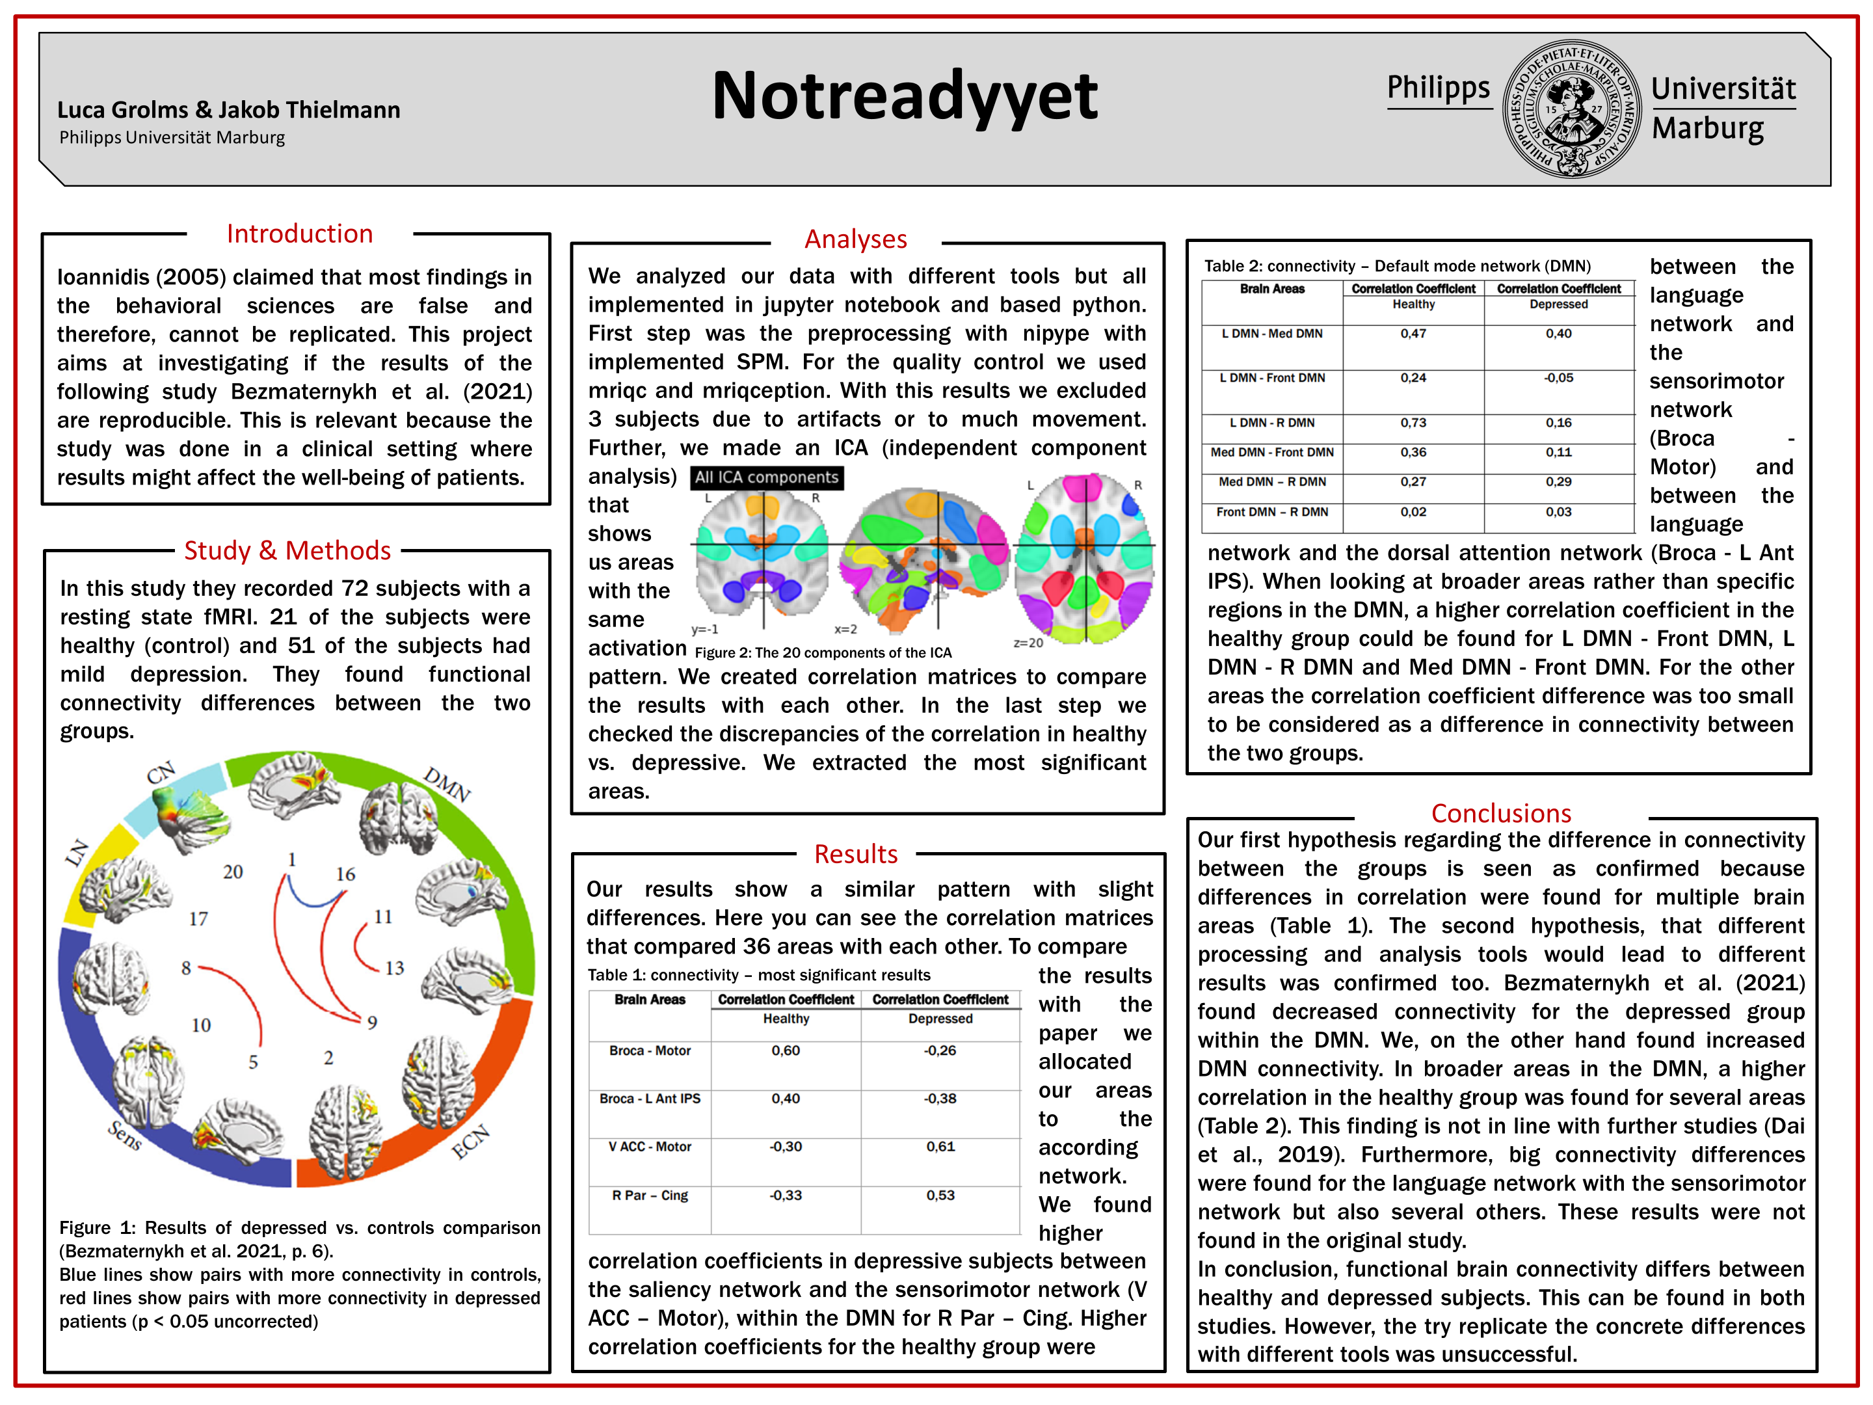
References
Bezmaternykh, D. D., Melnikov, M. Y., Savelov, A. A., Kozlova, L. I., Petrovskiy, E. D., Natarova, K. A., & Shtark, M. B. (2021). Brain Networks Connectivity in Mild to Moderate Depression: Resting State fMRI Study with Implications to Nonpharmacological Treatment. Neural Plasticity, 2021, e8846097. https://doi.org/10.1155/2021/8846097
Buchanan, A., Wang, X., & Gollan, J. K. (2014). Resting-state functional connectivity in women with Major Depressive Disorder. Journal of Psychiatric Research, 59, 38–44. https://doi.org/10.1016/j.jpsychires.2014.09.002
Dai, L., Zhou, H., Xu, X., & Zuo, Z. (2019). Brain structural and functional changes in patients with major depressive disorder: A literature review. PeerJ, 7, e8170. https://doi.org/10.7717/peerj.8170
Doucet, G. E., Bassett, D. S., Yao, N., Glahn, D. C., & Frangou, S. (2017). The role of intrinsic brain functional connectivity in vulnerability and resilience to bipolar disorder. The American journal of psychiatry, 174(12), 1214–1222. https://doi.org/10.1176/appi.ajp.2017.17010095
Guilbert, J. J. (2003). The world health report 2002—Reducing risks, promoting healthy life. Education for Health (Abingdon, England), 16(2), 230. https://doi.org/10.1080/1357628031000116808
Hillary, F. G., & Medaglia, J. D. (2020). What the replication crisis means for intervention science. International Journal of Psychophysiology: Official Journal of the International Organization of Psychophysiology, 154, 3–5. https://doi.org/10.1016/j.ijpsycho.2019.05.006
Ioannidis, J. P. A. (2005). Why Most Published Research Findings Are False. PLOS Medicine, 2(8), e124. https://doi.org/10.1371/journal.pmed.0020124
Martino, M., Magioncalda, P., Huang, Z., Conio, B., Piaggio, N., Duncan, N. W., Rocchi, G., Escelsior, A., Marozzi, V., Wolff, A., Inglese, M., Amore, M., & Northoff, G. (2016). Contrasting variability patterns in the default mode and sensorimotor networks balance in bipolar depression and mania. Proceedings of the National Academy of Sciences of the United States of America, 113(17), 4824–4829. https://doi.org/10.1073/pnas.1517558113
Nosek, B. A., Alter, G., Banks, G. C., Borsboom, D., Bowman, S. D., Breckler, S. J., Buck, S., Chambers, C. D., Chin, G., Christensen, G., Contestabile, M., Dafoe, A., Eich, E., Freese, J., Glennerster, R., Goroff, D., Green, D. P., Hesse, B., Humphreys, M., … Yarkoni, T. (2015). Promoting an open research culture. Science, 348(6242), 1422–1425. https://doi.org/10.1126/science.aab2374
Open Science Collaboration. (2015). Estimating the reproducibility of psychological science. Science, 349(6251). https://doi.org/10.1126/science.aac4716
Wang, J., Wu, X., Lai, W., Long, E., Zhang, X., Li, W., Zhu, Y., Chen, C., Zhong, X., Liu, Z., Wang, D., & Lin, H. (2017). Prevalence of depression and depressive symptoms among outpatients: A systematic review and meta-analysis. BMJ Open, 7(8), e017173. https://doi.org/10.1136/bmjopen-2017-017173
Lit.: https://jakob236.github.io/notreadyyet/Literature.html

