Slide 1
flodym: A library for dynamic material flow analysis
Brightcon course 2025
Jakob Dürrwächter
With: Bennet Weiß, Merlin Hosak, Falko Ueckerdt

Slide 2
Motivation
What is MFA?
Mass balance: Tracks material through system along life cycle stages
Why Dynamic MFA (In the context of LCA)
Stock-and flow time dynamics
  Future demands
  Secondary material availability
  Temporal inter-dependency
  Circular economy interventions
Concise and complete map of single materials’ social metabolism
Don’t take my word for it
  Review paper¹ found 200 studies on LCA-MFA combination
  DdS Autumn school
¹Barkhausen et al. 2023, J. Clean. Prod.
https://doi.org/10.1016/j.jclepro.2023.137017

Slide 3
Why Flodym?
ODYM by Stefan Pauliuk¹
Great concept: abstraction, data classes
> 100 citations
But: Doesn’t make full use of available data structures
Flodym
Objects & structure similar to ODYM
Integrated dimension management
Other functional extensions & API streamlining
Complete refactor/rewrite with current software development practices
→ Flexible, extensible, clean and simple application
¹https://github.com/IndEcol/ODYM

Slide 4
Outline of this course
Intro & MFA Principle
Short presentation
flodym API
Jupyter slides
Small JupyterLab exercises in between

Slide 5
Example Research Question
You’d like to compare the future emission intensity of automobile production
in the EU and the US.
For this, you need the future share of steel production from scrap
→ How much steel is produced from scrap in these regions in the future?

Slide 6
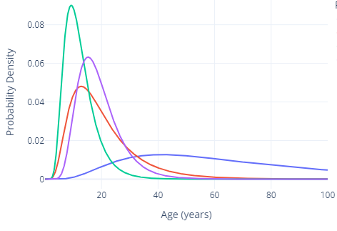







How does dynamic MFA work?
Vocabulary
System environment
Process
$$F_{S→M}(t,r,g)$$
$$F_{M→U}(t,r,p)$$
$$F_{U→S}(t,r)$$
Flow
Raw Steel
Production
Manu-facturing
Use
Recycling
Use
Stock
Dynamic Stock:
Lifetime distribution functions
Different stock types:
Inflow-driven, stock-driven, …
$$P$$
Parameter
$$F_{M→S}(t,r)$$
Dimensions
$t$ – time
$r$ – region
$g$ – grade
$p$ – product
$F_{S→M}(t,r,g)=P_{production}(t,r,g)$
Multiplication:
Multiply element-wise
Sum over excess
$F_{M→S}\left(t,r\right) =F_{S→M}(t,r,g)∗P_{loss_rate}(t)$
Subtraction:
Sum over excess dimensions
Subtract element-wise
$F_{M→U}\left(t,r,p\right)=(F_{S→M}\left(t,r,g\right)−F_{M→S}\left(t,r\right))∗P_{product_share}\left(r,p\right)$
$F_{U→S}(t,r)=S_{U}(F_{M→U}(t,r,p), P_{lifetime}(p))$

Slide 7
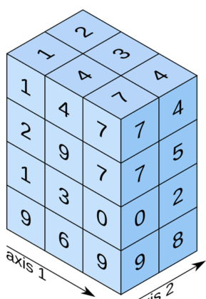
FlodymArrays
These operations need dimension information → FlodymArray class:
FlodymArrays are used
  As Flows
  As Parameters
  In Stock Models (inflow, outflow, stock)
FlodymArray
dims: DimensionSet
values: np.ndarray
“t”
“Time”
“r”
“Region”
“p”
“Product”
2020
2030
2040
2050
“EUR”
“USA”
“CHA”
“Vcl”
“Bld”

Slide 8
Flodym Functionality
Handles operations of/between multi-dimensional arrays
Embedded in MFASystem class, with mass balance checks
Integrates dynamic stock models
System definition & data read-in
Plotting and data export
Different degrees of integration / customization

Slide 9
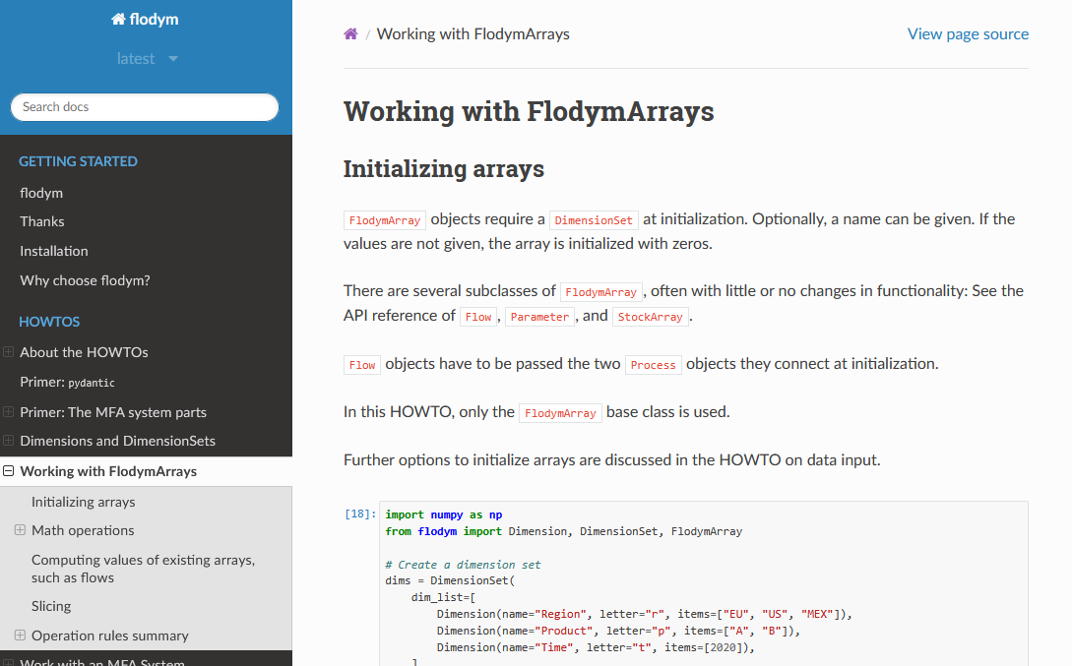
Resources
Installation: `pip install flodym`
Github: https://github.com/pik-piam/flodym
Documentation: https://flodym.readthedocs.io
  Howtos
  Examples
  API Reference
This course: https://github.com/jakobbd/flodym_course
Publication (submitted): https://joss.theoj.org/papers/92b6faa2d82b8694f4ad5d394053ef32

