Slide 1
Scrandle Predictor
Applied Machine Leaning
By Christopher Plykker, Jakob Fugl, Ludvig Andreas Pio and Ulrik Steen Andersen

Slide 2
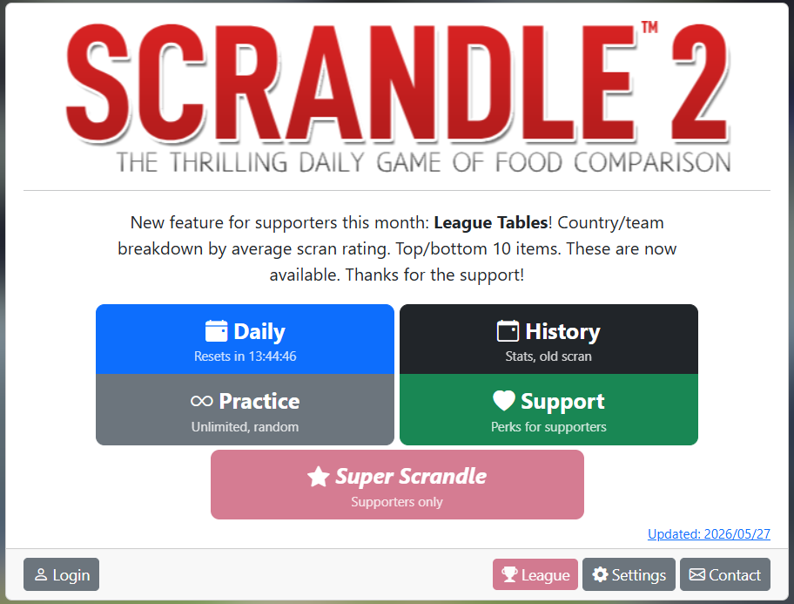
Data
Dates from 2025-04-20 to 2026-05-31 (407 days)
Each date has 10 matches
Each match has 2 foods
Each food has up to 10 metadata:
- Picture
- Title
- Subtitle
- Price
- Score
- Position (which date, which match and left or right)
- Sportsclub
- Country
- Year of origin of the picture
- Elo-score

Slide 3
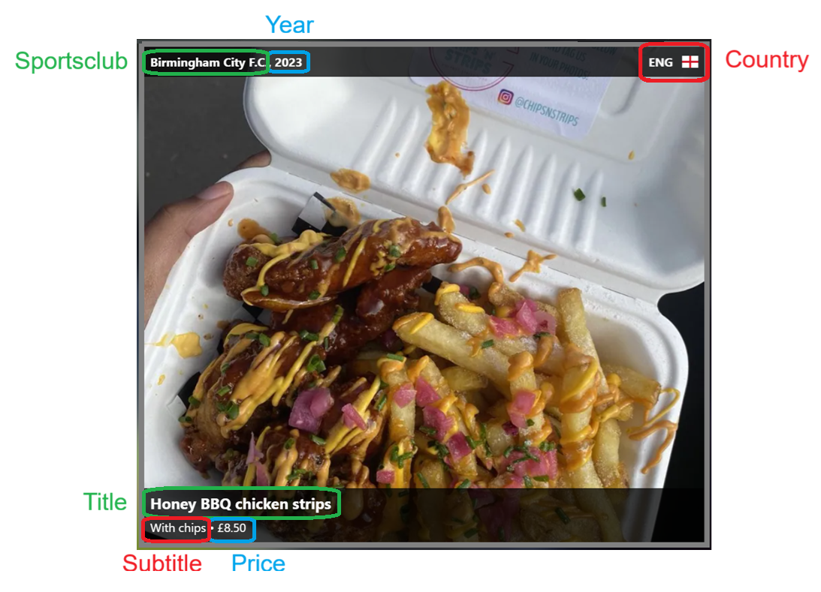
An individual case of Scrandle

Slide 4
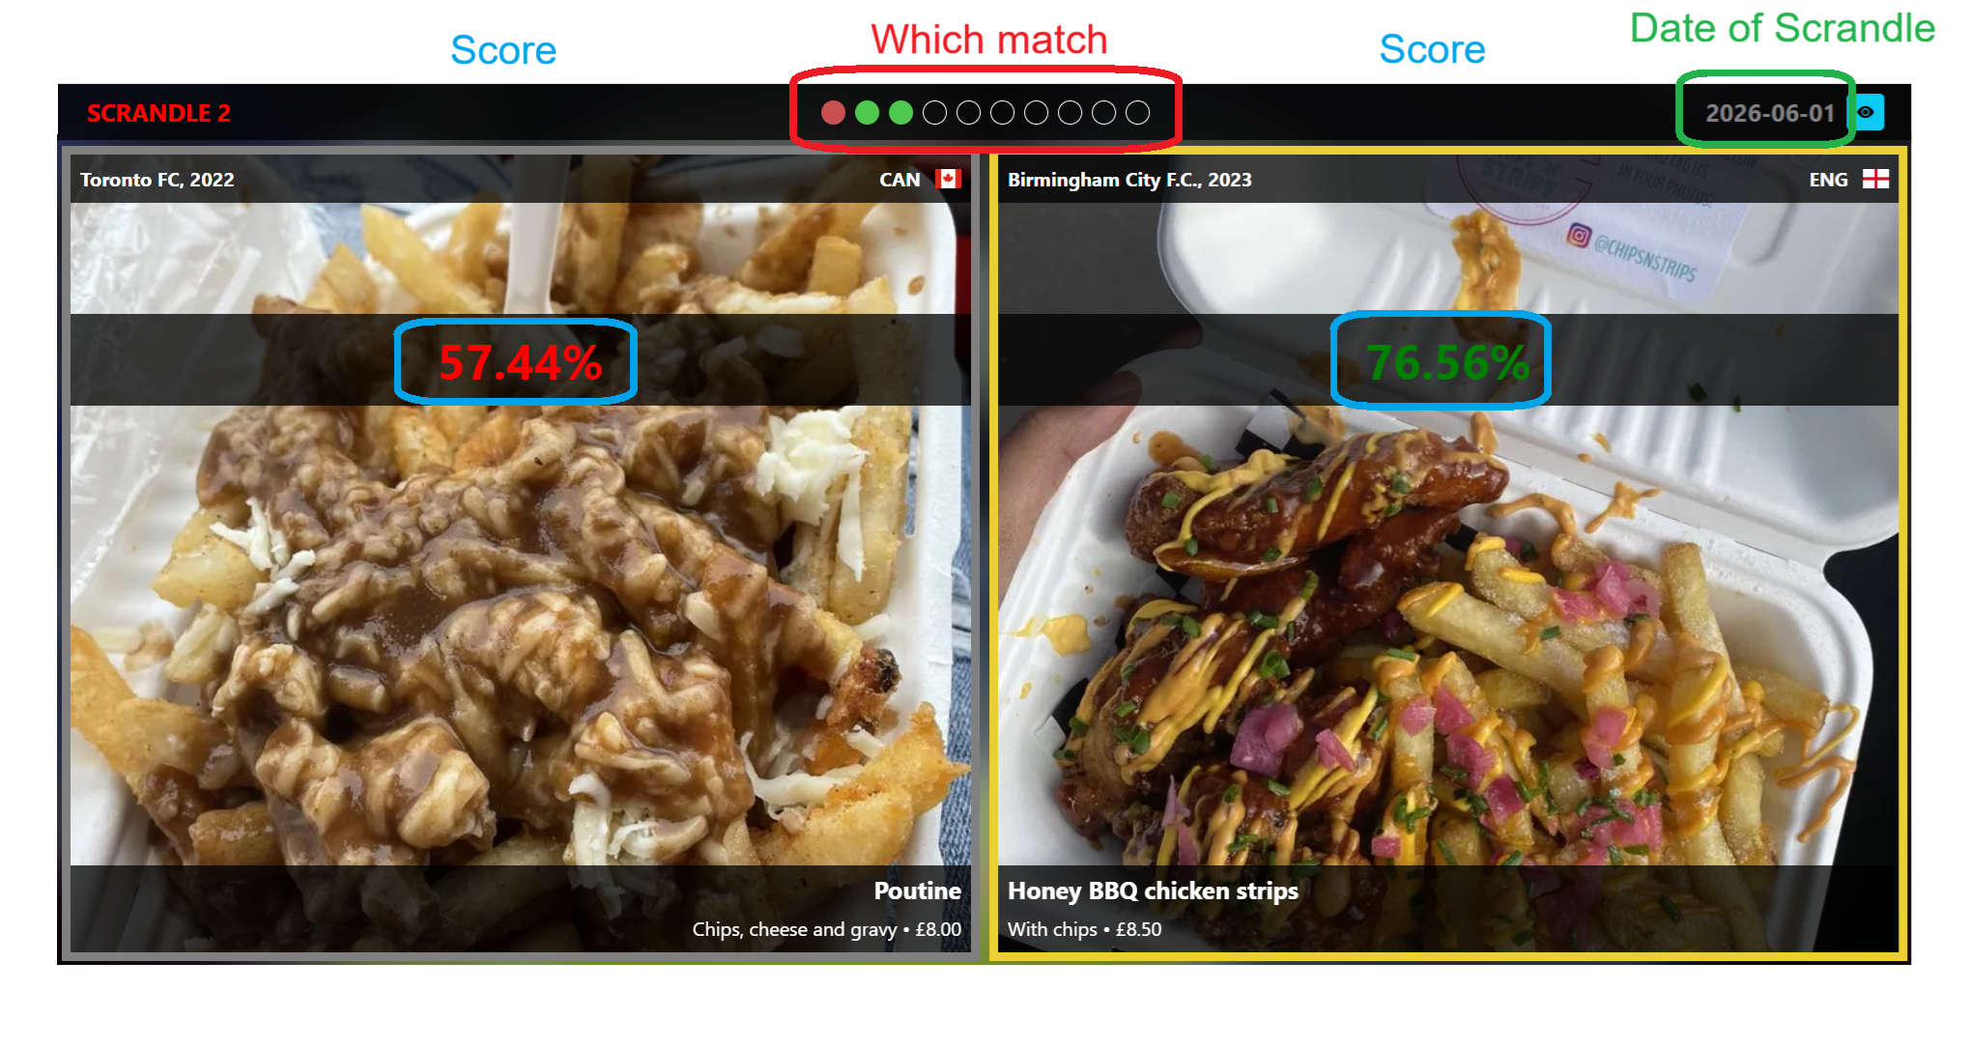
How the match is presented

Slide 5
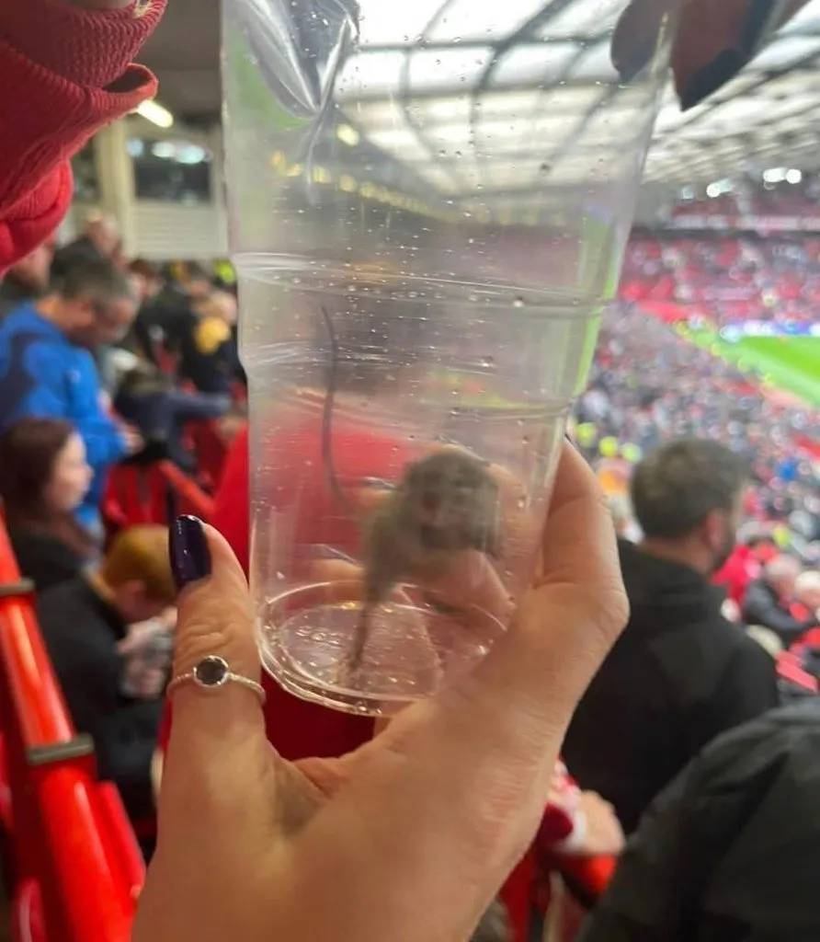
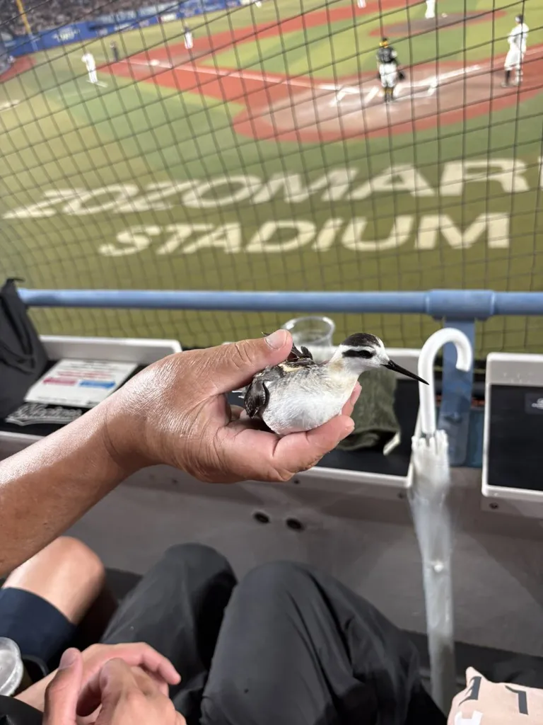
Preprocessing
Data is WEIRD!
Inconsistent metadata, price can be:
{0 , “No price” , “ “ , “Free for soldiers”…}
Raw data
Freshly scraped from scrandle.com
407 days, 4070 matches, 8140 cases
Unique cases
Duplicate cases removed
4827 unique cases
Unique foods
Only foods with unique pictures remain
3193 unique foods
Data contains jokers;
rats, birds and mushrooms are “foods”!

Slide 6
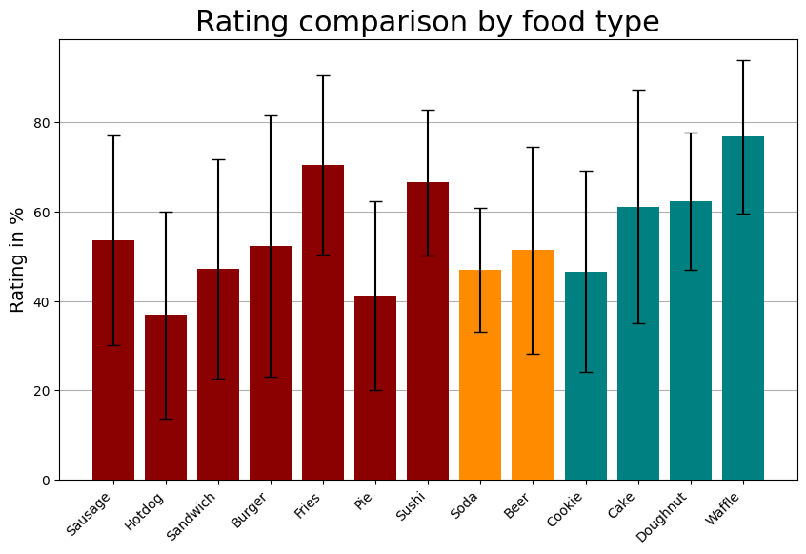
Data visualization, food types

Slide 7
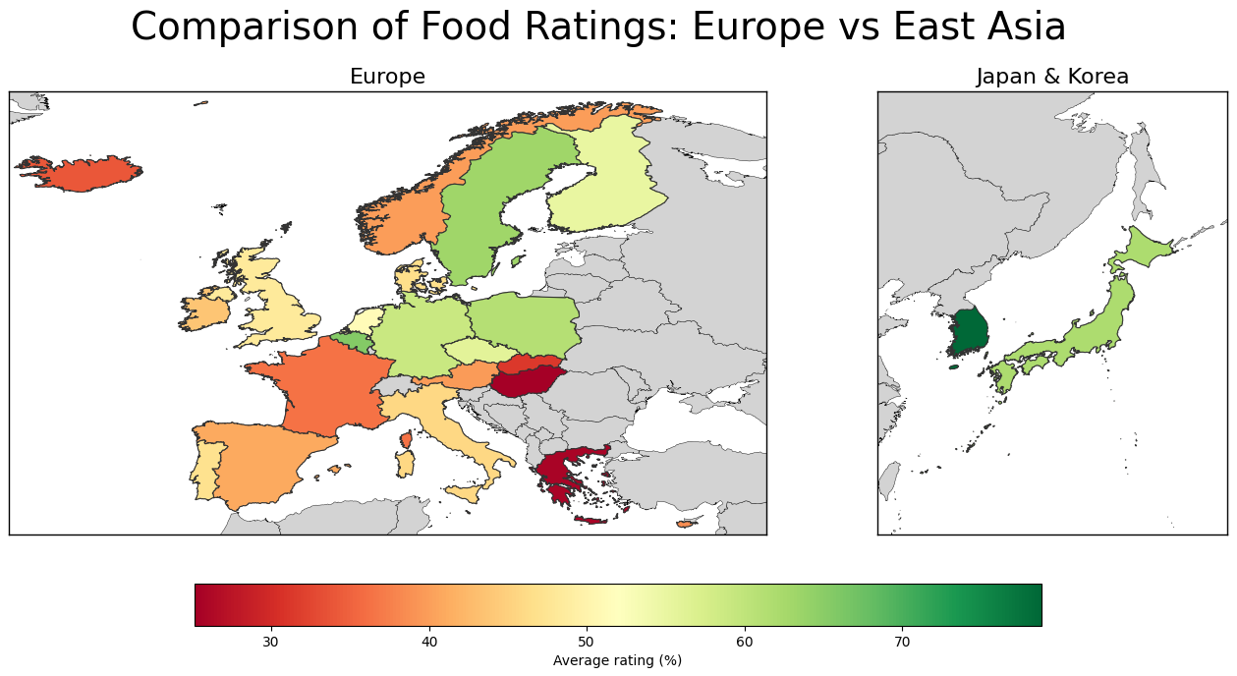
Data visualization, country averages

Slide 8
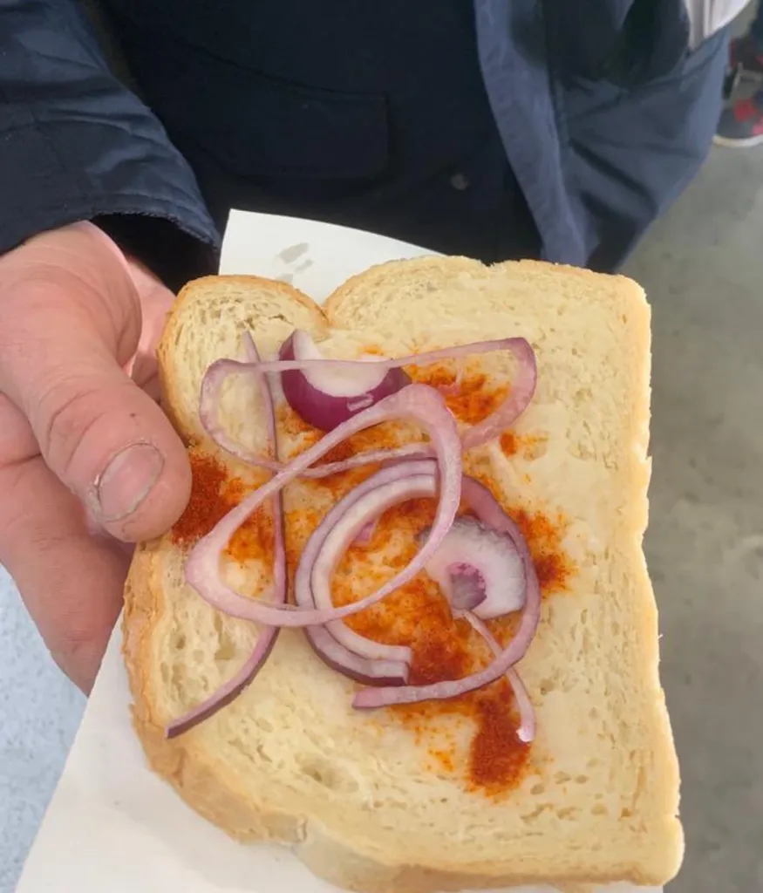
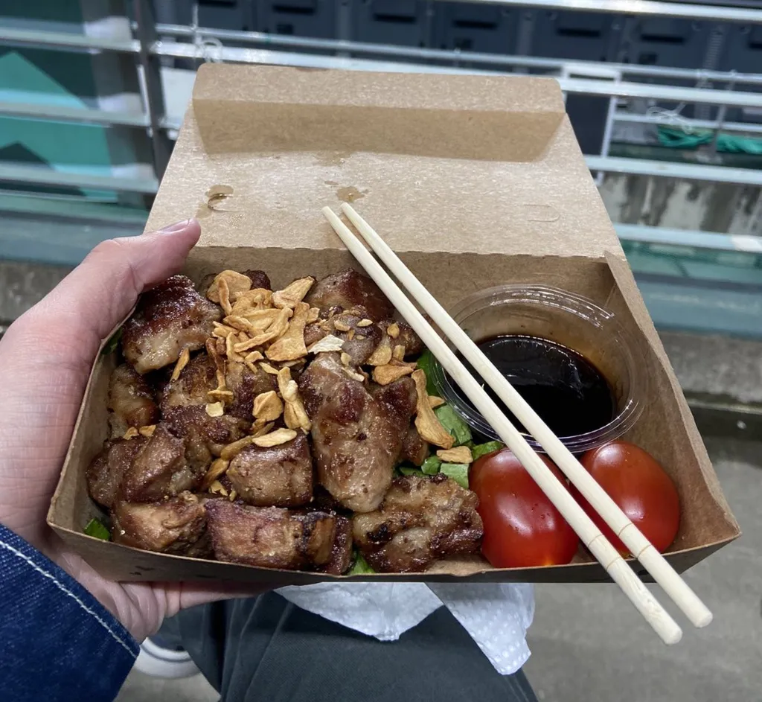
Example of Hungarian and Korean Scrandle
Hungarian zsíros deszka,
Average rating = (25.12±12.78) %
Korean pork steak
Average rating = (78.85 ±15.08) %

Slide 9
Scrandle Predictor

Slide 15
Appendix

Slide 16
Generative adversarial network
-

