Slide 1
Is it possible to use sea ice thickness to get a rough estimate of the sea ice salinity regardless of the growth history?
S ~ S(sea ice thickness)

Slide 2
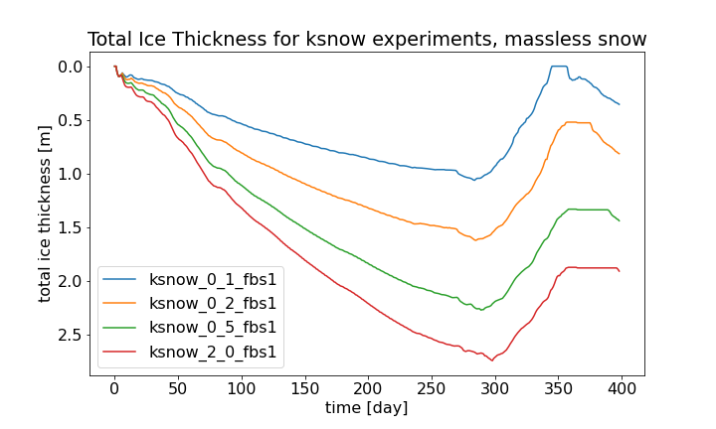
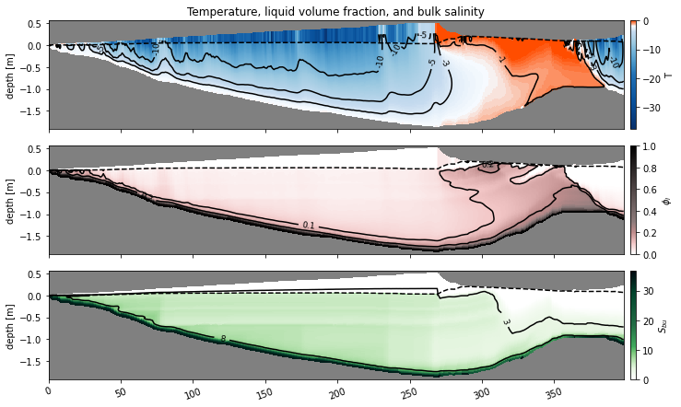
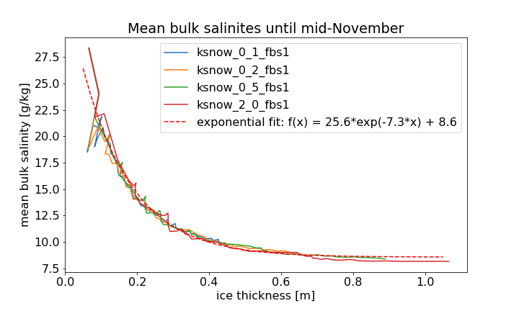
Parameterization of salinity with ice thickness: S = S(ice thickness)

Slide 3
Seasonal cycle with diff amplitude
Profiles with porosity on top

Slide 4
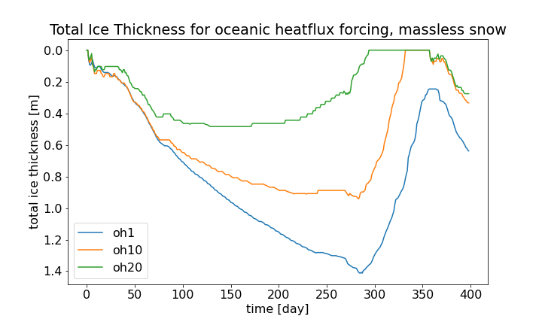
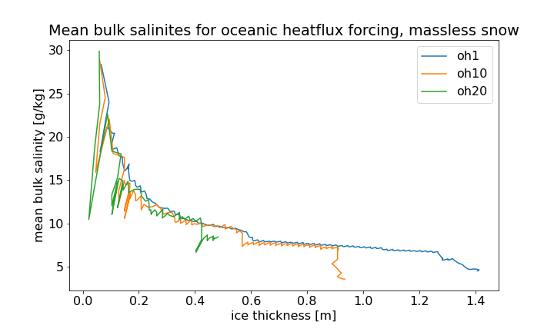
Oceanic heatflux with massless snow

Slide 5
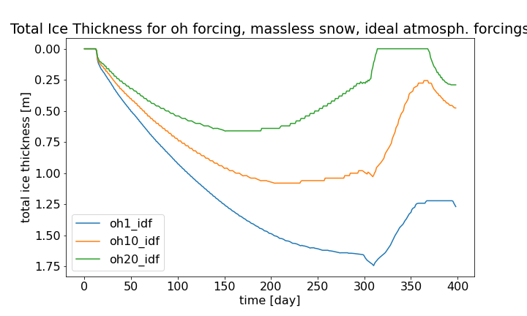
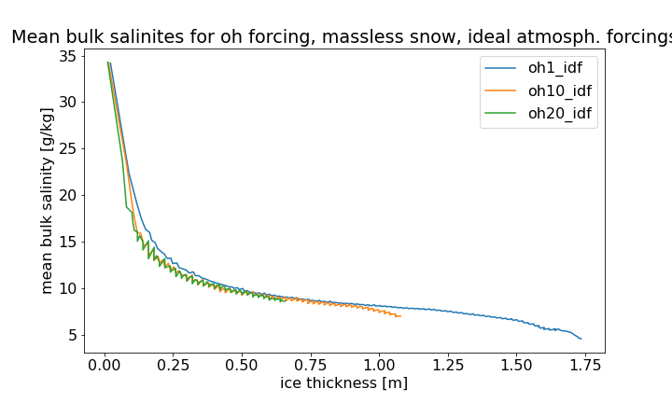
Oceanic heatflux with idealized forcing

Slide 6
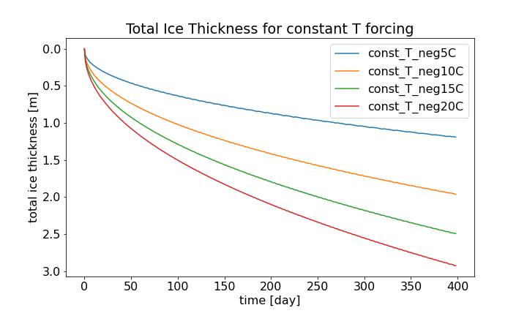
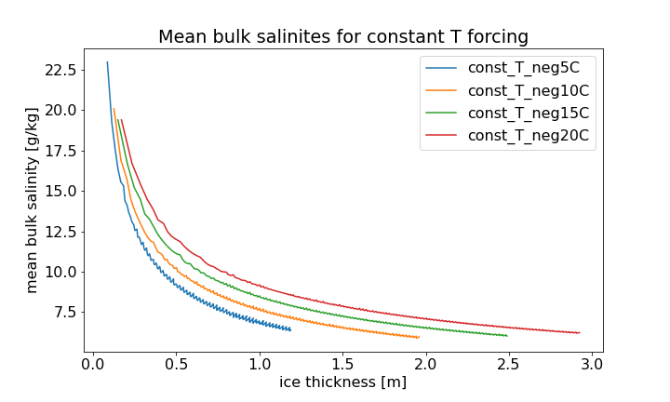
Constant temperature forcing

Slide 7
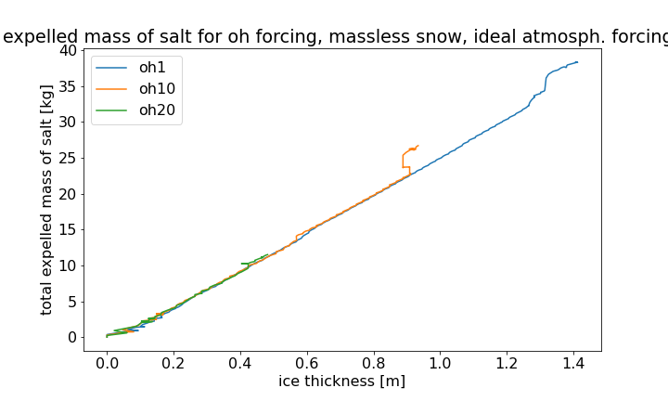
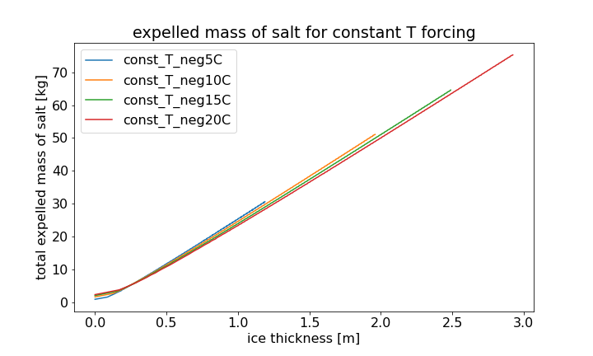
Expelled mass of salt

