Slide 1

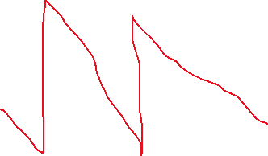
Predicting RUL for components
This app predicts RUL for each component in the selected machine.
Predicted RUL (in hours) for machineID: X
Choose machineID:
comp1:
XX hours
Prob X %
comp2:
XX hours
Prob X %
comp3:
XX hours
Prob X %
comp4:
XX hours
Prob X %
12
v
X
Show chart
Barplot
Comp1
Comp2
Comp3
Comp4
Hours

