Slide 1
Lab Report: Beer Tracker Load Testing
Jakob Schlager · Stefan Kastenhofer · Pascal Stadler
13 November 2026
Notes:
Overview of what we did in the lab, the load test results, and the problems we hit along the way.

Slide 2
Who Did What
JS
SK
PS
Jakob Schlager
Stefan Kastenhofer
Pascal Stadler
TBD
Fixed startup issues in the local services and ran all load tests.
TBD
Notes:
Contributions per team member. Jakob's and Pascal's sections still need to be filled in.

Slide 3
Load Test Outcomes
✗
newcomers
SLO breached
Takeaway
Back-to-back runs skew results. Leave a cooldown between tests so each one starts from a stable baseline.
✗
gate (right after newcomers)
http_req_failed threshold exceeded
✓
gate (re-run after cooldown)
Clean run
Notes:
newcomers breached the SLO. Starting gate immediately afterwards pushed http_req_failed over its threshold; after waiting, gate ran clean.

Slide 4
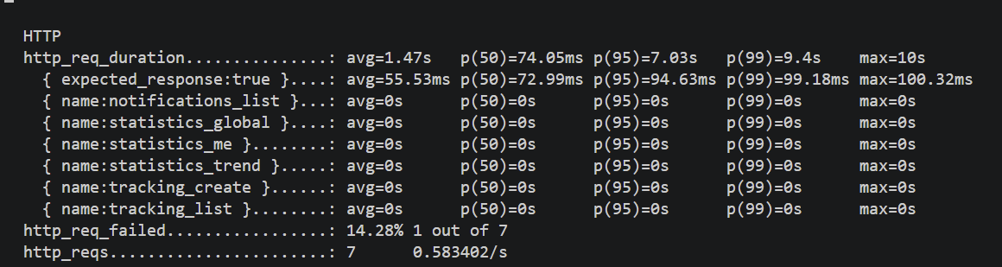
gate: Failed Run in Detail
1 / 7
requests failed (14.3%), breaching http_req_failed
10 s
max duration, likely a timeout; successful requests averaged 56 ms
0 s
on every named endpoint: the scenario never reached them
Notes:
Only 7 requests ran in total. One of them took the full 10 seconds, which looks like a timeout and is what pushed the failure rate to 14%. Every named endpoint reports 0 s, so the actual test scenario was never exercised: the run likely aborted during setup. The successful requests were fast, averaging around 56 ms.

Slide 5
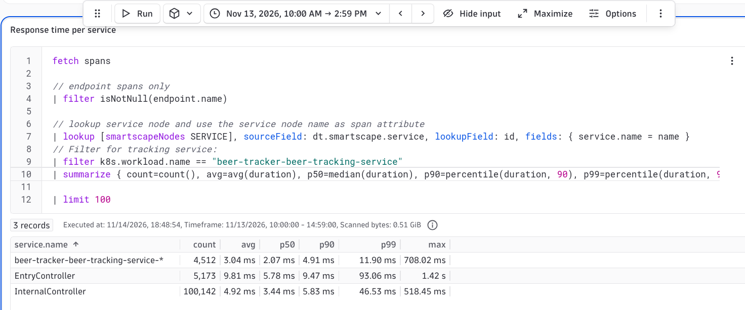
beer-tracking-service Monitoring
3 controllers
recorded
~2-6 ms
median response time once the service settled
11:30–12:00
latency spikes right after startup, stable afterwards even during loadtests
Notes:
Response time of the beer-tracking-service over the last six hours. Traffic starts around 11:30 when the services came up; latency spikes until about 12:00 and then settles around 2 ms. Only the readiness and liveness health-check endpoints were recorded, so none of the load-test requests to the tracking endpoints show up here.

Slide 6
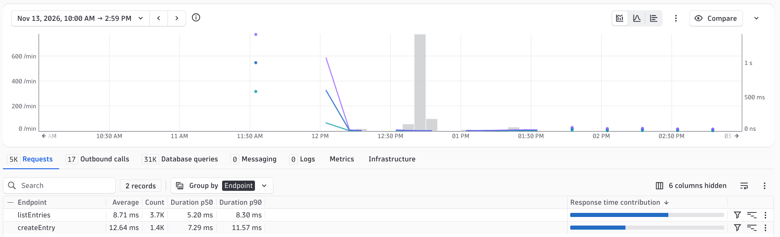
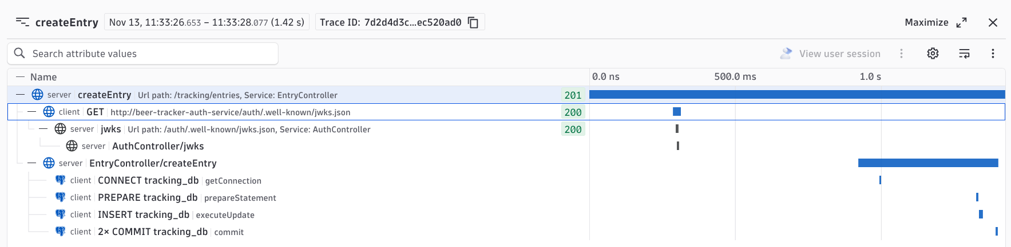
beer-tracking-service Monitoring
Possible next steps
Detailed profiling / logging
Increase startup health delay
Notes:
Response time of the beer-tracking-service over the last six hours. Traffic starts around 11:30 when the services came up; latency spikes until about 12:00 and then settles around 2 ms. Only the readiness and liveness health-check endpoints were recorded, so none of the load-test requests to the tracking endpoints show up here.

Slide 7
Issues Encountered
Database connection failed: all services started without the DB password (SCRAM authentication error).
Private key format: Windows OpenSSL produced a PKCS#1 key, but the auth service needs PKCS#8. Fixed by generating the key in WSL.
newcomers: breached the SLO.
gate right after newcomers: 1 of 7 requests timed out (14% failed) and no endpoints were reached. Passed after a cooldown.
Notes:
Summary of every issue we hit during the lab. More issues can be added to this list.

