Slide 1
Banking Marketing
Alpha Mbarushimana Ntakiyimana
Jakob Sig Dransfeldt &
Mikkel Rune Jørgensen

Slide 2
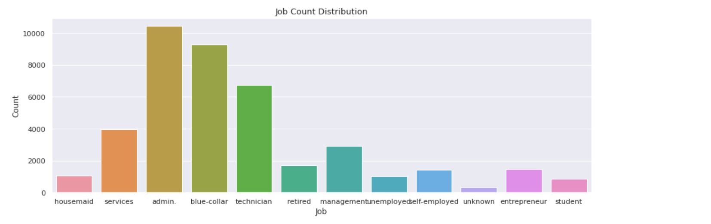
Job count distribution
The chart shows the distribution of jobs across 12 different categories

Slide 3
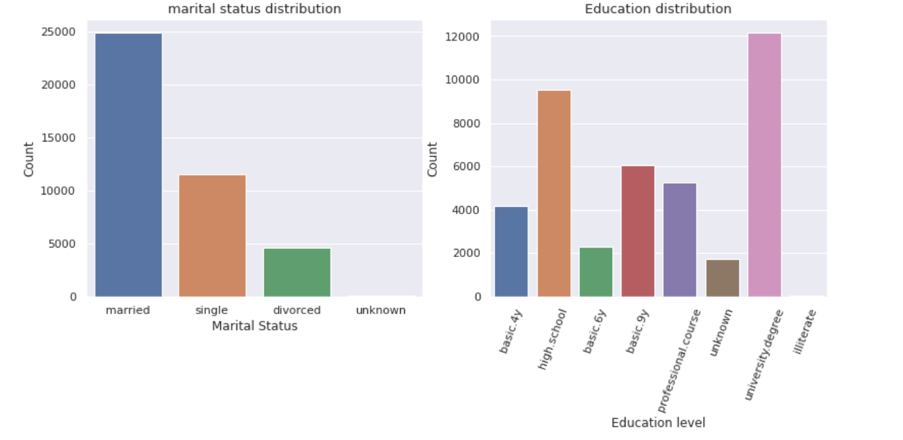
Distribution of marital status and education
The charts shows the distribution of the marital status and Education

Slide 4
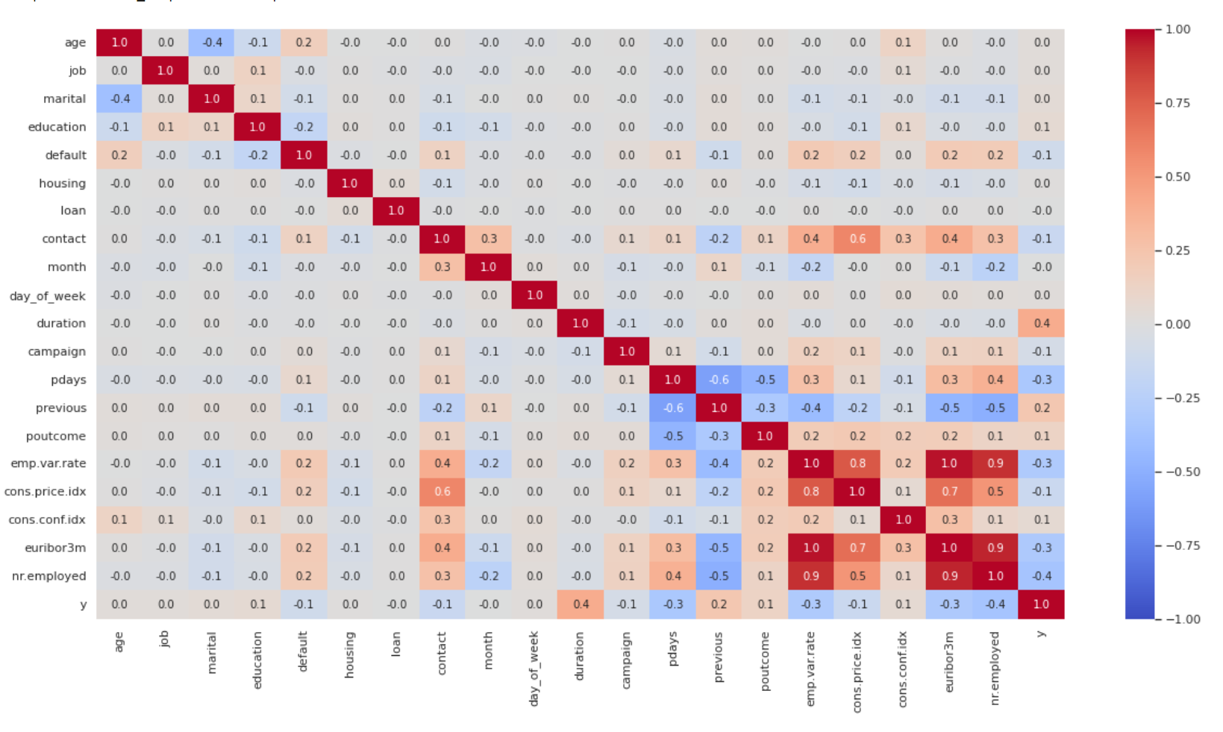
The correlation within the categories
We can see that there is a correlation between y and duration. It tells us the time that the caller and the clients have been talking, and shows the longer the call the higher chance of a yes to the marketing campaign
Notes:
We can see that there is a correlation between y and duration. That tells us the time that the caller and the call taker have been talking, and the chance that there will come a yes or no.

Slide 5
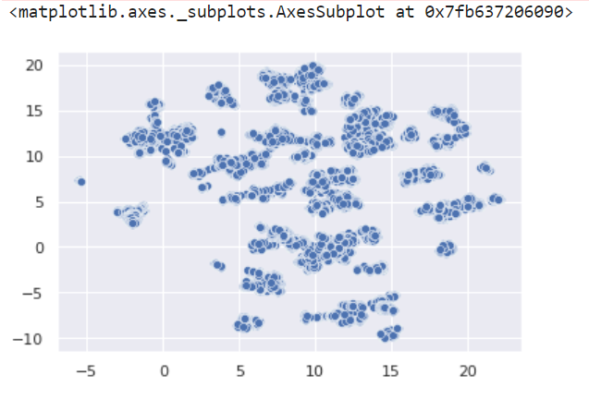
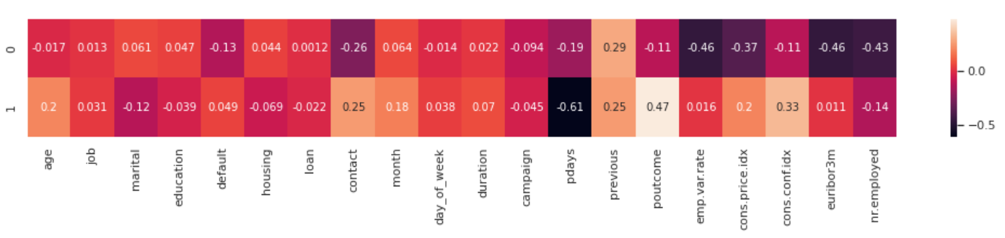
PCA Umap of the redused data

Slide 6
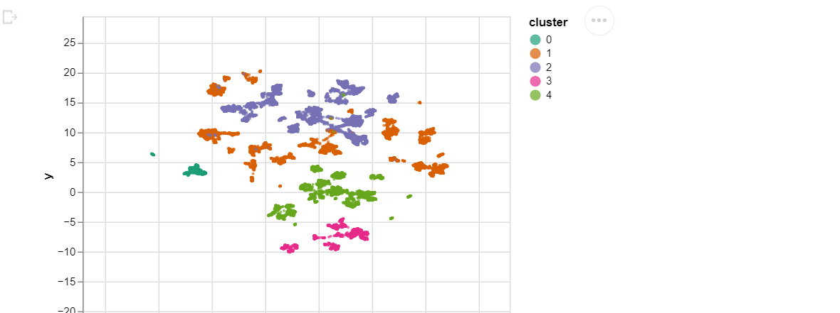
The clustered data
As the chart shows the clustering of the variables are hard to place in direct clusters. There are 5 clusters, but they are scattered all around which make it hard to see the correlation between the variables in the clusters

