Slide 1
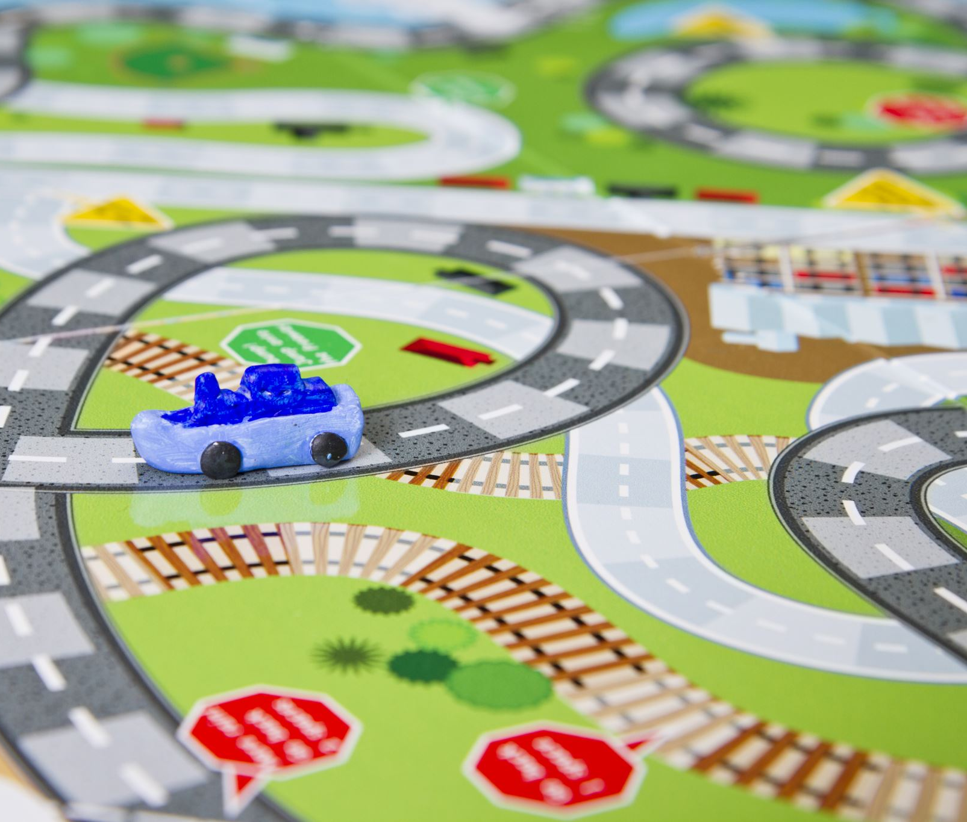
Multiplayer 2-D Racing Game
Team members:
Jakobie Brown
Kaden Goodrid
Logan Titzer
Course: CS478 Software Development
Instructor: Xue Han

Slide 2
Project Pivot – Why?
Thought it would be more fun
Decided to use Unity at Dr. Han's recommendation
Multiplayer game fits better with development environment and experience level
Allows us to put more attention toward one game = higher quality end product

Slide 3
Project Pivot – What changed?
What We Had:
  Web based gaming application
  Multiple simple game options (Tic-tac-toe, Pong, etc)
  FCFS Matchmaking
What's New:
  2D multiplayer platformer racing game
  One larger, more detailed game
  Elo based rank matchmaking system
  Built in Unity

Slide 4
Project Over View
2D Unity Game
Platformer game gameplay
Race through levels and compete against friends
Collect power ups and navigate through platforming obstacles
Programming Languages:​
  C#​
Development Tools​
  Visual Studio (IDE)​ Unity Editor
  Github (Version Control)​
Libraries and Frameworks​
  Net Game Objects

Slide 5
Team Roles & Responsibilities
Game Systems & Multiplayer Lead: Jakobie
Player movement & physics
Collision detection & level design
Powerups & obstacles
Multiplayer sync & lobby system
Backend & Database Lead: Kaden
Account creation & authentication
Database schema design
Elo rating calculation
Match results & leaderboard APIs
UI, DevOps & Integration Lead: Logan
UI screens (login, profile, leaderboard)
Frontend-backend integration
GitHub project management
CI/CD pipeline & deployment

Slide 6
Release Plan Overview
Release Strategy
Milestone-based releases
One release per project phase
Phases
Phase I: Core functionality & playable demo
Phase II: Ranking systems, polish & deployment

Slide 7

Phase 1 Release (Core Gameplay)
Phase I Features
Account creation & login
Single playable 2D race level
Core movement & collision system
Basic multiplayer session
Match result storage
Goal
End-to-end playable Demo

Slide 8

Phase 2 Release (Enhancements)
Phase II Features
Elo rating system
Leaderboards
Achievement tracking
Improved matchmaking
UI polish & usability
Deployed backend for demo
Goal
Competitive progression & user experience

Slide 9

Project Management
Tool Used: GitHub Projects
Backlog of user stories
Task tracking (To Do, In Progress, Review, Done)
Integrated with GitHub Issues & Pull Requests
Purpose
Track progress & deadlines
Maintain visibility across team

Slide 10

Source Control Workflow
Workflow
Create feature branch
Implement changes
Open pull request
Review & approve
Merge into main
Goal
Maintain stable codebase

Slide 11

Rules for Branching
Main Branch Rules
No direct pushes to main
Pull requests required
Minimum of 1–2 code reviews
CI checks must pass before merge
Reason
Prevent bugs & unstable code

Slide 12
Summary & Q&A
Clear role separation
Structured release plan
Professional Git workflow
Continuous integration for quality

