Slide 1


Chrome DevTools By ACM USI
Topics
Inspecting Elements
Console Website Interaction
Debugging JS
Network Monitoring
Comprehension Questions
What are Chrome DevTools used for?
How do you open Chrome DevTools?
Which panel allows you to modify HTML and CSS?
How do you halt the execution of JavaScript?
What is the console panel used for?
Jakobie Brown

Slide 2
Workshop Setup
Download files from https://github.com/JakobieBrown/ChromeDevToolsWorkshop Or from ACM discord **
Open File with Chrome Browser and a Text Editor

Slide 3
Opening
Chrome DevTools
Keyboard Commands
Windows: Ctrl + Shift + I
Alternative Navigation
Menu → More Tools → Developer Tools
Right-click → Inspect
Mac: Cmd + Option + I

Slide 4
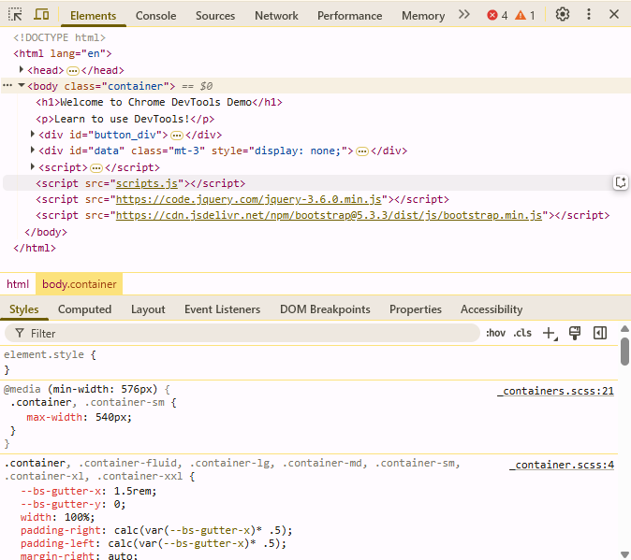
Panel Navigation
Errors/Warnings counter
Subpanel
Navigation

Slide 5
Inspecting Elements
Keyboard Commands
Windows: Ctrl + Shift + C
Alternative
Mac: Cmd + Option + C
Right-click on desired Element→ Inspect

Slide 6
Element Panel
Navigation
Open Inspector → Elements
Inspect & Edit HTML
Uses
View & Modify Styles

Slide 7
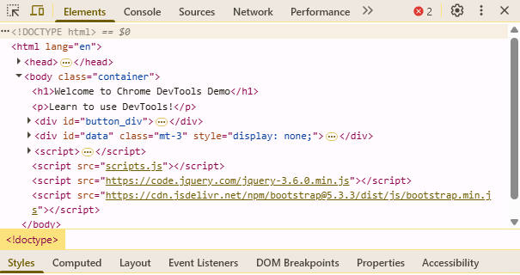
Element Panel

Slide 8
Activity #1
Modify a website’s text and styles in the Elements panel.
Instructions
Open the Elements tab.
Change "Welcome to the Chrome DevTools Demo" to "DevTools are Awesome!“
Find the ‘<h1>’ element
In the styles panel, change ‘<h1>’ color from blue to red.
Modify ‘<button id="loadData“>’ by removing the ‘hidden’ attribute
Click the button
Find ‘<button id=“displayData”>’ in ‘<div id=“buttonDiv”>’ and click on it
In the styles panel, change the button’s display from ‘none’ to ‘inline-block’

Slide 9
Console Panel
Navigation
Right-click → Inspect → Console
Log Messages
Uses
Run JavaScript
Inspect Objects
Debug Errors
Interact with the page

Slide 10
Console Panel
Open Commands
Windows: Ctrl + Shift + J
Mac: Cmd + Option + J
Clear Console Commands
Windows: Ctrl + L
Mac: Cmd + K

Slide 11
Console Panel
Console functions
console.clear()
console.log(message)
console.assert(condition, message)
console.error(message)
console.warn(message)
console.info(message)

Slide 12
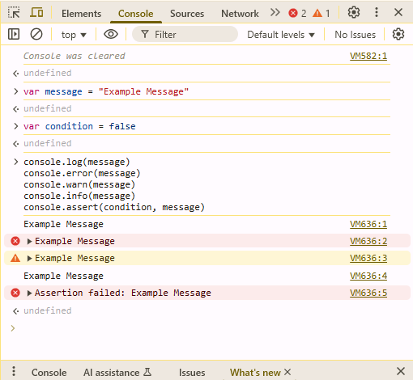
Console Panel

Slide 13
Activity #2
Change elements and call a function
In the console, enter the following
headers[0].style.color = "green";
const headers = document.querySelectorAll("h1");
displayEntries(); // a function defined in scripts.js
document.getElementById("callAPIs").style.display = "inline-block";

Slide 14
Sources Panel
Navigation
Open Inspector → Sources
Uses
Debugging JavaScript
Viewing Loaded Resources
Editing Files in Real-Time

Slide 15
Sources Panel
Resume Execution
Windows: F8 – Mac: F8
Set Break Point
Open file in Sources panel
Step Over
Windows: F10 – Mac: F10
Click line number
Step Into
Windows: F11 – Mac: F11

Slide 16
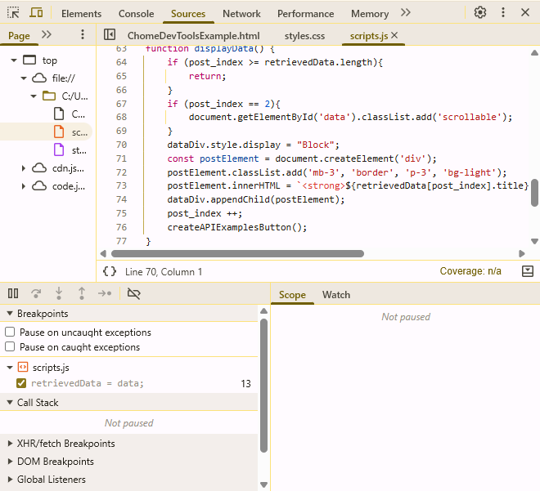
Sources
Panel

Slide 17
Activity #3
Set break points and use function keys
In the sources panel
Open scripts.js
Set break point on line 13
Press the Load Data button
Press F10 until line 16
Press F11
Press F8

Slide 18
Activity #4
Toggle break points
In the sources panel
Expand the sub-panel and locate Break Points
Under scripts.js uncheck the break point
Press the Load Data button

Slide 19
Network Panel
Navigation
Open Inspector → Network
Uses
Monitoring Network Requests
Analyzing Performance
Inspecting Request and Response Details
Debugging API Requests
Simulating Network Conditions

Slide 20
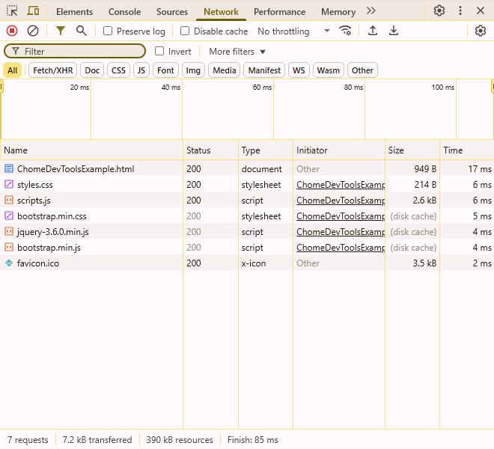
Network
Panel

Slide 21
Activity #5
Instructions
Navigate to Network Panel
Click the Example APIs button and watch the requests
Right-click on ‘bootstrap.css’
Select Block Request URL
Block ‘styles.css’ as well
Refresh the page
Ensure recording is enabled to see API requests
Click on the request “10”
Monitor and block the API request

Slide 22
Bonus Activity #1
Add a button with JS in the console
Instructions
In the console, enter the following:
function removeEntries(){ document.getElementById('data').innerHTML = ""; post_index = 0; }
const removeButton = document.createElement("button");
removeButton.id = "removeData";
removeButton.className = "btn btn-danger w-auto";
removeButton.textContent = "Remove Data";
removeButton.addEventListener('click', removeEntries);
document.getElementById('button_div').appendChild(removeButton);

Slide 23
Chrome DevTools By ACM
Resources
https://developer.chrome.com/docs/devtools/
Comprehension Questions
What is Chrome DevTools used for? ● Inspecting and debugging websites
How do you open Chrome DevTools? ● Ctrl + Shift + I / Cmd + Options + I ● Right-click → Inspect
Which panel in Chrome DevTools allows you to modify HTML and CSS? ● The Elements Panel
How do you halt the execution of JavaScript? ● Set a breakpoint in the Sources Panel.
What is the console panel used for? ● Viewing logs, debugging JavaScript errors, and running JavaScript commands.
Jakobie Brown

