Slide 1
Dynamic Web Applications lecture 08
Andrea Valente
anva@mmmi.sdu.dk

Slide 2
What are we going to do
more npm for front-end development:
unit testing (Mocha)
linters (eslint)
bad smells and refactoring

Slide 3


(1) Using mocha – the basics
https://mochajs.org/
npm install -g mocha
Next, we’ll create a project directory named test
In our test folder we’ll create a file named test.js
Finally, we’ll initialize our project by running npm init
Let’s do this together
Notes:
From https://codeburst.io/how-to-test-javascript-with-mocha-the-basics-80132324752e

Slide 4
> npm init
Answer the questions and hit enter
The question that is most important here is ‘test command:’ -> respond with ‘mocha’
This way we can run mocha by simply typing npm test

Slide 5
Writing a test
In test.js write:
Now run our test in the command line using npm test
var assert = require('assert'); describe('testing the array', function() { describe('test of indexOf()', function() { it('should return -1 when the value is not present', function(){ assert.equal( -1 , [1,2,3].indexOf(4) ); }); }); });

Slide 6
Groups and single tests
A group of tests
var assert = require('assert'); describe('testing the array', function() { describe('test of indexOf()', function() { it('should return -1 when the value is not present', function(){ assert.equal( -1 , [1,2,3].indexOf(4) ); }); }); });
A sub-group of tests
A specific test

Slide 7
Mocha tests
When writing a test, there are two basic function calls you should be aware of: describe() and it()
describe() a way to group tests in Mocha. You can nest tests in groups as deep as needed
it() is an individual test case. it() should be written as if you were saying it out loud: “It should equal zero”, “It should log the user in”, etc.

Slide 8
Assertions
With the testing framework Mocha, we can use assertion libraries. An assertion library is a tool to verify things are correct.
Here we’re simply using Node.js’ built-in assert module
So our test.js code starts with:
var assert = require('assert');

Slide 9
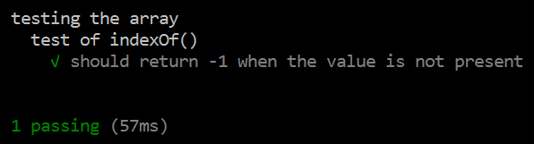
How to read Mocha result
The result broken down line by line is:
Our first test group testing the array
Our nested test group test of indexOf()
A check mark indicating a passing test, along with the description of our test
A summary indicating we have 1 passing test and the testing took XX milliseconds

Slide 10
Exercise
Work on your test.js file
Create a new test group named Math
Create two tests within the group Math.
Test one: Should test if 3*3 = 9
Test two: Should test if (3–4)*8 = -8
then run npm test
10 min

Slide 11
Test frontend code
Look at the folder code\my_test
index.html
and aModule.js
(Q) What does the function doubleOrNothing do?
Now check out test.js where it says: …testing an external module Notice how the aModule.js file is required, then tested by describe() and it()
then run npm test
(Q) finally: look at the end of the aModule.js file… what is the ”very cool trick” doing?

Slide 12
Exercise
Work on your code\my_test\test.js file
Create a new test in the group named Math
test that doubleOrNothing(a)+ doubleOrNothing(b) is always less or equal to 2*(a+b) , because sometimes doubleOrNothing returns 0 … For example: doubleOrNothing(3)+ doubleOrNothing(5) <= 2*(3+5) = 16
something like: it “should be dON(3)+ dON(5) <= 2*(3+5)”
then run npm test
10 min
Notes:
doubleOrNothing(3) + doubleOrNothing(5) <= 16
(0 or 6) + (0 or 10) <= 16
0 + 0 <= 16 ==> TRUE
6 + 0 <= 16 ==> TRUE
0 + 10 <= 16 ==> TRUE
6 + 10 <= 16 ==> TRUE
OK!

Slide 13

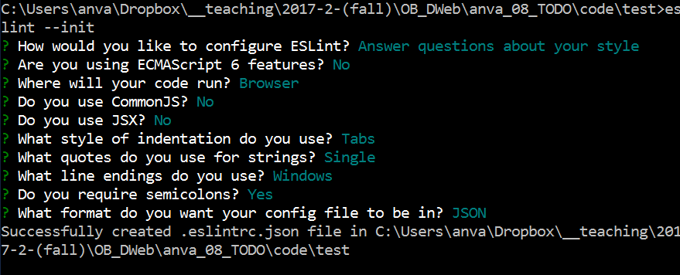
(2) Linting
How to get more info about my code?
Stay in folder code\my_test
eslint https://www.npmjs.com/package/eslint
run: npm install eslint --save-dev
Then type: eslint --init
Notes:
Or you could install eslint globally:
npm install -g eslint

Slide 14
How complex is your code? eslint can tell you…
Now, run by typing: eslint test.js
Add these lines to the init file .eslintrc.json
as the last 3 lines of the object "rules" Remember to respect object syntax (i.e. put a comma before ”complexity”)
And run again: eslint test.js
"complexity": [2, 5],
"max-statements": [2, 7],
"max-statements-per-line": [2, { "max": 1 }]
Also remove rule "indent” ! To get a cleaner report.
Notes:
From https://wecodetheweb.com/2016/11/05/improving-code-quality-using-eslint/
Also remove rule "indent” ! To get a cleaner report.

Slide 15
How complex is your code?
Check out also http://jshint.com/
online linter.
copy/paste your test.js code into jshint and read the report

Slide 16
What are these measures?
complexity -> ”Cyclomatic Complexity measures the number of linearly independent paths through a program’s source code” https://eslint.org/docs/rules/complexity
max-statements -> “… allows you to specify the maximum number of statements allowed in a function” https://eslint.org/docs/rules/max-statements
max-statements-per-line -> “A line of code containing too many statements can be difficult to read” https://eslint.org/docs/rules/max-statements-per-line

Slide 17
(3) Enter “refactoring”
(Def) Refactoring is way to change the code… BUT without changing the behavior of the code
How do you guarantee that behavior does not change?
by using tests (and version control)
your code must pass the same tests before and after you refactor it!
What is the point of changing the code if the behavior doesn’t change?
the point is to improve quality while preserving behavior
if the code was working OK -> no new errors can be added, but the code will have better quality (for example being more more readable)
Notes:
From book http://refactoringjs.com/ [chpt 1]
http://refactoringjs.com/files/refactoring-javascript.pdf

Slide 18
Exercise
You decide to refactor the function doubleOrNothing in file code\my_test\aModule.js
You don’t want to change the behavior of the function, but simply use 2*n instead of adding n+n to compute the double (perhaps because you already know that you will have to implement a tripleOrNothing function later today, so having a 2 in the formula could be easier to change into a 3 later or turn into a parameter…)
So you run npm test
see that all tests about doubleOrNothing pass
Then change the implementation of the function, and…
… then run npm test again, to check that nothing changed!
10 min
We have just REFACTORED the code!
Notes:
The function:
function doubleOrNothing(n){
if (Math.random()<0.5){
return n+n;
}
return 0;
}
Becomes:
function doubleOrNothing(n){
if (Math.random()<0.5){
return 2*n;
}
return 0;
}

Slide 19

Code of good quality
Some measures/principles to ensure quality in the code
DRY: Don’t repeat yourself -> avoid copy/paste
KISS: Keep it simple, stupid -> low # statements in functions, and per line, and low cyclomatic complexity
EVAN principles of code quality:
Extract functions and modules to simplify interfaces -> work with modules and require them (with browserify)
Verify code behavior through tests -> use assertions (with Mocha for example)
Avoid impure functions when possible -> functions should only work with their parameters, not alter global variables (*)
Name variables and functions well -> follow standards, like camelCase
Notes:
Javascript syntax standards
https://www.w3schools.com/js/js_conventions.asp (*) An impure function that has a side effect on a variable outside of its own scope.
A pure function doesn’t depend on and doesn’t modify the states of variables out of its scope.
var count = 0;
function increaseCount(val) {
count += val;
}
Pure version would be:
var count = 0;
function increaseCount(counter,val) {
return counter + val;
}
count = increaseCounter(count);

Slide 20
Impure/pure functions
(*) An impure function that has a side effect on a variable outside of its own scope.
A pure function doesn’t depend on and doesn’t modify the states of variables out of its scope.
Impure function:
var count = 0;
function increaseCount(val) {
count += val;
}
increaseCount(10);
The pure version would be:
var count = 0;
function increaseCount(counter,val) {
return counter + val;
}
count = increaseCounter(count,10);

Slide 21

Bad Smells
How to know when your code is of bad quality?
“A code smell is a surface indication that usually corresponds to a deeper problem in the system” CodeSmell by Martin Fowler https://martinfowler.com/bliki/CodeSmell.html
We need:
to define a few bad smells by name and decide how we should recognize them in our JS code
and how to fix them (using refactoring)
As an example, let’s work on a piglatin translator, folder code\test2
Notes:
then look at: http://elijahmanor.com/talks/js-smells/#/1

Slide 22
Unit test -> refactor (and repeat)
Let’s work on a piglatin translator, folder code\test2
Open page in code\test2\html in the browser and look at the code too! Then:
First, remember have mocha installed globally (once before at least) npm install -g mocha
Then: npm test
Now: fix the code so the test work! (don’t do too much, just make the test pass even if your code is not really correct…)
Add more tests in file test.js to check that the piglatin translation works correctly for some more of the strings (see next page)
You will get more errors now when you run: npm test
At this point you should fix your code more to make it pass the new tests… but instead we will simply switch to use file pigLatin_v2.js
10 min
Note: we wrote the tests, then fixed the code. This is called ”test-first” development

Slide 23
Pig Latin examples
1. If starts with consonant (or consonant cluster), then move the end and append "ay"
"pig" → "igpay"
"banana" → "ananabay"
"trash" → "ashtray"
"happy" → "appyhay"
"glove" → "oveglay"
2. If starts with vowel or silent letter, then keep word along and append "way"
"egg" → "eggway"
"inbox" → "inboxway"
"eight" → "eightway"

Slide 24
Working with pigLatin_v2.js
Change the code code\test2\test.js so that it test the new version of the pigLatin module
Then: npm test
are all tests working?
Fix also the html file code\test2\html\pigLatin.html so that it works with pigLatin_v2.js instead of the first version as it does now. Open the page in the browser to see it in action
Let’s see if this new version is good quality or it smells
let’s try linting it!
first, remember have eslint installed globally (once at least) npm install -g eslint
then lint it with: eslint html/js/pigLatin_v2.js
Let’s discuss the report that came out…
Notes:
Don’t forget to check out the eslint init file to see how the quality metrics are set: .eslintrc.json

Slide 25
Does it smell?
Too Many Statements
Too Much Depth
Too Much Complexity
Could find more problems using these params for eslint:
max-len:[2, 65] max-params:[2, 1] max-nested-callbacks:[2, 0]
Let’s try them out… add them to code\test2\.eslintrc.json then eslint html/js/pigLatin_v2.js
this code is too complex, let’s call it “Convoluted Code Smell”
Notes:
More details at: http://elijahmanor.com/talks/js-smells/#/1

Slide 26
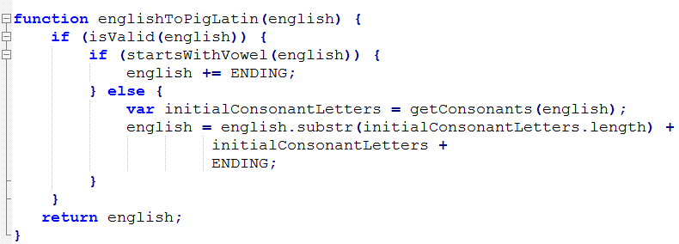
Fix bad smells one step at the time using refactoring
We need to have a group of tests to establish the behavior of our code (DONE): npm test
then we can refactor! ... See the code in code\test2\html\js\pigLatin_v3_refactored.js It is a new version of the module, and it has the same behavior (test it to see if it is so! Change code\test2\test.js to require this new version of the module, and run: npm test -> you should see all tests pass as before :) But the code is different (check out the code) and if we lint it again...

Slide 27
One lint more
(Check out the code) What happened to the code? How has it been refactored?
What happened to the functions?
Number of statements in the body of the functions?
What happened to CONSONANTS and the other “constants”?
From folder code\test2\ try: eslint html\js\pigLatin_v2.js and compare the results with: eslint html\js\pigLatin_v3_refactored.js
Can we say that we improved the code’s quality?
Notes:
More details at: http://elijahmanor.com/talks/js-smells/#/1

Slide 28
Other bad smells
The “jQuery Inquiry” AKA “extreme chaining” smell: the code is chained so difficult to debug in pieces -> http://elijahmanor.com/talks/js-smells/#/6
Another interesting smell is “repeated assignment”
var a = 10; a = f(a);
a = g(a);
a = h(a);
It could be rewritten as: /* nested function calls */
a = h( g( f(a) ) );
Or as: /* foreach */
var funcs = [ f,g,h ];
funcs.forEach(function(func) {
a = func(a);
});
-> http://elijahmanor.com/talks/js-smells/#/8
Beware: other smells are more complex/advanced

Slide 29
To summarize – iterative devpmt
Implement a new story:
Write a group of tests (Mocha) to specify what your program/page will do
Add new code until all tests pass
Improve the quality of your code:
Detect bad smells (with a linter to get an evaluation of your code)
Refactor your code, and run all tests to see that it still has the same behavior
Now your code is a deliverable version

Slide 30
Next lecture
Do we really need jQuery?
Start reading “you don't need jquery” https://github.com/oneuijs/You-Dont-Need-jQuery
MVC frameworks – Angular.io https://angular.io/
Typescript https://www.typescriptlang.org/
https://www.typescriptlang.org/docs/handbook/typescript-in-5-minutes.html
Angular
https://angular.io/guide/quickstart
https://angular.io/tutorial

Slide 31
More resources
Good tutorial for Mocha
https://github.com/ideaq/learn-mocha
More javascript bad smells
http://elijahmanor.com/javascript-smells/

