Slide 1
Dynamic Web Applications Lecture 2
ANVA

Slide 2
Topics
chapter 9 Learning jQuery 4th edition:
jQuery traversing -> page 241
custom pseudo-class (aka selector plugin)
custom DOM traversing methods & plugins: how-to

Slide 3
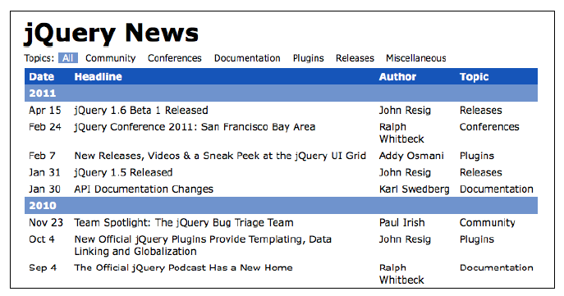
Chapter 9
chapter 9 Learning jQuery 4rd edition:
Use a couple of minutes to familiarize yourself with the table in file code/01[book]chpt09/index.html

Slide 4
Advanced Selectors and Traversing
Selecting rows and columns in various ways
Filter a table dynamically: (from page 243)
Based on a topic (selected by user)...
hide all rows that do not contain the selected topic -> listing 9.2 p. 244
instead of the selector :not consider the method .not()
.not() is like .filter() : also not can take an anonymous function as parameter -> listing 9.3 p. 245
$('#news tr:has(td):not(:contains("' + topic + '"))') .hide();
VS
$('#news').find('tr:has(td)').not(function() {
return $(this).children(':nth-child(4)').text() == topic;
}).hide();
The second takes care of topic that happens to appear as part of a news headline This new code eliminates some of the complex selector expression text by adding DOM traversal methods.

Slide 5
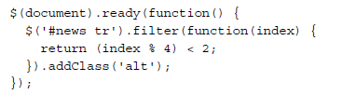
Table row striping
:nth-child(4) -> a pseudo-class
:nth-child(even) -> replacement for :even custom selector
Problem: how to stripe the table 2 by 2 ?
use filter instead -> listing 9.5 page 247
where does index come from?
modulus operator % -> Z_{n}
-> see img page 246
-> listing 9.4
index index%4
0 0 <2 => T
1 1 <2 => T
2 2 <2 => F 3 3 <2 => F 4 0 <2 => T
5 1 <2 => T …

Slide 6
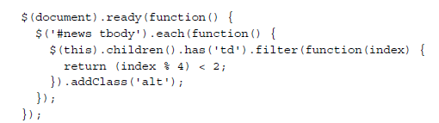
A couple of loose ends
Need to clean up:
no longer using :nth-child() -> the alternation does not begin again within each <tbody>
also: we should be skipping table header rows
-> listing 9.6 page 274
result: a more continous striping across the page -> see img page 248

Slide 7
Disappearing rows
When a particular topic is selected, many rows of the table disappear -> it makes the striping look silly
solution: when topic is selected, force a re-striping
-> listing 9.7 page 248-249
Use a function to put the code we want to re-use (for striping)
Advantages:
cleaner code,
reusable,
programmer-defined operations (like function stripe() )

Slide 8


Slide 9
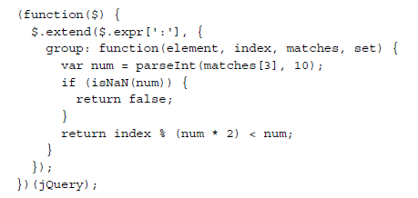
Writing a custom selector plugin
One way to improve legibility is to encapsulate code snippets in reusable components -> by creating functions (as we just did)
Another approach is to define plugins
easiest type of selector expression we can add is a pseudo-class (i.e. expressions that start with a colon) -> like :nth-child()
example: a custom pseudo-class called :group() -> page 250
Use group like this: $(‘tr’).filter( ‘:group(2)’ ).addClass(‘alt’);

Slide 10
The four parameters
The function is passed four parameters:
element: The DOM element under consideration.
index: The index of the DOM element within the result set.
matches: An array containing the result of the regular expression that was used to parse this selector. Typically, matches[3] is the only relevant item in the array; in a selector of the form :a(b), the matches[3] item contains b, the text within the parentheses.
set: The entire set of DOM elements matched up to this point. This parameter is rarely used.
:group( 4 )

Slide 11
OK, but what does it do??
Example: $(‘tr’).filter( ‘:group(2)’ ).addClass(‘alt’);
What is the effect of :group(2) ?
And of :group(5) ?

Slide 12
Let’s test :group()
Look at code/02slectorPlugins/group.html
Example num = 2
index index%(num*2)
0 0 <num => T
1 1 <num => T
2 2 <num => F 3 3 <num => F 4 0 <num => T
5 1 <num => T 6 2 <num => F 7 3 <num => F
…
Example num = 3
index index%(num*2)
0 0 <num => T
1 1 <num => T
2 2 <num => T 3 3 <num => F 4 4 <num => F
5 5 <num => F 6 0 <num => T 7 1 <num => T
…

Slide 13
Play with the selector plugin
10
min
(A) Stating from the code in code/02slectorPlugins/group.html
Create a new selector plugin called :first(n) that selects only the first n elements in the current selection
Test it on a copy of the group.html file
Example of use $(‘tr’).filter(‘:first(3)’).addClass(‘alt’); and the effect should be that only the first 3 lines are styled with class ‘alt’
(B) Try now to define a plugin :fromTo(a,b)
The behavior should be that it selects all elements from index a to index b (assume that a <= b).
Test it on a copy of group.html
Tricky part: read both 4 and 12 parameters in the :fromTo(4,12)
10
min

Slide 14


Slide 15
From selectors to traversal methods and DOM element stack
page 256
Open code/01[book]chpt09/index.html
And check out listing 9.10, 9.11, 9.12
-> var $cell = $('#release');
What is happening here?

Slide 16

selectors
$(‘ ... ’) VS .next() .parent() and .find() .not() .filter()
When using traversing methods jQuery keeps track of our path through the DOM!
Record-keeping:
jQuery objects are create when methods are applied to $()
each jQuery object instance has a .prevObject property pointing to the previous one -> AKA the DOM element stack
-> listing 9.13
?
See: page 258

Slide 17
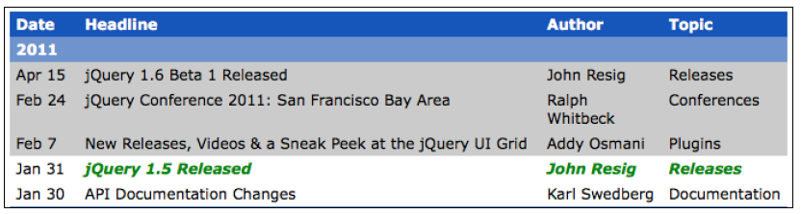
… it was andSelf() in older jQuery versions
result:
.addBack() -> jQuery looks back one step on the stack, and combines the two element sets
Here it means that the highlighted cells include both the two cells found by the .nextAll() call and the original cell
NOTE: the new, merged element set is then pushed onto the stack (so we could keep performing more operations on the set!)

Slide 18
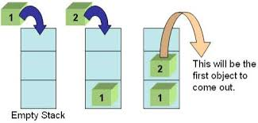
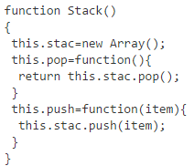
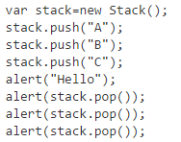
Stack
A nice example:
http://www.i-programmer.info/programming/javascript/1674-javascript-data-structures-stacks-queues-and-deques.html
See folder 01c_stack

Slide 19


Slide 20
DOM traversal plugin
How to write a my own DOM traversal method? (page 259)
$.fn -> listing 9.13
.closest( ) traverse the DOM upwards
given 1 cell, .column() returns its entire column
Notes:
Check out the final version in folder code/04traversalPlugin

Slide 21
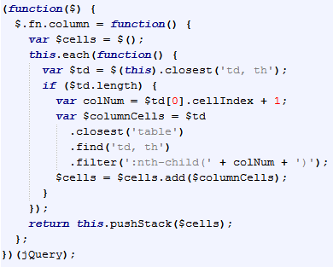
(3) .find(‘td’) .filter(‘:nth-child ...’) get all <td>s and keep those in this column
(2) go up to the table
(4) return all <td>s
in the column
(1) find the <td>

Slide 22
More about listing 9.13
this.each(...) because we might start with list of jQuery objects, and find columns for ech
pushstack() -> to keep the jQuery chaining stack up-to-date
How is the .column() method used? Listing 9.14
Performance: in general we have more legible code VS optimized code
However, ...

Slide 23
To improve performance...
method chaining
reduce repetition, avoid performing the same query twice
do 2 things on $(”#news”) as in listing 9.15
object chaching
use variables to store jQuery objects, to reuse later
listing 9.16
Exercise: using the files in folder 9
Create a new DOM traversal plugin method called .grandparent() that moves from an element or elements to their grandparent elements in the DOM
When clicking on one of the news, the new traversal method should be used to color the granparent element red
15
min

Slide 24
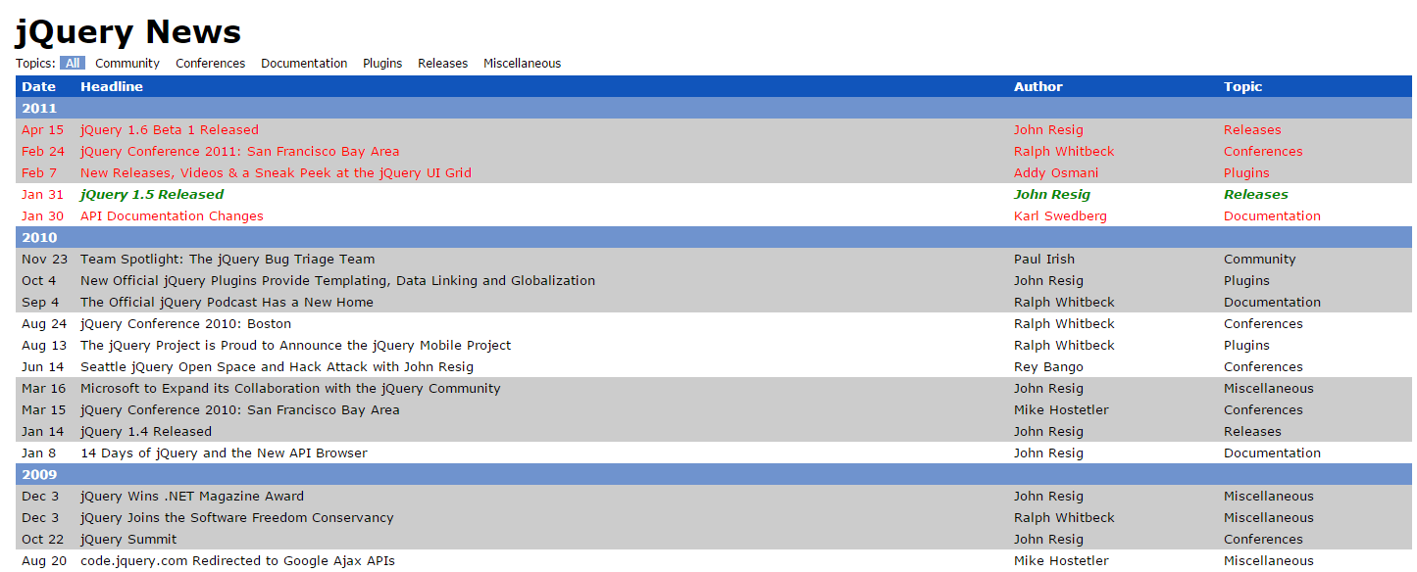
After clicking on ”John Resig” the entire sub-table should turn red

Slide 25
Next lecture
Chapter 10 Learning jQuery 4rd edition
JSON
Ajax
You need to install a local server:
something like WAMP http://www.wampserver.com/en/ (for Windows)
for other operative systems: http://softstribe.com/top-lists/10-highly-matching-alternatives-of-wampserver/
We will have Ajax and JSON working together (thanks to our local server)

Slide 26
This week’s task
Look in: code/05_task_solution[partial]
And code/06 new_task .txt
rest
of
lecture

