Slide 1
Dynamic Web Applications Lecture 3
ANVA

Slide 2
Topics
chapter 10^{(*)}:
AJAX for portions of HTML and together with JSON
events, binding, event bubbling, custom events, triggering and handling events
we will need a WAMP server to test the code
(or try running the examples from Brackets)
^{(*)}Note: some examples use jQuery code that is now obsolete; I fixed those examples.

Slide 3
Chapter 10
Advanced events
pages 266 – 284
Example: a photo gallery. But… we want to show few images, then load more photos on demand

Slide 4
Main goal
Keep the browser responsive during processing of events
On-going example: photo gallery (from the book)
could also be used to show long lists of quizzes
or lists of creators (with photo and bio for each)
Ajax $.get => more photos on demand
to test we need to place it on a server => WAMP!
Listing 10.1
$.get(url, function(data) { ... -> asynchronous

Slide 5

WAMP (a local server)
install WAMP server http://www.wampserver.com/en/
2. copy folder 10/ in WAMP’s public folder
3. open http://localhost/10/index.html

Slide 6
A bit about AJAX and JSON…

Slide 7
AJAX (and JSON)
AJAX = Asynchronous JavaScript And XML http://www.w3schools.com/xml/ajax_intro.asp
Now:
copy example_ajax folder under WAMP public folder
open http://localhost/example_ajax /example.html
Look at file myfile.json
How do you think $.getJSON work?

Slide 8
How does JSON work?
(def. https://www.w3schools.com/js/js_json.asp )
Open the javascript console in the browser, and try out these few examples:
var o = 3.1415;
// var o = [1,2, "abc", true];
// var o = {firstName:'John', lastName:"Doe"};
// var o = {obj:{a:1,b:2},c:3,d:[5,6,7,8]};
console.log( JSON.stringify(o) );

Slide 9
…
Now, try out these examples:
var text = "123.4";
// var text = "[1,2, \"abc\", true]";
// var text = "{\"a\":1, \"b\":\"abc\"}";
var o2 = JSON.parse( text );
console.log( text );
console.log( o2 );

Slide 10
Back to the photos…

Slide 11
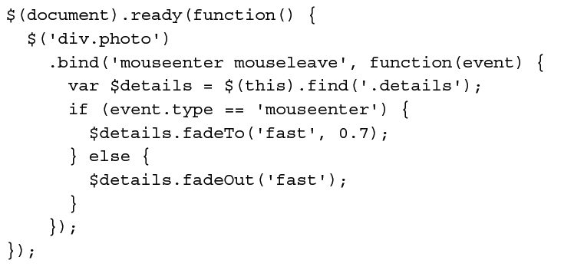
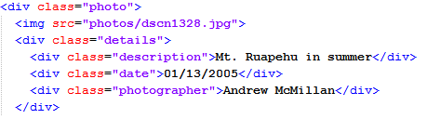
Back to photos: show photo data
on hover -> listing 10.2 (in folder 10/listings )
uses: $( selector ).hover( handlerIn, handlerOut )
why details look like that? Where is that specified?
alternative way: listing 10.3 -> bind 2 events at once

Slide 12
Problem
.bind does only bind existing elements
So after more photos are loaded
new photos don’t have event listeners :(
2 solutions:
re-bind - use: unbind() then bind() again on the photos, - or from jQuery v1.7, use on() and off()
Or bind higher up in the DOM elements: initially bind to a cointainer element (of the photo), then use event bubbling (aka event delegation)

Slide 13
Second approach: event bubbling
bind to a cointainer of the photo -> how to find the photo?
.closest() works upwards, from event target to container (via parent links) -> listing 10.4
if ( event.type == 'mouseover' && $target.length ) { ...
if ( event.type == 'mouseover' && $target.length!=0 ) { …
event.relatedTarget
in the case of mouseout: is the element being entered
in case of mouseover: indicates the element being exited
$target has at least 1 object
Nice visualization of events and how bubbling works: http://www.java2s.com/Book/JavaScript/DOM/Event_Flow_capture_target_and_bubbling.htm

Slide 14
More problems
Page 272
In the last example we had to change:
mouseenter and mouseleave
to mouseover and mouseout
But that also changes in subtle ways the behavior of our page: mouseover is triggered every time we move the mouse over the container of the photo
So: the detail <div> will fade in and out repeatedly :(
Solution
Event delegation can become too complex -> better use jQuery's delegation methods

Slide 15
Delegation methods
Check out 10/listing/10.6_new_.js
.on() -> [from http://api.jquery.com/on/ ]
Delegated events have the advantage that they can process events from descendant elements that are added to the document at a later time.
By picking an element that is guaranteed to be present at the time the delegated event handler is attached, you can use delegated events to avoid the need to frequently attach and remove event handlers.
We can bind to the gallery div;
$('#gallery').on('mouseenter mouseleave', 'div.photo',
function(event) …
Or we could bind our handler to document:
$(document).on('mouseenter mouseleave', 'div.photo',
function(event) …

Slide 16
To which element should we delegate event handling?
It can be convenient to attach event handlers directly to document when setting up event delegation
all page elements descend from document
so, we don't need to worry about picking the right container…
However: convenience VS performance cost!
in a complex DOM, events will need to bubble all the way up a many ancestor elements
this can grow costly on large pages

Slide 17
Advantages of early delegation
there are reasons we may yet choose to use document as our delegation context
Usually: we can only bind event handlers once the DOM elements they are attached to are loaded, which is why we typically place our code inside $(document).ready()
BUT… the document element is available immediately, so we don't need to wait for the whole DOM to be ready before we bind to it
… we can call .on() right away in the <head>
--> see book, listing 10.8 page 273

Slide 18
Custom events page 274
Manually triggered (VS DOM-triggered)
Decoupling between trigger and handler!
1 trigger => 0 or many handlers respond
the .on() call for a custom event is like a function definition,
the .trigger() call then acts like a function invocation
next page custom event -> listing 10.9 and 10.10 (book, p. 275)
compare with listing 10.1
2 handlers for document listen to next page
and are fired in sequence -> see folder multiple handler for same event
bubbling takes care of bringing events up to document

Slide 19
Infinite scrolling
See listing 10.11, page 277
now we want to trigger next page via a scrollbar
see folder window scrollbar experiment\
Event parameters (page 278)
when we define functions, we can set up any number of parameters to be filled with argument values when we actually call the function
in event handlers: 1st is always DOM evt object
scrollToVisible: optional param, boolean
bind + trigger event with params: listing 10.12, 10.13 (book)
extra parameters are optional: null if not set! (see folder variable number of parameters\ )

Slide 20
Task – custom event
Start from listing 10.10_new_.js
Add a new custom event named pageLoaded that fires when a new set of images has been added to the page.
Using nextPage and pageLoaded handlers, show a “Loading …” message at the bottom of the page only while a new page is being loaded.
10
min

Slide 21
Events triggered too often...
Consider listing 10.11 (book page 277)
in some browsers the scroll event is triggered repeatedly during the scrolling of the window
so checkScrollPosition() is called many times -> choppy or slow performance
Various events have this problem: scroll, resize, mousemove
Solution: event throttling technique
“do it only after a delay!” -> page 279
ignores calls that come more often than every 250 ms
if (!timer) { …
if (timer==0) { …
Short intro to javascript timing events: http://www.w3schools.com/js/js_timing.asp

Slide 22
Event throttling
Check listing 10.14
Try with different values (instead of 250 ms) for example 100, 500 and 1000
How do you precieve of the scrolling?

Slide 23
Another way to throttle: polling
Listing 10.15 page 280
use a single setInterval()
keeps checking the value of scrolled all the time, at 250 ms intervals
The effect is the same as with previous listing

Slide 24

Special events
DEF: a special event is an event that can react/know when a handler is bund and unbound
Read more: page 281
A trick is to to avoid polling all the time, and instead
check only if events have at least 1 handler!
setup + teardown VS add + remove
If a tree falls in the forest, but no one is around, will it make a sound?

Slide 25
Exercise – event throttling
Start from listing 10.14_new_FIXED.js
Bind a mousemove handler that logs the current mouse position, to photos. Use console.log()
Revise this handler to perform the logging no more than 5 times a second
15
min

Slide 26
Next week
Chapter 11 “Advanced Effects”, Learning jQuery
Also: procedural animation with canvas
short intro to Three.js, mainly to support the course in "Design of interactive systems for learning"

