Slide 1
Dynamic Web Applications Lecture 4
ANVA

Slide 2
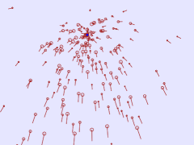

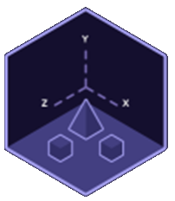
Topics
jQuery book -> chpt 11
animations,
deferred objects
promises
Procedural animation:
Particles
One-dimensional games
short intro to Three.js (to support the course in “Design of interactive systems for learning”)

Slide 3
jQuery effects library
Allows:
monitor ”state” of an animation
pause/re-start animations
fine-tune progress of effects

Slide 4
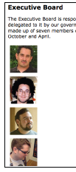
On mouse over animation
Check code page 289
Listing 11.1
x = (a==b)?1:2 the same as: if (a==b) x = 1; else x = 2;
.animate() jQuery method -> http://api.jquery.com/animate/ DEF: Perform a custom animation of a set of CSS properties.
It uses (linear) interpolation between 2 values (as start and an end value) of one or more css properties -> more about linear interpolation later
Problem: animation are queued, so when many ”mouse enter” + ”mouse exit” => long sequence in the queue, takes time to finish ☹

Slide 5
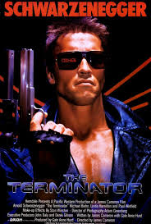
Animation state
Solution: listing 11.2
jQuery animation queue: $.fx
This solution is a bit like event throttling -> instead of time here we use state of <div> to skip events over
For that use: :animated pseudo-class
This avoids runaway animations … but…
Problem:
Still 1 animation must complete before another can start
Solution: force termination with .stop() ... listing 11.3

Slide 6

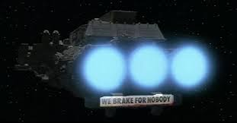
Stop!
.stop() is drastic!
some animations like slideDown() can be disrupted by stopping them in the middle of the animation [http://api.jquery.com/slidedown/ ]
Better solution:
.stop(true) -> ”go to end” parameter
but it can still result in jerky animations ☹
Better have full control over state at which animation stops: e.g. store the final value in a variable and animate to it explicitly using .animate()

Slide 7
Exercise: jQueryAnimation
Look in folder code\exercise_jQueryAnimation
start from the example animation3.html
the video shows what you should do:
make 6 DIVs, use jQuery to place them (with .css() and using ”top” and ”left” properties to place them on the page, and eventually: position: 'absolute'
attach onclick even handler to your DIVs, and using animation chaining, make them do like you see in the video
15 min

Slide 8
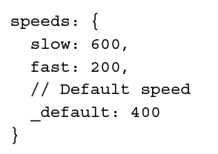
(back to the Executive Board example) Global effect properties
we can access the $.fx object to change at once how all animations work, globally
For example we can disable all effects -> listing 11.4
$.fx.off = true
Or we can fine-tune animation ”smoothness” => interval property (FPS)
-> see what small puppets and strobo-lights can achieve! (Studio Ghibli) https://www.youtube.com/watch?v=gyGoVrsBSz0
Or control effects duration: property speeds of the $.fx object
Add custom speeds: $.fx.speeds.crawl = 1200
And use them: $(someElement).animate({width: '300px'}, 'crawl');
“unfolding” effect -> Listing 11.6 + 11.7

Slide 9
Easing
jQuery has only 2 easings: linear and swing
... but jQueryUI plug-in adds more!
jQueryUI extra easing modes:
See the demo here http://api.jqueryui.com/easings/
Def: ”Easing functions specify the speed at which an animation progresses at different points within the animation.”
See listing 11.8 -> specialEasing option
What is missing? -> member's biography …

Slide 10
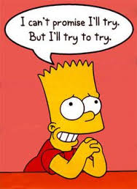
Deferred objects
A deferred object represents a process that takes time to complete, may even not finish
Creation: $.Deferred()
Every deferred object makes a promise to provide data to other code -> .promise() is represented by an object with 3 handlers:
.done()
.fail()
.always()
They work a bit like .bind() callbacks, BUT are called only once, when the deferred object is resolved or rejected

Slide 11
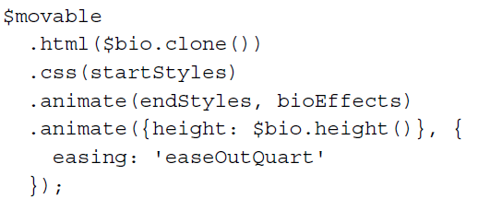
Animation promises
Every jQuery collection has a set of deferred objects associated with it
they track the status of queued operations on the elements in the collection
we can use a promise to take action after completion of all animations
Listing 11.9 + listing 11.10 ==> $.extend() is used to merge objects
Queuing animations
a new div

Slide 12
Problem
how to know when all animations are done?
Solution:
get the promise from the .each()
then use the .done() to set a handler showBio at end of all animations
basically showBio is called when the entire animation queue has finished!
See listing 11.11 -> notice: active members get deactivated and .fadeOut()

Slide 13
And now:
procedural animation

Slide 14
Procedural animation
A particle system -> can be used for <img> as well
1 Dimensional Games -> procedural generated graphics
Linear interpolation
numbers and movement:
synch VS asynch programming -> for-loop VS setTimeout
simple and in 2D
Spectacular animation with Paper.js http://paperjs.org/

Slide 15
Exercise
Look into the 1D game:
code\procedural animation\2_ one-dimensional games\rogue1D_pure1D\
Understand how rooms and doors are created and added to the game

Slide 16


Change the code:
modify rooms and doors to create a more complex maze
Change the draw function of the Room ”class” so that it draws the boxes more rounded. (consider this for your rounded rectangles https://developer.mozilla.org/en-US/docs/Web/API/Canvas_API/Tutorial/Drawing_shapes at the section ”Making combinations”)
Make the blocks larger (changing the BLOCK_SIZE variable) and kawaii eyes to your boxes! Consider randomizing the eyes for each block… (see https://developer.mozilla.org/en-US/docs/Web/API/Canvas_API/Tutorial/Drawing_shapes at the section ”Moving the pen”)
20 min

Slide 17
And now:
three.js

Slide 18
3D… ehm… three.js
Intro:
(longer) http://davidscottlyons.com/threejs/presentations/frontporch14/#slide-0
(short) https://medium.com/@necsoft/three-js-101-hello-world-part-1-443207b1ebe1
examples:
folder code\threejs
test01 -> basic example
test01_1_manyObjects -> click event + 3 cubes (with and without grouping)
test01_2a_manyObjectsRotation -> click event + 3 cubes using a group + rotation via animate() method
test01_2b_manyObjectsRotation -> click event + 3 cubes (no groups, but mesh can be parent of other meshes) + rotation

Slide 19
…
more examples:
test01_3_simpleRotation -> 1 cube with rotation (animate method)
test02_changeCamera -> use 2 range inputs to change camera parameters
test03_lights -> AmbientLight and DirectionalLight
test04_orbitingControls -> move around with the mouse
test05 -> sphere with image as texture (*)
test06-generation -> create a tree (+ VR example!)
test07_loading_models -> load obj file (*)
(*) require localhost to run

Slide 20
Next time
We will go thru chapters 12 and 13 of the jQuery book
You can start reading both chapters
Main topics:
Advanced DOM Manipulation, optimization
Advanced Ajax
AJAX & deferred objects -> promises
Ways to keep network trafic minimal -> caching and trhottling
… and some more stuff about animation of DOM elements

