Slide 1
Other Methodologies
Classical methodologies,
UP, AGILE, XP

Slide 2
Development
A software development process is a structure imposed on the development of a software product.
AKA:
  software life cycle
  software process
There are many models, each describing approaches to tasks or activities.

Slide 3
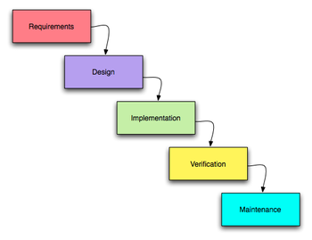
Waterfall
In the original waterfall model,
the following phases are followed in order:
  Requirements specification
  Design
  Construction (AKA implementation or coding)
  Integration
  Testing and debugging (AKA validation)
  Installation
  Maintenance

Slide 4
Criticism
David Parnas, in "A Rational Design Process: How and Why to Fake It", writes:
“Many of the [system's] details only become known to us as we progress in the [system's] implementation. Some of the things that we learn invalidate our design and we must backtrack.”
[from: http://web.cs.wpi.edu/~gpollice/cs3733-b05/Readings/FAKE-IT.pdf ]
The central idea here is sequential steps
…and it does not work in practice

Slide 5
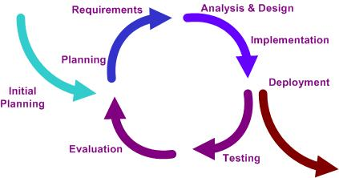
Iterative and Incremental development
The basic idea behind iterative development is to develop a software system incrementally:
  allows developers to learn during the development of earlier, incremental, deliverable versions of the system
  learning comes from both: the development and use of the system
Key steps in the process are:
  start with a simple implementation of a subset of the software requirements
  then iteratively enhance the evolving sequence of versions until the full system is implemented.
  At each iteration, design modifications are made and new functional capabilities are added.

Slide 6
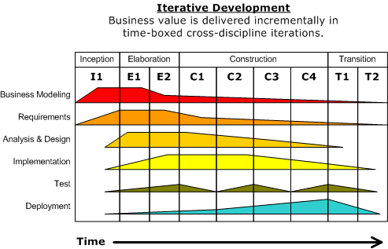
UP
The Unified Process is an iterative and incremental development process.
It is:
  Use Case Driven (to identify functional requirements)
  Architecture Centric (architecture is heart of the project)
  Risk Focused (address the most critical risks early )

Slide 7

UP phases
The Unified Process divides the project into four phases:
  Inception
  Elaboration
  Construction
  Transition
Each phase produces a milestone document as its output.

Slide 8
UP phases: Inception
The Unified Process divides the project into four phases:
  Inception
    quite short!
    Establish a business case for the project
    Establish the project scope and boundary conditions
    Outline the use cases and key requirements that will drive the design tradeoffs
    Outline one or more candidate architectures
    Identify risks
    Prepare a preliminary project schedule and cost estimate
    Output: Lifecycle Objective Milestone
  Elaboration
  Construction
  Transition

Slide 9
UP phases: Elaboration
The Unified Process divides the project into four phases:
  Inception
  Elaboration
    capture most of the system requirements
    address known risk factors
    validate the system architecture via the implementation of an Executable Architecture Baseline, built in a series of small, timeboxed iterations
    Output: Lifecycle Architecture Milestone (a plan, including cost and schedule estimates, for the Construction phase )
  Construction
  Transition

Slide 10
UP phases: Construction
The Unified Process divides the project into four phases:
  Inception
  Elaboration
  Construction
    the largest!
    the rest of the system is built
    features are implemented in a series of short, timeboxed iterations
    Each iteration results in an executable release of the software
    Output: Initial Operational Capability Milestone
  Transition

Slide 11
UP phases: Transition
The Unified Process divides the project into four phases:
  Inception
  Elaboration
  Construction
  Transition
    system is deployed to the target users
    Feedback may result in refinements to be incorporated over the course of several Transition phase iterations
    it includes system conversions and user training
    Output: Product Release Milestone

Slide 12
Refinements
Why?
  not everybody is happy with UP
  it can be ”customized” in different ways
For the game-development community for example: http://www.gamedev.net/reference/articles/article1940.asp

Slide 13
Another approach: be Agile!
Agile software development is a conceptual framework for undertaking software engineering projects
-> light-weight methodologies
Predictive methods focus on planning the future in detail
Adaptive methods focus on adapting quickly to changing realities

Slide 14
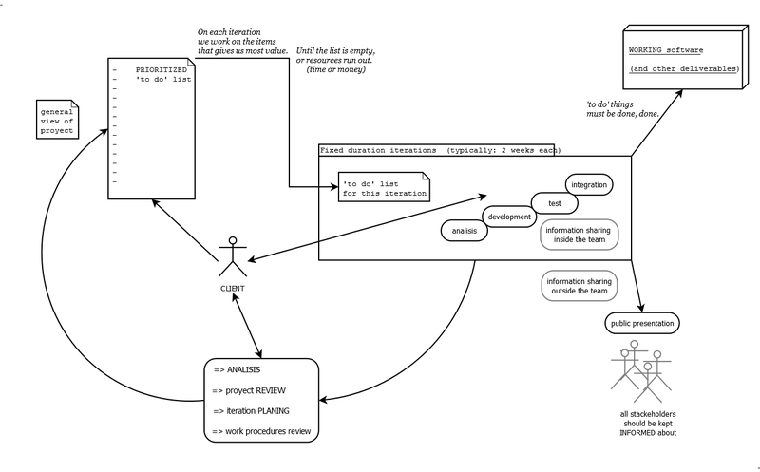
How does it work...
http://en.wikipedia.org/wiki/Agile_software_development

Slide 15
Agile Values
From the Manifesto
Individuals and interactions over processes and tools
Working software over comprehensive documentation
Customer collaboration over contract negotiation
Responding to change over following a plan
[from http://www.agilemanifesto.org/ ]

Slide 16
Agile principles
Our highest priority is to satisfy the customer through early and continuous delivery of valuable software. Welcome changing requirements, even late in development. Agile processes harness change for the customer's competitive advantage. Deliver working software frequently, from a couple of weeks to a couple of months, with a preference to the shorter timescale. | Business people and developers must work together daily throughout the project. Build projects around motivated individuals. Give them the environment and support they need, and trust them to get the job done. The most efficient and effective method of conveying information to and within a development team is face-to-face conversation.

Slide 17
Agile principles (...)
Working software is the primary measure of progress. Agile processes promote sustainable development. The sponsors, developers, and users should be able to maintain a constant pace indefinitely. Continuous attention to technical excellence and good design enhances agility. | Simplicity--the art of maximizing the amount of work not done--is essential. The best architectures, requirements, and designs emerge from selforganizing teams. At regular intervals, the team reflects on how to become more effective, then tunes and adjusts its behavior accordingly.

Slide 18
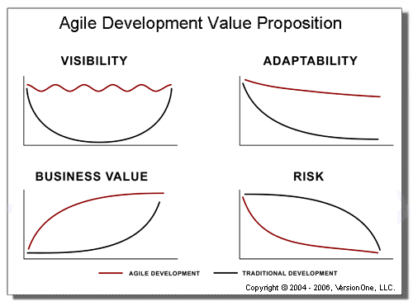
Does it work?
[from http://versionone.com/Resources/AgileBenefits.asp ]
Some advantages
Easily adapting to changing requirements throughout the process
More visibility into the actual progress of projects is available
Can reduce the risks associated with software development
Better addresses the business and customer needs

Slide 19
Some numbers…
[from http://versionone.com/Resources/AgileBenefits.asp ]
A study in the United Kingdom shows that of 1,027 projects, only 13% did not fail, and waterfall-style scope management was the "single largest contributing factor for failure, being cited in 82% of the projects as the number one problem."
A 1995 study of over $37 billion USD worth of US Defense Department projects concluded that "46% of the systems so egregiously did not meet the real needs (although they met the specifications) that they were never successfully used, and another 20% required extensive rework" to be usable.
…
…another study of 6,700 projects, it was found that four out of the five key factors contributing to project failure were associated with and aggravated by the waterfall model, including inability to deal with changing requirements, and problems with late integration.
And finally, another study of over 400 waterfall projects reported that only 10% of the developed code was actually deployed, and of that, only 20% was actually used.

Slide 20
A specific AGILE methodology
Kent Beck Extreme Programming (XP)
http://www.extremeprogramming.org/

Slide 21
What is XP?
[XP] A light-weight methodology for small-to-medium-sized teams developing software in the face of vague or rapidly changing requirements.
Why EXTREME ?

Slide 22
Why EXTREME
Code reviews are good
  -> review code all the time ->
  -> pair programming
Testing is good -> everybody test all the time
Design is good
  -> always re-design ->
  -> refactoring
Integration testing is good
  -> several times a day (continuous integration)
...
EXTREME: set all knobs on 10 and see what happens!

Slide 23
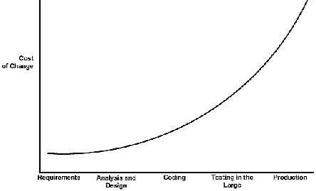
Can something like this work?
It all depends on the cost of change...
Classical view
time

Slide 24
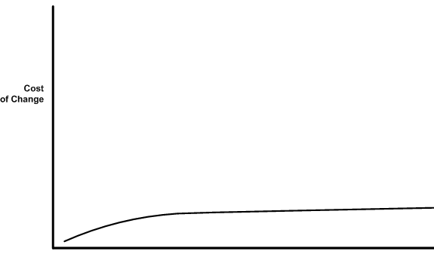
Can something like this work? (...)
BUT... sometimes the curve can be flattened
time
If the cost of change rise slowly... then:
make big decisions as late as possible
implement only what you have to
develop a simple architecture -> avoid risk of over-design
confidence in being able to quickly fix/extend the system

Slide 25
4 variables
According to XP, there are 4 variables to control in a project:
  Cost
  Time
  Quality
  Scope
External forces* pick 3 of these, development team picks 1.
( * = customers, managers )
Beck argues that the values of all four variables need to be visible

Slide 26
XP project - overview
Short releases
Planning: Decide the scope, functionalities, technology for the implementation. Priorities.
Develop (code and tests) together with users
Refactoring: improve the internal quality of the (working) product
Metaphor: guide dev with a simple shared story about how the whole system works

Slide 27
XP project (...)
Forget the old saying ”implement for today - and design for tomorrow”
  You don’t know what tomorrow brings
  Refactoring substitutes long-term design
  Do not ”borrow troubles”!
1 week = 40 working hours
continuous integration
collective ownership
adopt coding standards

Slide 28
Management strategy
The manager makes all the decisions
  doesn’t work: no one knows enough
  centralization -> overhead
Everyone does what they want
  no one has a ”bigger view” of the project
In XP management is divided in 2 roles:
  the coach - keep together the metaphor/architecture
  the tracker
    uses a metric to estimate develpment
    Ideal Engineering Time vs Calendar Time

Slide 29
Extreme design
The system (code and tests) must communicate everything you want to communicate
No duplicated code
Fewest possible classes
Fewest possible methods
Traditional approach to design
reduce the probability and cost of rework
Xtreme
Reduce costs by doing only what is strictly necessary
  If: cost of making a decision today is high
  And: the probability of being right is low
  Then: just-in-time design

Slide 30
Testing
Tests in XP come in two basic flavors:
  Unit Tests are automated tests written by the developers to test functionality as they write it. Each unit test typically tests only a single class, or a small cluster of classes. Unit tests are typically written using a unit testing framework (such as NUnit).
  Acceptance Tests (also known as Functional Tests) are specified by the customer to test that the overall system is functioning as specified.
  [from http://www.jera.com/techinfo/xpfaq.html ]

Slide 31
Links and further reading
Software development process http://en.wikipedia.org/wiki/Software_development_process
Iterative and Incremental development http://en.wikipedia.org/wiki/Iterative_and_incremental_development
UP: http://en.wikipedia.org/wiki/Unified_Process
Agile Alliance http://www.agilealliance.org/
Adaptive vs. Predictive: Is the end clear? http://www.idea.org/adaptive.html
The Agile Unified Process (AUP) http://www.ambysoft.com/unifiedprocess/agileUP.html
Nunit, unit testing for C# http://www.nunit.org/
XP http://www.extremeprogramming.org/

