Slide 1
Dynamic Web Applications Lecture 5
ANVA

Slide 2
Topics
Chapters 12 and 13 of the jQuery book
Chpt 12 (page 305):
Advanced DOM Manipulation -> goals:
store/retreive parts of DOM -> restructure page on demand
understand how jQuery works -> optimize
Chpt 13 (page 331):
Advanced Ajax -> goals:
More about jQuery AJAX framework
AJAX & Error handling to cope with network interruptions

Slide 3
Chpt 12

Slide 4
Problem: sorting rows of a table
3 approaches:
Server-side sorting -> SQL ”order by” via PHP
AJAX -> requires a page reset for each sort operation -> progressive enhancement
Javascript -> client-side sorting (in the browser)
In javascript -> 3 mechanisms:
[A] array from HTML & sort
[B] use HTML5 data-* attributes
[C] table creation from JSON & sorting
http://www.javascriptkit.com/javatutors/arraysort.shtml
http://www.w3schools.com/tags/att_global_data.asp
Notes:
progressive enhancement -> The page works perfectly well without any JavaScript at all, as the links for server-side sorting are still present.
When JavaScript is available, however, we hijack the page request and allow the sort to occur without a full page load.

Slide 5
[A] Sorting by title
Look at the structure of the HTML file
listings 12.1 (wrap headers), 12.2 (sorts and uses append)
Check out folder: append_existing_element
Algorithm:
find all rows, and remember current column (title)
sort by comparing text in <TD>s at the right column
for each element in the sorted array =>
append it back into the table
Problem: compare functions is slow -> solution: pre-compute!

Slide 6
Sort authors
Problem: authors should be sorted by last name
How? Pre-compute by wrapping last names into <spans>s
Listing 12.4 -> still OK for titles, but ...
... now also works for author(s)!
Then: sorting by publish date & by price:
these are not strings: how to compare?
pre-compute, and store temp data via .data() -> !! create data attributes!!
Listing 12.5 (prepare sortKeys map) + 12.6 (use sortKeys)
sortKeys map: ”a great way to conditionally call methods without using a bunch of if statements”
Problem: change sorting direction (up/down)?
we just have to find a way to ”change direction” to the sorting function!
we will use a variable sortDirection that is +1 or -1 ☺ Listing 12.7
Notes:
See:
code\12_2[data- attributes]
example

Slide 7
Exercise 1 about sorting
Start from Listing 12.7 , familiarize yourself
Modify the key computation for the first table so that dates are sorted by length, rather than time-wise:
Now 1 February 2018 comes before 1 March 2018
But it should be:
“February 2018” has length 13
“March 2018” has length 10
so “March 2018” comes before (is shorter than) “February 2018”
5/10min

Slide 8
[B] Sorting with HTML5 custom attributes
Work on the second table, which already has data-* attributes in it -> http://www.w3schools.com/tags/att_global_data.asp
jQuery .data() accesses the data-* attributes!
Listing 12.8
Advantages:
No need to pre-compute keys
Code is simpler and more legible (compare 12.7 and 12.8)

Slide 9
Exercise 2: total price
See Listing 12.8 look for: “Table 2: Sorting by reading HTML5 data.”
Write a function that:
reads the HTML5 data in the second table
computes the sum of all of the book prices
and console logs the resulting sum
call the function at the end of the existing code, outside the “click” handler.
10 min

Slide 10
[C] Sorting with JSON
Get table contents via JSON from server
Prepare rows data, using JSON objects
Listing 12.10 + 12.11 -> $.getJSON('books.json', ... ) -> WAMP SERVER
Then:
Modify headers as links
Write sorting function
see result in: Listing 12.12
Problem: buildRows function creates new DOM nodes, not just move them around -> slower ☹

Slide 11
Attribute hooks page 325-239 (self-read)
jQuery hooks
Shorthand element-creation syntax:
create a new CSS attribute -> colorglow
Read/discuss code 12.14
Def: Hooks are arrays in the jQuery namespace with names such as $.cssHooks and $.attrHooks And: Hooks are objects with a get and a set method
Use them: extend $.cssHooks to add support for an invented a CSS property “colorglow”

Slide 12
Chpt 13

Slide 13
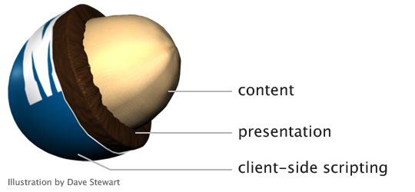
Chpt 13 - AJAX
Principle: progressive enhancement
working product 1st, embellishment after
AJAX: risk -> not working if javascript disabled
http://alistapart.com/article/understandingprogressiveenhancement

Slide 14
Example
(*) fixed by me :)
Search a user by name in github(*) using github’s API
the solution works with just a form
now: use javascript + AJAX -> listing 13.1
Problem1:
API page has different hostname, so JSON cannot work ( https://en.wikipedia.org/wiki/Cross-origin_resource_sharing ) -> use JSONP format ( https://en.wikipedia.org/wiki/JSONP )
-> see listing 13.2
Problem2: how to format JSON data to HTML?
Solution: use function buildItem() that takes a JSON object and returns a HTML list -> listing 13.3
In this case we can talk of MVC ->
Model = JSON object,
View = HTML list
Control = events
Notes:
Try searching for user:
Andrea270872
;)

Slide 15
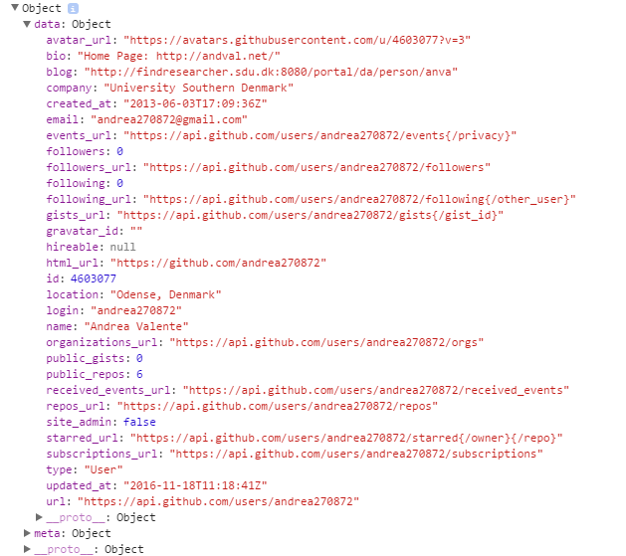
Exercise
10 min
Start from listing 13.4
Alter the buildItem() function so that it includes:
email
number of followers
and repositories URL

Slide 16
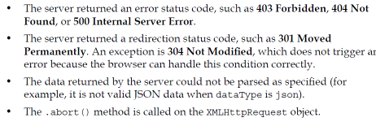
AJAX error handling
$.ajax() has an error callback -> listing 13.5
When is error triggered? -> various reasons ...
To detect and respond to errors: jqXHR.status -> kind of error
We can also set a timeout -> timeout = 15000; -> listing 13.6
Notes:
Listing 13.5 -> see:
$ajaxForm.bind('submit', function(event) { …

Slide 17
More about animation of DOM elements
See examples:
Animations and events:
animation and events(example)_v1
animation and events(example)_v2

Slide 18
Task (?)
no final task
instead:
start reading about software development methodologies UP and XP
slides & article in folder forNextLectureRead\

Slide 19
Next lecture
You will have read the slides and article before the lecture -> AKA “flipped classroom”
So we can start directly with a practical task to illustrate the steps in the Extreme Programming (XP) methodology
We will develop a webpage together, from 0, using and testing out some ideas from XP

