Slide 1
Look at the stories
File story cards.txt

Slide 2
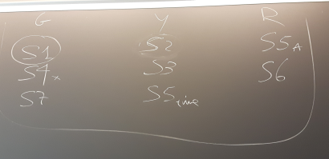
Results of the planning game on stories
User rating: (G is green, most important stories, Y is yellow less important, and R is red, least important stories)

Slide 3
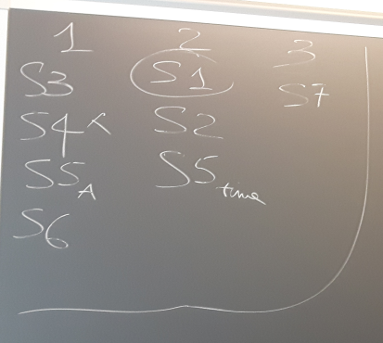
Results of the planning game on stories
Development rating: (1 are most clear, easy to evaluate stories, 2 are less clear, and 3 are most confusing ones)

Slide 4
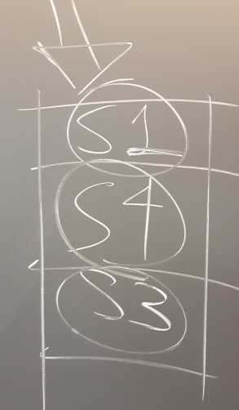
Decision: in the first iteration develop S1 then S4 then S3

Slide 5
Task (for next time)
Work alone or in groups
Implement the al least 5 stories from the pile (the first 3 plus 2 more that you think are important), starting from the give code in folder websiteExample, or starting from scratch if you like :)
This is the first of your portfolio tasks
you will deliver them all to me by November 16th
write down who participated to the implementation, so that if you worked in group I will only get 1 delivery per group

