Slide 1
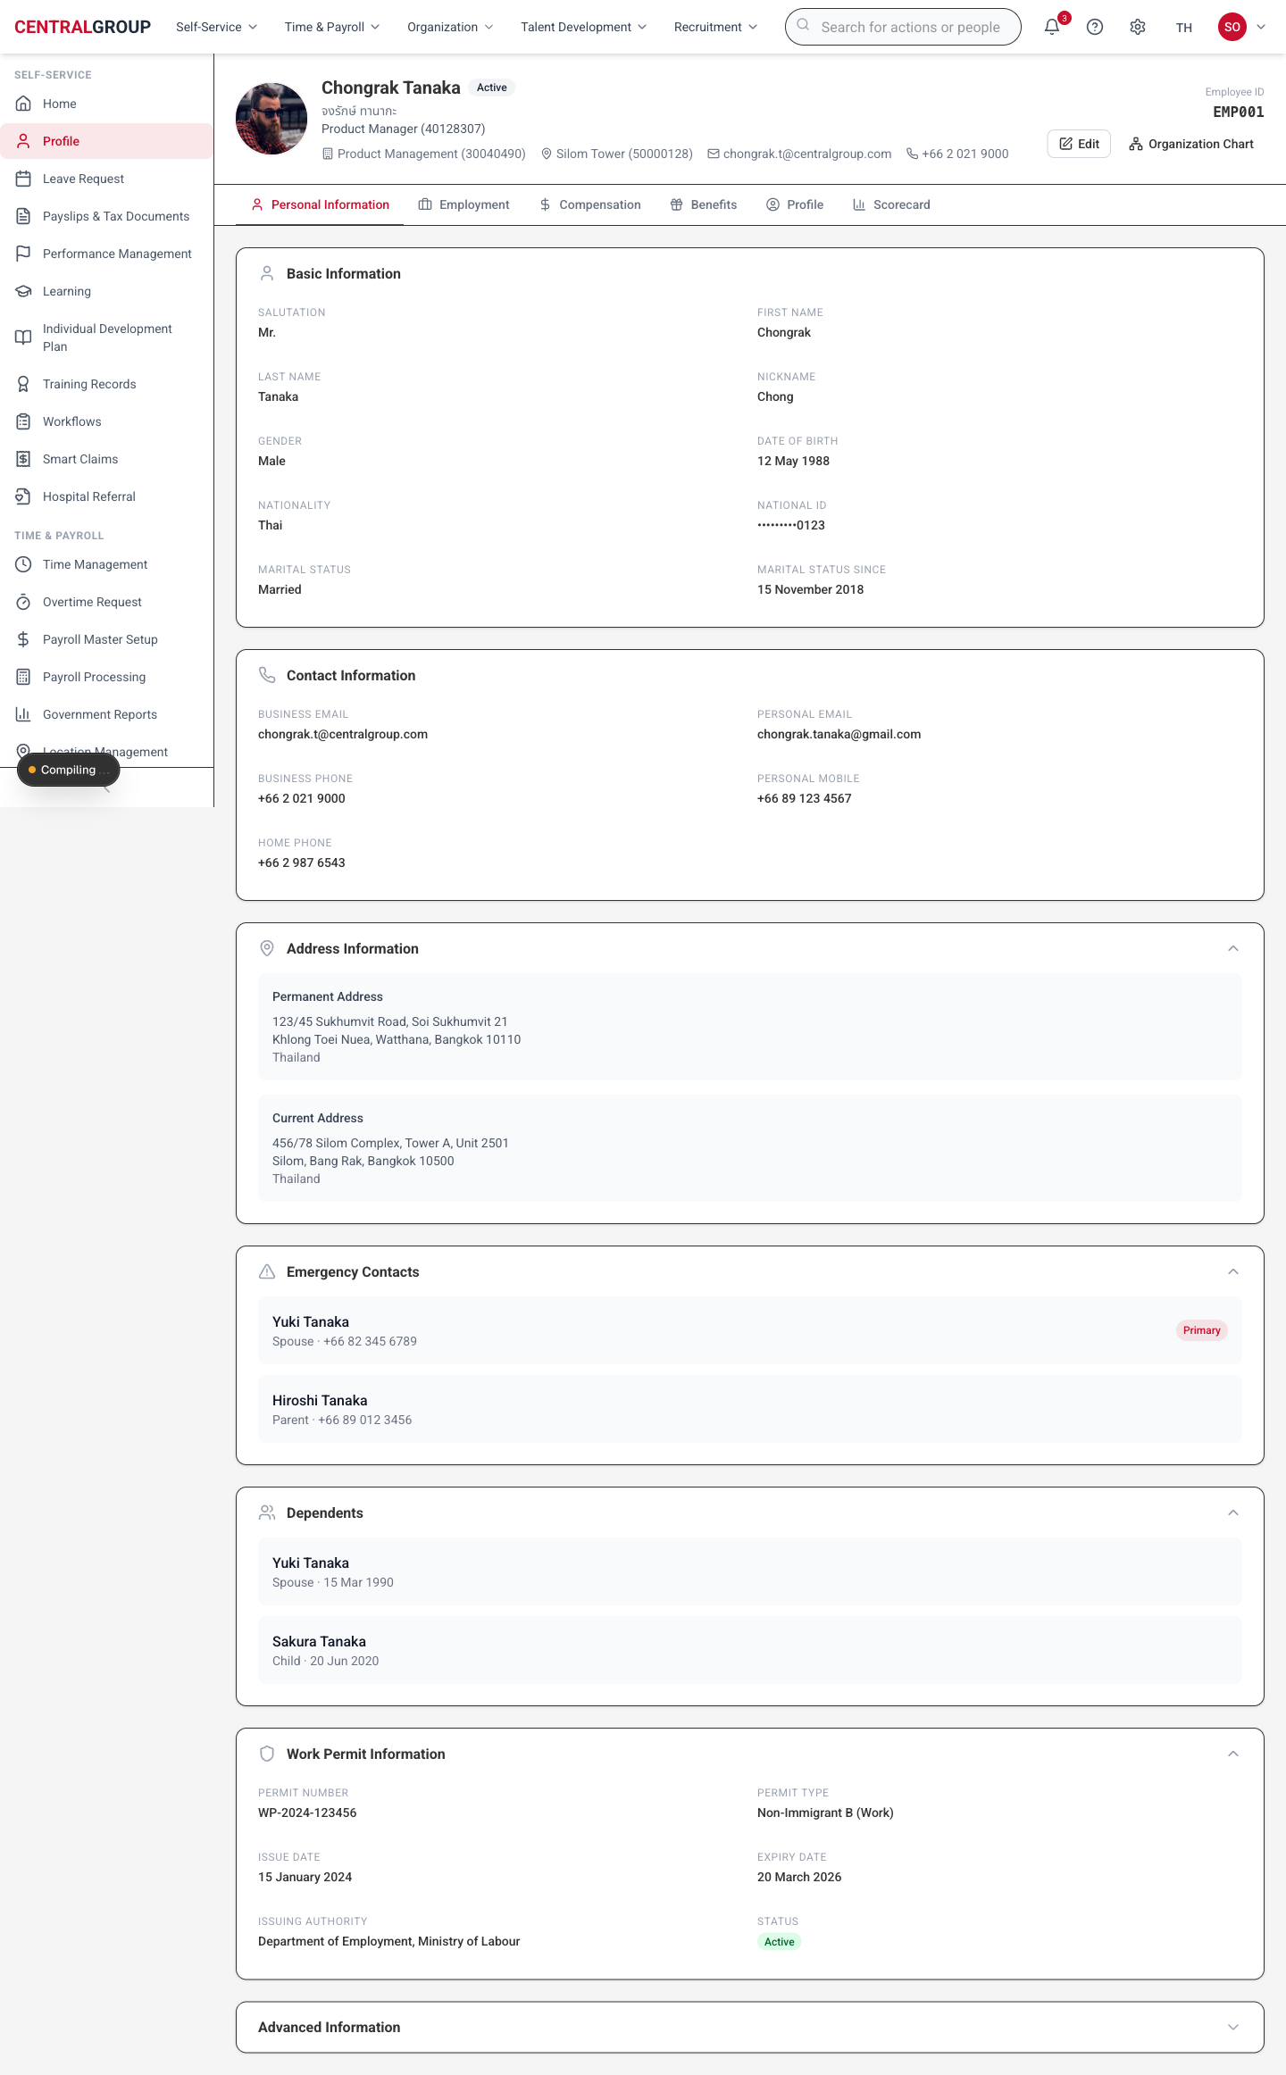
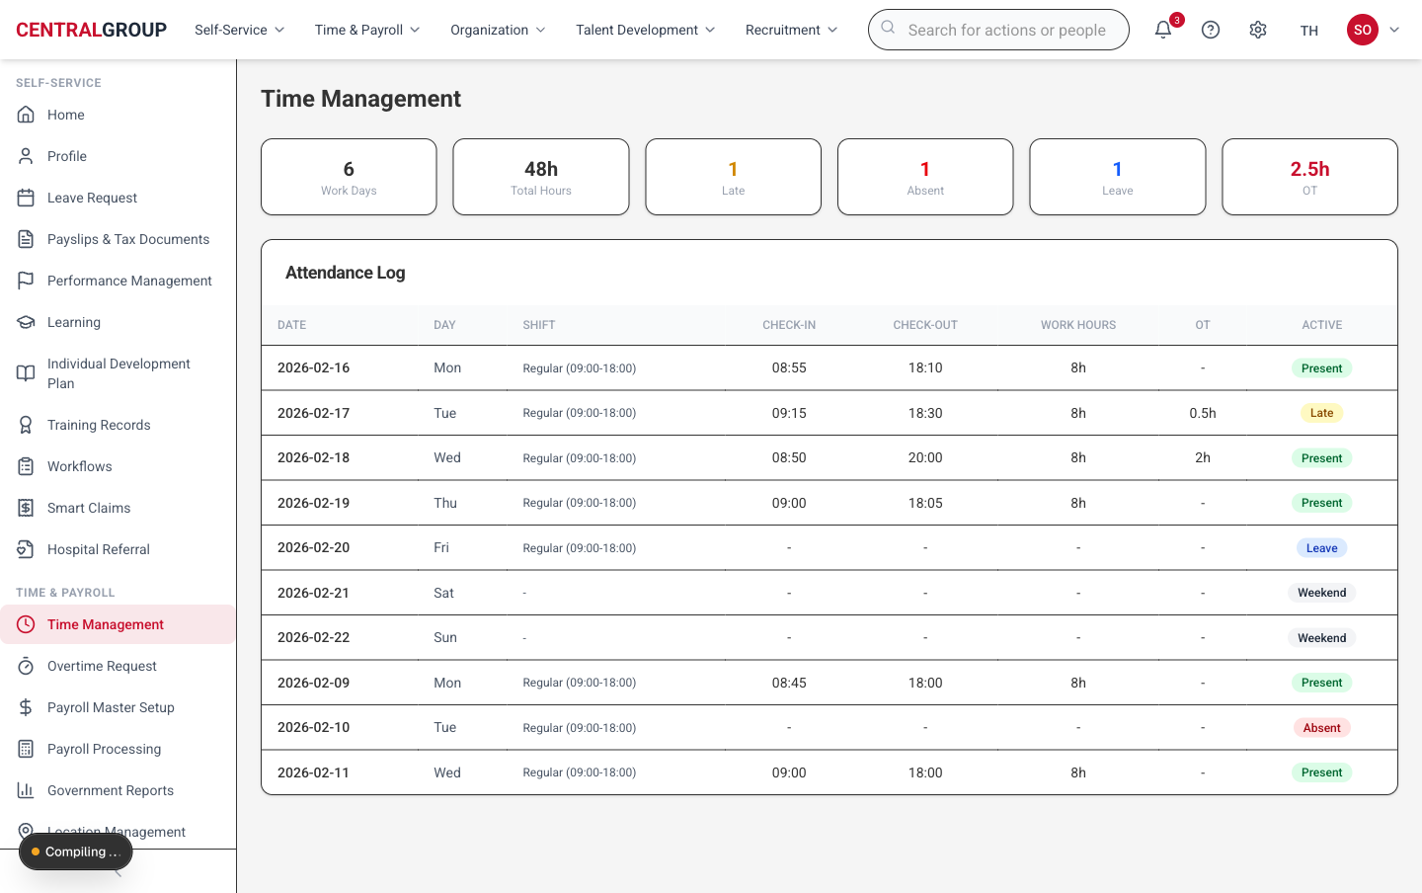
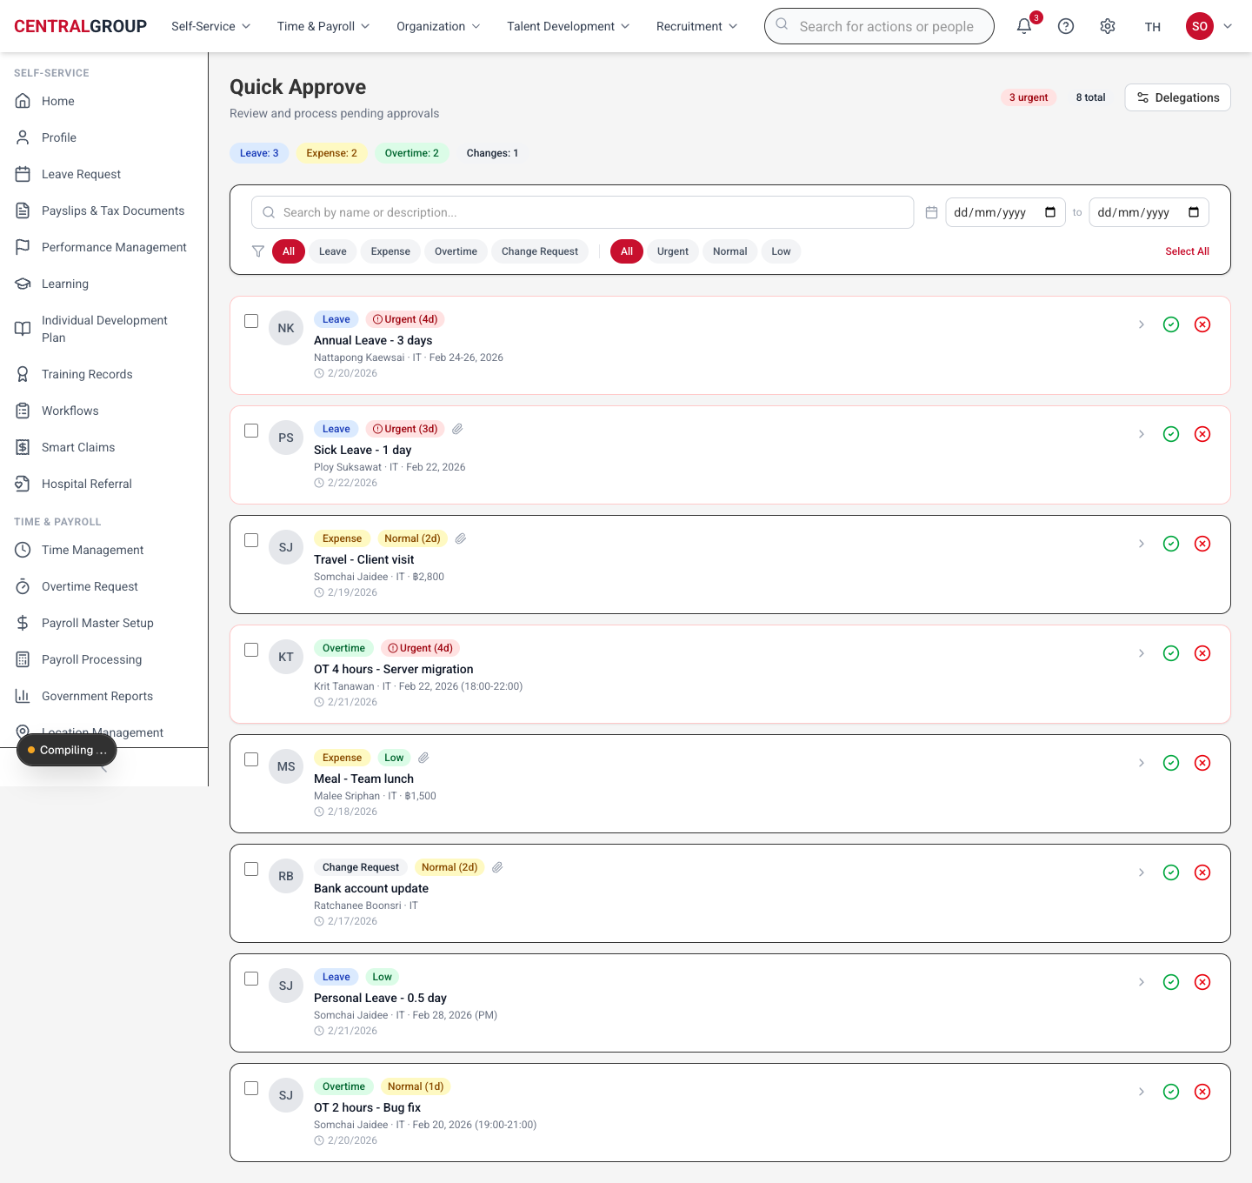
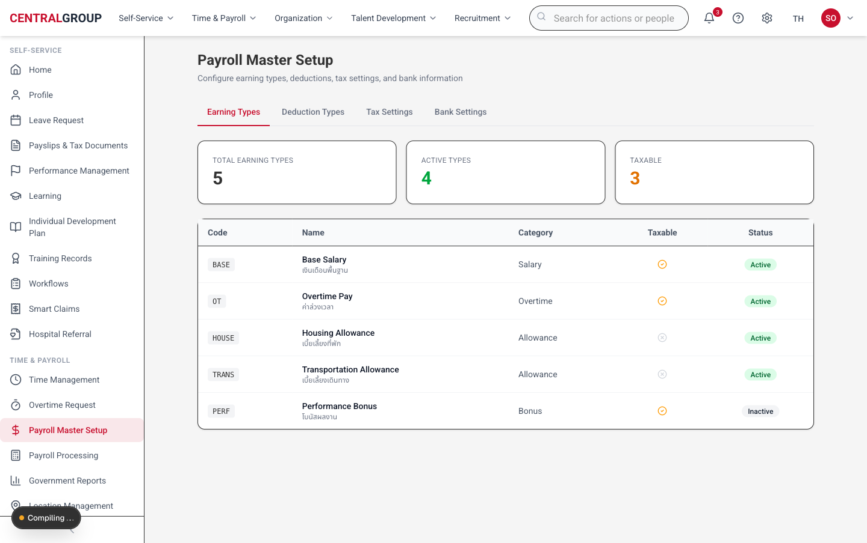
HR App
Demo Showcase
Module overview + mock-up walkthrough pack
5
module overviews
6
screen captures
0
backend claims
Prepared for app demo / design sign-off discussion
HR App Demo Showcase • 1/11

Slide 2
Demo storyline
โชว์ให้เห็น end-to-end และบอกคนดูว่าจะต้องมองอะไรในแต่ละ module
01
02
03
04
Employee self-service
Manager / HRBP decision
HR / Payroll readiness
Design approval
→
→
→
ดูข้อมูล profile, leave, payslip, benefit และ service request
ใช้ Quick Approve เป็นจุดรวม action และ wording ของ risk/caveat
ยืนยัน setup, review, report, owner sign-off ก่อน backend
เก็บ decision: field, owner, policy, backend-later contract
Deck update: added one overview slide per module and resized mock-up captures so every page sits inside a consistent frame.
HR App Demo Showcase • 2/11

Slide 3
Module overview map
แต่ละ module มี “where to look”, “main data focus”, และ “presenter storyline” ก่อนเข้า mock-up
01
Employee Center
Profile is the source-of-truth surface
Profile header, tabs, documents, lifecycle copy
02
Time
Request + policy caveat surface
Attendance, leave, OT, balances, approval state
03
Quick Approve
One place to decide
Risk wording, masked data, approve/return path
04
Payroll
Payroll readiness, not correctness
Setup, processing, reports, tax review caveats
05
Benefit
Benefit enrollment / claims / admin view
Eligible plan, request status, policy owner
HR App Demo Showcase • 3/11

Slide 4
Employee Center / Profile overview
หน้า overview เพื่อบอกโครงสร้าง design: ดูตรงไหน / focus อะไร / ขอบเขต mock คืออะไร
/employees/me/profile
Where to look
Start at profile header → scan tab navigation → open the active card/section → read caveat labels before discussing data ownership.
Main data to focus
Personal + employment identity, document status, compensation/lifecycle caveats, approval-state wording.
Presenter storyline
Use this slide to align “profile จะดูตรงไหน” and separate employee-visible data from HR/Admin-only controls.
Mock-up page capture is contained in-frame (no crop/cut-off) for presenter walkthrough.
HR App Demo Showcase • 4/11

Slide 5
Time overview
หน้า overview เพื่อบอกโครงสร้าง design: ดูตรงไหน / focus อะไร / ขอบเขต mock คืออะไร
/time + /timeoff + /overtime
Where to look
Start at summary tiles → inspect request table/card → verify status/action → note policy caveat before approval.
Main data to focus
Balance, request type, effective dates, manager approval state, policy caveat/TBD fields.
Presenter storyline
Position Time as an approval walkthrough, not a policy-calculation proof.
Mock-up page capture is contained in-frame (no crop/cut-off) for presenter walkthrough.
HR App Demo Showcase • 5/11

Slide 6
Quick Approve overview
หน้า overview เพื่อบอกโครงสร้าง design: ดูตรงไหน / focus อะไร / ขอบเขต mock คืออะไร
/quick-approve
Where to look
Start at action-required queue → open detail context → check risk/caveat banner → choose approve/return path.
Main data to focus
Decision queue, masked sensitive values, risk language, approve / return / reject reason.
Presenter storyline
Use Quick Approve as the anchor for Manager, HRBP, SPD decision alignment.
Mock-up page capture is contained in-frame (no crop/cut-off) for presenter walkthrough.
HR App Demo Showcase • 6/11

Slide 7
Payroll overview
หน้า overview เพื่อบอกโครงสร้าง design: ดูตรงไหน / focus อะไร / ขอบเขต mock คืออะไร
/payroll/setup
Where to look
Start at payroll setup → check readiness table → separate preview/download mock action from backend payroll correctness.
Main data to focus
Payroll setup completeness, processing status, government report preview, tax-review caveat.
Presenter storyline
Be explicit: visual readiness only; numbers/calculation are non-binding until backend/data owner sign-off.
Mock-up page capture is contained in-frame (no crop/cut-off) for presenter walkthrough.
HR App Demo Showcase • 7/11

Slide 8
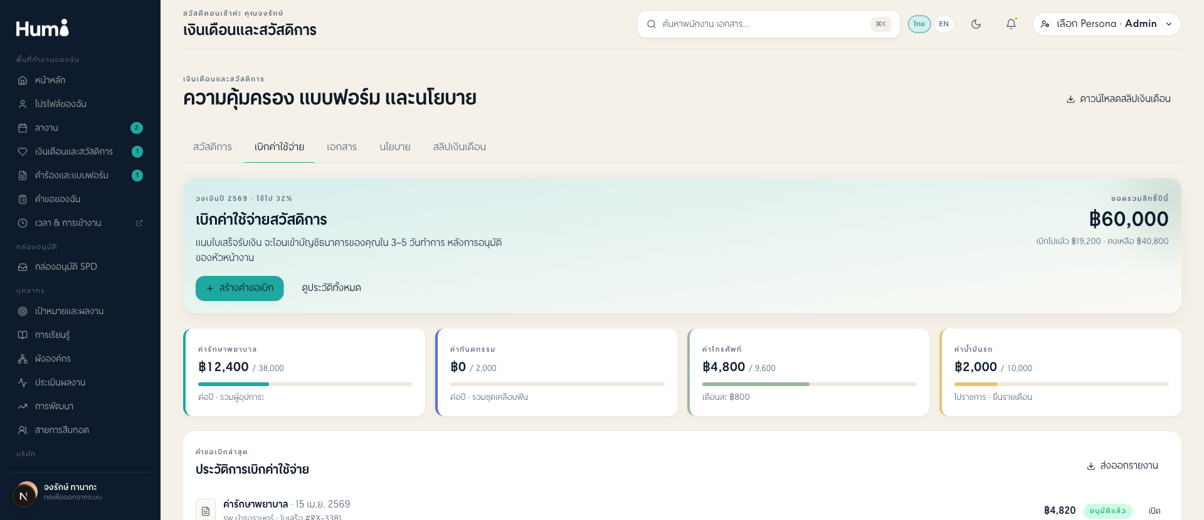
Benefit overview
หน้า overview เพื่อบอกโครงสร้าง design: ดูตรงไหน / focus อะไร / ขอบเขต mock คืออะไร
/benefits hub / claims
Where to look
Start at benefit hub → pick request/claim card → confirm owner/status → mark backend-later dependencies.
Main data to focus
Benefit eligibility, claim/request status, documents, approver/admin owner, payment/referral caveat.
Presenter storyline
Keep focus on member journey and admin control points, not insurer/payment integration proof.
Mock-up page capture is contained in-frame (no crop/cut-off) for presenter walkthrough.
HR App Demo Showcase • 8/11

Slide 9
Suggested live demo route
ใช้ sequence นี้เพื่อให้ story ลื่นและทุก module มี overview ก่อนเข้าหน้าจอจริง
01
Home / Employee Center
02
Profile overview
03
Time / Leave
ยืนยัน persona + employee data
ดู header, tabs, main profile data
request + policy caveat
04
Quick Approve
05
Payroll
06
Benefit
manager action + return reason
setup/review, no correctness claim
hub + claim/admin surface
Presenter rule: each screen = explain where to look → call out primary data → clarify caveat/backend-later boundary.
HR App Demo Showcase • 9/11

Slide 10
What this demo proves / does not prove
ตั้ง expectation ให้ถูกก่อนเข้าห้อง demo
PROVES
DOES NOT PROVE
✓
Visual readiness
—
No backend/database claim
UI looks coherent enough for stakeholder walkthrough
Static/mock frontend only
✓
Module design structure
—
No payroll correctness claim
Each module has focus area and data hierarchy
Numbers and calculations are non-binding
✓
Persona coverage
—
No workflow integration claim
Employee, Manager, HRBP, SPD/Admin paths visible
SF/workflow/audit are backend-later contracts
HR App Demo Showcase • 10/11

Slide 11
Meeting focus
เป้าหมายคือ alignment และ design approval ก่อน backend
1
Confirm module overview
แต่ละ module คนดูต้อง focus จุดไหนและ field ไหน
2
Validate mock-up capture
หน้าจอพอดี ไม่ถูก crop และใช้เป็น presenter reference ได้
3
Capture decisions
backend, integration, policy, data owner, approval wording
Recommended output: signed-off storyboard + issue list for backend-later work
HR App Demo Showcase • 11/11

