Slide 1

Sign Language Gesture Recognition Using Deep Neural Networks
Digital Image Processing and Analysis
Lucija Čorak, Mateo Jakšić, Petar Kuruc, Martina Šola, Klara Zagajski

Slide 2
Contents
Introduction
Problem Description
Existing Methods
Proposed Solution
Experimental Results
Conclusion and Future Work
References

Slide 3
Introduction
automatic sign‐language recognition as a bridge for deaf and hard‐of‐hearing inclusion
importance of robust gesture classification in real‐world applications
overview: develop and evaluate a sign‐recognition system based on deep learning

Slide 4
Problem Description
What is the problem?
Classify static hand‐gesture images corresponding to American Sign Language (ASL) letters.
Why is it important?
Enables real‐time translation of sign language into text/speech.
Promotes accessibility, social integration, and improved communication.
Applications:
assistive devices for deaf users
interactive educational tools for learning sign language
human-robot interfaces

Slide 5
Proposed Solution – Overview
Data Preparation
Use publicly available “Sign Language MNIST” dataset (24 static ASL classes, excluding J and Z)
Images are grayscale, 28 × 28 pixels, formatted in CSV

Slide 6
Proposed Solution – Overview
Image Processing Steps
resize and normalize pixel values to [0, 1]
data Augmentation (pixelation, brightness/contrast changes, rotation, filters)
histogram equalization to enhance contrast
super‐Resolution using ESRGAN (×2 and ×4 upscaling to 56 × 56 and 112 × 112)

Slide 7
Proposed Solution – Overview
Model Architectures
custom CNN trained from scratch
custom ResNet-style architecture

Slide 8
Dataset Description
Sign Language MNIST (DataMunge, Kaggle)
24 classes
total samples:
training: 27 455 images
testing: 7 172 images
original source: 1 704 RGB hand photos, augmented to ~ 28 × 28 grayscale.

Slide 9
Image Processing – Resizing & Normalization
convert all images to single‐channel grayscale
normalize pixel intensities to the [0, 1] range
maintain 28 × 28 resolution for baseline experiments

Slide 10
Image Processing – Data Augmentation
goals: reduce overfitting, increase generalization
techniques applied
5 % random pixel dropout (“pixelation”)
random brightness/contrast adjustment (±15 %)
small rotations (±3°)
random filter application (e.g., Mitchell, Spline)
outcome: training set with varied hand orientations, lighting

Slide 11
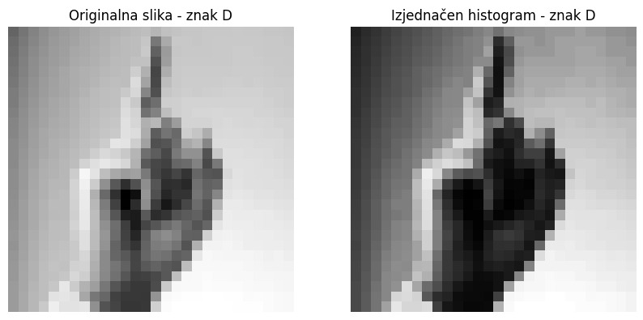
Image Processing – Histogram Equalization
purpose: improve contrast in low‐resolution images
procedure:
compute cumulative distribution function (CDF) of pixel intensities per image
remap pixel values so that output histogram is more uniform
convert result to 8‐bit format to preserve consistency
expected benefit: sharper edges and clearer finger‐hand contours for feature extraction
example

Slide 12
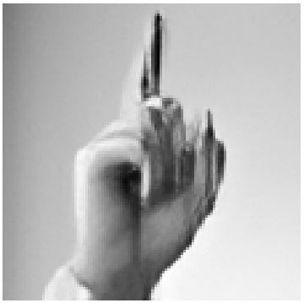
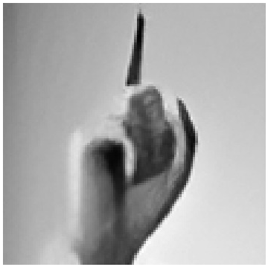
Image Processing – Super‐Resolution
motivation: low‐resolution (28 × 28) may lack detail needed by deep models
method: use ESRGAN (Enhanced Super‐Resolution GAN) pre‐trained model
variants:
×2 upscaling → 56 × 56 → then center‐crop or resize to 112 × 112
×4 upscaling → directly to ~112 × 112
result: higher‐resolution images with finer details
×2:
×4:

Slide 13
Model Architectures – Custom CNN
Architecture Highlights:
3–4 convolutional blocks (Conv → ReLU → BatchNorm → MaxPool)
dropout layer (e.g., 0.5) before fully connected layers
fully connected layers
Training Setup:
optimizer: Adam (learning rate tuned experimentally)
loss: Categorical Crossentropy
early stopping based on validation loss to prevent overfitting

Slide 14
Model Architectures – Custom ResNet
core idea: uses “residual blocks” to let the network learn deeper features without degrading performance
28×28 Version:
one initial convolutional layer (32 filters)
three groups of residual blocks
Global average pooling → Dropout → Softmax output for 24 classes
112×112 Version (after Super-Resolution):
adds fourth group of residual blocks
uses the same global pooling, dropout, and softmax steps

Slide 15
Experimental Setup
Data Splits:
training: 80 % of augmented images
validation: 10 % of training split
testing: 7 172 held‐out images
Training Parameters:
batch size: 64
number of epochs: up to 50 (with early stopping)
kearning rate: 1e-3 initial, reduce on plateau

Slide 16
Evaluation Metrics
accuracy
precision
recall
f1‐score
training time

Slide 17
Quantitative Results
Metric | CNN | ResNet
Accuracy (%) | 94 % | 100 %
Precision (%) | 99 % | 100 %
Recall (%) | 88 % | 100 %
F1-Score (%) | 93 % | 100 %
Training Time (s) | 1 384 s | 7 240 s
Super-Resolution ×2 (56 × 56 → 112 × 112)

Slide 18
Experimental Results – Discussion
Effect of Histogram Equalization:
CNN suffers from uneven pixel distributions; ResNet remains robust
Impact of Super‐Resolution:
×2 SR helps CNN’s precision and F1, but still falls shy of ResNet’s perfect scores
trade‐off: increased input size → longer training but richer features
CNN vs. ResNet Comparison:
ResNet achieves higher accuracy but with more parameters and longer training time
CNN may be more lightweight and faster, but lower generalization on high‐detail gestures

Slide 19
Experimental Results – Discussion
Limitations:
no dynamic gestures (letters J and Z missing)
dataset bias toward frontal hand orientation, limited lighting variation
ResNet consistently achieves near-perfect or perfect classification (≥ 97 % accuracy) on all four data versions
CNN falls behind on recall and F1 when pixel distributions change but benefits from SR ×2 and ×4
super-resolution helps CNN, but the resulting CNN+SR training time is an order of magnitude larger
for real-time or low-compute environments, the simpler CNN on 28 × 28 may suffice
watch out for labeling

Slide 20
Conclusion
on raw 28 × 28 data, ResNet achieves 99 % accuracy (100 % F1), CNN achieves 92 % acc (91 % F1)
histogram equalization drops CNN’s recall to 73 % (F1 = 82 %), while ResNet remains at 97 % accuracy (98 % F1)
SR ×2 → CNN: 94 % acc in 1 384 s; ResNet: 100 % in 7 240 s
SR ×4 → CNN: 95 % acc in 1 195 s; ResNet: 100 % in 8 289 s
if time is limited, a small CNN on 28 × 28 might be acceptable (92 % acc in 33 s)

Slide 21
Conclusion
Key Takeaways:
appropriate image enhancement + state‐of‐the‐art architectures
ResNet is superior across all conditions – robust to pixel distribution changes and minor resolution
Future Work:
incorporate dynamic gestures (J, Z) via short video clips or optical‐flow features
expand dataset with more hand orientations, skin tones, backgrounds
deploy a real‐time mobile/web application for on‐device inference

Slide 22
References
[1] He, K., Zhang, X., Ren, S., & Sun, J. (2016). Deep Residual Learning for Image Recognition. CVPR
[2] DataMunge. Sign Language MNIST, https://www.kaggle.com/datasets/datamunge/sign-language-mnist
[3] AI-Forever Real-ESRGAN, https://huggingface.co/ai-forever/Real-ESRGAN/tree/main

