Slide 1
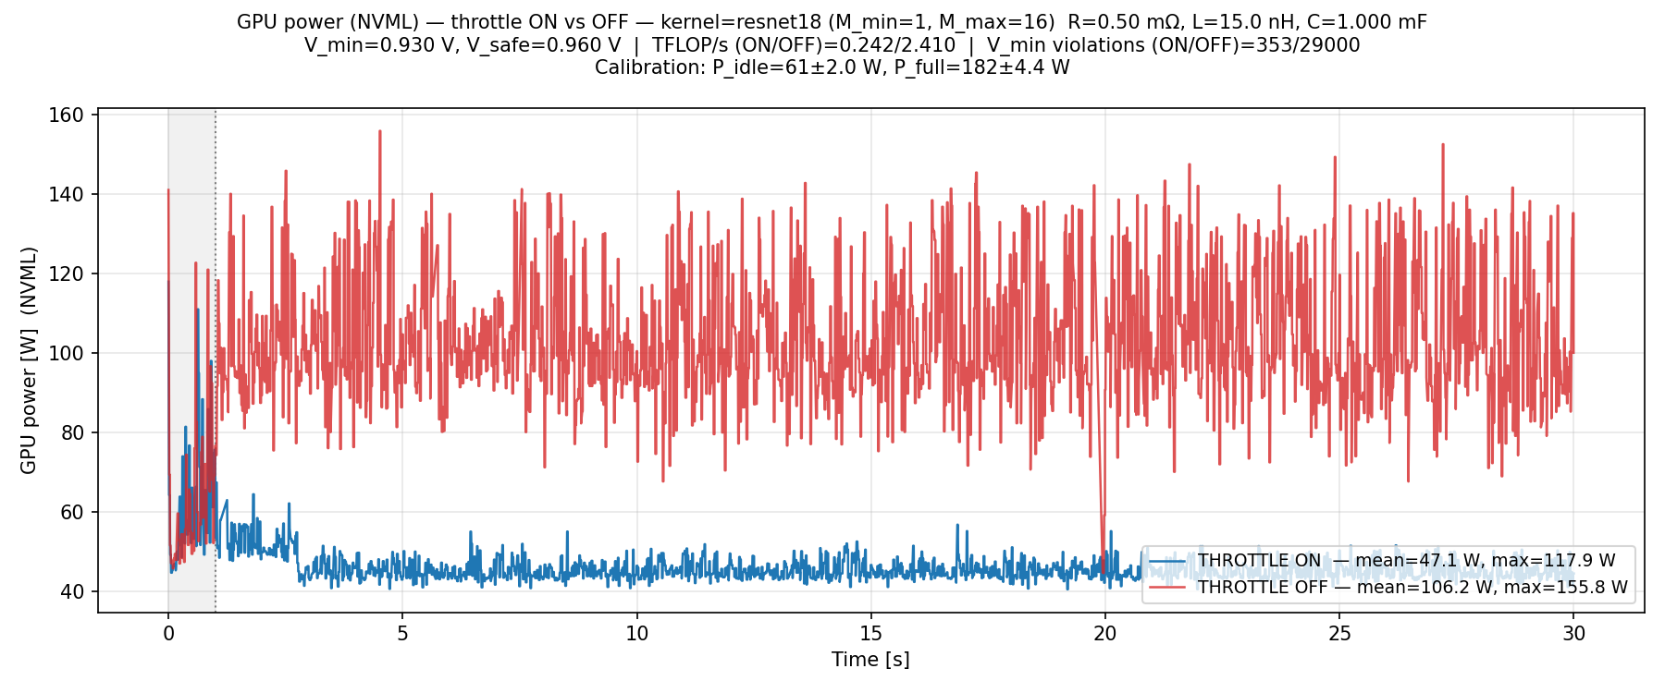
Closed-loop voltage droop controller for ML workloads
Slew Guard
ECE 69500 - Hardware for Machine Learning
Nikhil Reddy Mummadi, Jakub Mroczek

Slide 2
CONTENT
Problem Statement
Slew Guard Architecture
Controller Operation
Workload Specifications
Workload Performance Results
Sensitivity to PDN specs
Conclusion

Slide 3
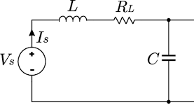
The Problem: GPU Voltage Droop
How Droop Occurs
GPU power delivery network (PDN) has series resistance R, inductance L. Both contribute to droop.
V_load = V_nom − V_dc − V_ac
V_dc – I * R (DC resistive drop)
V_ac = ΔI · Z_LC · overshoot_factor
Z_LC = √(L/C)
GPU demand for more current leads to higher V_dc, V_ac resulting in a decreased V_load
Why Droop Matters
V_load < V_min => timing violations, data corruption, or crash
To account for voltage droop either a voltage guard band or lower operating frequency are needed
Voltage guard band:
Higher V_nom to ensure V_nom – V_droop > Vmin
Costs more power (P ∝ V²)
Reduce operating frequency:
Lower voltage requires lower clock frequency as transistor switching time is reduced.
Must account for the worst-case droop voltage, reducing performance to avoid timing violations
Current Sink (GPU)
Notes:
Our goal is to mitigate GPU droop so there is not a vmin violation. Traditionally this is done by either increasing operating voltage at the same frequency (which uses more power), or by reducing frequency to reduce transistor switch time so a lower VDD is required for safe operation. We solve this by measuring droop and react by adjusting batch size so the gpu draws less current. Reducing the current will reduce both components of V_droop, V_dc and V_ac. Our PDN (power delivery network) is modelled by a RLC circuit as shown on screen, which is the assumption we used when calculating droop during operation.

Slide 4
SLEWGUARD ARCHITECTURE
Workload
Profiler
GEMM (naive / tiled-GELU)
ResNet-18 forward pass
Batch size M is the control knob
1
Real GPU telemetry at sub-ms
NVML power ring-buffer drain
Calibrate P_idle & P_full.
Controller uses this to predict ΔI when M is adjusted
4
2
Controller
PDN Model
Bang-bang controller around V_shrink
V_shrink = V_safe - deadband_mv
Auto-tune M grow/shrink step to not exceed V_ac budget
Controller grow period > τ_env to allow ripples to dissipate
3
2nd-order RLC circuit
Calculates I_instant and I_steady to get V_ac and V_dc
Splits current with IIR filter (τ_env = 50 ms)
Computes worst-case peak droop per tick (first trough)
PDN natural freq ≈ 41 kHz (L=15 nH, C=1 mF) | Controller tick = 50 µs
Notes:
As voltage grows past V_shrink we increase batch size, and when it drops below V_shrink we reduce batch size. The change in current demand will impact our droop. 30mV above Vmin is our safe voltage, and a deadband can be added for programming.

Slide 5
How the controller works
Three Phases
Per-Tick Decision (50 µs)
Timing Constraints
Phase 1 — NVML Calibration
1
p_dc = load_power(M)
tick = 50 µs
• Run kernel at M_min and M_max
Linear interpolation P_idle→P_full at current M
• Every tick evaluates droop
• NVML ring buffer drained for each
2
p_drive = p_dc + noise(σ)
• Shrink fires at most once per shrink_period
• Measure mean P_idle, P_full, and σ
Add NVML-calibrated jitter (seeded RNG)
• Grow fires at most once per grow_period
• Derive V_safe, V_shrink, grow_step
3
V_load = PDN.step(p_drive, dt)
• Tick sets max responsiveness to fast droops
RLC model: V_nom − I_filt·R − ΔI·Z_LC·overshoot
shrink_period = 1 ms, (5 × τ_env)
Phase 2 — Ramp Warm-up
4
V_load < V_shrink?
• Min wall time between consecutive shrinks
• Linearly ramp M: M_min → M_max
Compare against V_safe − deadband threshold
• Prevents over-throttling a droop the last shrink already started correcting
• Controller observes only — no throttle
5
SHRINK: M − shrink_step
• GPU reaches steady-state performance
If yes AND reset time elapsed since last shrink. Increase grow delay
grow_period = 200 µs, (1 × τ_env)
• PDN model pre-charged to avoid startup spike
6
GROW: M + grow_step
• Min wall time between consecutive grows
Phase 3 — Closed-Loop Control
If no AND reset time elapsed since last grow
• Each grow causes ΔI → V_ac spike
• 50 µs tick loop starts
7
HOLD: M unchanged
• Wait for previous spike to decay before next grow
• Each tick: PDN → V_load → decision → new M
If period not elapsed — wait for cooldown
8
Worker picks up new M
• After a shrink next grow is delayed by 1ms instead
• Shrink / grow / hold based on V_shrink
Kernel runs at new batch size
• Records events and telemetry throughout
V_safe = V_min + 30 mV (comfort floor) | V_shrink = V_safe − deadband (single trigger) | Grow fires above V_shrink · Shrink fires below V_shrink
Notes:
I_raw = float(power_w) / self.V_nom (function of current batch, discrete)
I_instant = power_w + P_noise
σ (noise_sigma(M)) is the standard deviation of residuals measured from NVML during calibration phase. This was needed so Vnom would vary at the given batch size.
I_instant = (float(power_w + P_noise) / self.V_nom)
I_steady_new = I_steady + (dt/(t_env + dt)*(I_raw + I_steady) when tau is large I_steady lags behind current steps
- V_dc is the steady-state droop, driven by I_steady
- V_ac is the transient spike, driven by I_instantaneous - I_steady_old
Vload = Vnom – Vdc – Vac
Compare Vload to Vshrink
If we shrank before, wait 1ms before growing. Grown/shrink period are over 200us, which is much larger than the 24us PDN natural period, so noise oscillation or ringing should dampen before we determine new I_ac and I_dc. A larger resistance can help achieve a shorter shrink/grow period. Currently our controller does not account for undamped noise on the rail.

Slide 6
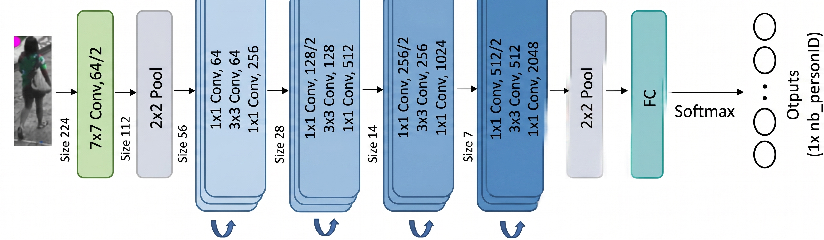
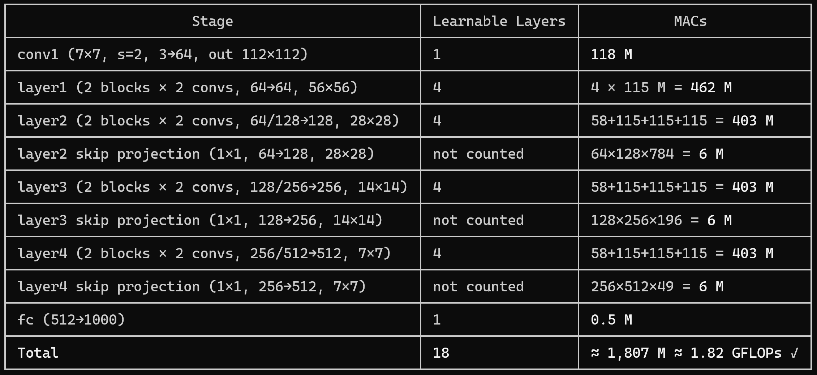

The workload
Torchvision ResNet-18. Max-batch input preallocated once: [M_max, 3, 224, 224]
M is the only control knob — no weight changes, no model swap
Power scales linearly with M between P_idle (M=1) and P_full (M=16)
Reducing M by 1 image reduces power by ΔP = (P_full − P_idle) / (M_max − M_min) per step
As batch size increases execution time increases. A shrink can only affect the next kernel launch, which may take up to 10ms
flops(M) = M × 1,820,000,000 | 1 MAC = 1 FLOP

Slide 7
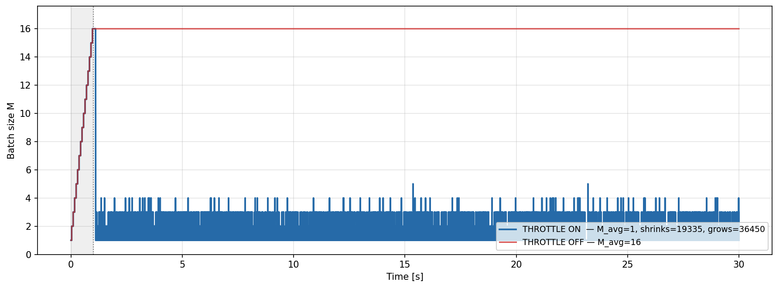
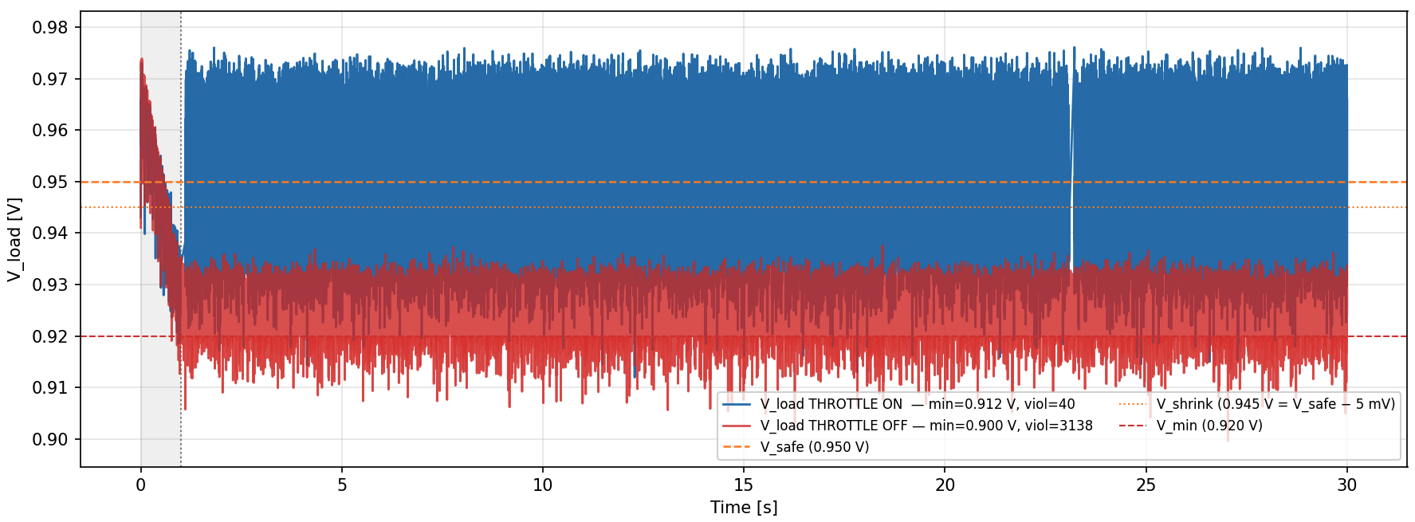
RESNET-18 Performance
Batch Throttling benefits:
Vmin violations reduced from 3138 to just 40
Achieved Performance with throttling is 0.887 TFLOP/s
Workload fails without batch throttling.
System Specs:
Vmin = 0.92V
Vshrink = 0.945V
Deadband = 0.005V
RLC = 0.3mohm/15nH/1mF
Notes:
Resnet-18 is in action here. The Vmin is set to 0.92V which sets the Vshrink to 0.945V.
Without any batch throttling, Resnet-18 causes more than 3000 Vmin violations in a span of 30 seconds, which is a guaranteed crash. But with throttling, the # violations comes down to only 40, which is a 99% reduction in Vmin violations.
However, an obvious caveat is that there is a performance hit due to continuous batch throttling. So the key takeaway here is that the workload actually runs with throttling, but without SlewGuard, the workload fails entirely due to voltage instability.

Slide 8
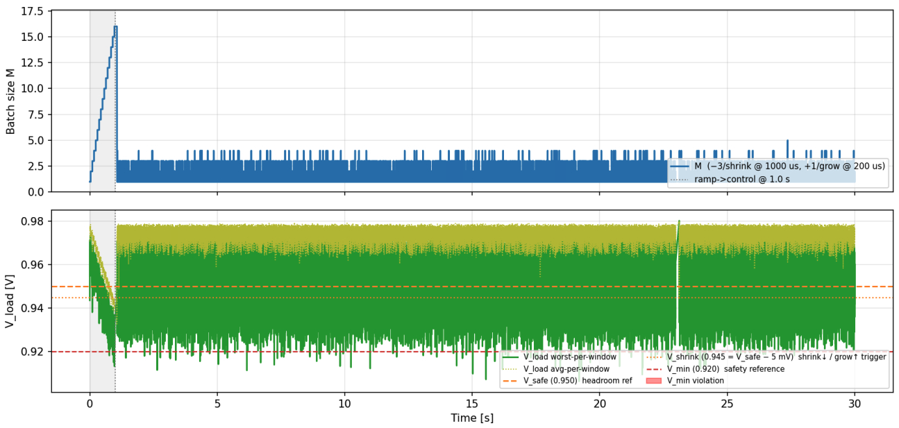
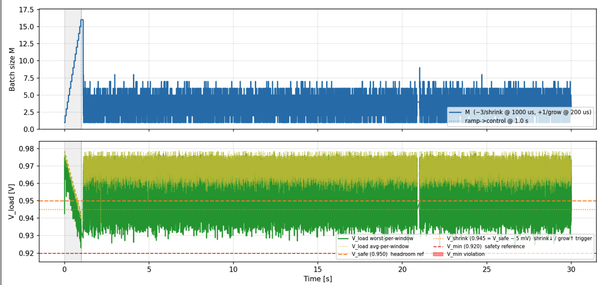
Capacitive Sensitivity
Capacitors mitigate high-frequency noise by acting as local charge reservoirs.
Benefits of higher capacitance:
Solves all Vmin violations
Less throttling
Higher average performance achieved:
With 1mF: 0.919 TFLOP/s
With 2mF: 2.022 TFLOP/s
Die capacitance = 1mF
Vmin violations reduces from 110 to 0!
Die capacitance = 2mF
System Specs:
Vmin = 0.92V
Vshrink = 0.945V
Deadband = 0.005V
RLC = 0.3mohm/15nH/1mF vs 2mF
Notes:
Now that we've seen the benefit of throttling, let us explore the effect of throttling coupled with PDN sensitivity. Capacitors act as local charge reservoirs that help mitigate high-frequency noise.
When we double the die capacitance from 1mF to 2mF, the results are dramatic.
Higher capacitance solves all Vmin violations, reducing them from 110 to 0.
Because the voltage is more stable, the controller doesn't have to throttle as aggressively. This allows the average performance to more than double, jumping from 0.919 TFLOP/s to 2.022 TFLOP/s.

Slide 9

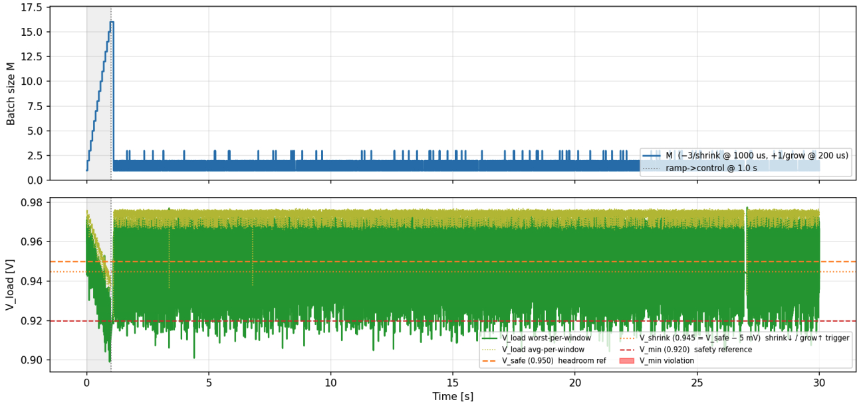
Inductive Sensitivity
Higher Inductance makes high-frequency noise worse due to its resistance to rapid di/dt events.
Performance Loss:
With 15nH: 0.859 TFLOP/s
With 30nH: 0.756 TFLOP/s
Die inductance = 15nH
Vmin violations increases from 18 to 565!
Die inductance = 30nH
System Specs:
Vmin = 0.92V
Vshrink = 0.945V
Deadband = 0.005V
RLC = 0.3mohm/15nH vs 30nH/1mF
Notes:
If capacitance is our friend, inductance is the enemy. High inductance resists rapid changes in current, making high-frequency noise significantly worse.
When we increase die inductance from 15nH to 30nH, the system's stability collapses.
Vmin violations skyrocket from 18 to 565.
The controller is forced to throttle much harder to compensate for these inductive spikes, leading to a performance drop from 0.859 TFLOP/s down to 0.756 TFLOP/s. This highlights why low-inductance PDN design is critical for ML hardware

Slide 10
CONCLUSIONs
Dynamic batch throttling lowers Vmin violation risk but does not solve the issue completely.
Software latency floor: Slew Guard protects against macro-level voltage droops managed at the firmware/software level, whereas the PDN handles the micro-level events
Optimized Power Delivery Network (PDN) is necessary to protect device against all possible noise based Vmin violations.
Ideal PDN criteria:
Contains capacitors distributed across Silicon die to mitigate noise in the MHz to GHz domain.
Maintain low target impedance to prevent resonance-induced voltage ringing.
Improved Voltage Regulators with high control loop bandwidth and multi-phase interleaving.
Optimized PDN → Reduced Voltage Guard band → Less Aggressive Throttling → Maximum TOPS
Notes:
A Multi-Level Approach: Dynamic batch throttling is a powerful tool for lowering violation risks, but it is not a "silver bullet" that solves the issue completely.
Latency Realities: There is a software latency floor. SlewGuard is excellent for managing macro-level voltage droops at the firmware level, but the physical PDN must still handle micro-level events.
Ideal PDN Criteria: To protect a device fully, we need optimized PDNs that feature:
Distributed capacitors to mitigate noise in the MHz to GHz domain.
Low target impedance to prevent resonance-induced ringing.
High-bandwidth voltage regulators.
The Ultimate Goal: By combining SlewGuard with an optimized PDN, we can reduce voltage guard bands, minimize throttling, and achieve Maximum TOPS.

