Slide 1


…ON THE ROAD SINCE 2010
…ON THE ROAD SINCE 2010
COMPANY PRESENTATION
International groupage · Ždírec nad Doubravou, Czech Republic
KM 01 / 13

Slide 2


…ON THE ROAD SINCE 2010
ROUTE PLAN
KM 03
Company overview
KM 04
Strategic location
KM 05
Services offered
KM 06
Storage solutions and Equipment
KM 07
Technologies
KM 08
Experience and Expertise
KM 09
Fleet details
KM 11
Our headquarters
KM 12
Team Introduction
KM 13
Contact information
KM 02 / 13

Slide 3







…ON THE ROAD SINCE 2010
WHO WE ARE
CORE VALUES
MISSION
Reliability
To deliver reliable and efficient transport solutions that exceed our customers’ expectations through exceptional service and innovative logistics.
We ensure timely and dependable service.
Safety
We prioritize the safety of our staff and goods.
Integrity
We uphold the highest ethical standards in all our dealings.
VISION
To be the leading provider of transport services, recognized for our commitment to quality, sustainability, and customer satisfaction.
Innovation
We embrace new technologies to enhance our services.
Customer Focus
We are dedicated to understanding and fulfilling our customers' needs.
KM 03 / 13

Slide 4

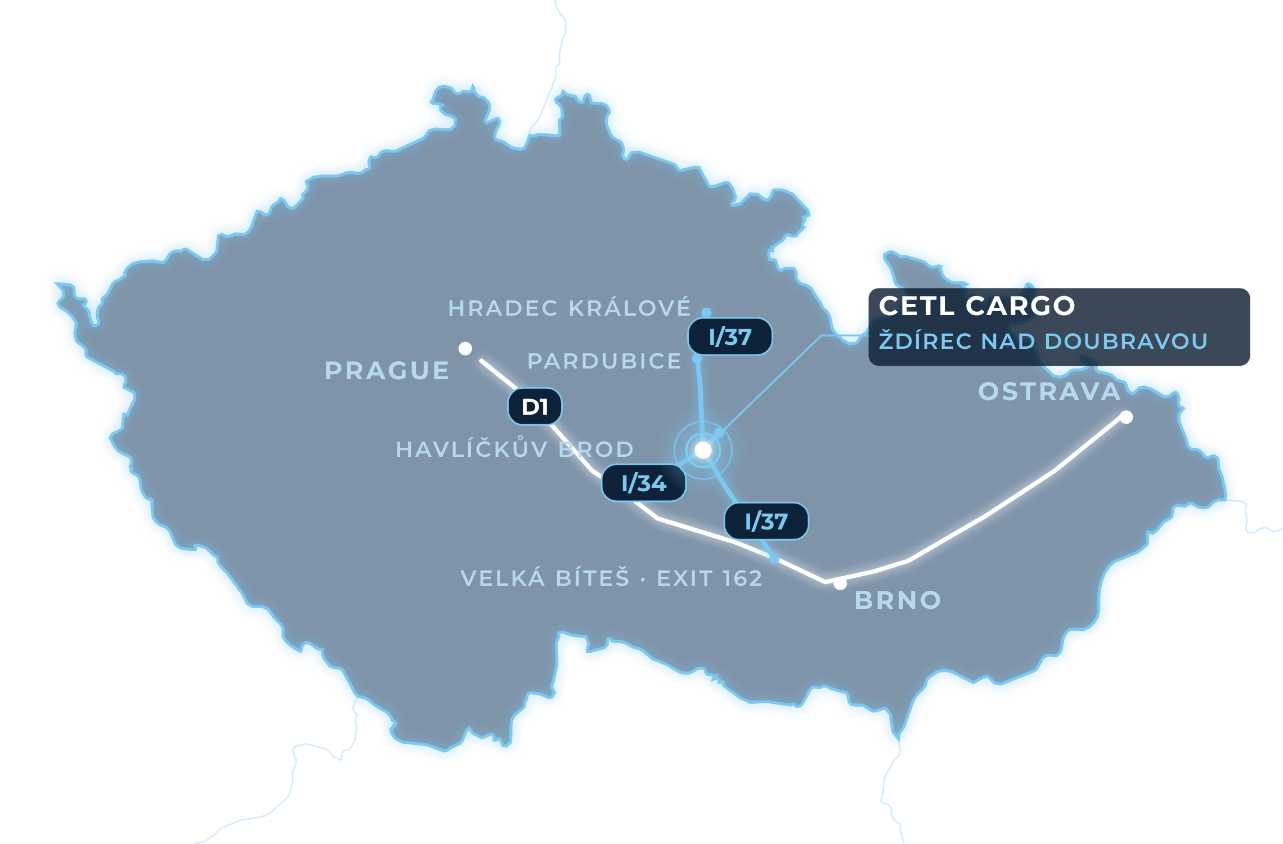





…ON THE ROAD SINCE 2010
WHERE WE ARE
01
IN THE HEART OF THE COUNTRY
Ždírec nad Doubravou lies in the middle of the Czech Republic, in the Vysočina Region.
02
CROSSROADS OF I/34 AND I/37
Two first-class roads cross right in Ždírec: I/34 (Havlíčkův Brod – Hlinsko) and I/37 (Chrudim – Žďár nad Sázavou).
03
D1 MOTORWAY CONNECTION
The I/37 leads south to the D1 motorway (exit 162, Velká Bíteš) and north to Pardubice and Hradec Králové.
KM 04 / 13

Slide 5







…ON THE ROAD SINCE 2010
WHAT WE DO
01
Eco-friendly Options
Sustainable practices and green transport solutions.
02
Efficient Delivery
Timely and reliable transport services, ensuring goods reach their destination on schedule.
03
Wide Coverage
Extensive network covering various regions, both local and international.
04
Cutting-edge Technology
Advanced tracking systems and logistical software to improve efficiency and transparency.
05
Customizable Solutions
Tailored services to meet the specific needs of each client, offering flexibility and personalized service.
KM 05 / 13

Slide 6
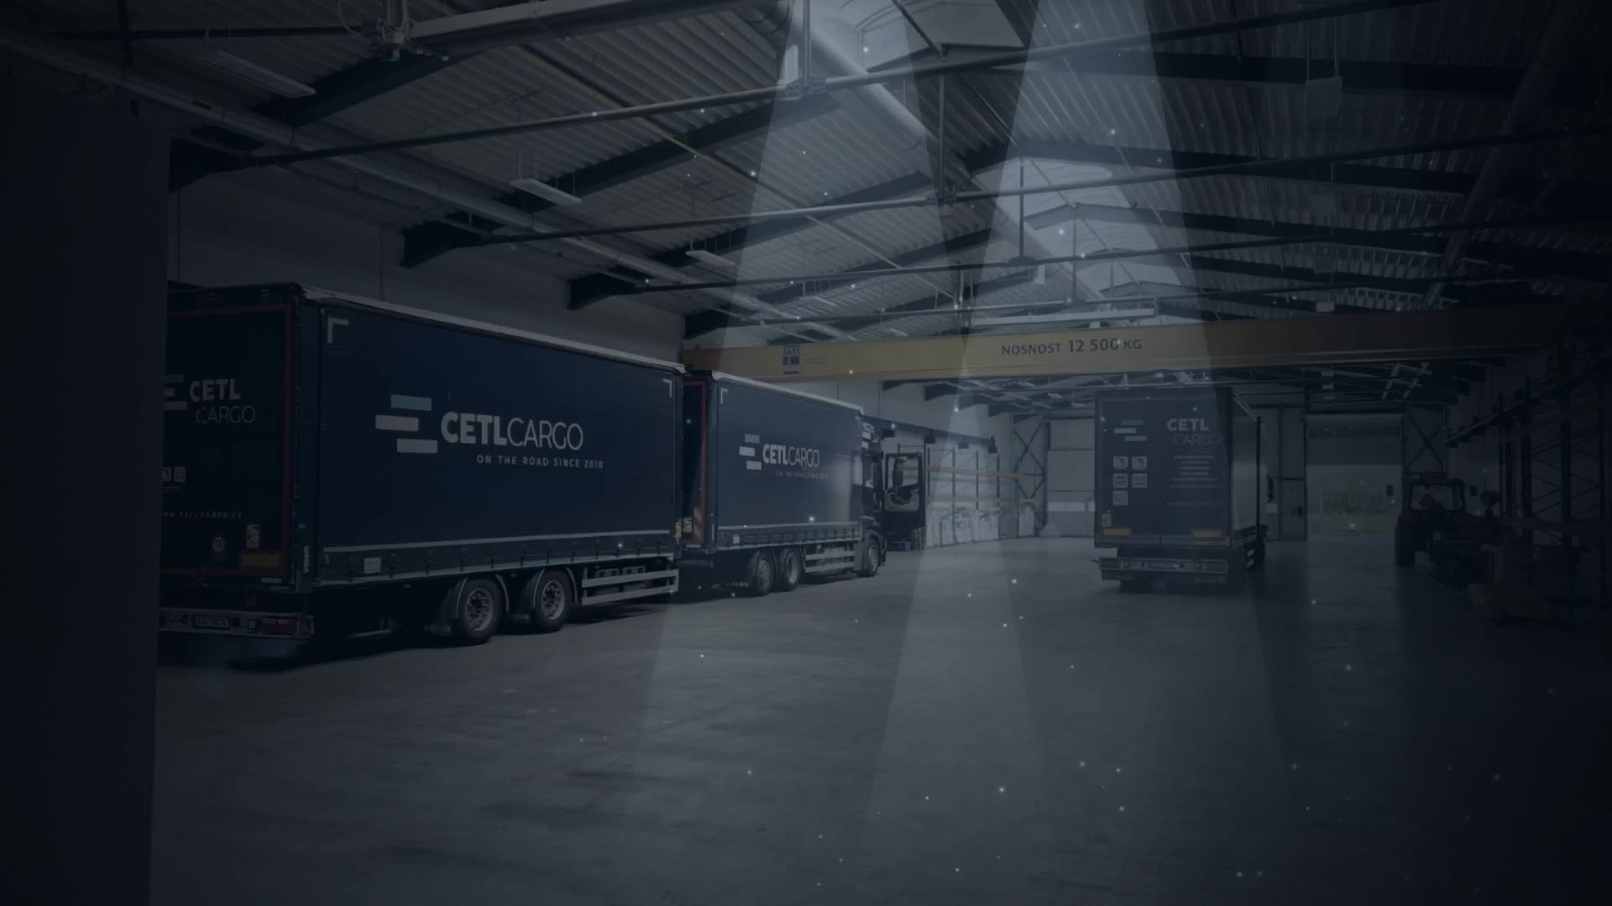

…ON THE ROAD SINCE 2010
SERVICES OFFERED // WAREHOUSE
TOTAL STORAGE AREA
STORAGE HANDLING AREA
BRIDGE CRANE
FORKLIFT TRUCKS
SECURITY
A total of 3,400 m² of storage and handling space.
Our storage includes a 12-ton bridge crane, allowing us to handle heavy and oversized goods with ease.
We have 3 forklift trucks for efficient and flexible handling of various cargo types.
Advanced security systems ensure the safety of your goods.
KM 06 / 13

Slide 7









…ON THE ROAD SINCE 2010
SERVICES OFFERED // CAMPUS
ENERGY // PHOTOVOLTAICS
MAX OUTPUT
BATTERY CAPACITY
Photovoltaic power plant with a maximum output of 100 kW and a battery capacity of 200 kWh, powering the entire campus.
CAMPUS FACILITIES
SAFETY AND SECURITY
Industrial weighbridge
The entire campus is monitored by a CCTV system
Gantry truck wash
The halls are protected by an EPS fire alarm system
Filling station: Diesel + AdBlue
KM 07 / 13

Slide 8



…ON THE ROAD SINCE 2010
ON THE ROAD SINCE 2010
YEARS OF EXPERTISE
SHIPMENTS PER YEAR
Demonstrating our long-standing presence in the transport industry.
Successfully handling more than 23,000 shipments per year.
12 COUNTRIES // WE PROVIDE TRANSPORT SERVICES TO
● Germany
● France
● Spain
● Portugal
● Italy
● Belgium
● the Netherlands
● Denmark
● Sweden
● Finland
● Luxembourg
● Austria
FINANCIAL PERFORMANCE // LAST 3 YEARS
2025 248 000 000 Kč
≈ 9.92 mil. EUR
2024 243 000 000 Kč
≈ 9.72 mil. EUR
2023 214 000 000 Kč
≈ 8.56 mil. EUR
KM 08 / 13

Slide 9






…ON THE ROAD SINCE 2010
OUR FLEET
MAINTENANCE
Our vehicles are regularly maintained to ensure reliability and safety.
VARIETY
Our fleet includes tautliner trucks and curtain-sided vans.
Fleet size: our company operates a robust fleet of:
delivery vans
tautliner 120 m³ vehicles
3 725 000 km
4 271 000 km
tautliner 13.6 m vehicles
TOTAL PER YEAR
TOTAL PER YEAR
KM 09 / 13

Slide 10



…ON THE ROAD SINCE 2010
FLEET DETAILS // EVERY YEAR
TAUTLINER TRUCKS
3 725 000 km
DELIVERY VANS
4 271 000 km
TOTAL PER YEAR
7 996 000 km
EARTH’S CIRCUMFERENCE
40 075 km
≈ 21 900 km every day · ≈ 10× to the Moon and back
KM 10 / 13

Slide 11

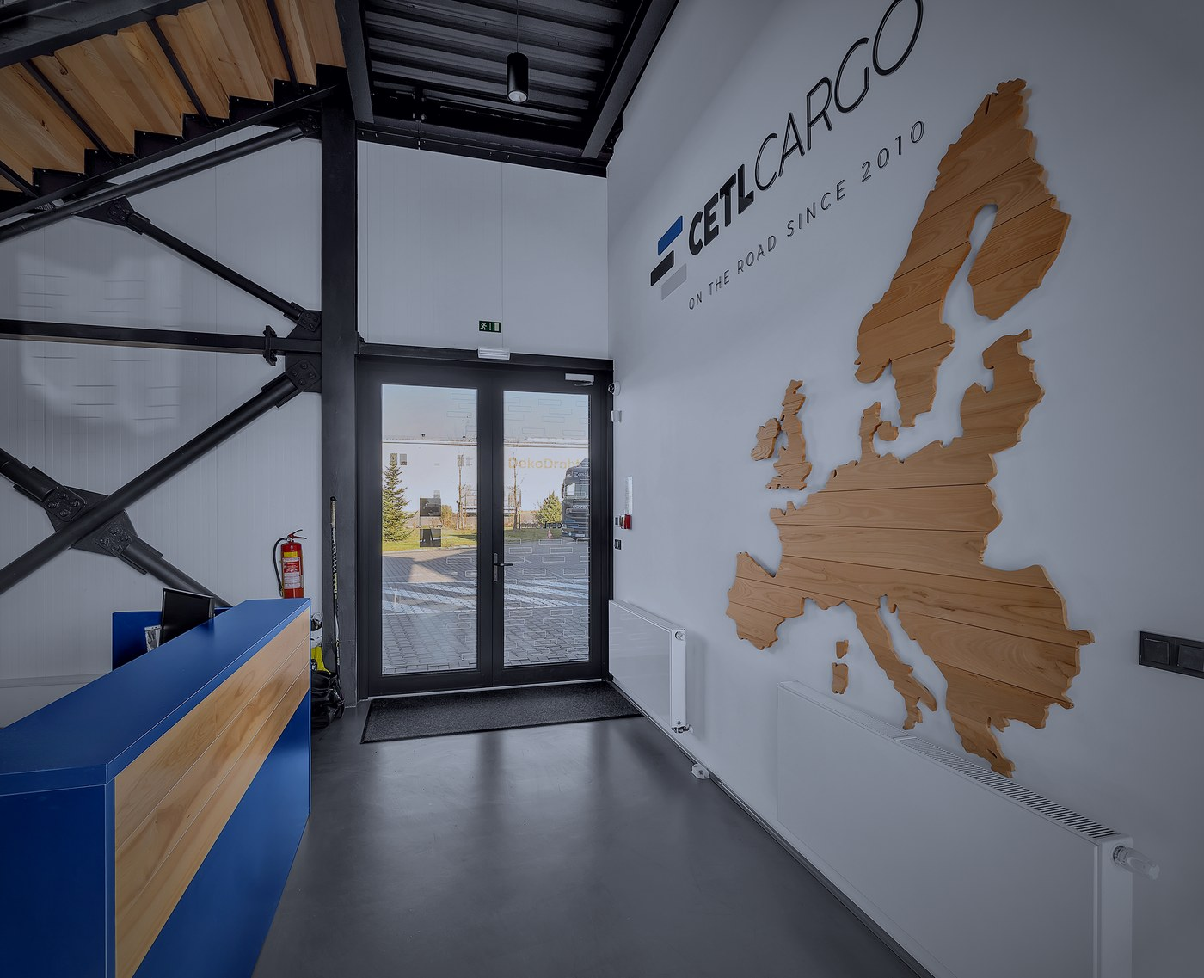
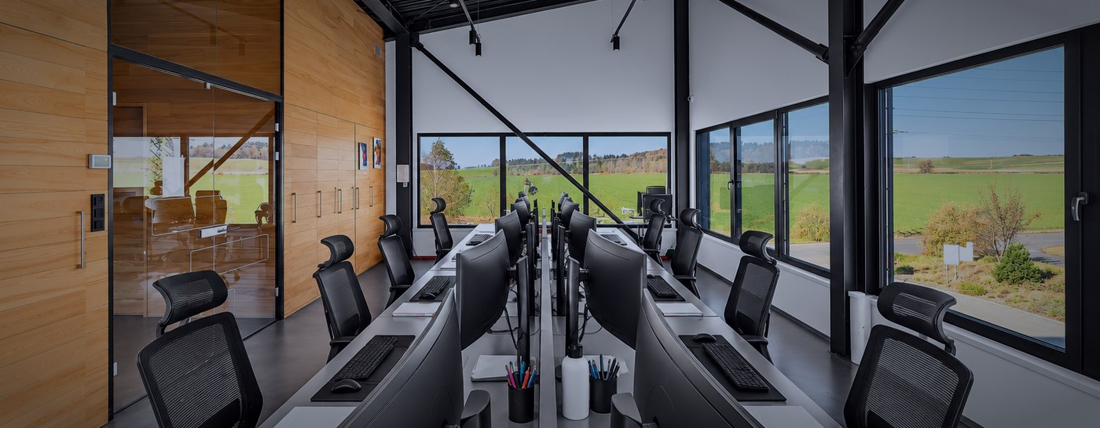
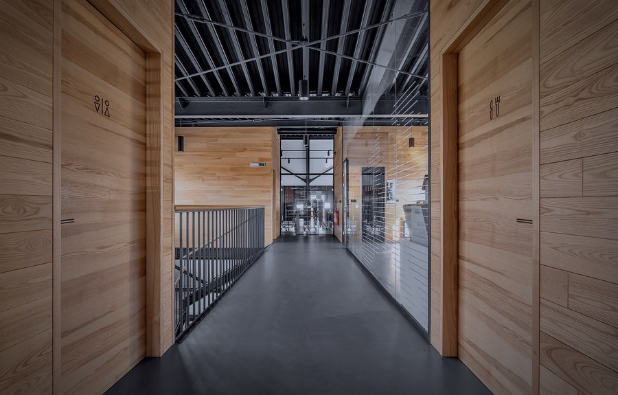
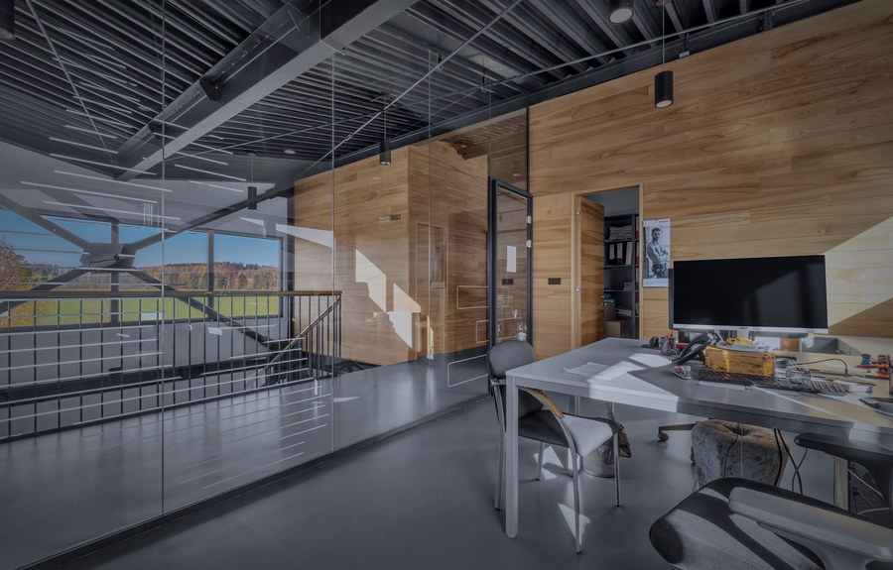
…ON THE ROAD SINCE 2010
WHERE WE WORK
DISPATCH CENTER
RECEPTION
CORRIDOR
OFFICES
KM 11 / 13

Slide 12














…ON THE ROAD SINCE 2010
PEOPLE BEHIND EVERY DELIVERY
OWNERS
DISPATCHERS
MARTIN CERAL
+420 774 442 987
DIS. VLADISLAV BÍLEK
MGR. PETR KLOBÁSA
TOMÁŠ TLUSTÝ
BC. MARTIN OSTRÝ
ceral@cetlcargo.cz
+420 775 442 986
+420 603 387 220
+420 774 442 779
+420 605 862 041
info@cetlcargo.cz
info@cetlcargo.cz
info@cetlcargo.cz
info@cetlcargo.cz
MGR. JIŘÍ TLUSTÝ
+420 774 442 988
VÁCLAV HANUS
PETR CULEK
ING. PAVEL VESELSKÝ
ROMAN NETOLICKÝ
tlusty@cetlcargo.cz
+420 725 948 379
+420 775 442 262
+420 720 994 172
+420 730 151 216
info@cetlcargo.cz
info@cetlcargo.cz
info@cetlcargo.cz
info@cetlcargo.cz
Overall more than 90 employees.
road-train drivers trained every year from our own van drivers (CETL School)
KM 12 / 13

Slide 13
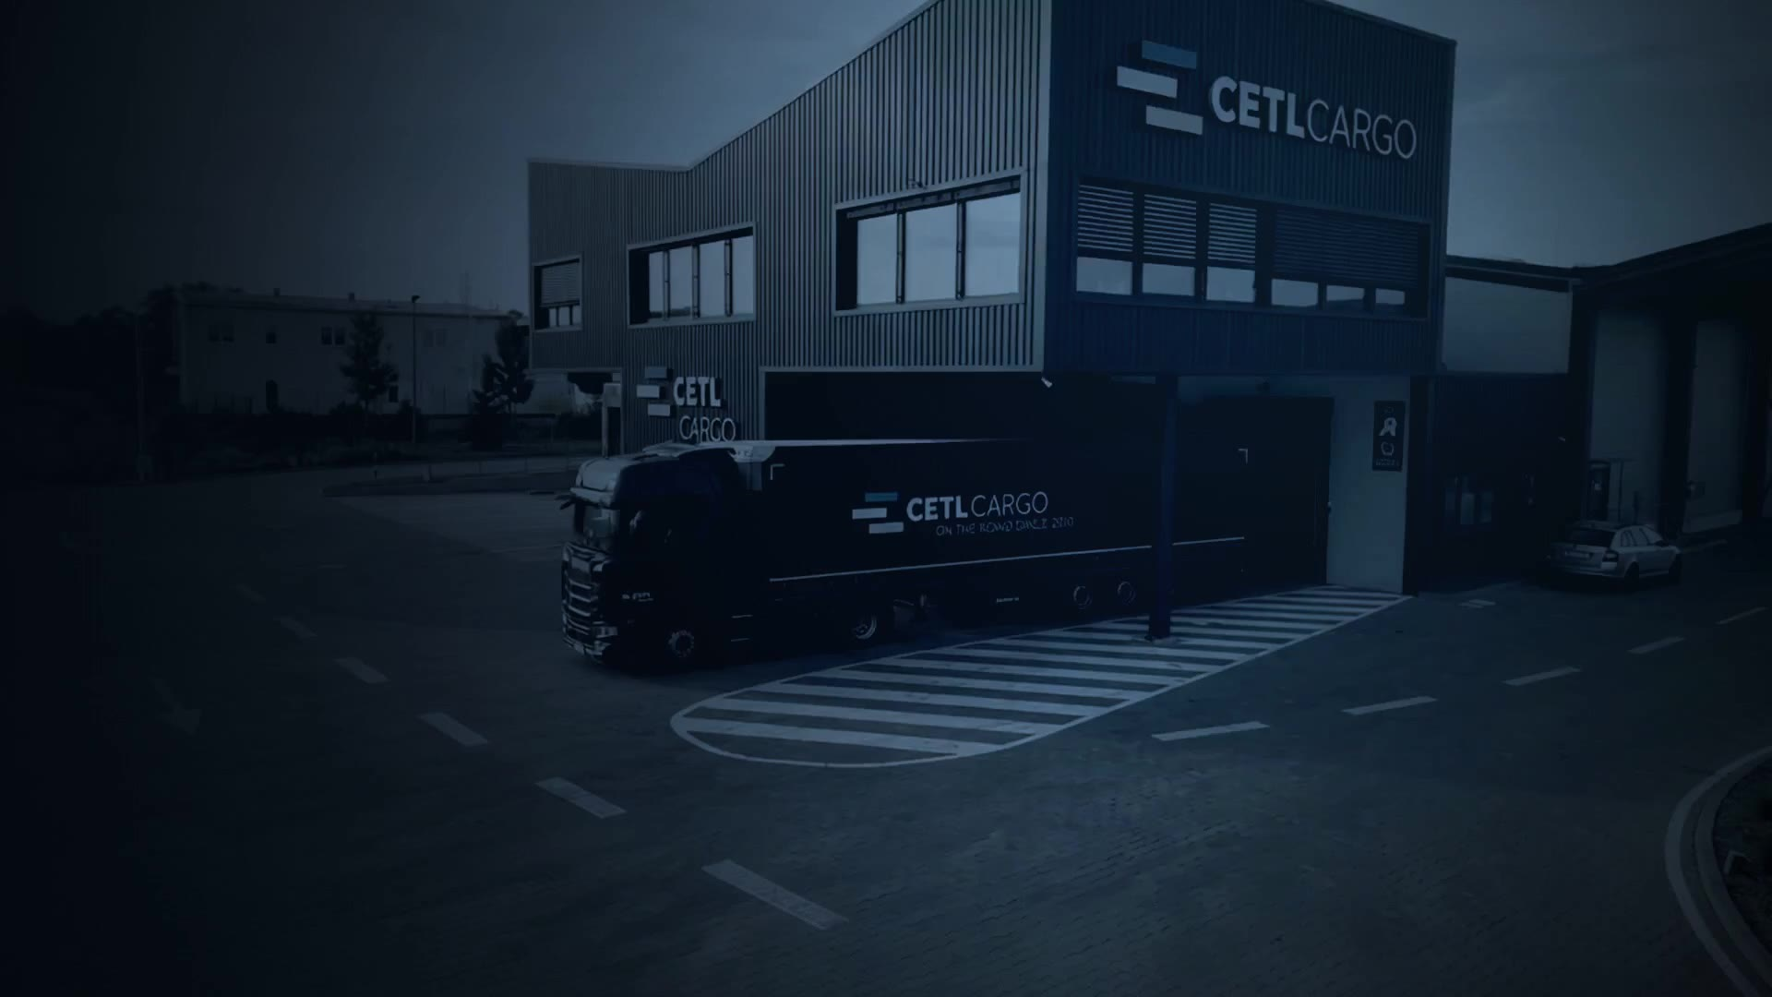







…ON THE ROAD SINCE 2010
LET’S KEEP MOVING
COMPANY NAME
CETL Cargo s.r.o.
ADDRESS
Pilská 659, 582 63 Ždírec nad Doubravou, Czech Republic
WEBSITE
www.cetlcargo.cz
EMAIL
ceral@cetlcargo.cz, tlusty@cetlcargo.cz
SOCIAL MEDIA
LinkedIn · Facebook · Instagram
…ON THE ROAD SINCE 2010
KM 13 / 13

