Slide 1
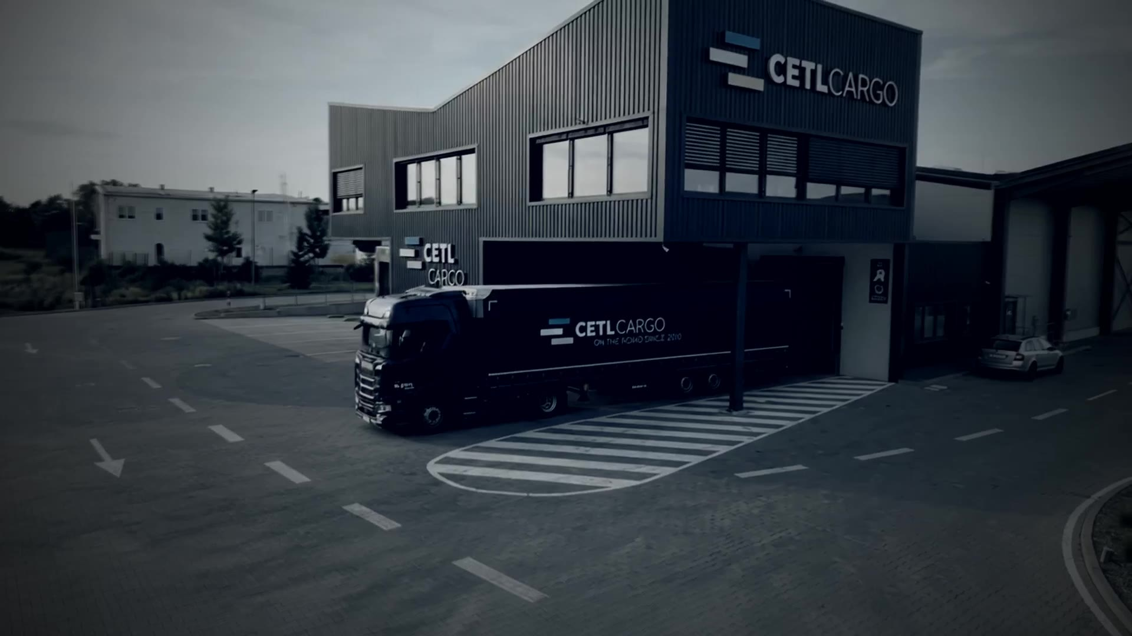



CETL CARGO // OPERATIONS CENTER
LIVE · 49.6961° N 15.8136° E
LIVE DRONE CAM 01 · CETL CAMPUS, ŽDÍREC NAD DOUBRAVOU
ON THE ROAD SINCE 2010
> INITIALIZING CETL CARGO OPERATIONS CENTER ...
> HQ ........ ŽDÍREC NAD DOUBRAVOU, CZ ... ONLINE
> FLEET ..... 71 UNITS ................... ONLINE
> NETWORK ... 12 COUNTRIES ............... ONLINE
SYS ONLINE · FLEET 71 · COUNTRIES 12 · ON THE ROAD SINCE 2010
01 / 08

Slide 2
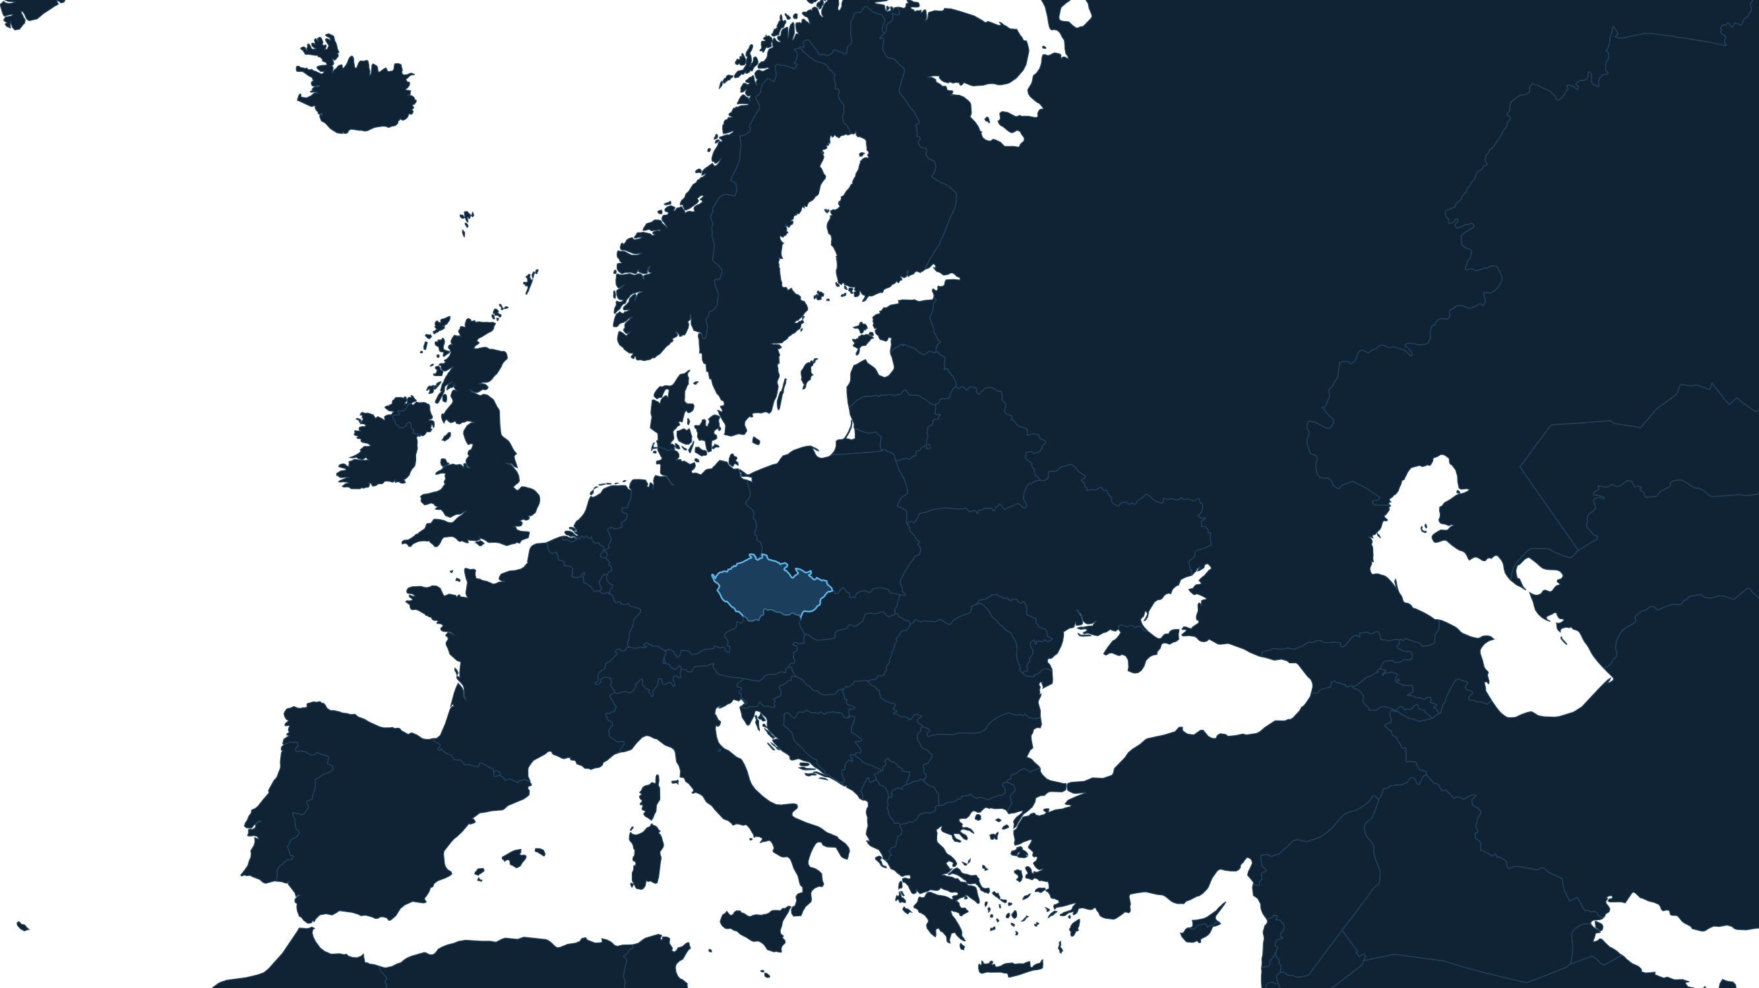























CETL CARGO // OPERATIONS CENTER
LIVE · 49.6961° N 15.8136° E
NETWORK // LIVE ROUTES
NETWORK STATUS
From Ždírec
to 12 countries.
12
COUNTRIES SERVED
23,000+
SHIPMENTS / YEAR
ŽDÍREC · HQ
● AUSTRIA
● GERMANY
● LUXEMBOURG
● ITALY
● NETHERLANDS
● BELGIUM
● DENMARK
● FRANCE
● SWEDEN
● FINLAND
● SPAIN
● PORTUGAL
SYS ONLINE · FLEET 71 · COUNTRIES 12 · ON THE ROAD SINCE 2010
02 / 08

Slide 3



CETL CARGO // OPERATIONS CENTER
LIVE · 49.6961° N 15.8136° E
FLEET STATUS // ALL UNITS
TELEMETRY // PER YEAR
71 units on the road.
3,725,000
KM · TAUTLINERS
4,271,000
KM · DELIVERY VANS
7,996,000
KM · WHOLE FLEET
TAUTLINER 120 m³ × 31
TAUTLINER 13.6 m × 5
DELIVERY VAN × 35
SYS ONLINE · FLEET 71 · COUNTRIES 12 · ON THE ROAD SINCE 2010
03 / 08

Slide 4

CETL CARGO // OPERATIONS CENTER
LIVE · 49.6961° N 15.8136° E
DISTANCE // EVERY YEAR
7,996,000 km
driven by the CETL CARGO fleet every year
200×
around the Earth.
≈ 21,900 km
≈ 10×
every single day
to the Moon and back
3,725,000 km (tautliners) + 4,271,000 km (vans) · Earth's circumference 40,075 km · Moon 384,400 km
SYS ONLINE · FLEET 71 · COUNTRIES 12 · ON THE ROAD SINCE 2010
04 / 08

Slide 5
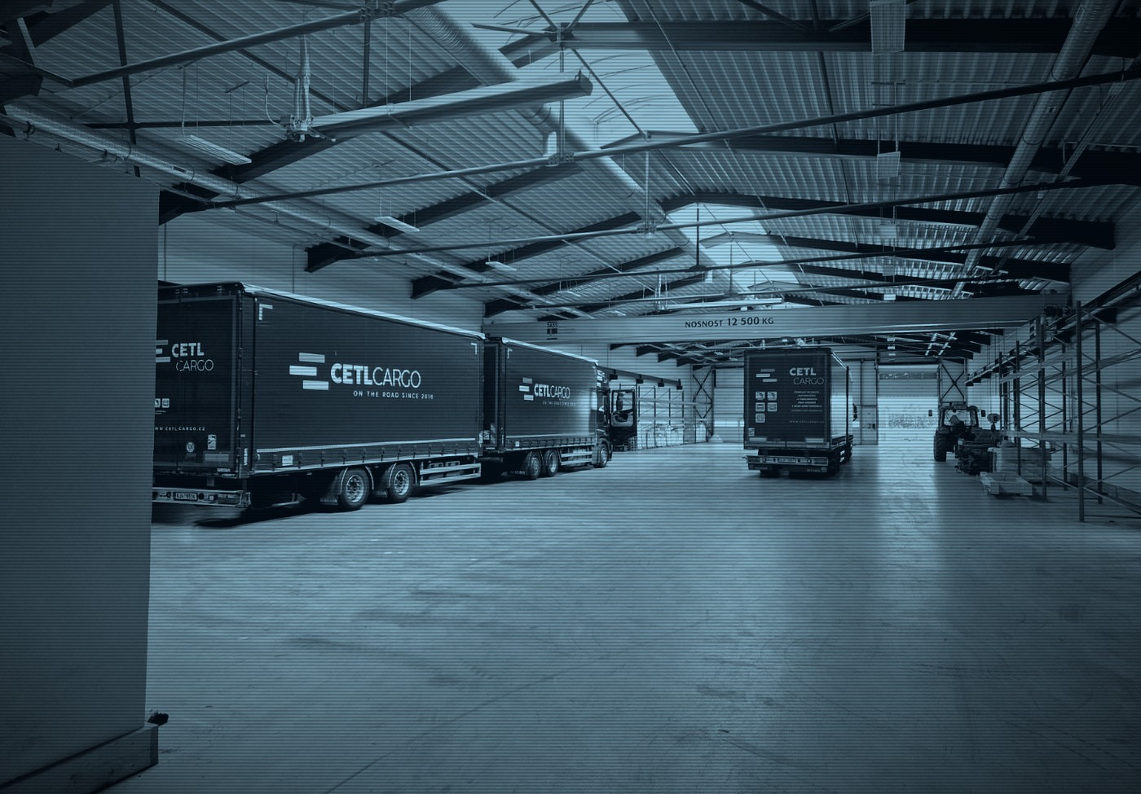










CETL CARGO // OPERATIONS CENTER
LIVE · 49.6961° N 15.8136° E
HOME BASE // ŽDÍREC NAD DOUBRAVOU
Every system online.
WAREHOUSE
● ONLINE
EXTERNAL STORAGE
● ONLINE
REC CAM 01 · WAREHOUSE HALL
2,500 m² · own use
900 m²
BRIDGE CRANE
● ONLINE
FORKLIFTS
● ONLINE
12 t
3 units
WEIGHBRIDGE
● ONLINE
TRUCK WASH
● ONLINE
Industrial scale
Gantry wash
FUEL STATION
● ONLINE
CCTV
● ONLINE
Diesel + AdBlue
Campus-wide
2,500 m² + 900 m² · 12 t BRIDGE CRANE
FIRE SAFETY
● ONLINE
SOLAR + BATTERY
● ONLINE
EPS in the halls
100 kW · 200 kWh
> ALL SYSTEMS NOMINAL
SYS ONLINE · FLEET 71 · COUNTRIES 12 · ON THE ROAD SINCE 2010
05 / 08

Slide 6

CETL CARGO // OPERATIONS CENTER
LIVE · 49.6961° N 15.8136° E
ENERGY // SOLAR-POWERED CAMPUS
Powered by the sun.
100
200
Solar power and battery storage supply the entire campus.
kW
kWh
STATUS: ACTIVE
PV PLANT · MAX OUTPUT
BATTERY · CAPACITY
SYS ONLINE · FLEET 71 · COUNTRIES 12 · ON THE ROAD SINCE 2010
06 / 08

Slide 7
CETL CARGO // OPERATIONS CENTER
LIVE · 49.6961° N 15.8136° E
FINANCIALS // TURNOVER, CZK M
Growing every year.
248 M
GROWTH // 2023 → 2025
243 M
214 M
+16 %
200
turnover growth in two years
100
CZK 214 M → CZK 248 M
0
2023
2024
2025
SYS ONLINE · FLEET 71 · COUNTRIES 12 · ON THE ROAD SINCE 2010
07 / 08

Slide 8
CETL CARGO // OPERATIONS CENTER
LIVE · 49.6961° N 15.8136° E
MISSION
Reliable and efficient transport that exceeds expectations.
RELIABILITY
SAFETY
INTEGRITY
INNOVATION
CUSTOMER FOCUS
> DISPATCH info@cetlcargo.cz
> PHONE +420 774 442 988 · +420 774 442 987
> HQ Pilská 659, 582 63 Ždírec nad Doubravou
> WEB www.cetlcargo.cz
> OWNERS Jiří Tlustý · Martin Ceral
LET'S MOVE YOUR CARGO.
SYS ONLINE · FLEET 71 · COUNTRIES 12 · ON THE ROAD SINCE 2010
08 / 08

