Slide 1
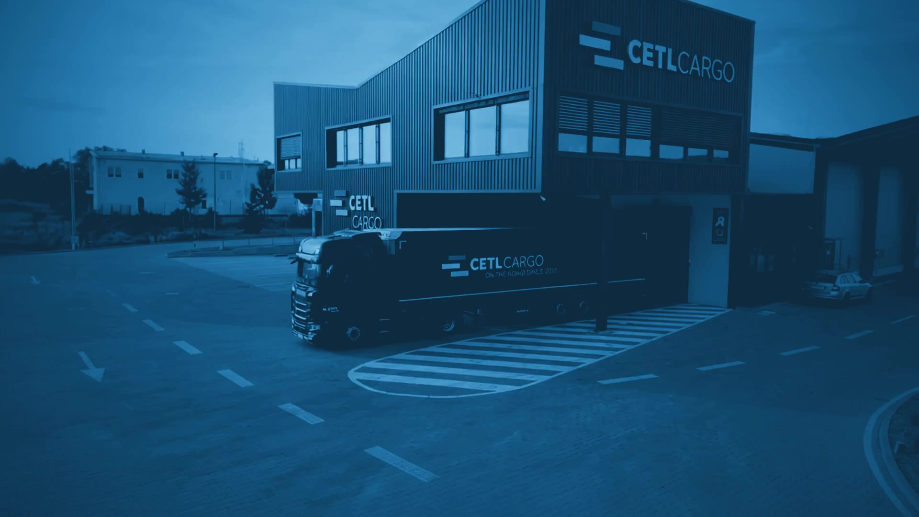



CETL CARGO // OPERATIONS CENTER
LIVE · 49.6961° N 15.8136° E
LIVE DRONE CAM 01 · CETL CAMPUS, ŽDÍREC NAD DOUBRAVOU
…ON THE ROAD SINCE 2010
COMPANY PRESENTATION
SYS ONLINE · FLEET 71 · COUNTRIES 12 · ON THE ROAD SINCE 2010
01 / 10

Slide 2
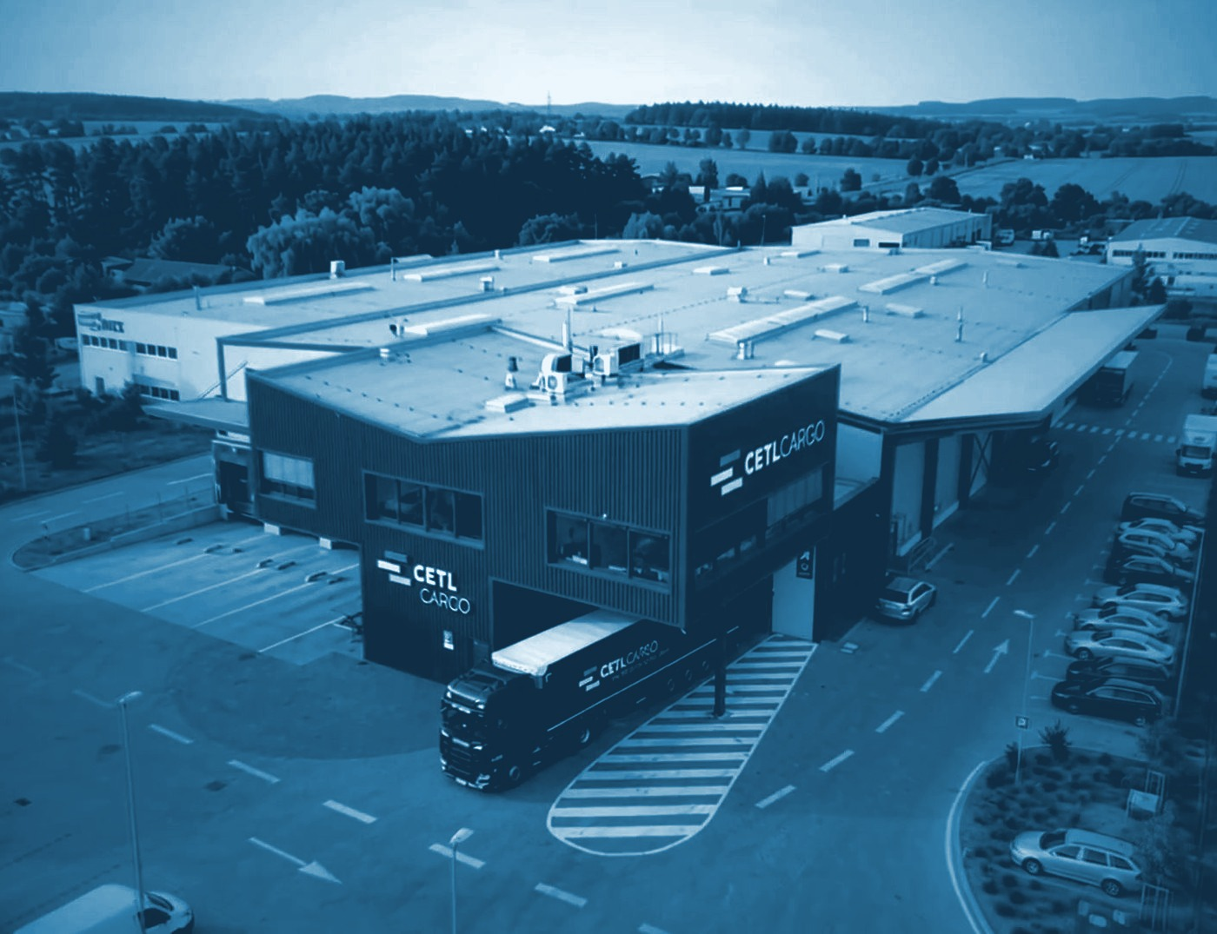
CETL CARGO // OPERATIONS CENTER
LIVE · 49.6961° N 15.8136° E
CONTENT // AGENDA
Content
01
Company overview
02
Services offered
03
Storage solutions and Equipment
04
Technologies
05
Experience and Expertise
06
Fleet details
07
Team Introduction
CAM 01 · CETL CAMPUS, ŽDÍREC NAD DOUBRAVOU
08
Contact information
SYS ONLINE · FLEET 71 · COUNTRIES 12 · ON THE ROAD SINCE 2010
02 / 10

Slide 3





CETL CARGO // OPERATIONS CENTER
LIVE · 49.6961° N 15.8136° E
COMPANY OVERVIEW
Company overview
CORE VALUES
MISSION
Reliability
To deliver reliable and efficient transport solutions that exceed our customers’ expectations through exceptional service and innovative logistics.
We ensure timely and dependable service.
Safety
We prioritize the safety of our staff, clients, and goods.
Integrity
VISION
We uphold the highest ethical standards in all our dealings.
To be the leading provider of transport services, recognized for our commitment to quality, sustainability, and customer satisfaction.
Innovation
We embrace new technologies to enhance our services.
Customer Focus
We are dedicated to understanding and fulfilling our customers' needs.
SYS ONLINE · FLEET 71 · COUNTRIES 12 · ON THE ROAD SINCE 2010
03 / 10

Slide 4





CETL CARGO // OPERATIONS CENTER
LIVE · 49.6961° N 15.8136° E
SERVICES OFFERED
Services offered
01
02
03
04
05
Efficient Delivery
Wide Coverage
Cutting-edge Technology
Eco-friendly Options
Customizable Solutions
Timely and reliable transport services, ensuring goods reach their destination on schedule.
Extensive network covering various regions, both local and international.
Advanced tracking systems and logistical software to improve efficiency and transparency.
Sustainable practices and green transport solutions.
Tailored services to meet the specific needs of each client, offering flexibility and personalized service.
SYS ONLINE · FLEET 71 · COUNTRIES 12 · ON THE ROAD SINCE 2010
04 / 10

Slide 5
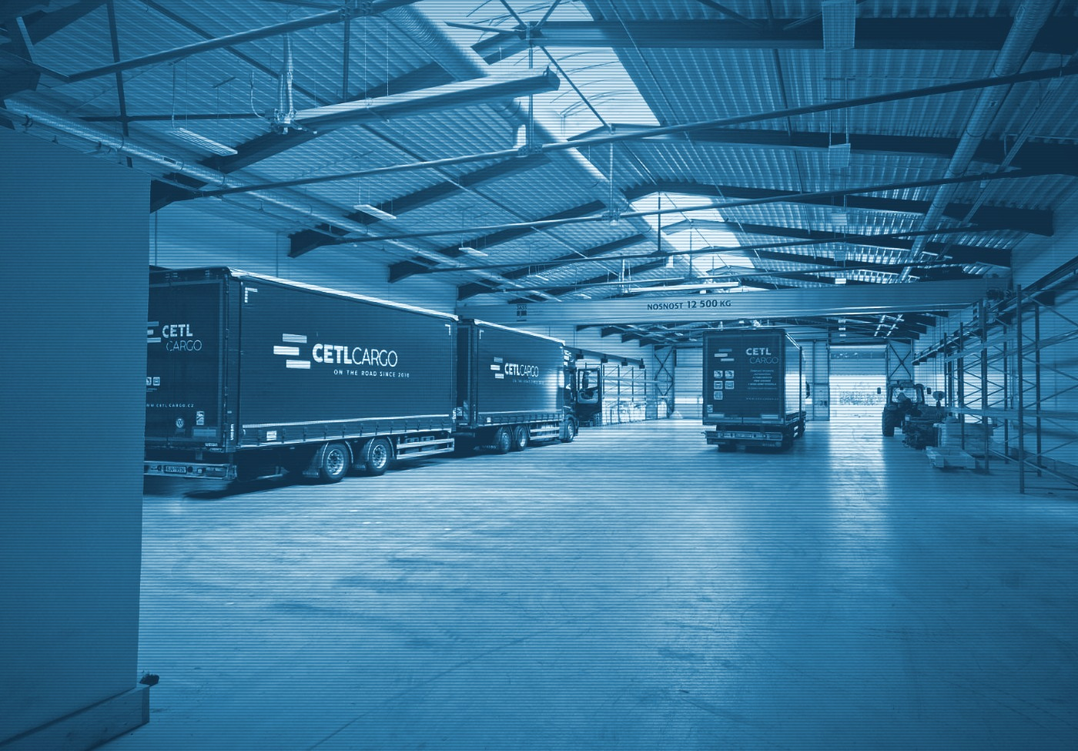



CETL CARGO // OPERATIONS CENTER
LIVE · 49.6961° N 15.8136° E
SERVICES OFFERED // STORAGE SOLUTIONS AND EQUIPMENT
Storage solutions and Equipment
STORAGE HANDLING AREA
● ONLINE
REC CAM 02 · WAREHOUSE HALL
2,500 m² for our own use and 900 m² for external storage.
BRIDGE CRANE
● ONLINE
Our storage includes a 12-ton bridge crane, allowing us to handle heavy and oversized goods with ease.
FORKLIFT TRUCKS
● ONLINE
We have 3 forklift trucks for efficient and flexible handling of various cargo types.
SECURITY
● ONLINE
Advanced security systems ensure the safety of your goods.
SYS ONLINE · FLEET 71 · COUNTRIES 12 · ON THE ROAD SINCE 2010
05 / 10

Slide 6





CETL CARGO // OPERATIONS CENTER
LIVE · 49.6961° N 15.8136° E
SERVICES OFFERED // TECHNOLOGIES
Technologies
ENERGY // PHOTOVOLTAICS
CAMPUS FACILITIES
Industrial weighbridge
100
200
Gantry truck wash
kW
kWh
Filling station: Diesel + AdBlue
MAX OUTPUT
BATTERY CAPACITY
SAFETY AND SECURITY
The entire campus is monitored by a CCTV system
Photovoltaic power plant with a maximum output of 100 kW and a battery capacity of 200 kWh, powering the entire campus.
The halls are protected by an EPS fire alarm system
SYS ONLINE · FLEET 71 · COUNTRIES 12 · ON THE ROAD SINCE 2010
06 / 10

Slide 7
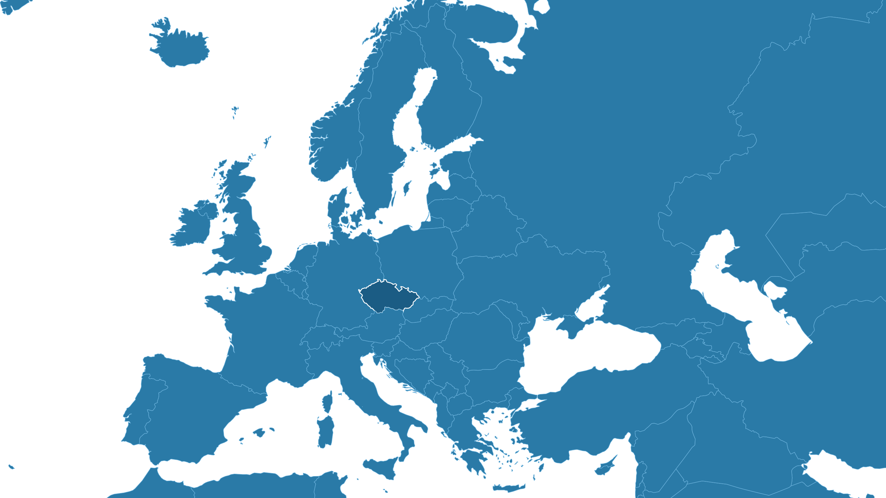











CETL CARGO // OPERATIONS CENTER
LIVE · 49.6961° N 15.8136° E
EXPERIENCE AND EXPERTISE
Experience and Expertise
15
23,000+
YEARS OF EXPERTISE
SHIPMENTS PER YEAR
Demonstrating our long-standing presence in the transport industry.
Successfully handling more than 23,000 shipments per year.
COUNTRIES // WE PROVIDE TRANSPORT SERVICES TO
● Germany
● France
● Spain
● Portugal
● Italy
● Belgium
● the Netherlands
● Denmark
● Sweden
● Finland
● Luxembourg
● Austria
FINANCIAL PERFORMANCE // LAST 3 YEARS
2025 248 000 000 Kč ≈ 9.92 mil. EUR
2024 243 000 000 Kč ≈ 9.72 mil. EUR
2023 214 000 000 Kč ≈ 8.56 mil. EUR
SYS ONLINE · FLEET 71 · COUNTRIES 12 · ON THE ROAD SINCE 2010
07 / 10

Slide 8


CETL CARGO // OPERATIONS CENTER
LIVE · 49.6961° N 15.8136° E
FLEET DETAILS
Fleet details
Fleet size: our company operates a robust fleet of:
CAM 03 · TAUTLINER COMBINATION
CAM 04 · DELIVERY VAN
31×
tautliner 120 m³ vehicles
3 725 000 km
35×
delivery vans
4 271 000 km
5×
tautliner 13.6 m vehicles
TOTAL PER YEAR
TOTAL PER YEAR
MAINTENANCE
VARIETY
Our vehicles are regularly maintained to ensure reliability and safety.
Our fleet includes tautliner trucks and curtain-sided vans.
SYS ONLINE · FLEET 71 · COUNTRIES 12 · ON THE ROAD SINCE 2010
08 / 10

Slide 9

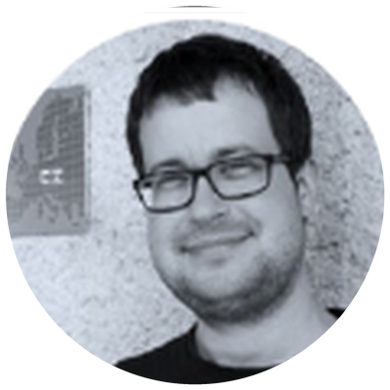




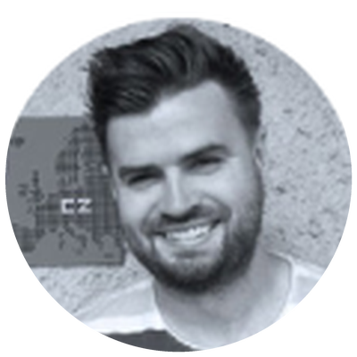
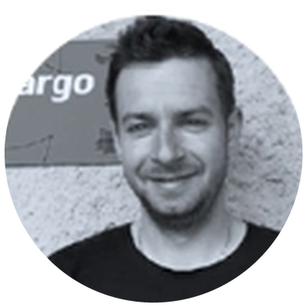
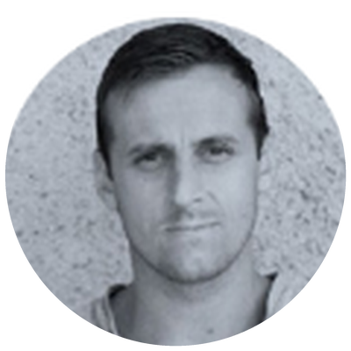
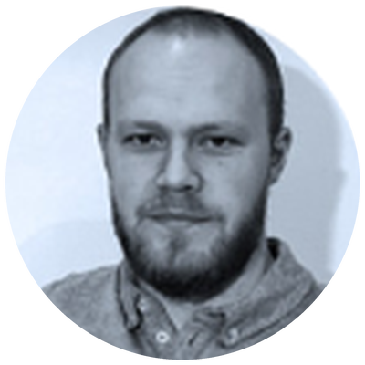
CETL CARGO // OPERATIONS CENTER
LIVE · 49.6961° N 15.8136° E
TEAM INTRODUCTION
Team Introduction
OWNERS
DISPATCHERS
MARTIN CERAL
+420 774 442 987
DIS. VLADISLAV BÍLEK
MGR. PETR KLOBÁSA
TOMÁŠ TLUSTÝ
BC. MARTIN OSTRÝ
ceral@cetlcargo.cz
+420 775 442 986
+420 603 387 220
+420 774 442 779
+420 605 862 041
info@cetlcargo.cz
info@cetlcargo.cz
info@cetlcargo.cz
info@cetlcargo.cz
MGR. JIŘÍ TLUSTÝ
+420 774 442 988
VÁCLAV HANUS
PETR CULEK
ING. PAVEL VESELSKÝ
ROMAN NETOLICKÝ
tlusty@cetlcargo.cz
+420 725 948 379
+420 775 442 262
+420 720 994 172
+420 730 151 216
info@cetlcargo.cz
info@cetlcargo.cz
info@cetlcargo.cz
info@cetlcargo.cz
90+ Overall more than 90 employees.
SYS ONLINE · FLEET 71 · COUNTRIES 12 · ON THE ROAD SINCE 2010
09 / 10

Slide 10
CETL CARGO // OPERATIONS CENTER
LIVE · 49.6961° N 15.8136° E
CONTACT INFORMATION
Contact information
> COMPANY NAME
CETL Cargo s.r.o.
> ADDRESS
Pilská 659, 582 63 Ždírec nad Doubravou, Czech Republic
> WEBSITE
www.cetlcargo.cz
> PHONE
+420 774 442 987
> EMAIL
ceral@cetlcargo.cz, info@cetlcargo.cz
> SOCIAL MEDIA
LinkedIn · Facebook
…ON THE ROAD SINCE 2010
SYS ONLINE · FLEET 71 · COUNTRIES 12 · ON THE ROAD SINCE 2010
10 / 10

