Slide 1

Monster Hunter World
The best game about hunting big monsters!

Slide 2



What is this game?
The Main Goal
The Gear
The Difficulty
MHW is a game where you hunt monsters (obviously). Its made by Capcom and it looks really good.
You kill a monster, take its bones and skin, and then make a better sword. Then you kill a bigger one!
Some monsters are very hard. You need to learn how they move so you dont die instantly.

Slide 3

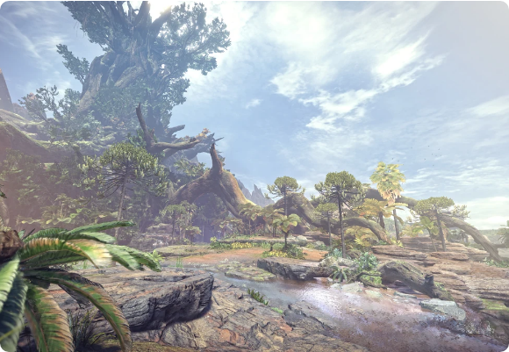
The "New World"
The graphics is amazing. There is no loading screens between areas anymore which is great.
•
Ancient Forest: Lots of trees and vines.
•
Wildspire Waste: A big desert with sand.
•
Coral Highlands: It looks like the ocean but on land.
Its very fun to just walk around and find plants.

Slide 4
The Monsters
There is many different beasts. The most famous one is Rathalos, a big fire dragon.
They fight each other too! Sometimes a big dinosaur will bite another monster and help you win.
Dont forget to eat food before you go hunt or you will have no stamina.

Slide 5

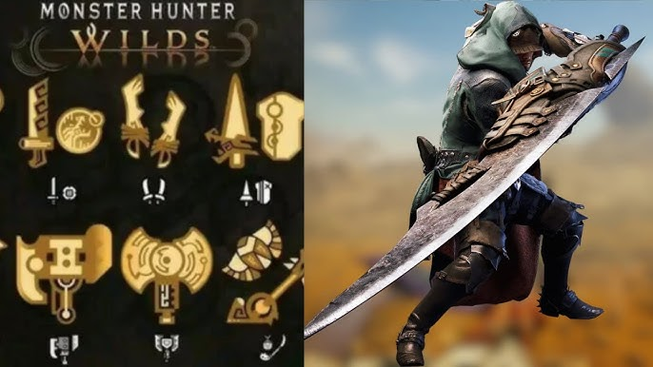
All the Weapons
There is 14 weapon types. Everyone can find one they like!
Great Sword (Big and slow)
Dual Blades (Very fast)
Bow (Shoot from far away)
Hunting Horn (You play music!)

Slide 6
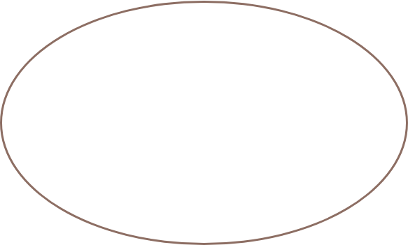
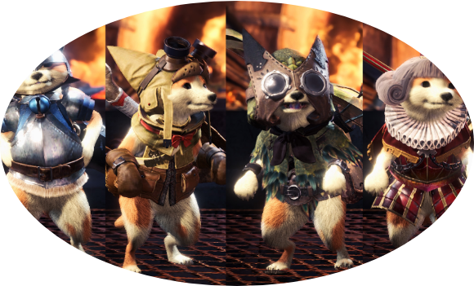
Your Cat Buddy
Palicoes
You get a cat called a Palico. They help you fight and they can heal you with green flies.
You can even give them a cute hat and armor. My cat looks like a little knight.

Slide 7


Playing with Friends
Online Co-op
The Hub
Its much easier to kill big monsters with 4 people. You can use an SOS Flare if you are stuck.
You can meet other players in the gathering hub. You can even do arm wrestling matches!

