Slide 1
Get ready for your weather data world to be shocked!

Slide 2
Introducing the latest product from your favourite company…

Slide 3
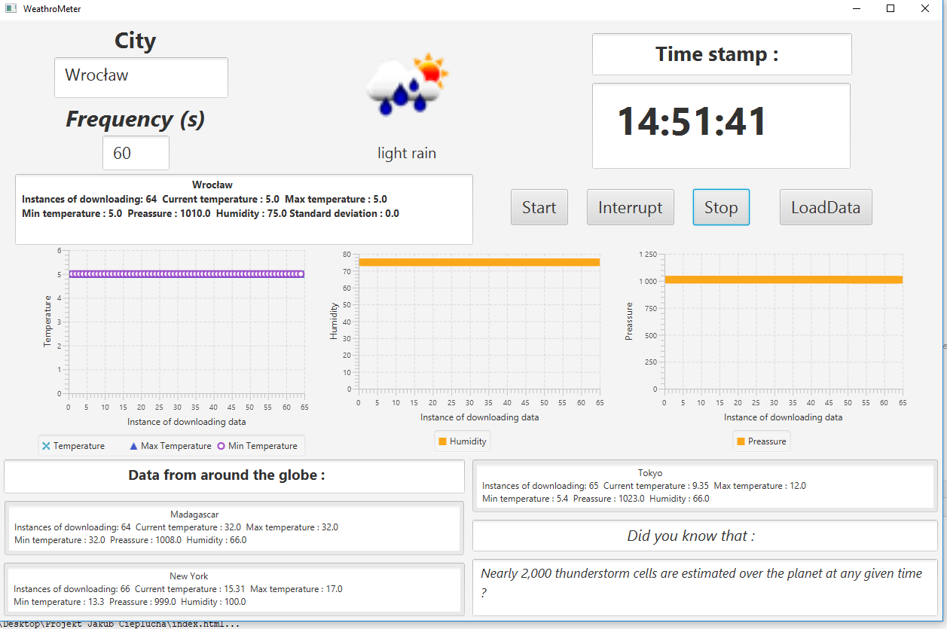
The WeathroMeter

Slide 4
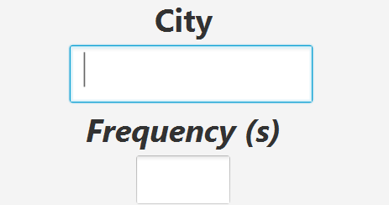

You just need to type in the city, data from which you want to gather and the frequency at which you want that to happen .
And then click START

Slide 5
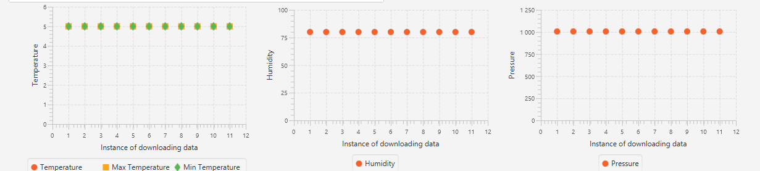
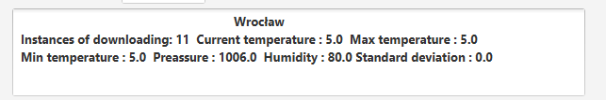
As soon as you do that the application will begin displaying data in the form of three charts ..
And a box presenting you with the current temperature , pressure, standard deviation of temperature and so much more …

Slide 6
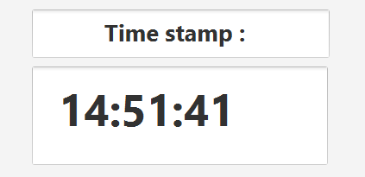
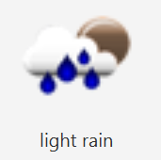
In the top right corner we have included a time stamp for you to know when the latest update has been made
In the top center you will see the visual representation of the current weather along with its description

Slide 7


Whenever you would like to stop or interrupt gathering data just click the appropriate button
Furthermore once you click Stop, all the data gathered will be saved to a JSON file which you can later load into the application by clicking the Load Data buton.

Slide 8
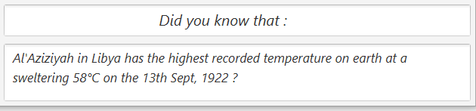
We have also decided to include a little something for all our weather facts enthusiasts
This box will display a different weather fact every time new data has been gathered

Slide 9
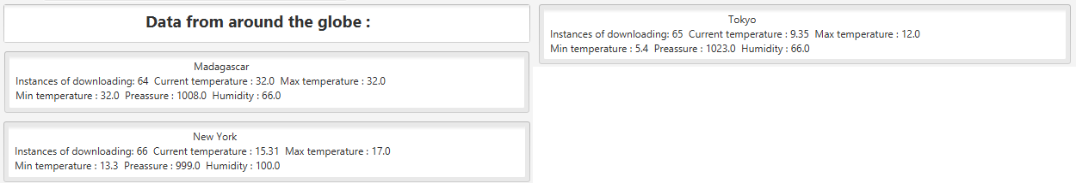
On top of all that you will also get data fom Madagascar , Tokyo and New York !!*
*For an option to change those cities aks our consultant about our exclusive plan .

Slide 10
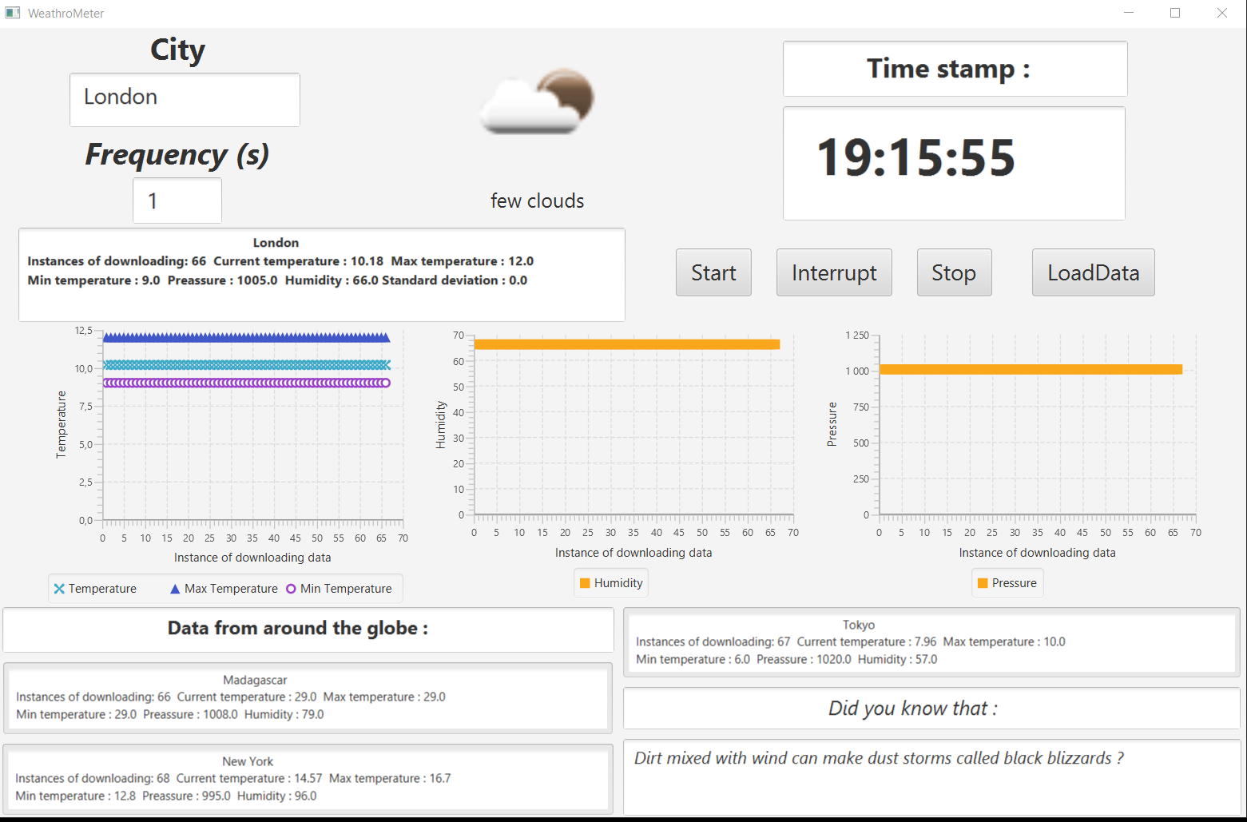
Why buy the rest when you can choose the best !
Contact us now to learn more about the greatest thing since sliced bread - WeathroMeter

