Slide 1
Using metagenomics for antimicrobial resistance monitoring in livestock animals
By Patrick Munk

Slide 2
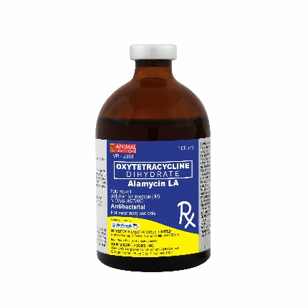

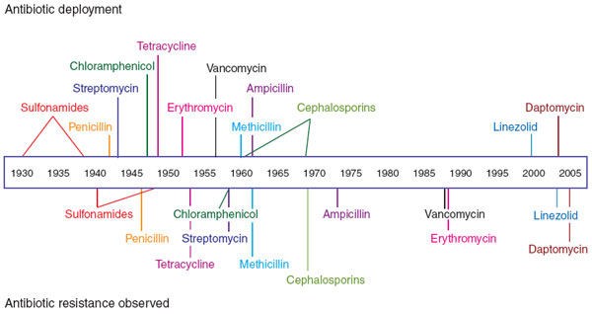
AMR Timeline

Slide 3
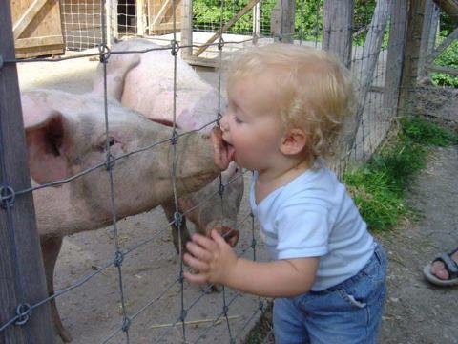
Zoonotic antimicrobial resistance

Slide 4

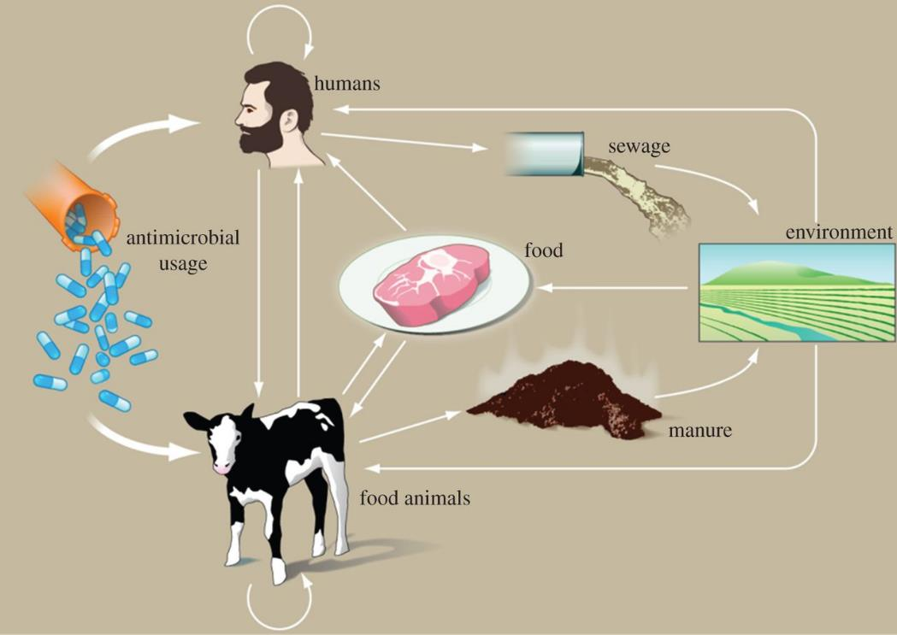
AMR Transmission network

Slide 5

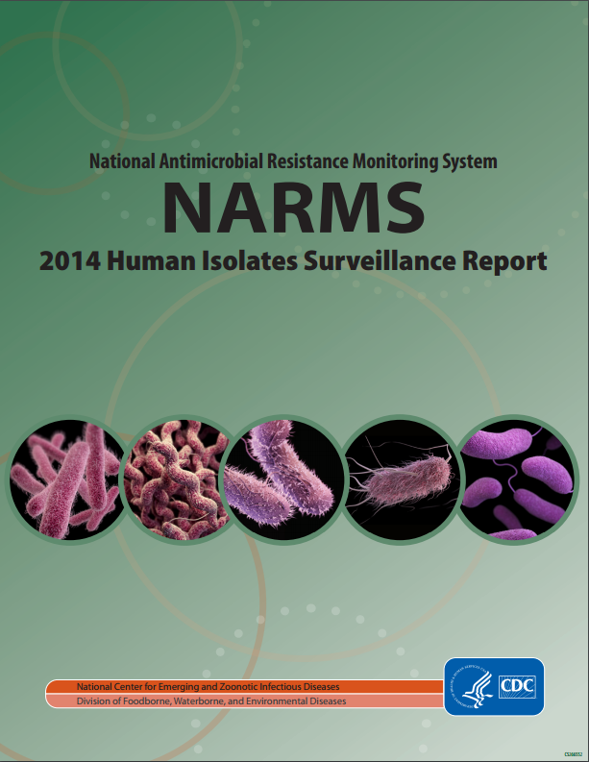
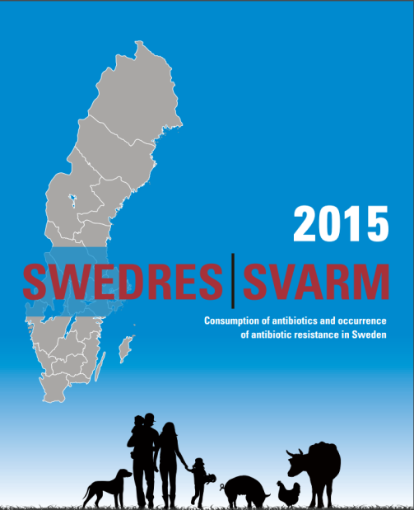

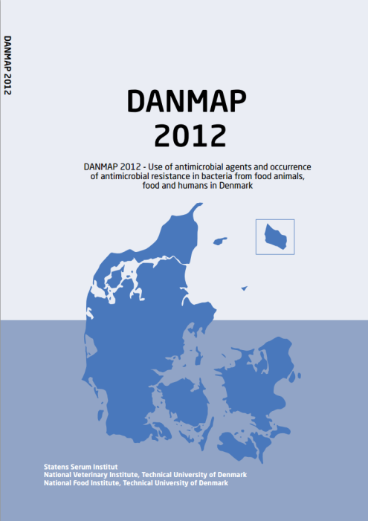
Resistance Surveillance Programs

Slide 6

The project

Slide 7
Ecology from Farm to Fork Of microbial drug Resistance and Transmission (EFFORT)
Studies the ecology of AMR in the food chain
Studies interactions in bacterial communities, pathogens and commensals in animals
Identify AMR risk factors and model their effect
URL: http://www.effort-against-amr.eu/

Slide 8
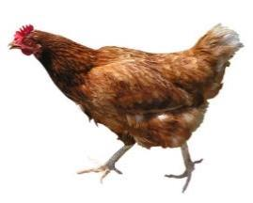
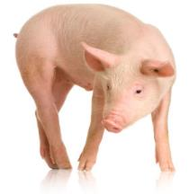
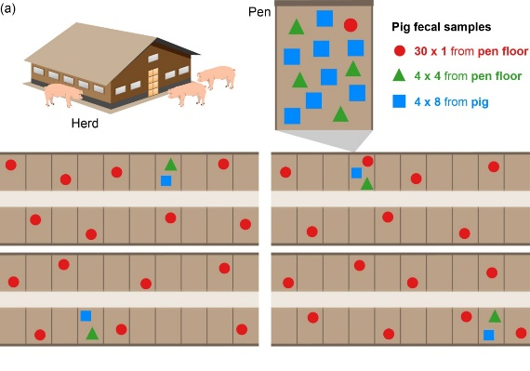
Study design and sampling
Swine and poultry samples from 9 countries
Belgium, Bulgaria, Denmark, France, Germany, The Netherlands, Italy, Poland and Spain
20 pig and 20 chicken farms from each country
Each sample is pool of 25 individual fecal samples
 | Number | Note
Species | 2 | Pig & Poultry
Countries | 9 | Belgium, Bulgaria, Denmark, France, Germany, Italy, Netherlands, Poland, Spain
Herds per country | 20 | Per animal species

Slide 9
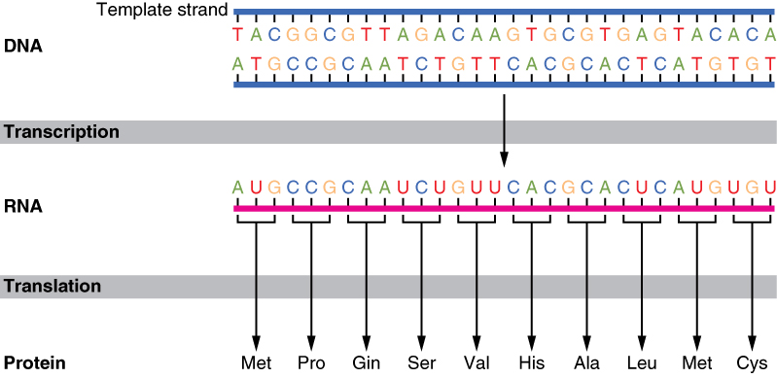
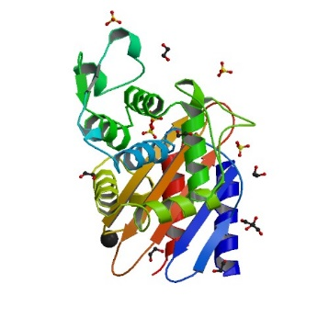
Central dogma of molecular biology
What we identify and quantify with sequencing
What can provide resistance
(blaCTX-M-15 protein)

Slide 10
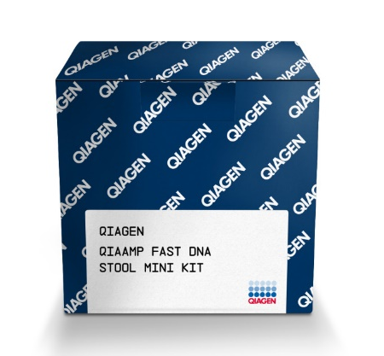
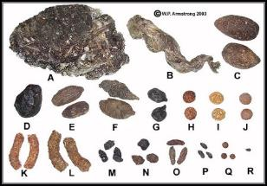
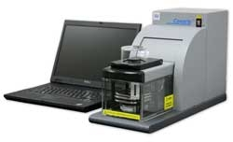
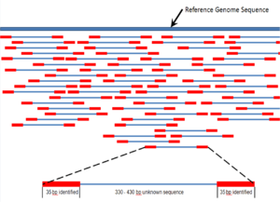

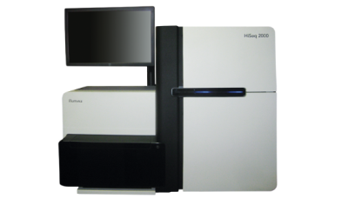
Lab methods
Pooled fecal sample
DNA Extraction
QIAamp Fast DNA Stool Mini Kit +
Bead beating – custom protocol
DNA Shearing
~ 300 bp
Paired-end reads
Paired-end sequencing (2x150bp)
HiSeq3000
NEXTflex PCR-free library preparation

Slide 11
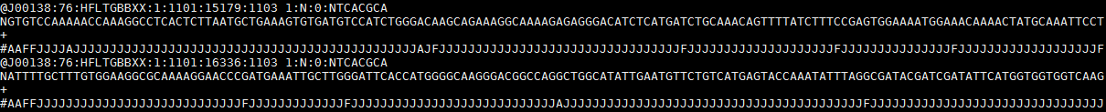

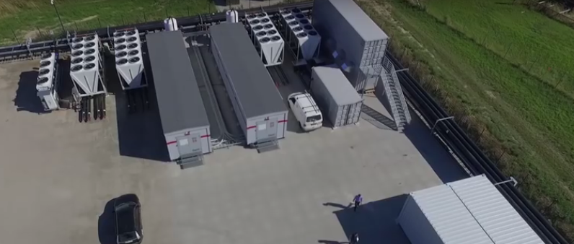
Data output
Around 50 million PE reads per sample (100 million reads)
More than 5 TB (5000 gigabases) of DNA sequence
Processed on Computerome, DTU, Risøe Campus
Read name
DNA seq
Comment (empty)
Phred quality

Slide 12
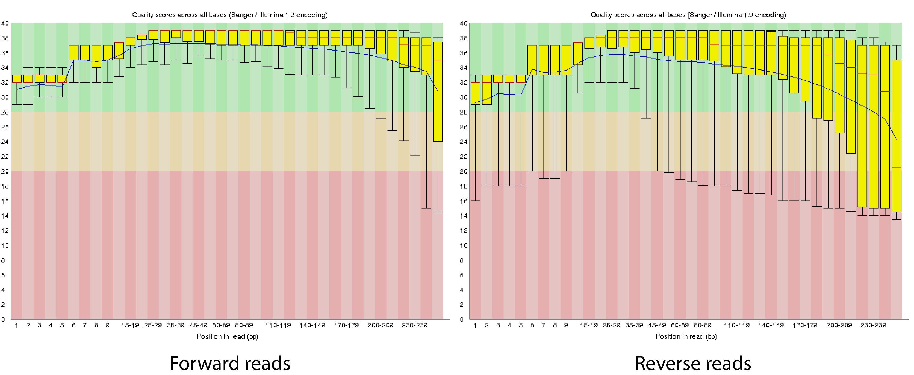
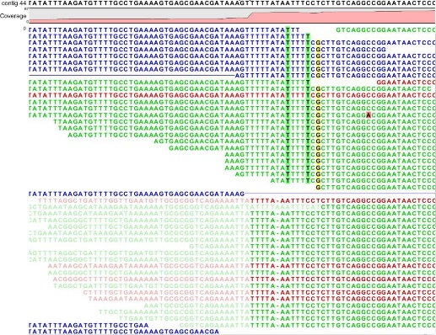
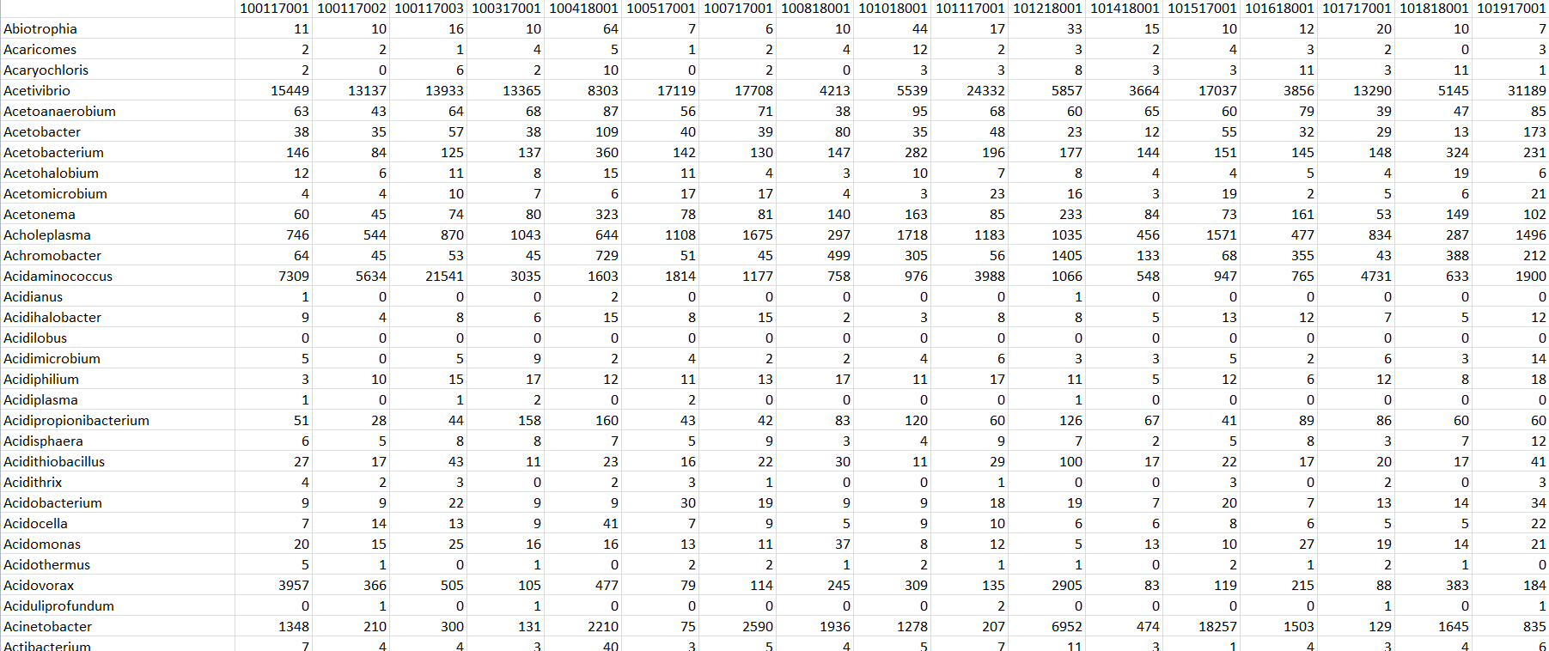
In silico methods
Adapter- and quality trim
(Bbduk)
Read quality report
(fastqc)
PE DNA reads (FASTQ)
Trimmed PE DNA reads (FASTQ)
QC Report
(FASTQC)
Align reads to references
(Mgmapper / BWA)
Parsing results
BAM file
Count table

Slide 13
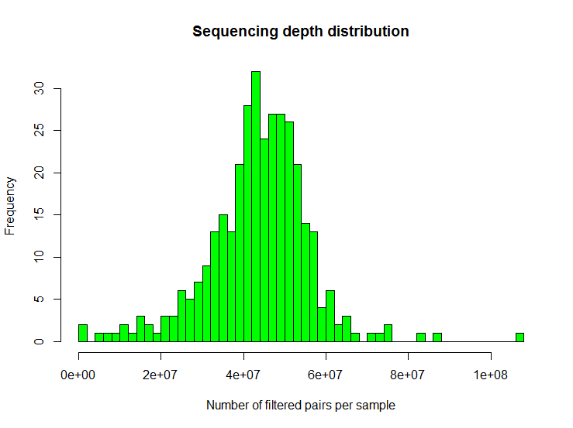
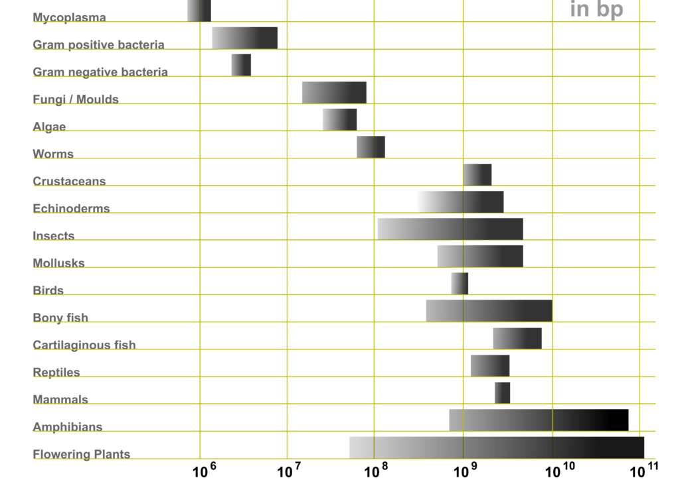
Analyzing read count data
Variation in amount of data per sample
Variation in gene lengths and genome sizes in databases
Zero-inflated data
Data follows a negative binomial distribution

Slide 14
Questions the data could help answer
Does a country’s veterinary AM usage affect AMR?
Which AMR genes are affected by what drugs?
What is the mathematical relationship between drug use and AMR / how will a drug use decrease affect AMR?
Are certain AMR genes associated with specific countries?
What are the difference between the pig and poultry resistance gene pools?

Slide 15
Thank you for listening ☺
Questions?

