Slide 1

Gradle
A short intro
Axel Wogawa
Software Engineer
16.10.2023

Slide 2
Create a Gradle Application with IntelliJ

Slide 3
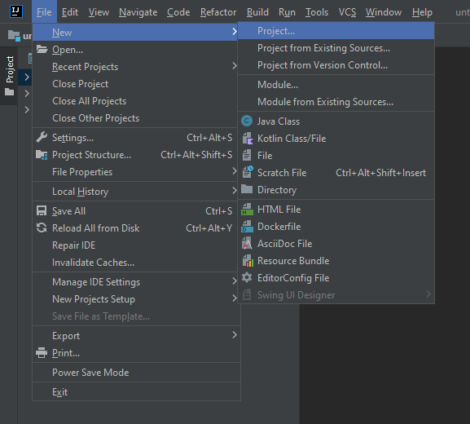
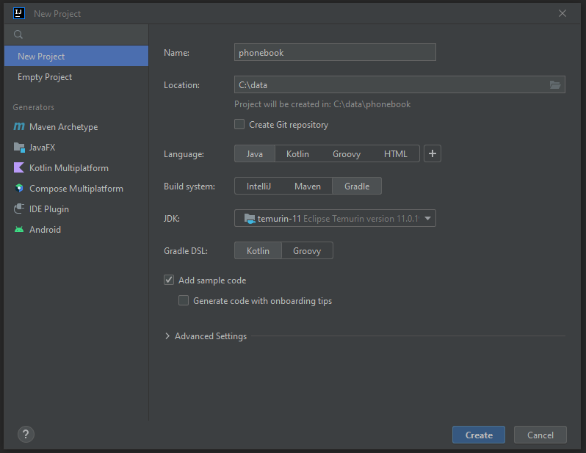
Creating a Gradle Project with IntelliJ
Create new project
Configure project name, location and type

Slide 4
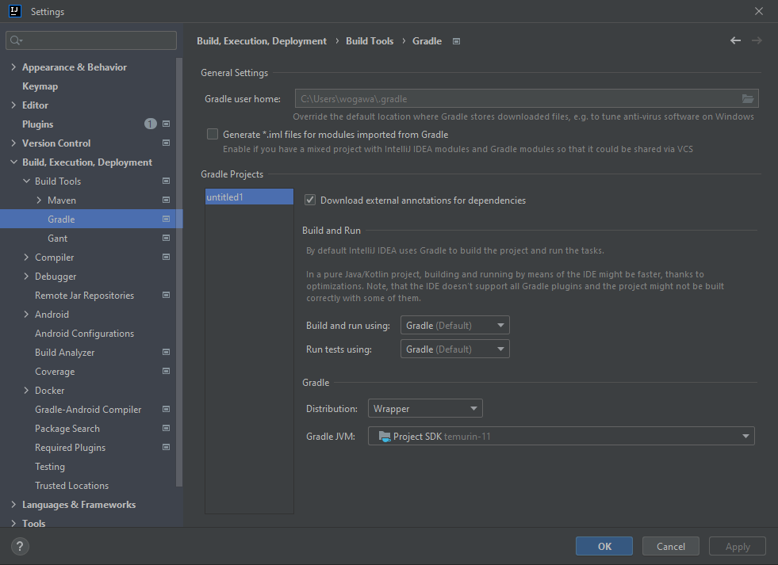
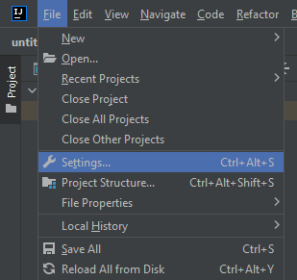
Configure IntelliJ to Use Gradle
Open settings
Configure IntelliJ to
use Gradle

Slide 5
What is Gradle?

Slide 6
What is Gradle?
Gradle is a build tool
Supports Android, Java, Kotlin Multiplatform, Groovy, Scala, Javascript, and C/C++
Open source, free, very popular
Learn more at: https://docs.gradle.org/current/userguide/userguide.html

Slide 7
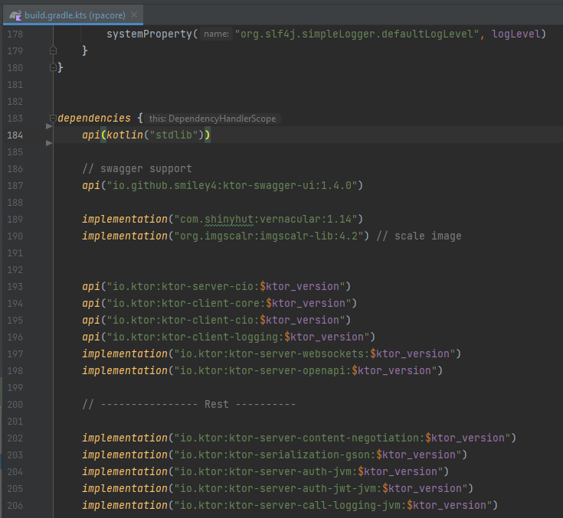
What does Gradle do?
Dependency management
You can declare dependencies in the gradle.build(.kts) file
Gradle automatically downloads all declared dependencies
group
name
version

Slide 8
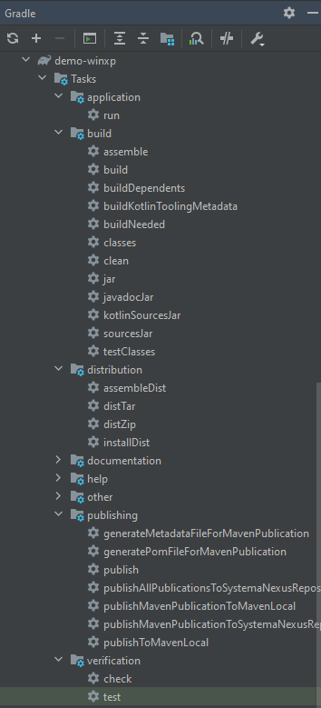
What does Gradle do?
Dependency management
Build automation
Gradle provides “tasks” to automate steps in the software development process
Tasks can be run via IDE or command line, e.g.: ./gradlew build

Slide 9
Why Use Gradle?
Define dependencies as text (gradle.build(.kts) file) instead of including .jar files
Automate recurring tasks
Compile code
Executing tests
Building distributable package (→ the customer can unzip and run the app straight away)
…
Share build and run config (gradle.build(.kts) file) with fellow developers
Everyone can run and build the app with the exact same outcome
Gradle is
Well documented
Customizable
Popular and stable

Slide 10
Start Your Mini-Application With Gradle

Slide 11
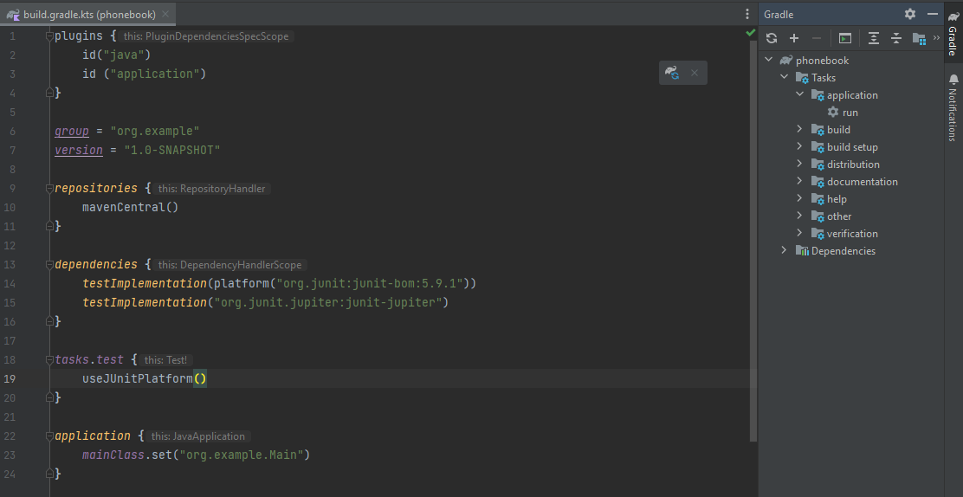
Use Gradle to Run Your App – IntelliJ
Add application plugin
Reload Gradle project
Define main class
Run your app with IntelliJ

Slide 12
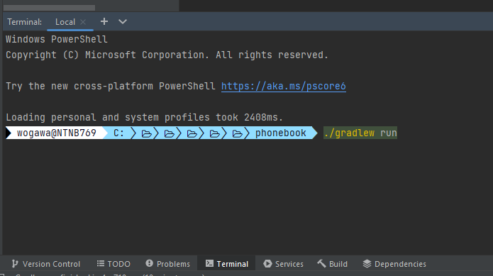
Use Gradle to Run Your App – Command Line
Run your app with the Gradle command line interface (CLI)

Slide 13
Add a New Dependency

Slide 14
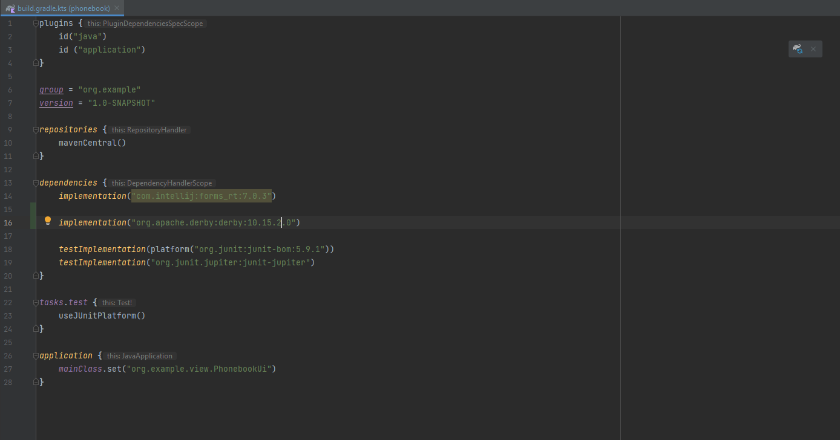
Add a New Dependency
Add your dependency to the build.gradle.kts file
Reload gradle project
gradle will download the dependency from repository mavenCentral()

