Slide 1
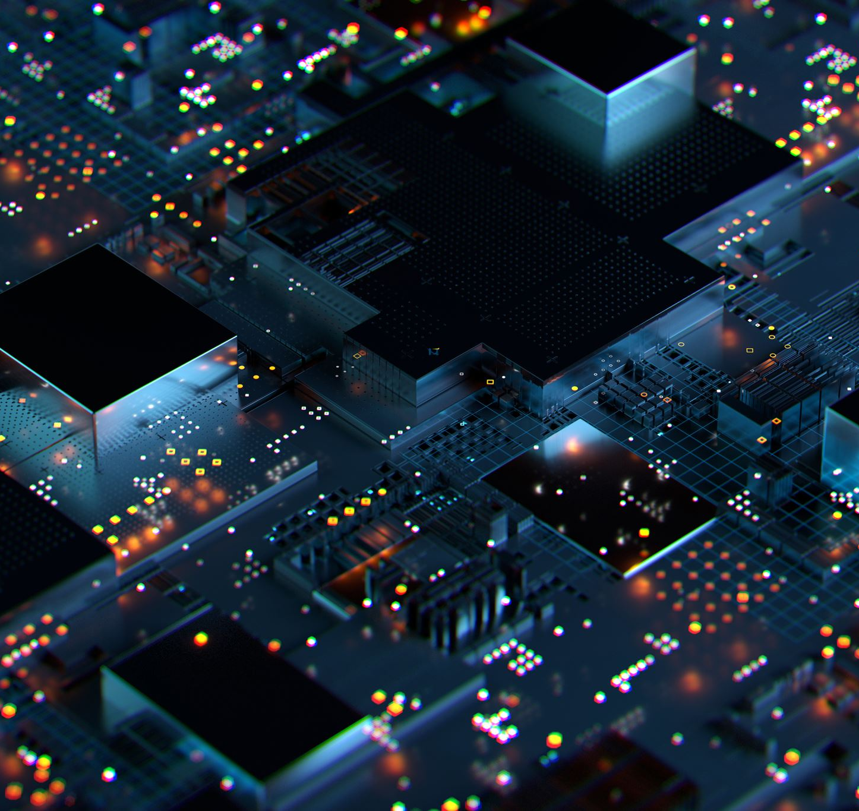
Quantum Computers
Jakub Harań 54394

Slide 2
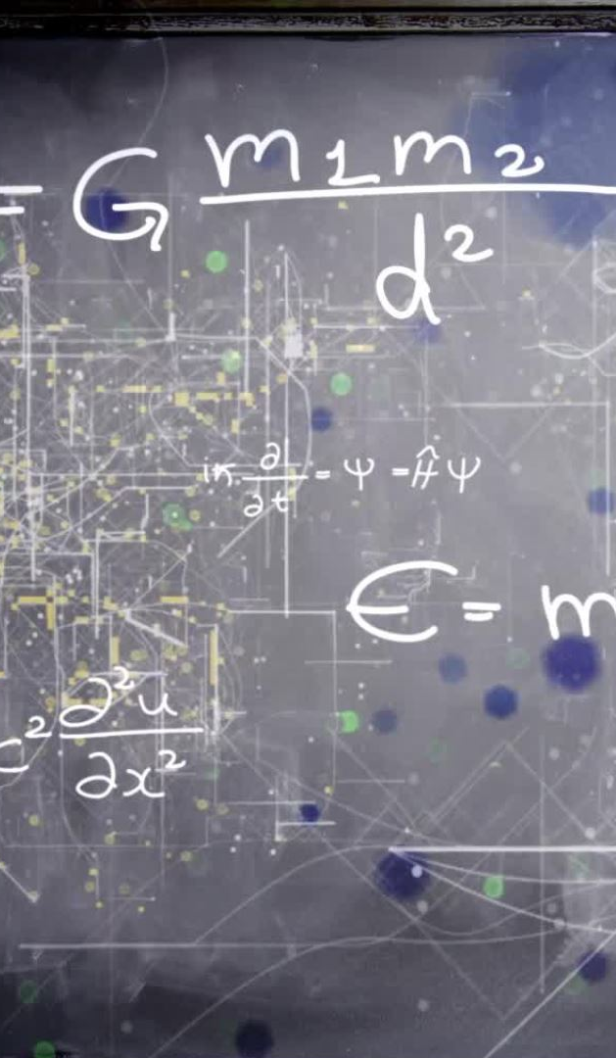
Why Quantum Computers Matter?
Simulate quantum systems in physics and chemistry
Break or improve cryptographic systems
Optimize complex systems (logistics, finance, AI)
Accelerate machine learning and data analysis

Slide 3
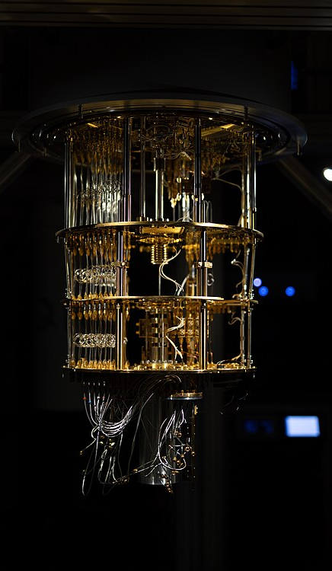
What is it?
Quantum computers use principles of quantum mechanics
Solve problems intractable for classical computers
Not just “faster” – they are fundamentally different
Instead, bits use Qubits

Slide 4

What is a Qubit?
Quantum bit A qubit is a basic unit of quantum information.
It can be in state 0, 1, or both at the same time (superposition).
This allows quantum computers to handle more data at once.
Enables parallel processing of many possibilities.
Qubits can also become entangled, linking their states.

Slide 5
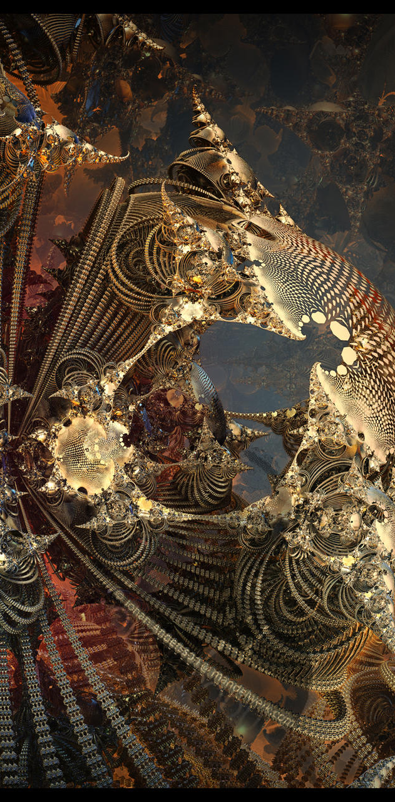
Quantum Superposition The Core of Quantum Computing
Superposition lets qubits be in multiple states at once. (10 qubits = 1,024 simultaneous states)
Two qubits can be in a superposition of all four classical states (00, 01, 10, 11)
Mathematically, the state of a qubit is represented as: ∣ψ⟩=α∣0⟩+β∣1⟩ ψ - wavefunction α, β = Complex numbers (where |α|² + |β|² = 1).
|α|² = Probability of measuring |0⟩.
|β|² = Probability of measuring |1⟩.

Slide 6
Quantum Decoherence
Key Points About Decoherence:
Cause – Any interaction with the external environment ,
Effect – Qubits behave like classical bits,
Decoherence Time – The duration a qubit maintains its quantum state
Countermeasures:
Extreme cooling,
Quantum error correction,
Isolation techniques

Slide 7
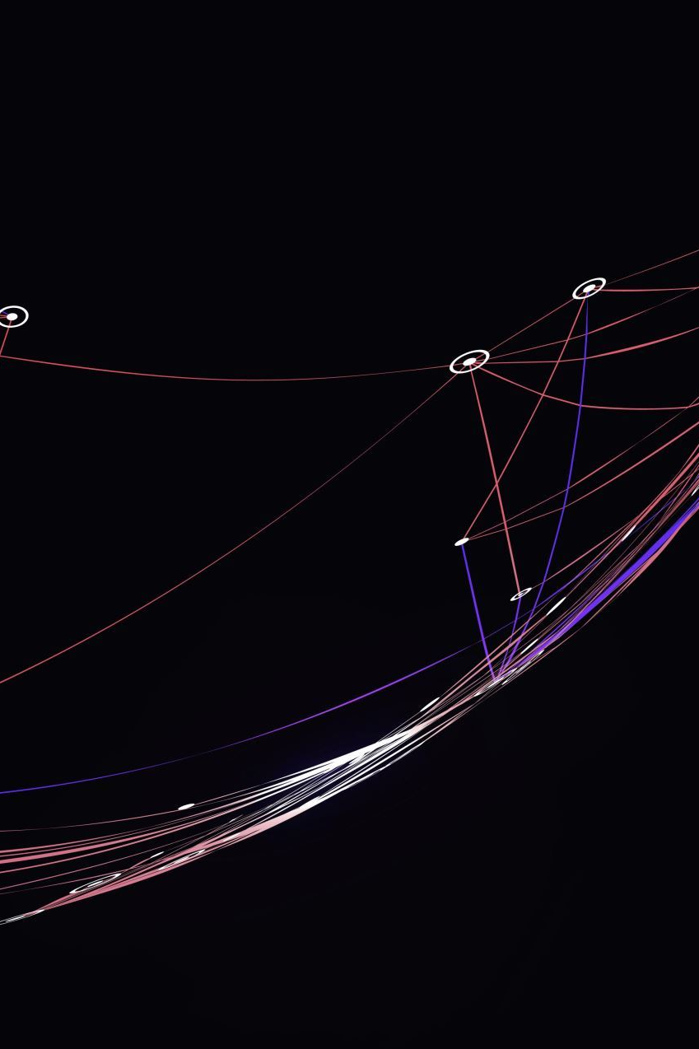
Entanglement – Quantum Link
Quantum entanglement is situation where two or more qubits become so deeply connected that their states cannot be described independently.
Changing one qubit affects the other instantly.
This enables fast, powerful information transfer.

Slide 8
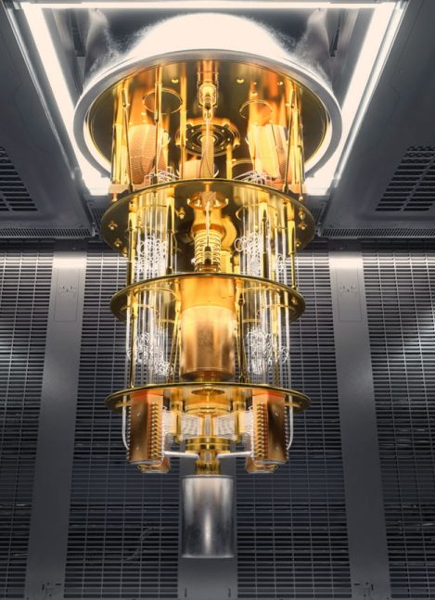
Technical Challenges
Quantum computers are very fragile and sensitive to environmental disturbances.
Qubits tend to lose their quantum state (decohere) in microseconds, making it hard to perform long calculations.
Need for ultra-cold temperatures To stay stable, qubits must operate at temperatures close to absolute zero (near -273°C).
Stability is a major hurdle Maintaining coherence over time is one of the biggest technical challenges in building scalable quantum computers.

Slide 9
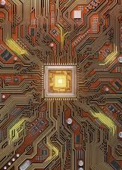
The Future of Quantum Computing
Quantum computing is still in development
Massive investment by tech giants and researchers
Potential to change the world

Slide 10
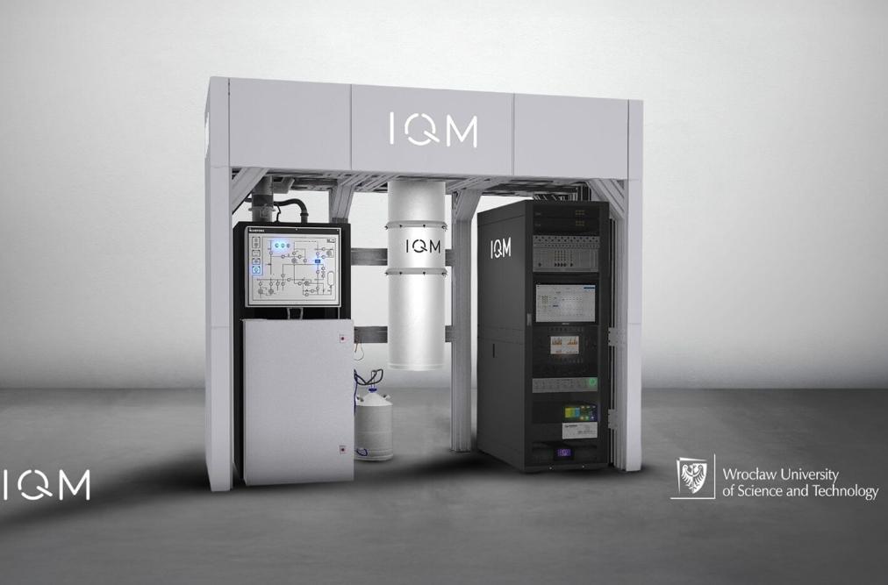
Quantum Leap in Poland – Wrocław’s Big Step
In 2024, Wrocław University of Science and Technology acquired a quantum computer. It is the first quantum computer in this part of Europe. The system is used for education, research, and software testing.

Slide 11
Vocabulary – Key IT Terms
Qubit, Superposition, Entanglement, Algorithm, Processor, Encryption
Quantum supremacy, Error correction, Simulation, Network, AI
Shor’s algorithm, Quantum teleportation, Optimization, Data

