Slide 1

Data Science Salaries 2020-2024
Patrycja Całkowska Jakub Marciniak

Slide 2

Dataset
work_year: The year the salary was paid.
experience_level: The experience level in the job during the year
employment_type: The type of employment for the role
job_title: The role worked in during the year.
salary: The total gross salary amount paid.
salary_currency: The currency of the salary paid as an ISO 4217 currency code.
salaryinusd: The salary in USD
employee_residence: Employee's primary country of residence in during the work year as an ISO 3166 country code.
remote_ratio: The overall amount of work done remotely
company_location: The country of the employer's main office or contracting branch
company_size: The median number of people that worked for the company during the year
Source: https://ai-jobs.net/salaries/download/

Slide 3

Factors
experience_level:
EN - Entry-level / Junior;
MI - Mid-level / Intermediate;
SE - Senior-level / Expert;
EX - Executive-level / Director
employment_type:
PT - Part-time
FT - Full-time
CT - Contract
FL - Freelance
remote_ratio:
0 - No remote work (less than 20%)
50 - Partially remote/hybrid
100 - Fully remote (more than 80%)
company_size:
S - less than 50 employees (small)
M - 50 to 250 employees (medium)
L - more than 250 employees (large)

Slide 4

Job titles - groups
DATA SCIENCE AND AI/ML ROLES
ANALYTICS AND BI ROLES
BIG DATA AND CLOUD ROLES
DATA MANAGEMENT AND OPERATIONS ROLES
DATA QUALITY AND ARCHITECTURAL ROLES
VISUALIZATION, MANAGEMENT, AND SPECIALIZED ROLES

Slide 5

Interactivity
Dropdown box
Checkboxes
Map markers

Slide 6

Dashboard overview

Slide 7
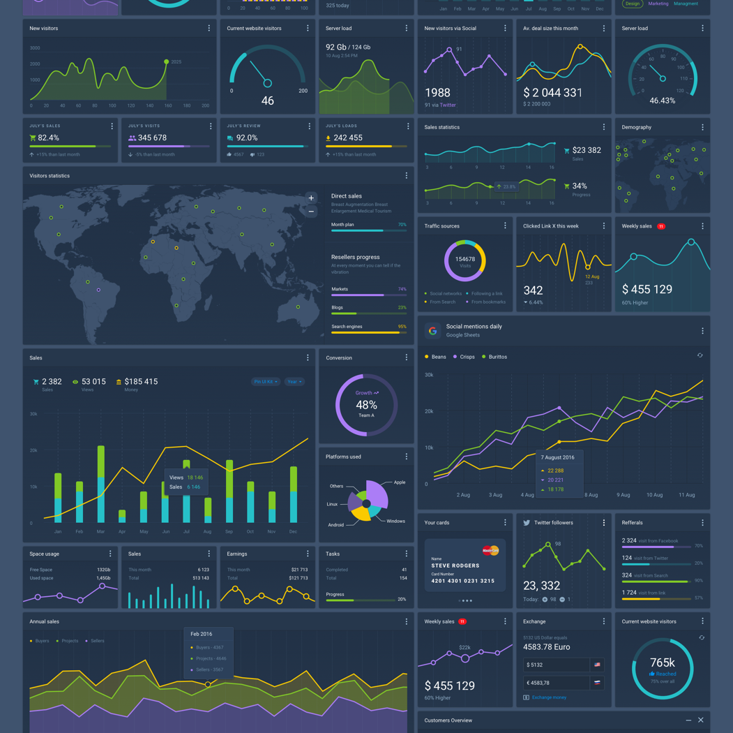
Custom styling

Slide 8
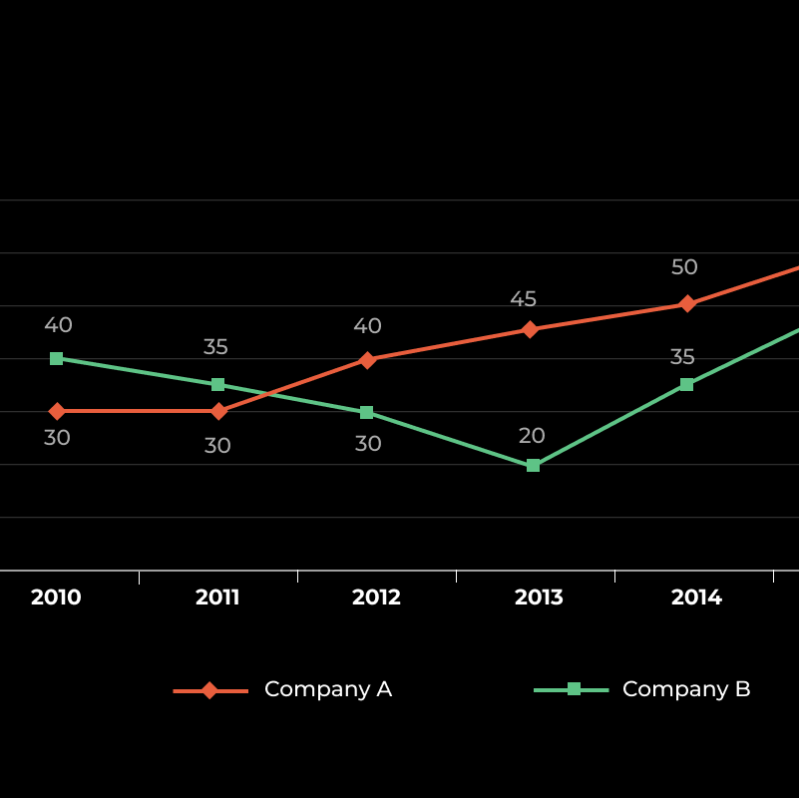
Libraries Used
shiny
shinydashboard
bslib
ggplot2
leaflet
shinythemes
DT
KableExtra
DescTools::d.countries

Slide 9

Insights from Visualizations

