Slide 1

Data Science Salaries 2020-2024
Patrycja Całkowska Jakub Marciniak

Slide 2

Dataset
work_year: The year the salary was paid.
experience_level: The experience level in the job during the year
employment_type: The type of employment for the role
job_title: The role worked in during the year.
salary: The total gross salary amount paid.
salary_currency: The currency of the salary paid as an ISO 4217 currency code.
salaryinusd: The salary in USD
employee_residence: Employee's primary country of residence in during the work year as an ISO 3166 country code.
remote_ratio: The overall amount of work done remotely
company_location: The country of the employer's main office or contracting branch
company_size: The median number of people that worked for the company during the year
Source: https://ai-jobs.net/salaries/download/

Slide 3

Factors
experience_level:
EN - Entry-level / Junior;
MI - Mid-level / Intermediate;
SE - Senior-level / Expert;
EX - Executive-level / Director
employment_type:
PT - Part-time
FT - Full-time
CT - Contract
FL - Freelance
remote_ratio:
0 - No remote work (less than 20%)
50 - Partially remote/hybrid
100 - Fully remote (more than 80%)
company_size:
S - less than 50 employees (small)
M - 50 to 250 employees (medium)
L - more than 250 employees (large)

Slide 4

Job titles - groups
DATA SCIENCE AND AI/ML ROLES
ANALYTICS AND BI ROLES
BIG DATA AND CLOUD ROLES
DATA MANAGEMENT AND OPERATIONS ROLES
DATA QUALITY AND ARCHITECTURAL ROLES
VISUALIZATION, MANAGEMENT, AND SPECIALIZED ROLES

Slide 5

Data Analysis
Salary Analysis: the distribution of salaries across different experience levels, job titles, and employment types.
Geographical Analysis: distribution of employees and companies across different countries; correlation between the employee's residence and the company's location.
Remote Work Analysis: remote work ratio and its variations based on experience level, job title, and company size; is there a relationship between remote work and salary.
Company Characteristics: the median company size and its impact on salaries; whether company size influences the type of employment or remote work policies.

Slide 6

Data visualisation

Slide 7
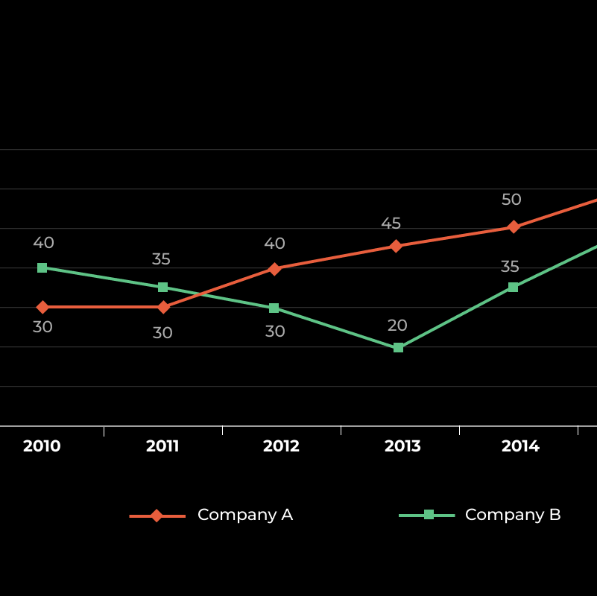
Line plot
showing overall trends or progress
Interactive with dropdown menu(fields) showing mean salary of the field over the course of years

Slide 8
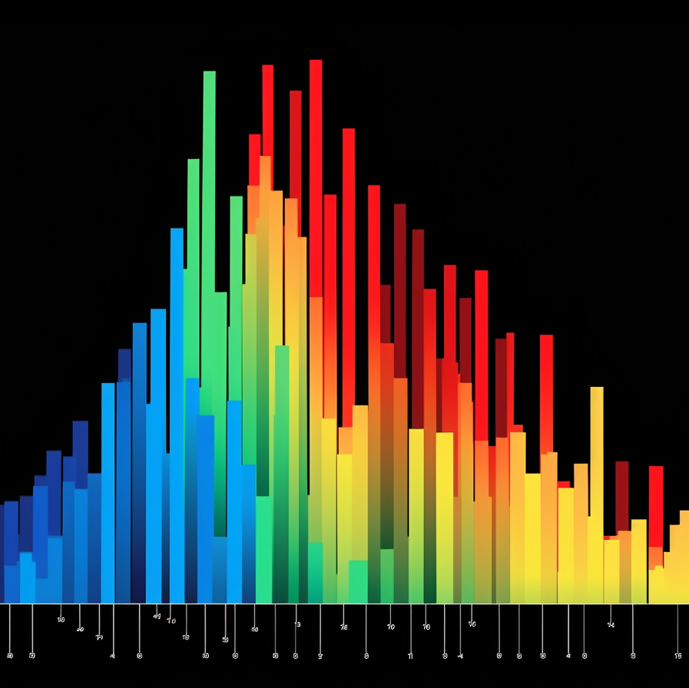
Histogram
the numbers are grouped into ranges
different heights correspond to the frequency of each group
Showing number of employees falling into different salary groups
??interactive option: dropdown menu – company_location/employee_residence??

Slide 9
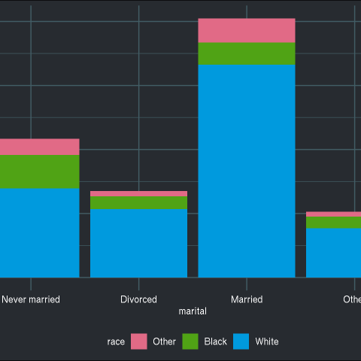
Bar plot

Slide 10
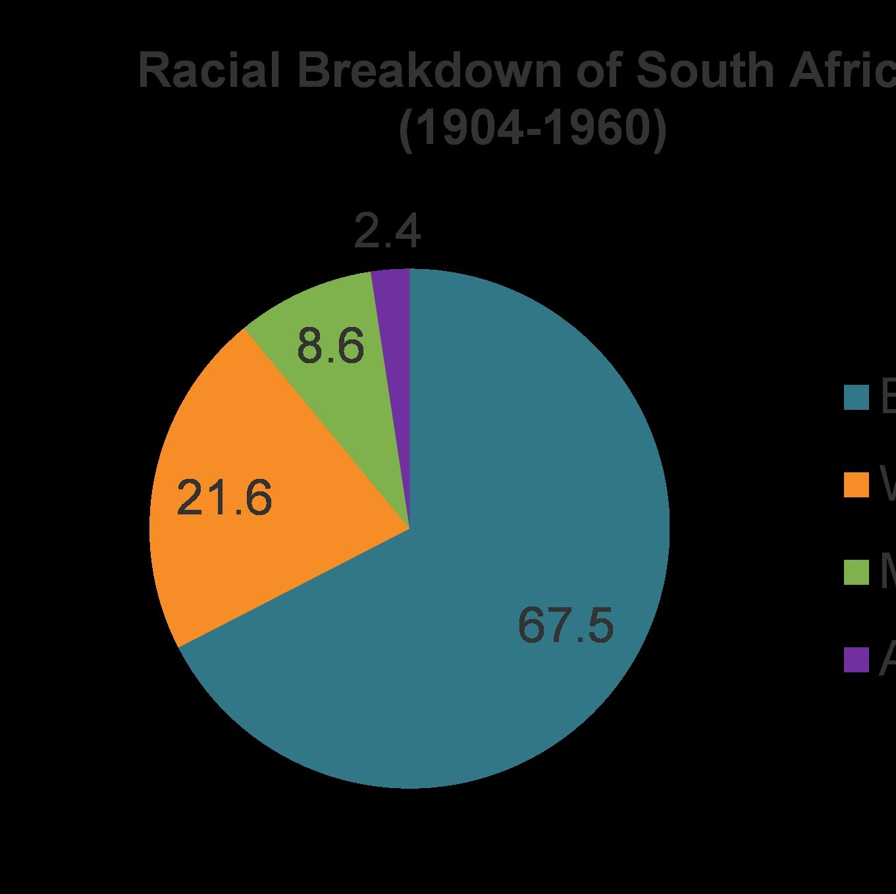
Pie chart
Showing remote-ratio by continent(dropdown menu)

Slide 11
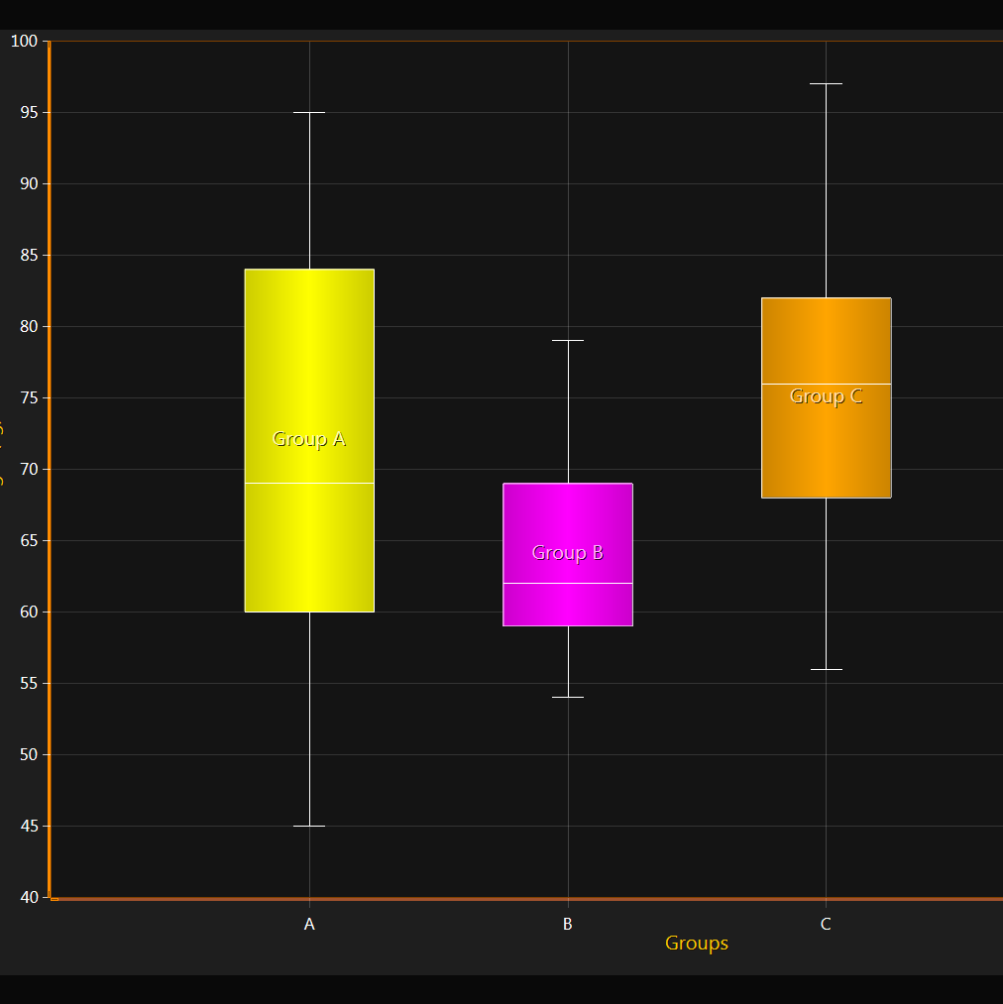
Box plot
Salary distribution by company size

Slide 12

Interactive map
PROVIDES STATS BASED ON:
EMPLOYEE RESIDENCE
COMPANY LOCATION

Slide 13
Licznik/suwak?
Postac z szerokiej na dluga pozwala na robienie wykresow obok siebie jednocześnie pivot(tidyr) facet

Slide 14
