Slide 1
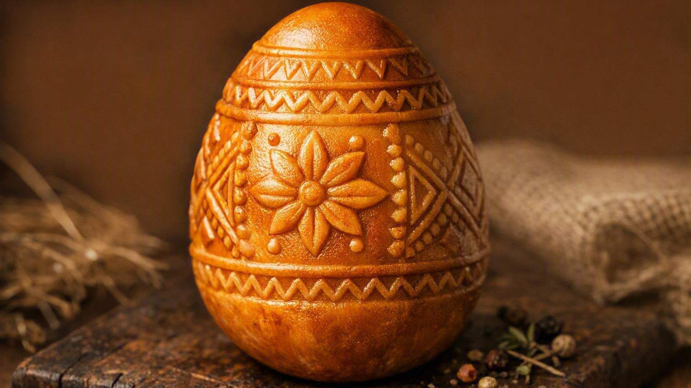
A TASTE OF THE CARPATHIANS
Oštiepok
The smoked mountain cheese of Slovakia — from shepherd's hut to hand-carved wooden mould

Slide 2
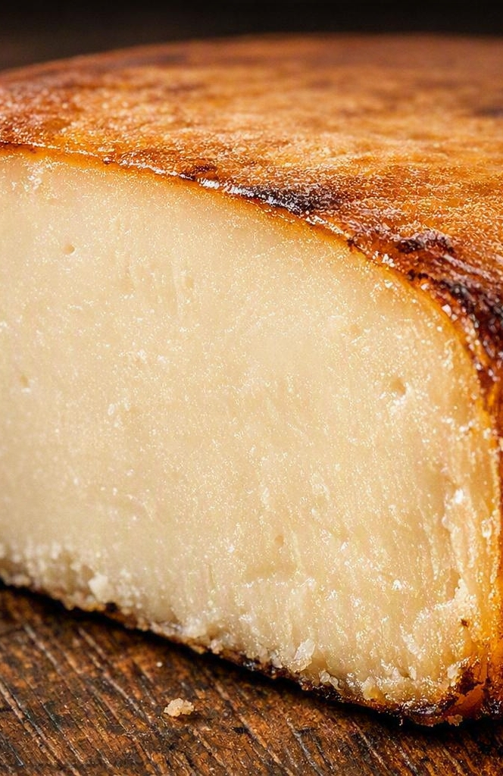
INTRODUCTION
What exactly is oštiepok?
A semi-hard, half-fat cheese from the mountains of Slovakia, usually sold smoked
Made from sheep's milk, cow's milk, or a blend of the two
Shaped like a large egg, a pine cone or an ellipsoid, pressed with folk ornaments
Golden-yellow to golden-brown outside once smoked; white to buttery-yellow inside
Protected across the EU since 2008 under the name Slovenský oštiepok

Slide 3
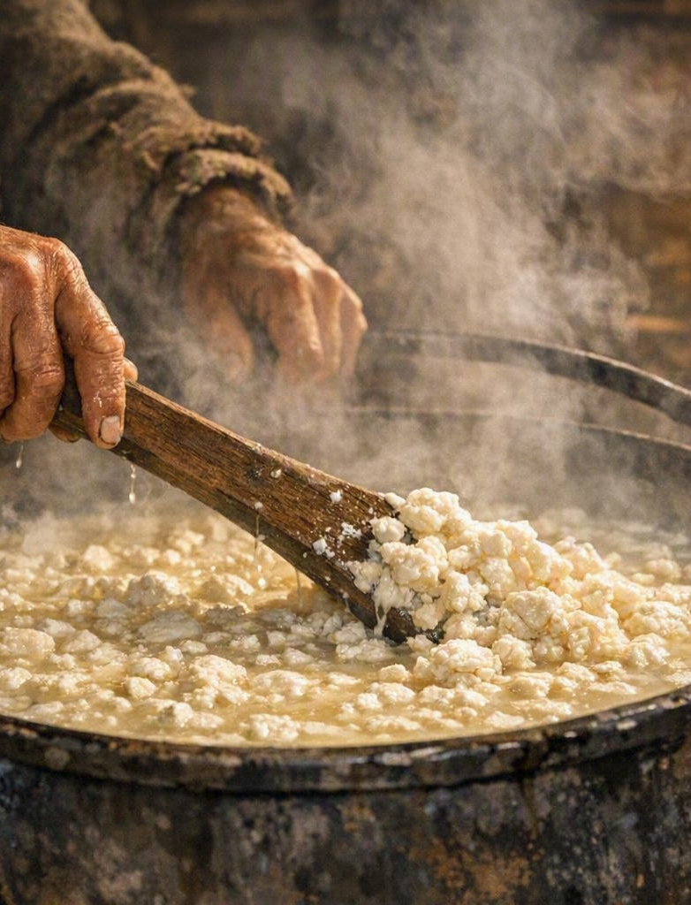
HISTORY
Born on the mountain pastures
Wallachian shepherds brought sheep herding along the Carpathian arc; the salaš — a small mountain sheep farm — became the heart of the craft
Family records and written documents place oštiepok production as early as the beginning of the 18th century
The firm, smoked cheese kept for weeks and travelled well with the flocks
Cow's milk production on an industrial scale began with the Galbavý family in Detva, 1921

Slide 4
PRODUCTION
From milk to smoke in six steps
01
02
03
Milking
Curdling
Ripening
Fresh sheep's or cow's milk is processed right after milking
Rennet sets the milk; the curd is cut and the whey drained
The curd rests and acidifies until it stretches properly
04
05
06
Steaming
Moulding
Brine & smoke
Hot water makes the curd elastic and silky — the pareny step
Pressed into carved wooden forms that emboss the pattern
A salt bath, drying, then cold smoke over wood

Slide 5
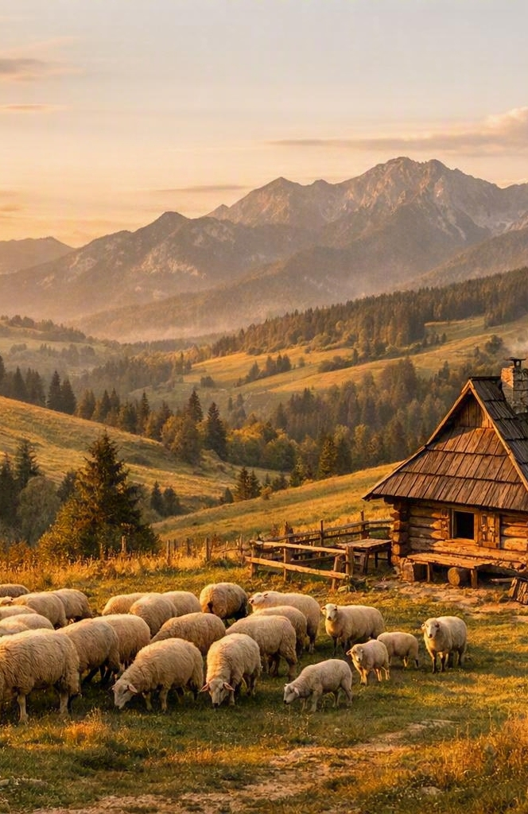
STEP 1–3
In the shepherd's hut
The bača — the senior shepherd chosen by the village — runs the salaš and makes the cheese, helped by young valasi
Milk is curdled immediately after milking, with no pasteurisation in the traditional on-farm method
The curd is stirred, gathered by hand and pressed to expel the whey
The leftover whey becomes žinčica, the shepherds' traditional drink

Slide 6
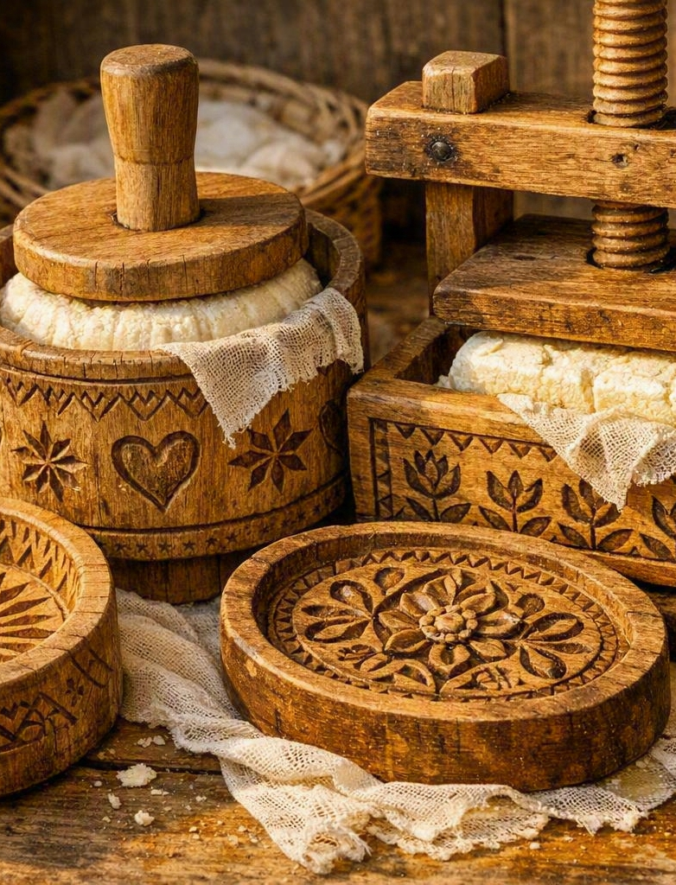
STEP 4–5
The carved wooden mould
The warm, elastic curd is packed into two-part wooden forms and pressed shut
The inside of each form is hand-carved, so the finished cheese carries a raised folk ornament
Patterns differ from region to region — the decoration is effectively the maker's signature
A finished piece typically weighs between roughly half a kilo and a kilo

Slide 7
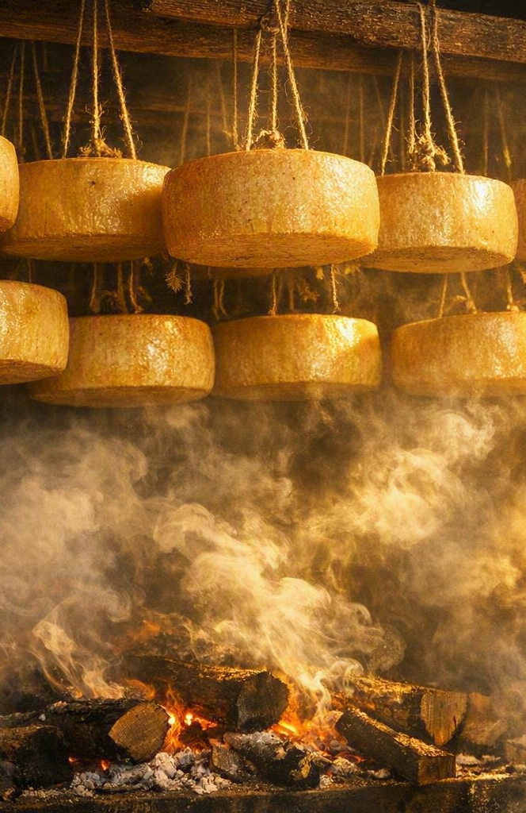
STEP 6
Brine, dry, smoke
The moulded cheese rests in a salt brine, which seasons it and firms the rind
After drying, it hangs in the smokehouse over smouldering wood
Cold smoke turns the rind golden to deep brown and lends the aroma everyone recognises
Unsmoked oštiepok also exists — paler, milkier and gentler in flavour
Longer ageing gives a firmer body and a sharper, saltier bite

Slide 8
PROTECTED ORIGIN
Slovenský oštiepok, PGI
Registered as a Protected Geographical Indication with the EU on 26 September 2008. The specification covers more than 80% of Slovak territory and admits both on-farm and dairy production.
MILK
Sheep's milk, a sheep–cow blend, or cow's milk
BREEDS
Valaška, Improved Valaška and Cigája sheep
FAT
At least 38% fat in dry matter
SHAPE
Large egg, pine cone or decorated ellipsoid
RIND
Golden-yellow to golden-brown after smoking
MAKING
Traditional salaš method or industrial dairy

Slide 9
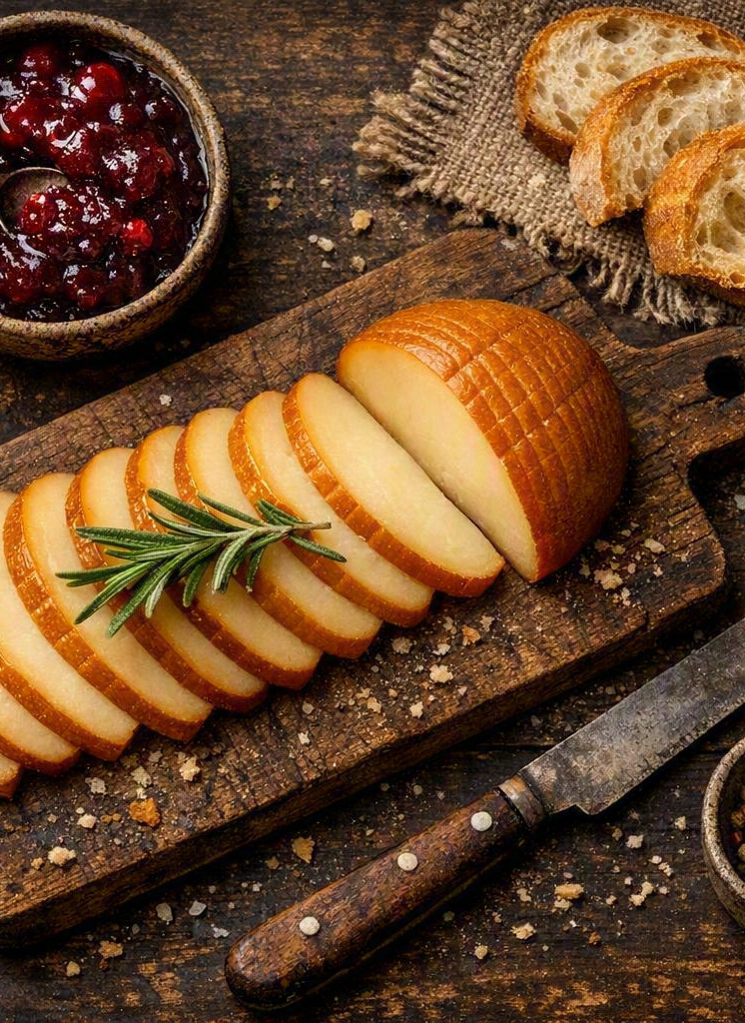
SENSORY PROFILE
How it tastes
Savoury and moderately salty, with a mild to gently piquant, slightly sour edge
A clear woodsmoke aroma when smoked; pure, milky sweetness when not
Firm and slightly elastic — it slices cleanly, with small cracks and few holes
Sheep's milk versions are richer and creamier than the cow's milk ones
Pairs beautifully with cranberry or plum sauce, dark bread and a dry white wine

Slide 10
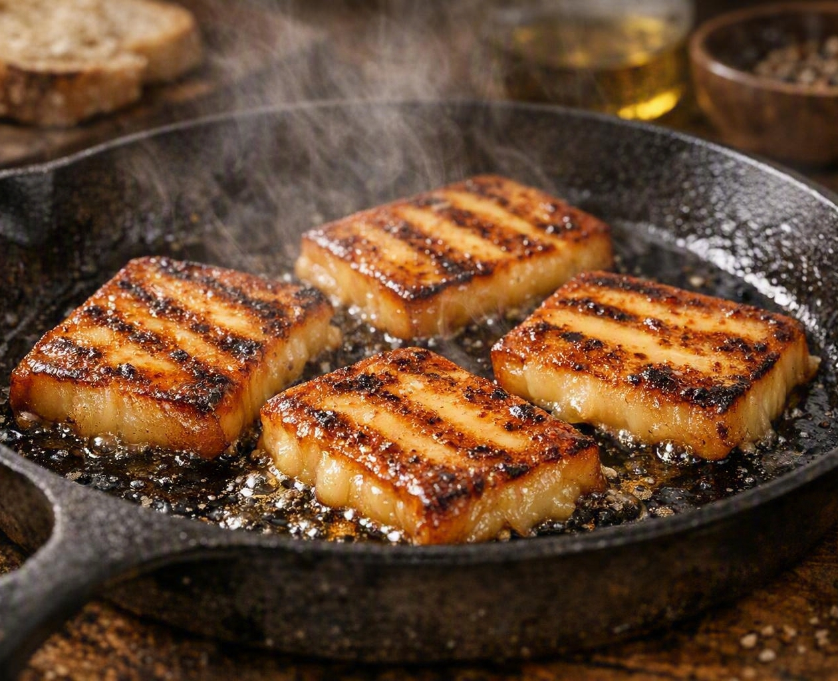
IN THE KITCHEN
Ways to enjoy it
Grilled or pan-fried
Cut thick slices and cook 2–3 minutes per side until a golden crust forms and the centre turns soft.
On a cheese board
Serve at room temperature with cured meats, walnuts, honey and rye bread.
Cooked into dishes
Grated over potato dishes, folded into dumplings, or melted onto soups and pasta.

Slide 11
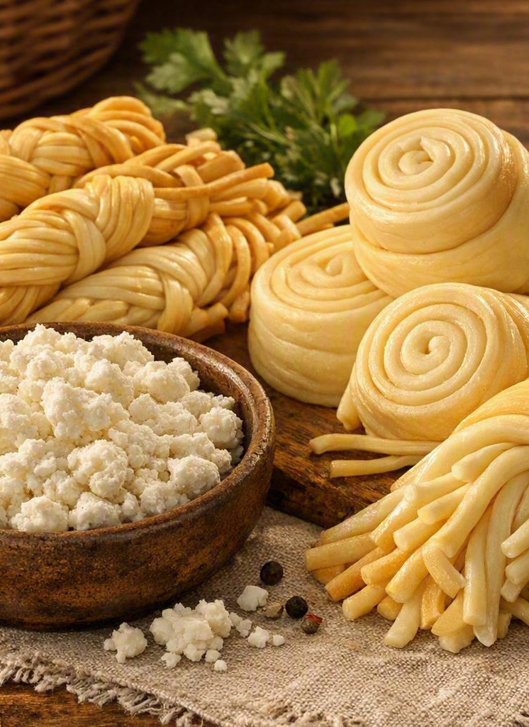
RELATED CHEESES
The Slovak cheese family
Bryndza — soft, tangy and spreadable sheep's cheese, the soul of bryndzové halušky
Parenica — steamed sheep's milk cheese rolled into a spiral, smoked or plain
Korbáčik — hand-stretched strands braided like a little whip, from Orava and Zázrivá
Oscypek — the closely related Polish cousin from the Tatras, made to a different recipe and ratio

Slide 12
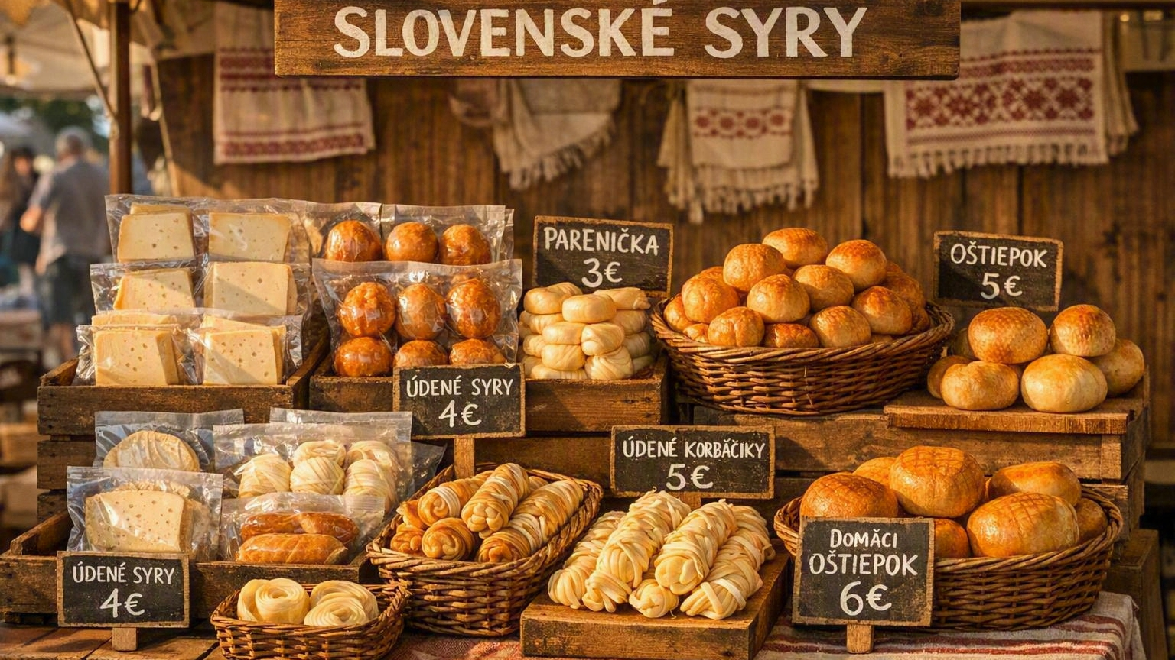
WHERE TO FIND IT
Taste it at the source
Mountain salaše in Liptov, Orava and Zázrivá sell hand-made cheese straight from the hut
Farmers' markets and farm shops carry fresh pieces by the piece
Supermarkets stock vacuum-packed smoked cheese, often boxed with cranberry sauce
Check the label for the milk used and look for the Slovenský oštiepok PGI mark

