Slide 1
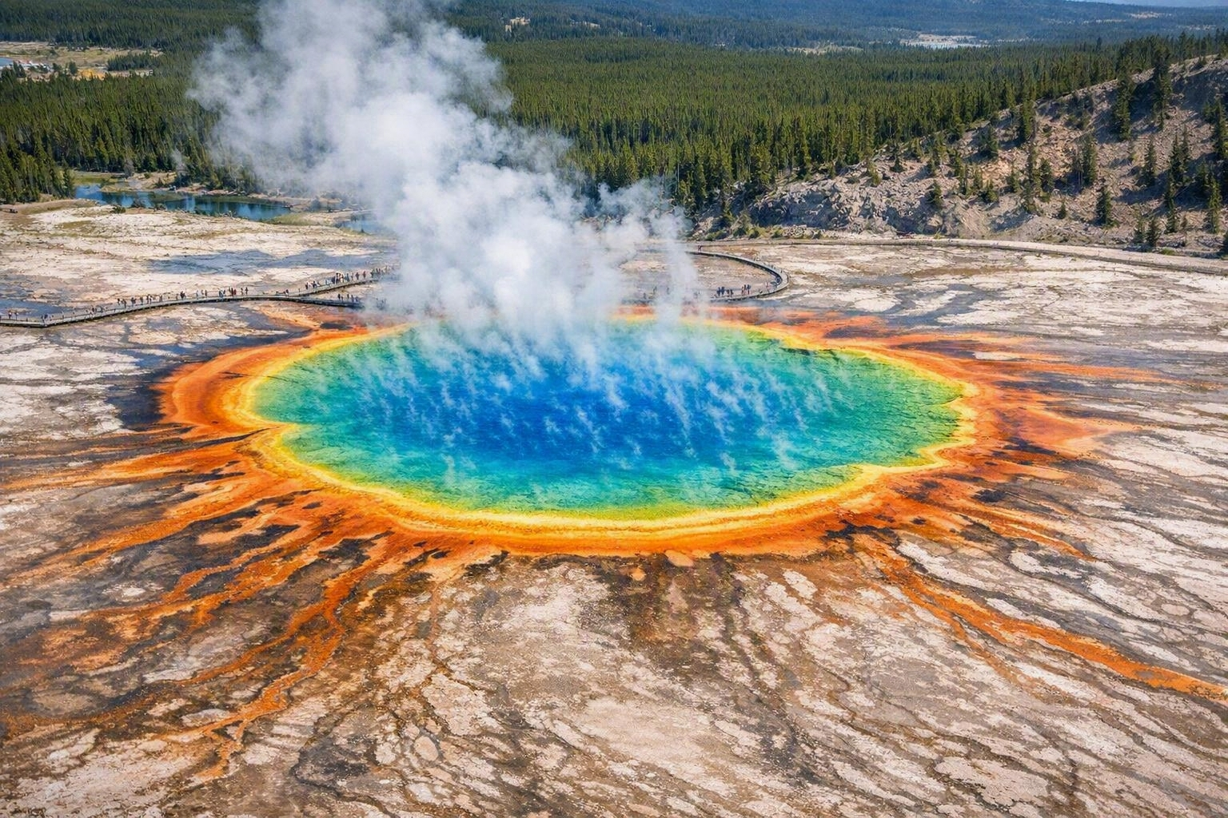
Yellowstone
National Park
A VISITOR'S GUIDE
The world's first national park — geysers, wildlife, and wilderness across 3,472 square miles of the American Rockies.
Established 1872 · Wyoming · Montana · Idaho

Slide 2
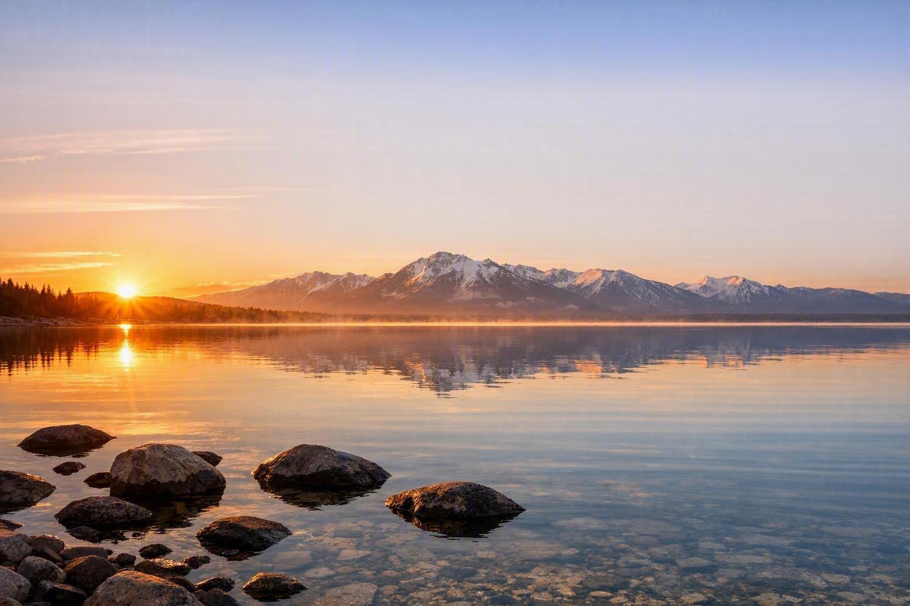
A Park Like No Other
Yellowstone sits on top of one of the largest active volcanic systems on Earth. That restless heat below ground is what gives the park its geysers, hot springs, and steaming terraces — and the surrounding wilderness shelters one of the last intact temperate ecosystems in the northern hemisphere.
1872
8,991
~10,000
Year founded — the
first national park
Square kilometres
of protected land
Thermal features,
half the world's total

Slide 3
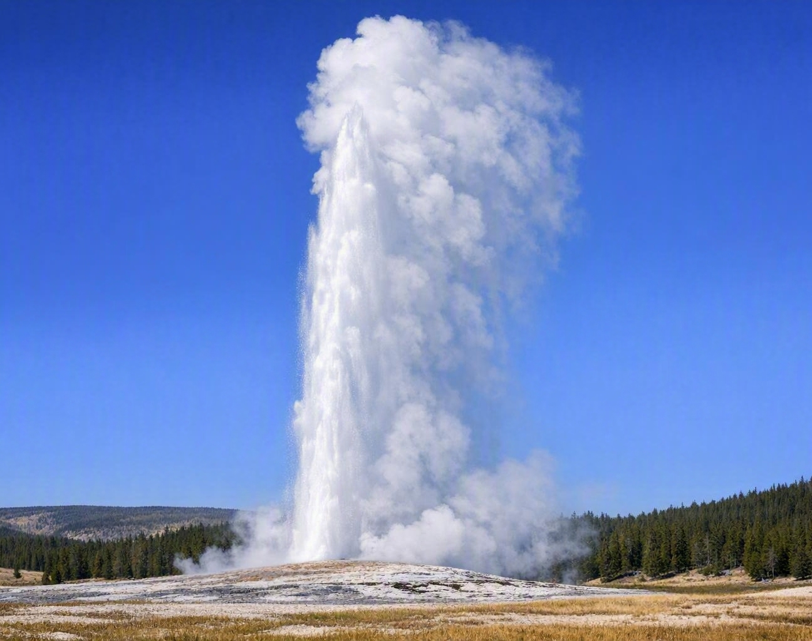
Geysers & Hot Springs
Old Faithful
Erupts roughly every 90 minutes, sending water 30–55 metres into the air.
The park protects about half of all active geysers on the planet.
Grand Prismatic Spring's rainbow rings come from heat-loving bacteria.
Boardwalks keep visitors safe — the ground crust is thin and water can exceed 90 °C.
Predictable, but never identical — no two eruptions look the same.

Slide 4
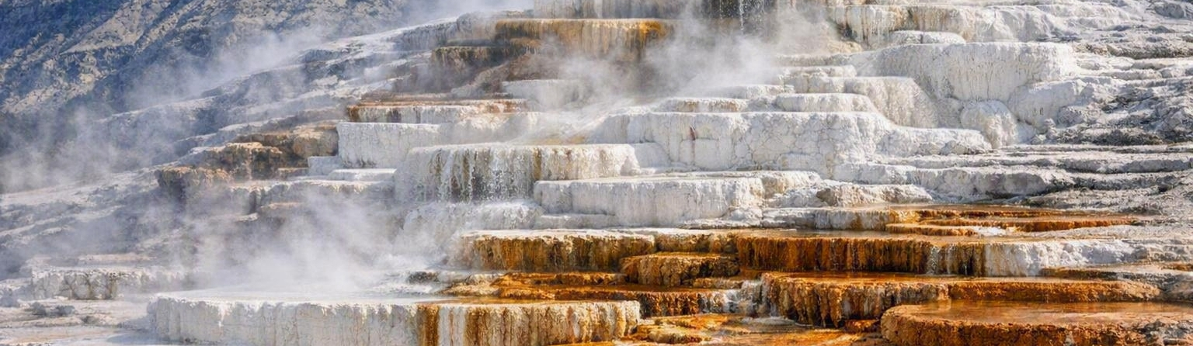
Colours of the Earth
Mammoth Hot Springs
Grand Prismatic
Norris Basin
Hot water carries dissolved limestone to the surface, building terraces that shift shape year after year.
The largest hot spring in the United States, ringed in orange, gold, and deep blue by microbial mats.
The hottest and most changeable thermal area in the park, with acidic springs and roaring steam vents.

Slide 5
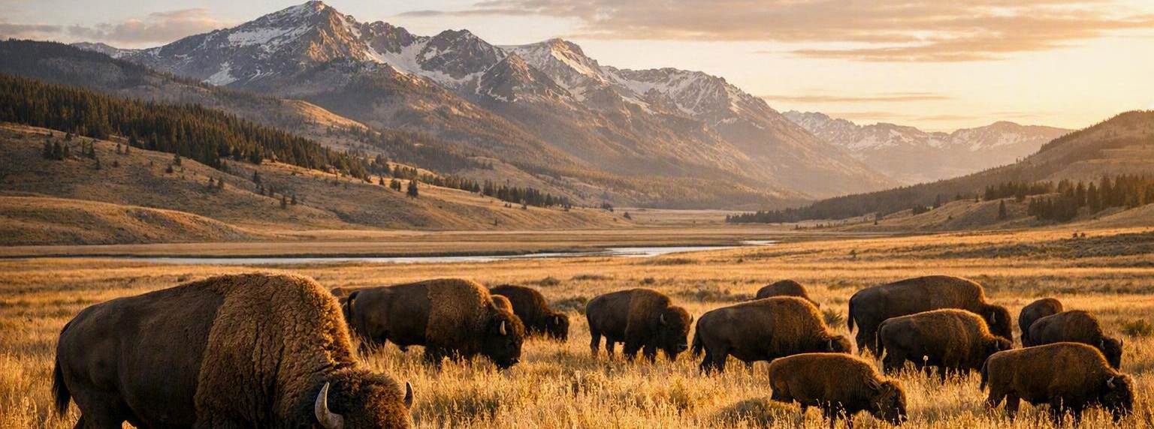
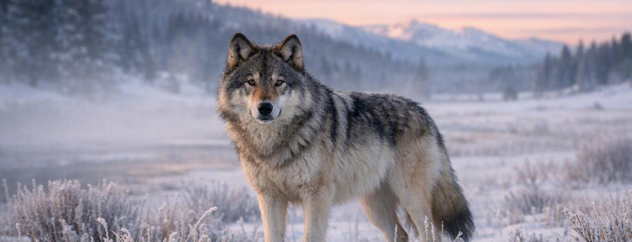
Wildlife of the Valleys
Yellowstone shelters the largest concentration of mammals in the lower 48 states — bison, elk, grizzly and black bears, wolves, pronghorn, and bighorn sheep.
~5,000
Wild bison — the oldest continuously free-ranging herd in the country
~100
Wolves, descended from animals reintroduced in 1995
~1,000
Grizzly bears across the Greater Yellowstone Ecosystem

Slide 6
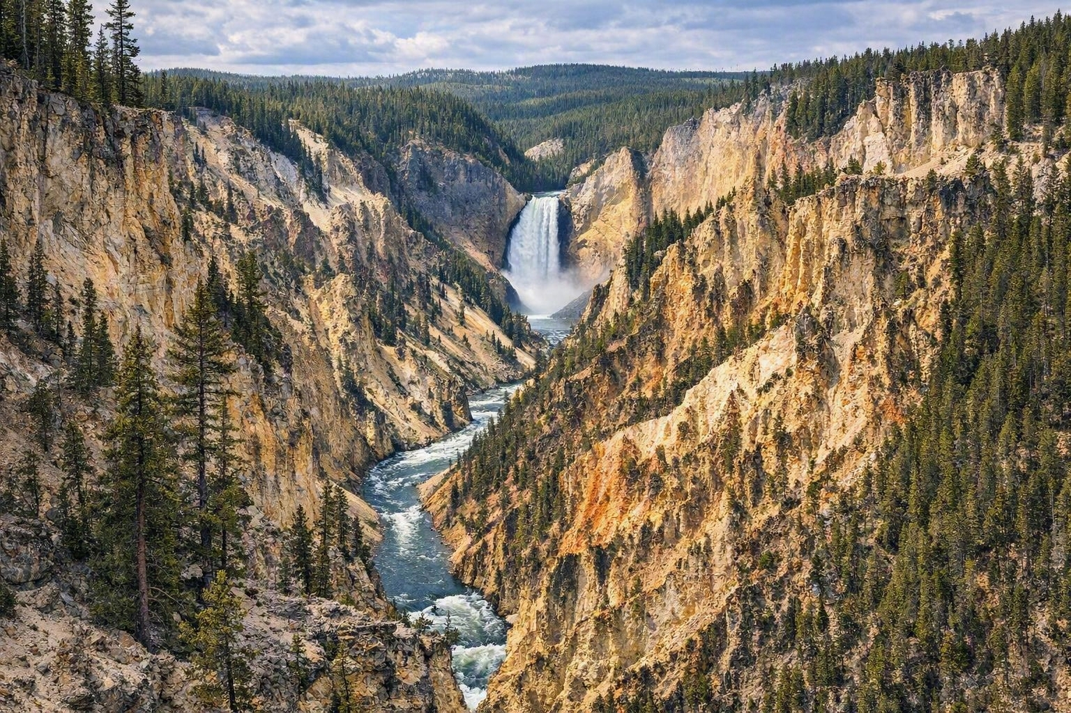
Canyons, Falls & Forests
The Grand Canyon of the Yellowstone
The Yellowstone River carved a canyon 32 kilometres long and up to 370 metres deep. Its walls glow yellow and rose — the result of hot water altering the volcanic rock.
Lower Falls drops 94 metres, nearly twice the height of Niagara, and is best seen from Artist Point at first light.

Slide 7
When to Visit
SPRING
SUMMER
AUTUMN
WINTER
Apr – May
Jun – Aug
Sep – Oct
Nov – Mar
Newborn bison calves, thundering waterfalls, and quiet roads. Some passes still closed by snow.
Every road and trail open, long warm days — and the busiest crowds of the year.
Golden aspens, the elk rut, crisp air and dramatically fewer visitors.
Snowcoach and ski access only. Steaming basins, frost-covered bison, deep silence.
Peak season runs July and August — book lodging inside the park six to twelve months ahead.

Slide 8
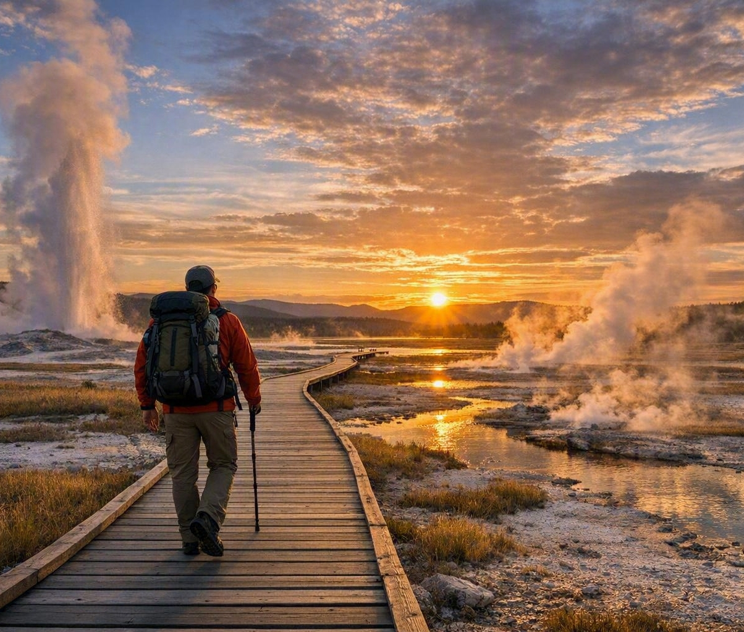
Visiting Responsibly
01
Keep your distance
Stay 25 metres from bison and elk, 100 metres from bears and wolves.
02
Stay on the boardwalks
Thermal crust is fragile and the water beneath it is scalding.
03
Start early
Wildlife is most active at dawn and dusk, and parking fills fast.
04
Pack for all weather
Snow is possible in any month at 2,400 metres of elevation.

Slide 9
Wild by Design
For the benefit and enjoyment of the people — the promise Yellowstone has kept since 1872.

