Slide 1
Multilingual subjectivity in News Articles
Group 15

Slide 2
Subjectivity Detection
What is the task about?
Tools to achieve it

Slide 3
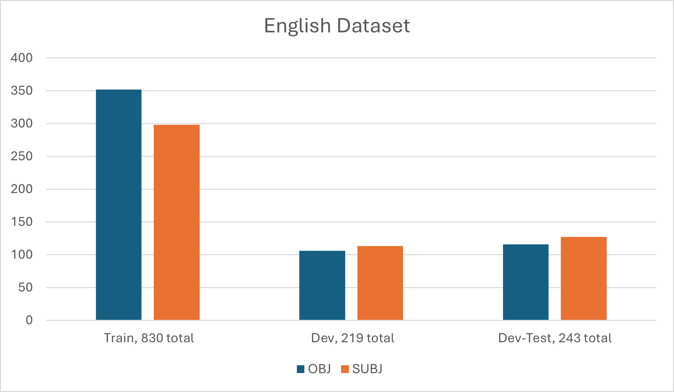
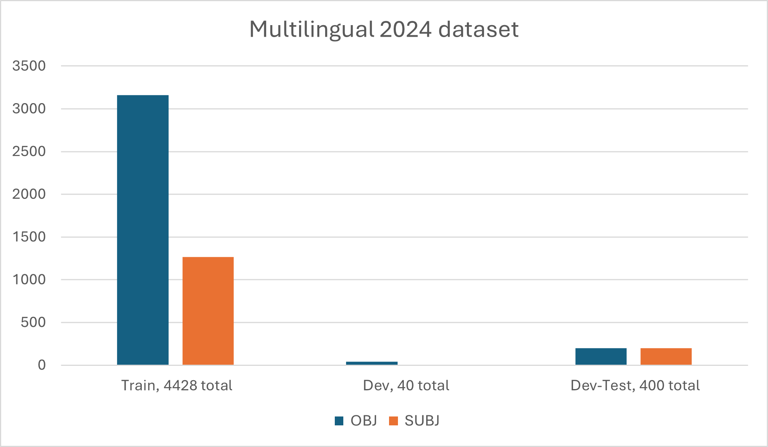
Datasets

Slide 4
Approach
Selecting values for parameterization
Training the model
Making predictions
Reevaluating

Slide 5
Experimentation
Parameterization
Epochs
Learning rate, drop rate

Slide 6
Technical limitations
Insufficient memory
Long training time

Slide 7
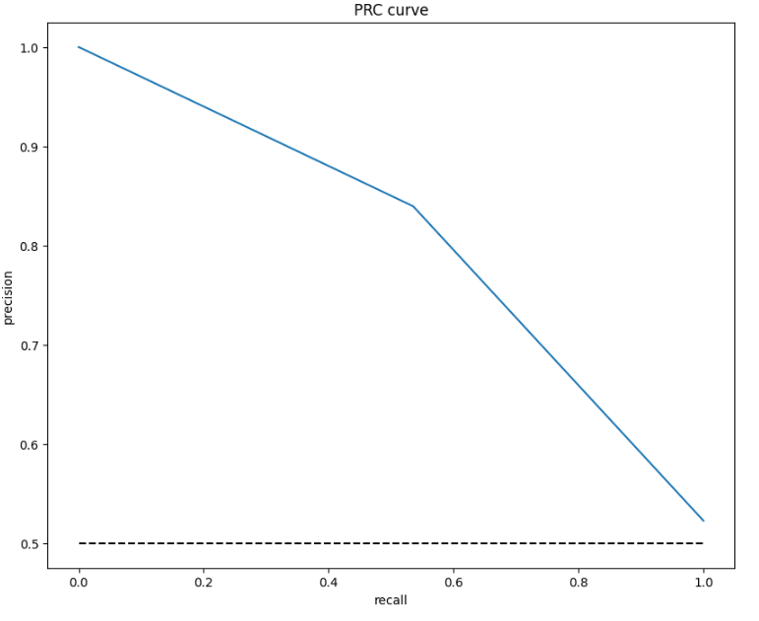
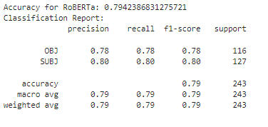
Results

