Slide 1
I’ve always loved computer vision counters — but endless code made them hard to use.
I needed a better way.

Slide 2

That is why I created an app everyone can use!
ComputerVision Counter — Count anything without coding (for images)

Slide 3
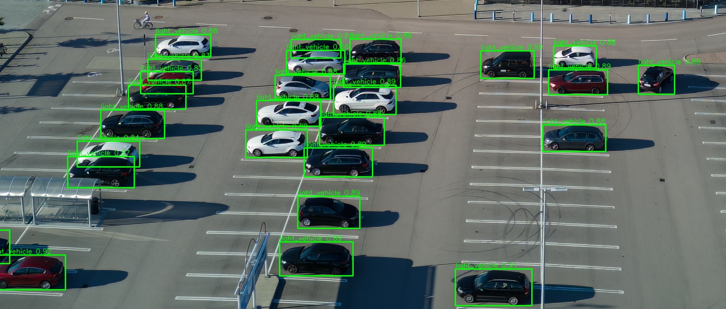
A STEP forward in computer vision
Using it in your workflow is a great STEP forward, because it’s…
S - safe – keep data offline, under your control
T - time saving – let the computer do the counting
E - easy – no coding, just a simple UI
P - portable – everything in one folder

Slide 4
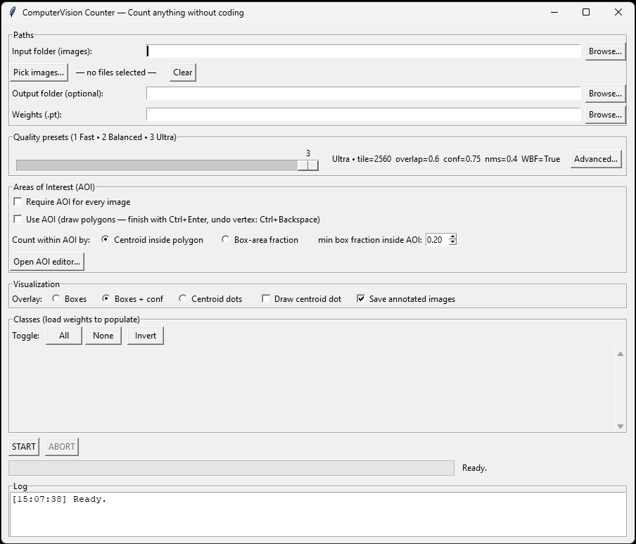
How it works ?
→ Add images → Select model & choose classes → Start
Your data + your model = fast detection, reliable object counts, zero programming.

Slide 5
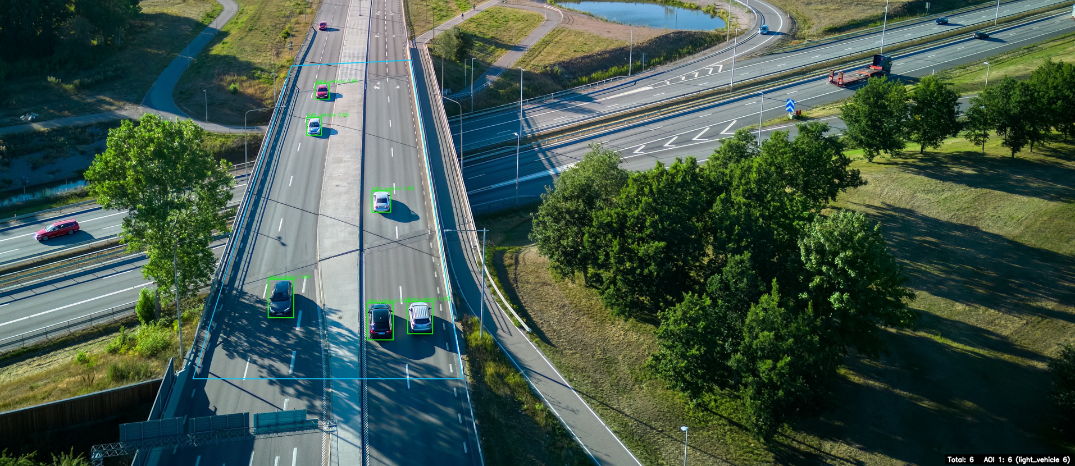
When to use it ?
Count cars in parking lots (e.g. drone images)
Count birds during migration
Detect objects in aerial images for GIS
Count objects inside defined zones (AOI)
Count (almost) anything with the right model

Slide 6
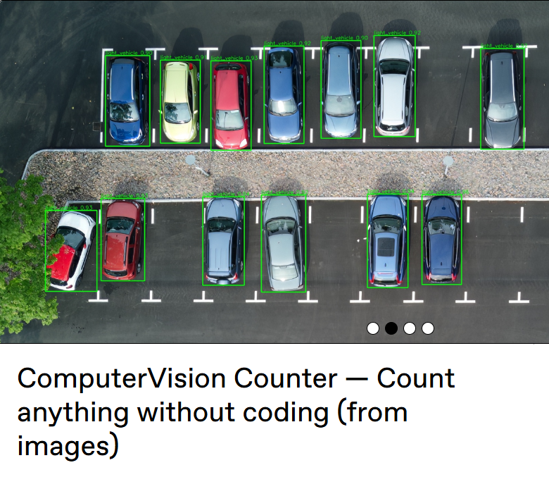

Where to get it?
Try it now on Gumroad: ComputerVision Counter — Count anything without coding (from images)
⚠️ Detection models are not included.

