Slide 1
Radio payload
Authors : Bc. Josef Vágner, Bc. Jakub Šmíd
Advisor: Ing. Ondřej Nentvich, Ph.D.
24.12.2023

Slide 2
Assignment
Develop a program for the Radio payload which can handle communication for the Cubesat.
Propose communication between Radio payload (nRF52832) and Ground station (PC in this case) in S-band.
The communication is based on CSP protocol.
Establish communication between radio part (nRF52832) and microcontroller which will handle communication with the rest of the CubeSat (STM32F413).
Develop a program (in Python) for ground station which will manage communication with the cubesat.
Selected MCUs are STM32F413 and nRF52832.

Slide 3
System architecture

Slide 4
Communication – BLE
TO-DO

Slide 5
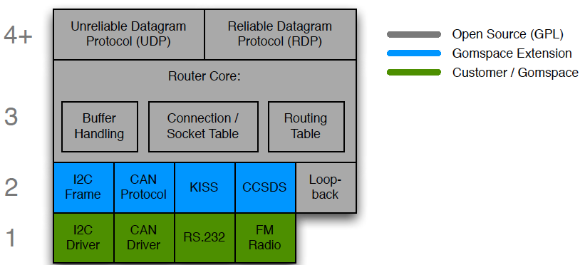
Cubesat Space Protocol
Based on a 32-bit header containing both network and transport layer information
Small – Great for embedded systems
Implemented in C (csplib)

Slide 6
Implementation problems
Poor documentation of csplib
Python bindings – GIL – Python can’t call functions from csplib
Missing BLE – Interface
GIL – Threads communicate through localhost ZeroMQ socket
We implemented new interface – basic
When data is received or ready to send the client script either sends received data to basic interface or csplib calls provided function for transmit.
Implementation problems – solutions

Slide 7
Current state
Both devices receive packet, but the csplib don’t response to message – internal library error

Slide 8
Děkuji za pozornost

