Slide 1
5 Radio payload
Authors : Bc. Josef Vágner, Bc. Jakub Šmíd
Advisor: Ing. Ondřej Nentvich, Ph.D.
24.12.2023

Slide 2
Assignment
Develop a program for the Radio payload which can handle communication for the Cubesat.
Propose communication between Radio payload (nRF52832) and Ground station (PC in this case) in S-band.
The communication is based on CSP protocol.
Establish communication between radio part (nRF52832) and microcontroller which will handle communication with the rest of the CubeSat (STM32F413).
Develop a program (in Python) for ground station which will manage communication with the cubesat.
Selected MCUs are STM32F413 and nRF52832.

Slide 3
System architecture

Slide 4
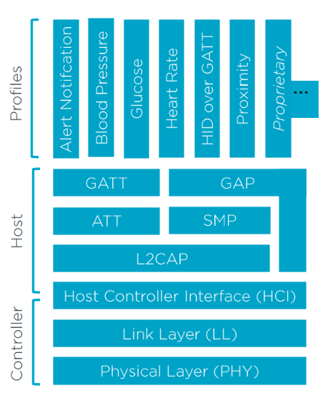
Communication – BLE
We are using nRF Connect SDK which runs on top of RTOS called Zephyr.
On the Ground Stations is used Bleak.
Advertising, binding
Nordic UART Service
Max. 20 byte payload
Tx function, callback for Rx

Slide 5
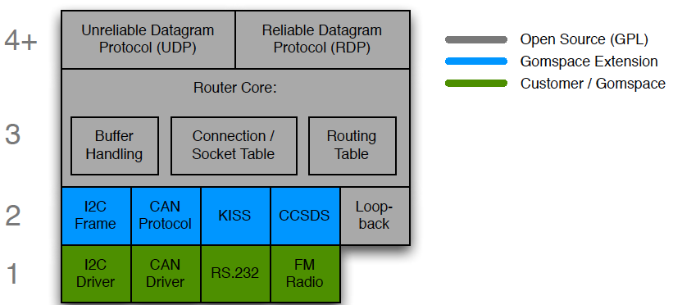
Cubesat Space Protocol
Based on a 32-bit header containing both network and transport layer information
Small – Great for embedded systems
Implemented in C (csplib)

Slide 6
Implementation problems
Poor documentation of csplib
Python bindings – GIL – Python can’t call functions from csplib
Missing BLE – Interface
GIL – Threads communicate through localhost ZeroMQ socket
We implemented new interface – basic
When data is received or ready to send the client script either sends received data to basic interface or csplib calls provided function for transmit.
Implementation problems – solutions

Slide 7
Current state
Both devices receive packet, but the csplib don’t response to message

Slide 8
Thank you for your attention
5 Radio payload

