Slide 1


Slide 2

Integrating AI into Software Project Development Courses
Shibbir Ahmed
Assistant Professor
Department of Computer Science
Texas State University
shibbir@txstate.edu
NAIRR Expansion Conference | Research Emerging, Large
Orlando, Florida | June 19, 2026

Slide 3
Why Integrate AI into a Project Course?
!
✓
The Problem
This Approach
Students reach for AI tools the moment they start coding.
Taught separately, AI feels disconnected from real engineering work.
They miss the fundamentals: iteration, testing, teamwork, judgment.
Teach the fundamentals first, without AI.
Then bring AI into the same project they already understand.
Compare both, so students see where AI helps and where judgment matters.
Responsible AI use, taught inside an existing course, not bolted on as a separate topic.

Slide 4
The Course: Software Project Development
50+
☰
↺
Students
Team Projects
Agile + XP + TDD
CS 4398 / 5394, undergraduate and graduate sections.
Real features built in teams across the semester.
User stories, iteration, tests first, continuous improvement.
A project-based course where AI fits naturally into work students already do.

Slide 5
Two Phases
First the discipline. Then the AI.
1
2
Traditional XP + TDD
AI-Assisted Development

Slide 6
Phase 1: Traditional Software Engineering First
What they do: Build real features in teams using Agile, XP, and TDD, with no instruction to use AI.
User stories
Break work into small, testable pieces.
Tests first
Write a failing test, then the code to pass it.
✓
✓
Iteration
Small increments, refactor, repeat.
Teamwork
Shared ownership, code review, continuous improvement.
✓
✓
Why first? Students internalize why these practices matter before AI can paper over the gaps. They feel the cost of skipping tests or unclear stories, firsthand.

Slide 7
Phase 2: AI-Assisted Development
What changes: Same project, same stories, now supported by an AI IDE (Cursor, Copilot, Claude Code).
Story
analyze
Tests
write failing
Code
make pass
Refactor
keep green
AI drafts story analysis, design diagrams, tests, and code. Students keep the TDD loop in control.
Example prompt
“Write the smallest failing tests for AuthService: valid signup, invalid email, short password, duplicate email. Do not implement production code yet.”

Slide 8
Inside One Class Session: Demo, Build, Reflect
1
2
3
Live demo
In-class build
Same-day survey
Instructor traces the signup story end to end in Cursor: story, tests, code, refactor.
Teams implement the same thin slice with their own AI IDE, tests leading every step.
Students rate the experience right after building. 32 responses across both sections.

Slide 9
Comparing the Two: Process and Experience
Without AI
With AI
Slower to a first working version.
Students write and own every line.
Deep familiarity with their own code.
Mistakes are visible and instructive.
Much faster to a first draft of code and tests.
More boilerplate handled automatically.
Risk: accepting code they do not fully understand.
Needs prompt iteration and careful validation.
Same task, two experiences. Students compare them directly.

Slide 10
What Students Said That Day
In-class survey, April 21. 32 responses across both sections (24 undergraduate, 8 graduate).
4.0 / 5
4.1 / 5
90%
helpful for generating initial code
helpful for generating test cases
said it helped them understand the story cards
Cursor 15
Claude Code 6
Copilot 4
Codex 2
Others 3
Tools students chose:
Immediately positive on speed and clarity. 77% would use AI-assisted tools again in XP and TDD work.

Slide 11
The Deeper Finding: Speed Is Not Quality
Follow-up extra-credit reflection. Students compared their own hand-written work with the AI-generated work.
8
5
7
AI better
About the same
My own better
They rated AI 4.4 to 4.5 out of 5 for productivity.
But 12 of 20 judged their own hand-written work as good as, or better than, the AI's.
AI made them faster. It did not make them better engineers. That part was still on them.

Slide 12
Where AI Helps, and Where It Adds Risk
✓
Where AI Helps
✗
Where It Adds Risk
Standardized, scaffolding, repetitive tests.
Getting unstuck and exploring options fast.
A faster first draft to react to.
Clarifying requirements and story scope.
Accepting code students do not understand.
Plausible code that is subtly wrong or untested.
Skipping the TDD discipline because it works.
Weaker ownership and team understanding.
Engineering judgment is exactly what AI does not provide, so that is what we teach.

Slide 13
A Model Other Instructors Can Adapt
1
Fundamentals first. Let students do real work without AI, so they feel why the practices matter.
2
Reintroduce with AI. Same project, same stories, now AI-assisted.
3
Compare directly. Process and output, with and without AI, side by side.
4
Reflect. Students write up what worked, what did not, and what they learned.
No new course required. Responsible AI use is taught inside the project work students already do.

Slide 14
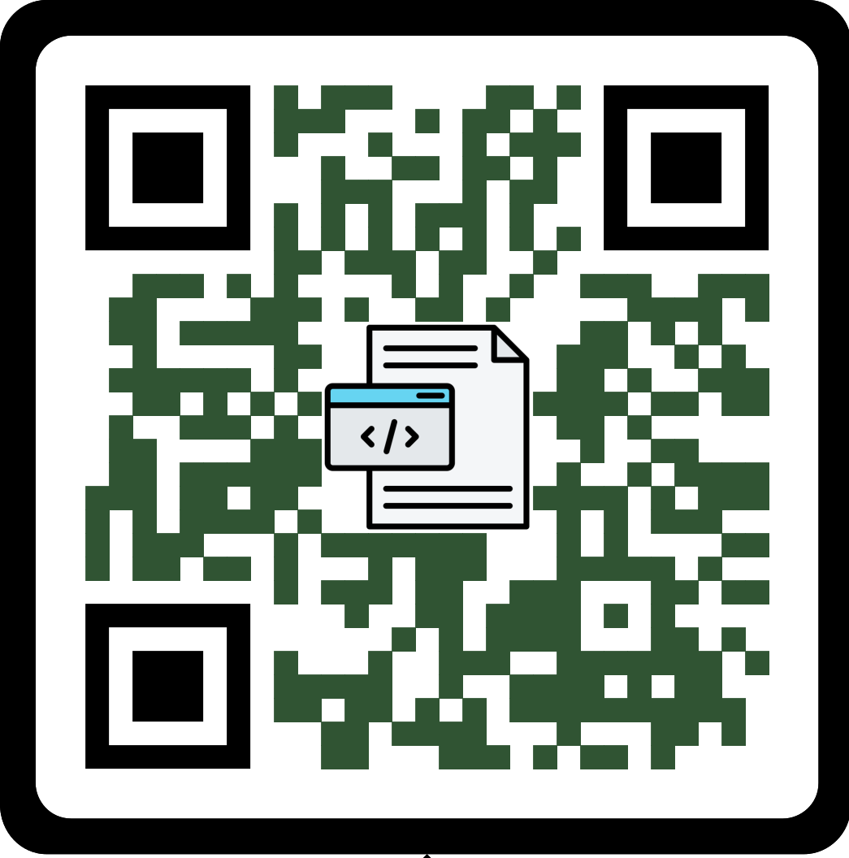
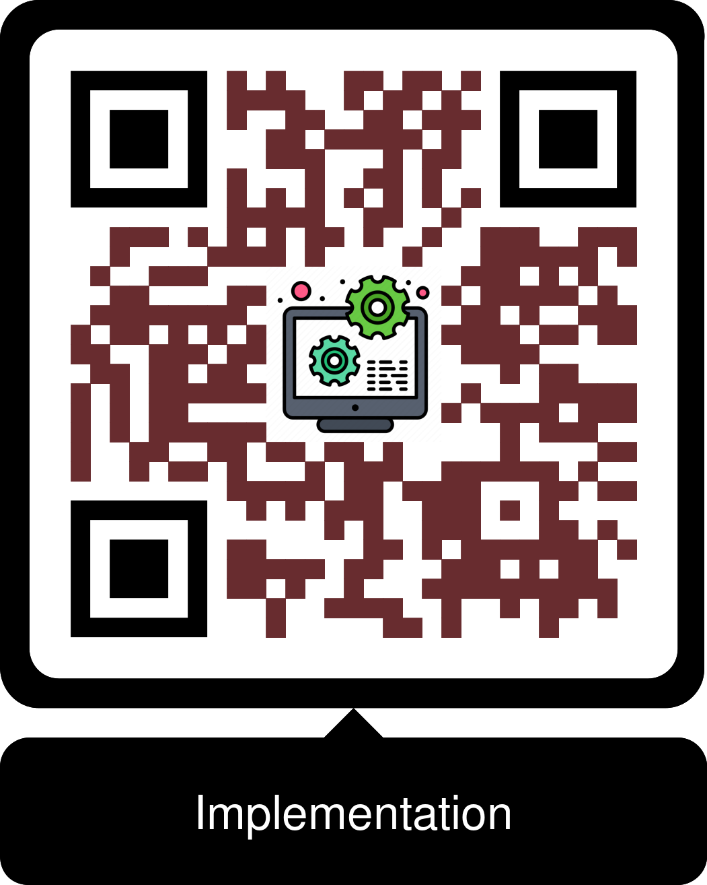
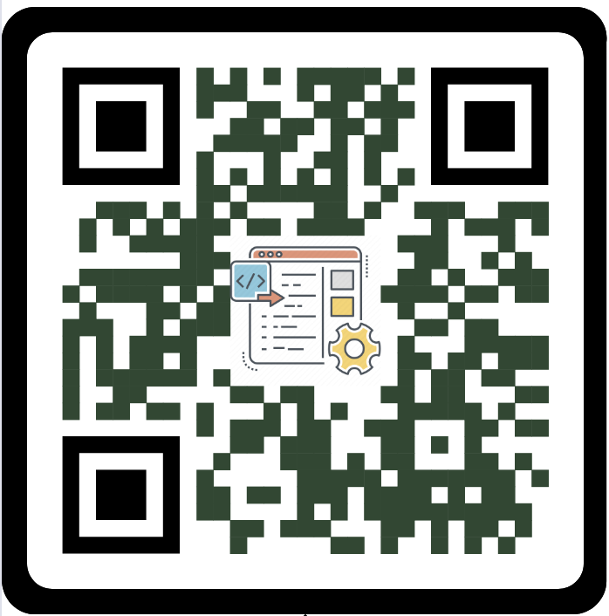
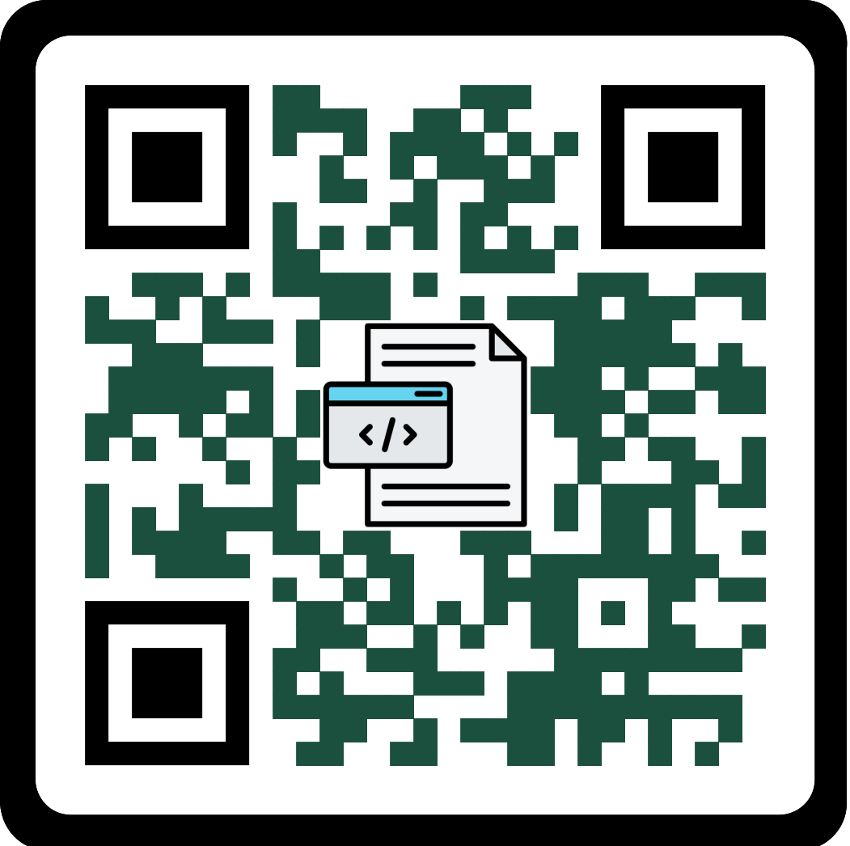
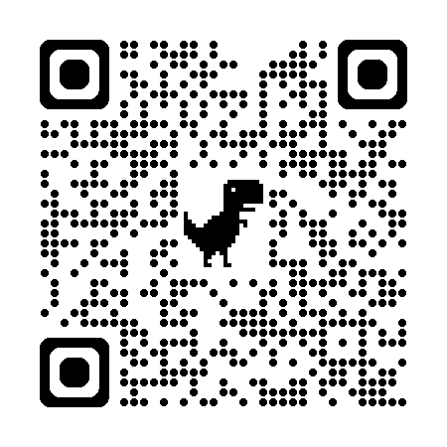
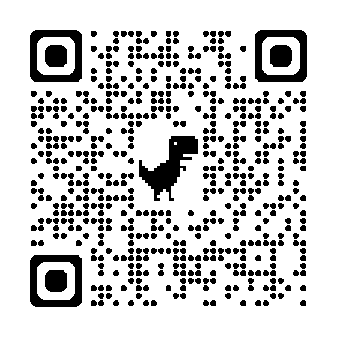
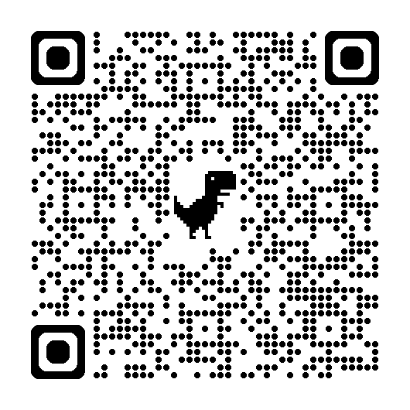


Thank You!
Questions?
Also building: a new “Responsible AI Engineering” course for our MS in AI program, and broader AI-curriculum work at Texas State University.
Shibbir Ahmed
Assistant Professor, Department of Computer Science, Texas State University
shibbir@txstate.edu
Get the slides, assignment, and survey

Slide 15

Stay Connected!
Follow CRA on social media

