Slide 1



Enhancing Cybersecurity Education with Retrieval Augmented Generation: A Virtual Teaching Assistant Approach
Presenter: Ankur Chatterjee, PhD
Student Contributors: Gaurab Baral, Sushant Shrestha and Mithlesh Sah
School of Computing & Analytics, College Of Informatics
Northern Kentucky University

Slide 2
Introduction
The Challenge: Scaling Specialized Support
Growing Industry Demand: Significant job growth in specialized roles like Incident Response (+12.1%) and GRC (+11.8%) highlights the need for advanced training.
The Support Gap: Online graduate programs struggle to provide timely, personalized guidance for complex technical topics due to limited instructional resources.
The Solution: RAG-Powered Virtual Teaching Assistant (vTA)
Advanced Tech Stack: Developed using a Retrieval-Augmented Generation (RAG) approach.
Model: OpenAI GPT-4.1 (non-reasoning) with text-embedding-3-small.
Architecture: Integrated vector database for context-aware, real-time responses.
Implementation: Deployed across two specialized graduate courses: Risk Management (MCY 660) and Data Privacy (MCY 620).

Slide 3
Novelty and Motivation
One of the few documented implementations of AI assistants in advanced, technical cybersecurity curricula.
Student feedback confirms the vTA as a scalable, responsive learning aid that bridges the gap in online instructional support.
Small-scale pilot involving only two classes, designed to demonstrate the potential future implementation of RAG chatbots.
Our Published IEEE Paper :-
Enhancing Cybersecurity Education with Retrieval-Augmented Generation: A Virtual Teaching Assistant Approach | IEEE Conference Publication | IEEE Xplore https://ieeexplore.ieee.org/abstract/document/11547122

Slide 4
Related Works
Topic | Key Points | Source
Need for Cybersecurity Education | Increasing digital threats such as cyberbullying, scams, and harmful content. Children are often unprotected due to limited supervision and lack of structured cybersecurity education. Schools should include cybersecurity lessons, teacher training, and awareness programs. | Rahman et al. (2020)
Cloud Computing in Cybersecurity Training | Cloud platforms like AWS provide scalable and hands-on cybersecurity labs. Supports activities like penetration testing and packet sniffing. Reduces setup time, provides remote access, lowers costs, and improves student engagement. | Khaled et al. (2015)
AI and RAG Systems in Education | Large Language Models (LLMs) provide personalized and context-aware learning. RAG systems improve accuracy by using domain-specific knowledge sources. Demonstrated better flexibility, scalability, and contextual understanding compared to intent-based chatbots. | Alsafari et al. (2024); Németh et al. (2024)
AI-Based Cybersecurity Learning Platforms | CyberMentor provides personalized mentorship, skill development, and updated learning resources. CyberRAG improves answer reliability using cybersecurity knowledge graphs. Our work evaluates a RAG-based virtual teaching assistant through real classroom deployment and student learning outcomes. | Wang et al. (2025); Zhao et al. (2024)

Slide 5
Research Questions Of Interest
How frequently do students use the chatbot during the semester?
How do students rate the usefulness and accuracy of the chatbot?
How does the chatbot impact students' academic performance in the respective courses?
In what specific ways does the chatbot support student learning and engagement?
Do students recommend the chatbot for other course settings?
What is the overall level of student satisfaction with the chatbot?
What are the pros, cons, and recommended improvements for the chatbot?

Slide 6
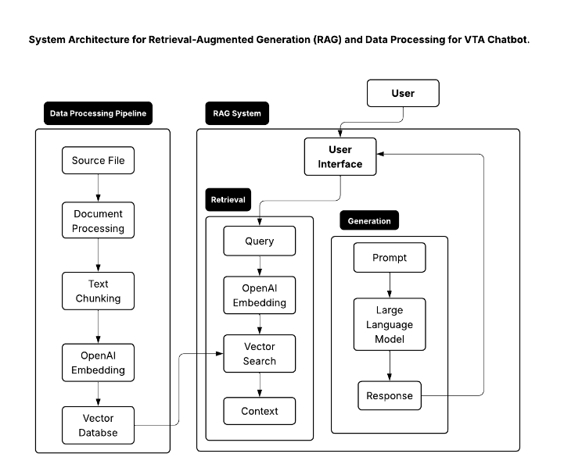
Chatbot Development
OpenAI GPT 4.1 + Retrieval-Augmented Generation (RAG) for accurate, context-aware responses.
Pinecone vector database stores and retrieves embeddings for fast and scalable search.
Course materials converted from PowerPoint → PDF → cleaned text (stopwords and unnecessary text removed).
Smart Chunking (50–75 words with similarity grouping) to maintain content coherence.
User queries are converted into embeddings and matched to the top 5 relevant results to generate responses.

Slide 7
Survey Findings 1
138 students
96 responses
49 (Risk Management) & 47 (Data Privacy)
This sample size meets the threshold required to achieve a 90% confidence level with a margin of error of ±5%, ensuring that the results are statistically representative of the broader student population.
78.05% of participants reported utilizing the chatbot at least once during the semester, with 36.25% indicating weekly usage. 7.3% of the participants also reported using the chatbot daily

Slide 8
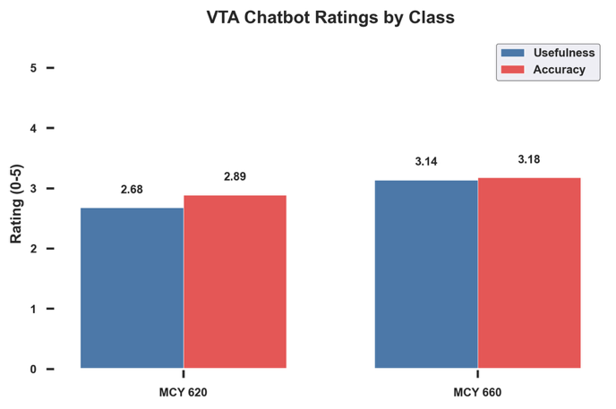
Survey Findings 2
For the two classes, average rating provided by user,
Blue is usefulness, how useful did the student find using the chatbot (1-5), 5 being the most useful.
Red is accuracy, how accurate did the student feel about the responses generated by chatbot.

Slide 9
Survey Findings 3
How did the chatbot help your performance for the respective class?
Course MCY 620:
- 55% of students reported that the chatbot improved their academic performance
- 41% indicated no noticeable effect
- 4% perceived a negative impact
Course MCY 660:
- 38% of students reported that the chatbot enhanced their learning
- 5% noted no significant effect
- 4% felt it hindered their performance

Slide 10
Survey Findings 4
The chatbot provided consistent information.
The chatbot gave easy-to-understand explanations and helped with finding resources for weekly discussions.
The chatbot was a helpful reference for quiz questions (validation and cross-checking).
The chatbot saved time compared to waiting for instructor responses.
The chatbot served as a useful supplement to class materials and kept students engaged.
Students preferred using the chatbot over emailing a TA or instructor.

Slide 11
Survey Findings 5
51% of students on average reported being somewhat or extremely satisfied
30% of students on average remained neutral
19% expressed some level of dissatisfaction on average between the two courses
Majority of the students recommended the chatbot for other course settings
Very few didn’t recommend the chatbot

Slide 12
Survey Findings 6
Pros: Ease of use, quick answers, and clear explanations, timely references and discussion post aid, exam prep, assignments, and module-specific clarifications.
Cons: Occasional inaccurate or vague answers, difficulty handling complex or course-specific questions, and responses that were too general.
Recommendation: Integration of classroom software and the need for better error handling.
Students wanted more accurate, detailed answers, practical examples, interactive features, better course integration, improved formatting, and tools for tracking conversations to better support studying and assignments.

Slide 13
Topic Modelling 1
Latent Dirichlet Allocation (LDA) helps categorize the student chats with the chatbot without any influence of external data.
Created between 5 and 30 clusters ( coherence scores: -19.45 vs. -19.575).
The LDA model grouped the student chatbot conversations into 5 distinct topics/themes based on patterns of words that frequently appear together.
The 5-topic model produced the most interpretable topics compared to other cluster counts.
Notes:
Higher coherence (closer to 0 or positive) → Better topic quality
Lower / more negative coherence → Topics are less clear or interpretable

Slide 14
Topic Modelling 2
Table 1: LDA Results showing common words in each topic cluster of user input for Course MCY 660
Key Words | Possible Topic Title | Count
['bcp', 'risk', 'common', 'involving', 'scenario', 'describe', 'real', 'world', 'occur', 'addressing', 'mistake', 'give', 'example', 'assessment', 'page'] | Real-World Risk Scenarios and BCP Mistakes | 18.9%
['risk', 'example', 'assessment', 'give', 'related', 'control', 'lab', 'compare', 'contrast', 'concept', 'important', 'course', 'used', 'mitigation', 'threat'] | Comparing Risk Control and Mitigation Concepts | 22.4%
['assessment', 'bcp', 'bia', 'included', 'impact', 'analysis', 'need', 'risk', 'control', 'report', 'critical', 'important', 'include', 'scope', 'business'] | BIA and BCP Integration in Risk Assessment | 16.6%
['risk', 'assessment', 'control', 'management', ‘exams, 'measure', 'effectiveness', 'objective', 'module', 'relate', 'asset', 'office', 'hour', 'important', 'vulnerability'] | Measuring Risk Management Effectiveness and Asset Vulnerability | 22.2%
['purpose', 'risk', 'phase', 'explain', 'list', 'business', 'objective', 'critical', 'mitigation', 'function', 'control', 'example', 'key', 'relate', 'recovery'] | Phases and Purpose of Risk Mitigation in Business Recovery | 19.9%

Slide 15
Topic Modelling 3
Table 2: LDA Results showing common words in each topic cluster of user input for Course MCY 620
Key Words | Possible Topic Title | Count
['privacy', 'data', 'personal', 'processing', 'consent', 'gdpr', 'individual', 'rights', 'controller', 'lawful', 'basis', 'example', 'give', 'important', 'compliance'] | GDPR Personal Data Processing and Individual Rights | 17.2%
['privacy', 'design', 'engineering', 'technical', 'control', 'security', grades, 'implementation', 'architecture', 'embed', 'feature', 'capability', 'management', 'process', 'deploy'] | Privacy by Design and Privacy Engineering Implementation | 19.3%
['data', 'anonymization', 'identification', 'dataset', 'algorithm', 'attack', 'threat', 'vulnerability', 'processing', 'collection', 'storage', 'access', 'dissemination', 'risk', 'breach'] | Data Anonymization Techniques and Privacy Threat Analysis | 22.6%
['privacy', 'education', 'training', 'awareness', 'culture', 'staff', 'organizational', 'employee', 'stakeholder', 'responsibility', 'duty', 'program', 'learning', 'knowledge', 'understanding'] | Privacy Education and Organizational Awareness Programs | 21.3%
['online', 'privacy', 'internet', 'cloud', 'computing', 'iot', 'database', grades, 'prevention', 'surveillance', exams, 'domain', 'application', 'digital', 'platform'] | Online Privacy and Emerging Technology Challenges | 19.6%

Slide 16
Overall Summary & Discussions
This work - a novel first of its kind experimental study with online graduate cybersecurity classes demonstrates that a Retrieval‑Augmented Generation (RAG)–based virtual teaching assistant can effectively address scalability and support challenges in graduate‑level cybersecurity education.
Survey results indicate that the chatbot functioned best as a supplementary learning tool, supporting quizzes, discussions, assignments, and exam preparation, while not replacing instructor guidance.
Topic modeling (LDA) revealed that student interactions focused on core learning objectives, including risk assessment, real‑world cybersecurity scenarios, privacy compliance, and applied conceptual understanding.
Despite limitations such as occasional inaccuracies and general responses, the findings highlight strong potential for RAG‑powered teaching assistants, with future improvements needed in course integration, accuracy, and adaptive personalization.
Future improvements/enhancements include usage of multimodal data (textual, images & media contents), and more extensive training with larger topic-specific data sets

Slide 17




Acknowledgements

Slide 18

Thanks for attending this presentation & for listening!
Any Questions and/or Comments?
<Email: chattopada1@nku.edu>

