Slide 1
Scaling AI Education for Safety-Critical Systems
A Low-Code AI Literacy Framework for Construction Management Students Using Construction Safety Contexts
NAIRR Pilot Classroom Expansion Conference — Research Emerging – Large
Orlando, FL | June 18–19, 2026
Dr. Yuting (Tina) Chen, Assistant Professor
Albert School of Construction, University of North Carolina at Charlotte

Slide 2
Why AI Education Matters for Construction Management Students
Construction graduates will increasingly work alongside AI-enabled technologies throughout the project lifecycle:
Bid preparation and proposal development
Safety monitoring
Digital twins
Decision support tools
Yet most construction management students have little or no coding experience.
Traditional AI courses are typically designed for computer science majors and often emphasize programming-intensive methods.
Construction programs need accessible pathways to AI literacy that focus on real-world problem-solving rather than coding proficiency.

Slide 3
Why Construction Safety?
Construction remains one of the most dangerous industries in the United States.
1,075
39.2% (421 deaths)
of construction fatalities were falls, slips & trips
construction fatalities in 2023
— the most of any U.S. industry sector
≈ 1 in 5 (20.8%)
of all U.S. workplace deaths occur in construction
Source: U.S. Bureau of Labor Statistics, National Census of Fatal Occupational Injuries, 2023 release (BLS, 2024) and 2024 release (BLS, 2026).

Slide 4
A Construction Safety Framework for AI Literacy
Teaching AI literacy to non-CS students through authentic construction safety problems.
Construction Safety Problem
Game Theory
Multi-Agent Simulation
Construction Safety AI Literacy
Responsible AI & Human Oversight
Phase 4
Phase 3
Phase 2
Phase 1
Current Implementation
Future Development
Notes:
The first two stages have already been implemented in my construction safety course, which serves approximately 150 students annually.
Through game theory and NetLogo simulations, students learn strategic decision making and systems thinking without requiring programming experience.
Attending the NAIRR conference helped me identify a future opportunity: extending this framework toward AI literacy and responsible AI education for construction management students.

Slide 5
Phase 1: Building Construction Safety Foundations
Learning Goal: Build foundational knowledge of construction hazards, regulations, and risk management.
Core Topics Covered
Hazard Recognition | Safety Management
Fall Protection | OSHA Standards
Struck-by Hazards | Job Safety Analysis (JSA)
Crane Safety | Hazard Identification
Trench Safety | Risk Assessment
Electrical Safety | Safety Culture & PPE
Source: Huang et al. (2022).
Notes:
Reiterate the 'illustrative, not measured' framing here — the first of several repetitions per Stage 3's framing requirement.

Slide 6
Phase 2: Teaching Strategic Decision Making Using a Construction Safety Scenario
Comply
Enforce
Worker
Manager
Shortcut
Relax Enforcement
Outcome (Payoffs)
Learning Objectives
Students learn:
How incentives influence behavior
Why unsafe shortcuts occur
How management decisions affect safety outcomes
Strategic decision-making under competing pressures
Source: Huang et al. (2022).
Notes:
Reiterate the 'illustrative, not measured' framing here — the first of several repetitions per Stage 3's framing requirement.

Slide 7
Phase 3: Multi-Agent Simulation Using NetLogo
Learning Outcomes
Students learn:
Agent-based modeling
Systems thinking
Emergent behavior
Scenario analysis
Computational experimentation
Students develop and explore simulation models for real-world construction and transportation safety challenges.
Ladder safety
Freeway trespassing
Work zone safety
Heat stress

Slide 8
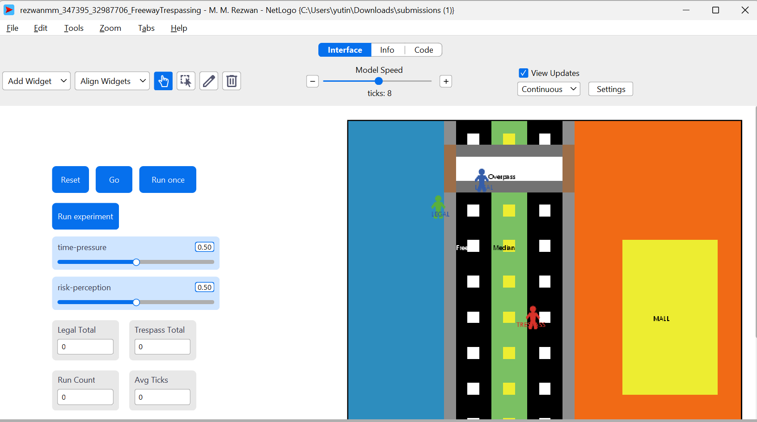
Phase 3: Multi-Agent Simulation Using NetLogo
Freeway Trespassing

Slide 9
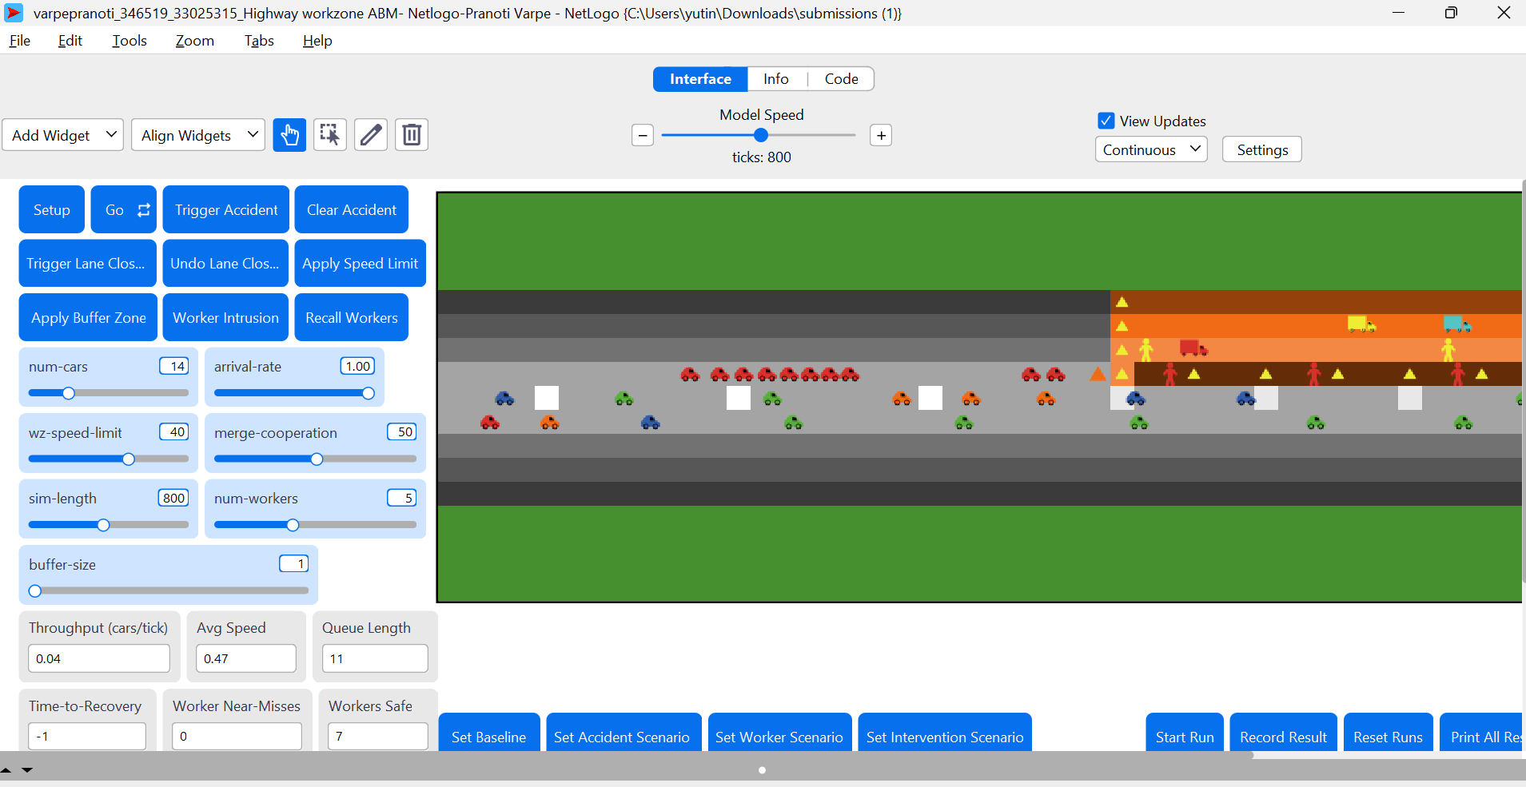
Phase 3: Multi-Agent Simulation Using NetLogo
Highway work zone safety resilience

Slide 10
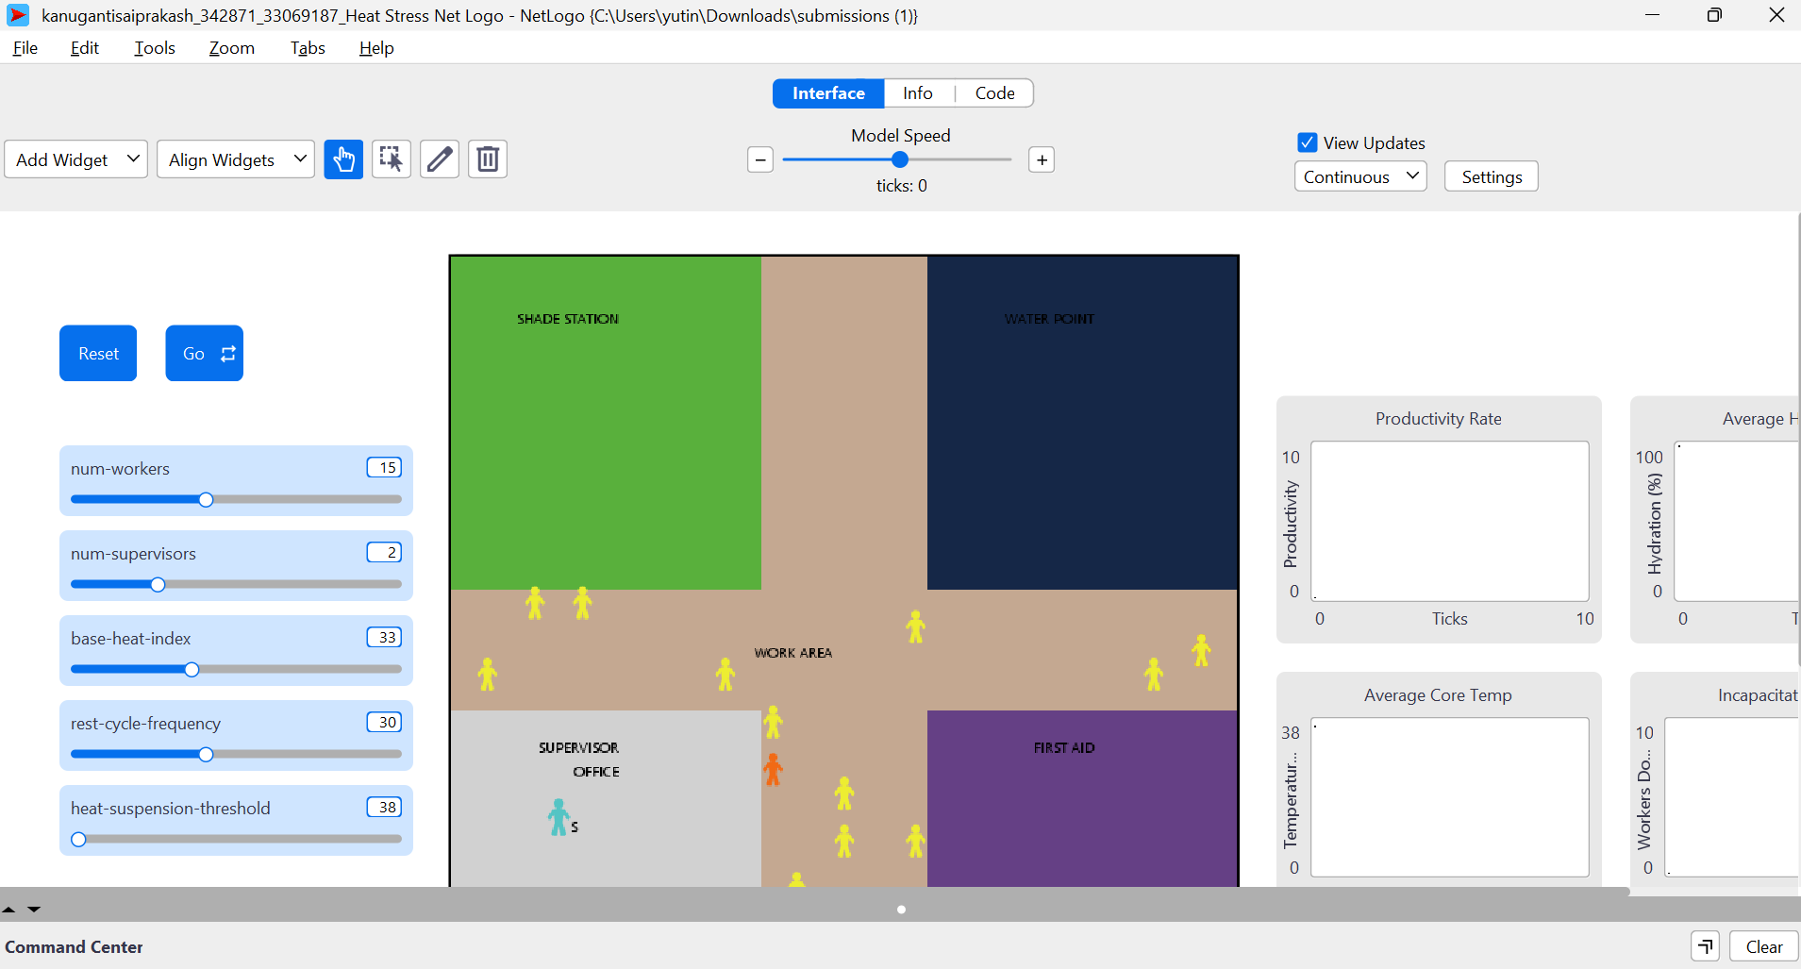
Phase 3: Multi-Agent Simulation Using NetLogo
Heat stress

Slide 11
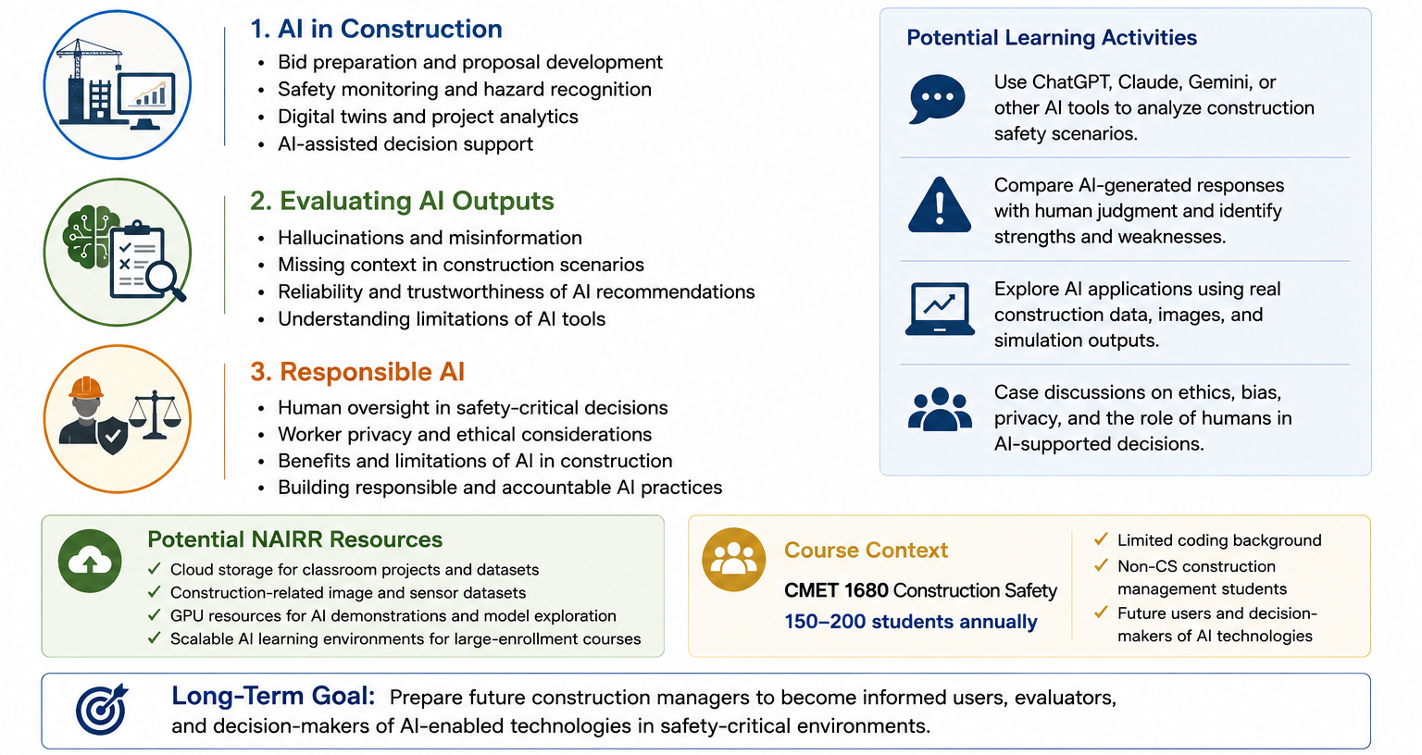
Phase 4: Future Development – Construction Safety AI Literacy Module
Building AI literacy for non-CS construction management students

Slide 12
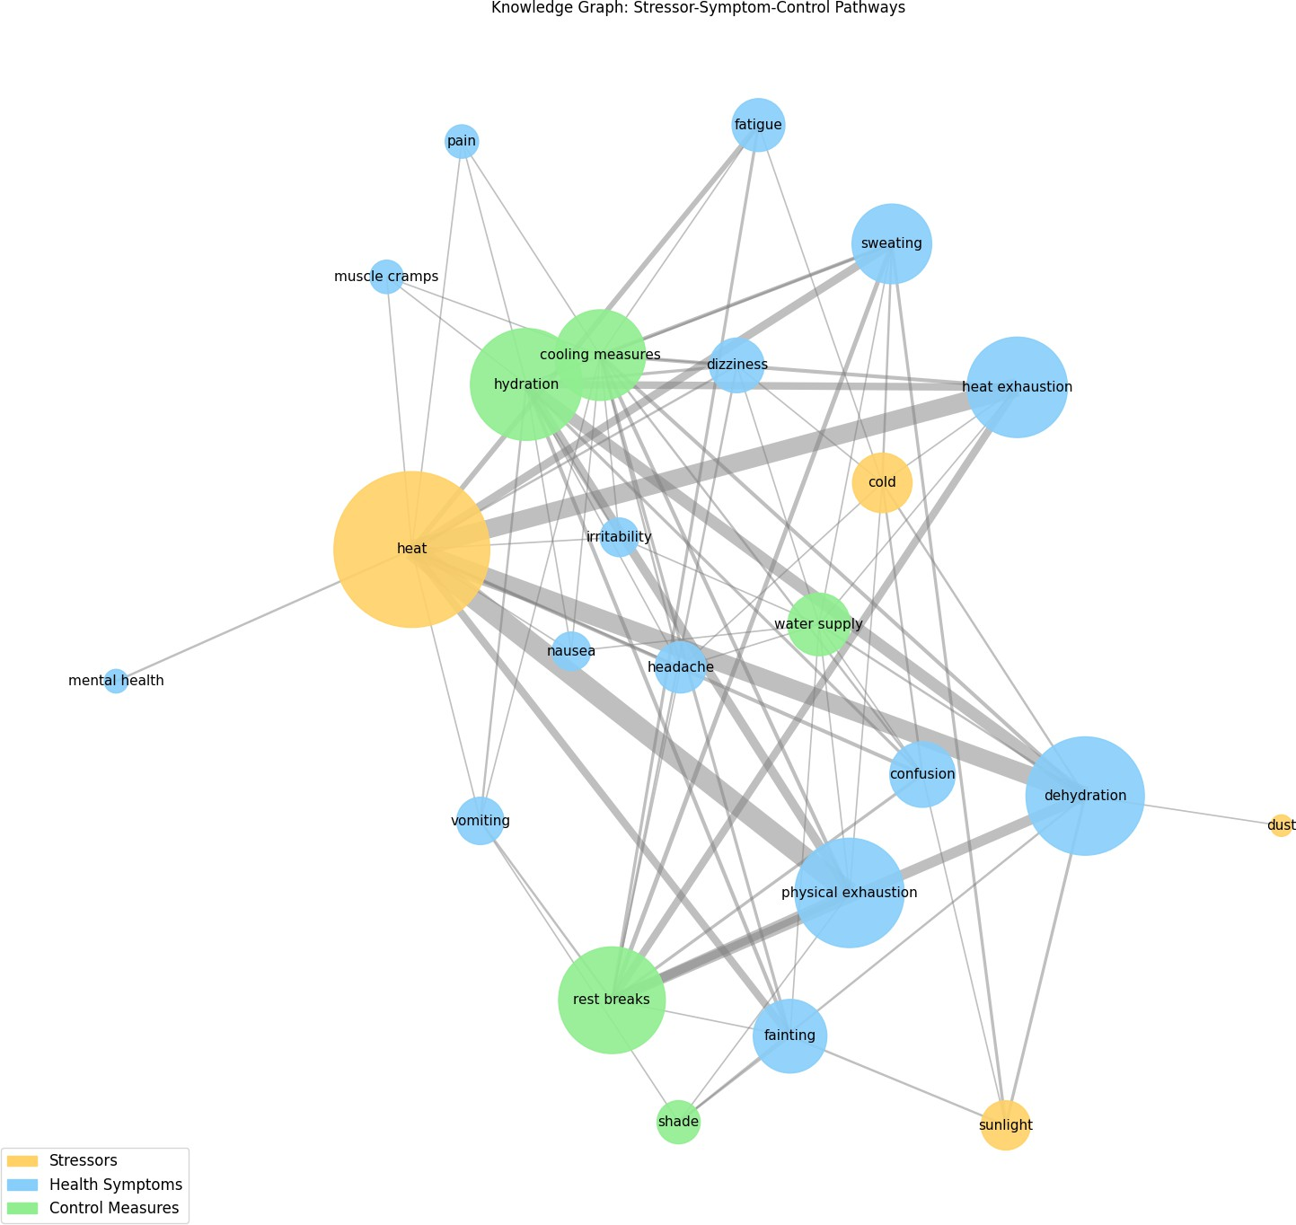
Future AI Literacy Topics for Construction Management Students
Topic 1: AI for Occupational Safety Intelligence
Social media analytics
Natural language processing
Knowledge graphs
Worker narratives
Source: D'Souza, Chen et al., ISARC 2026.

Slide 13
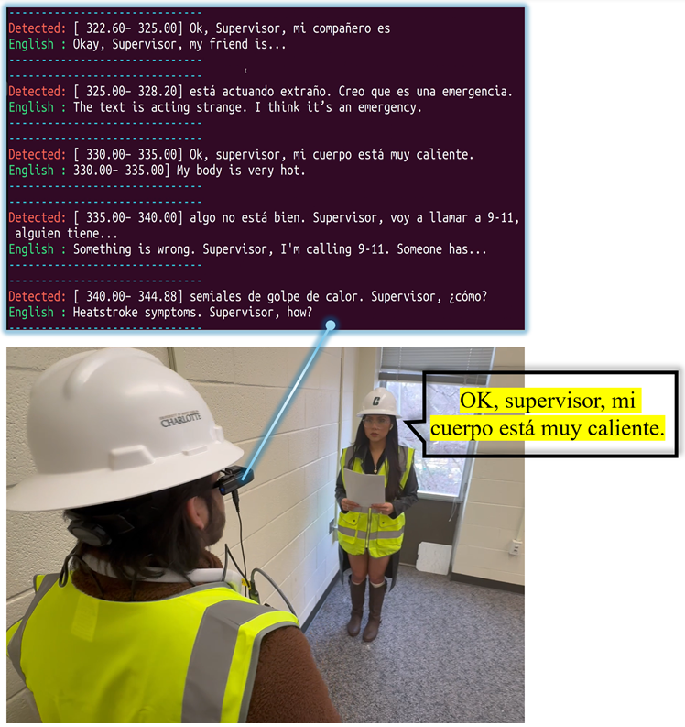
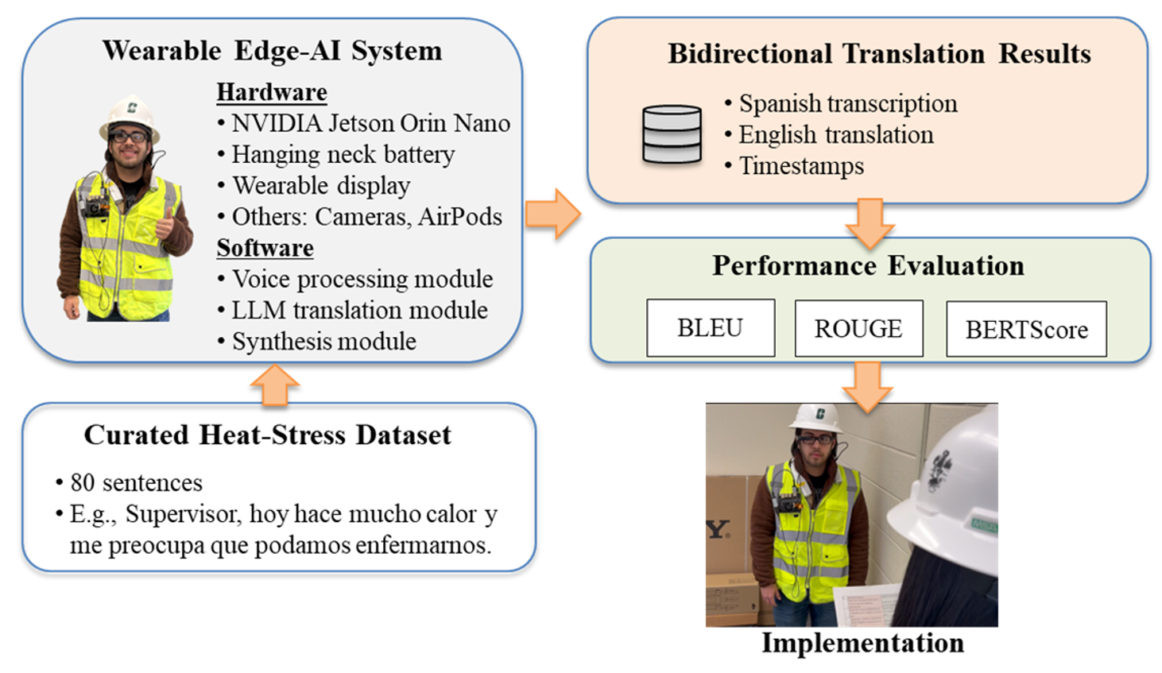
Future AI Literacy Topics for Construction Management Students
Topic 2: Wearable Edge-AI Safety Communication
Speech recognition
Machine translation
Edge AI
Human-AI interaction
Source: Chen et al., ISARC 2026.

Slide 14
Stay Connected!
Follow CRA on social media

