Slide 1
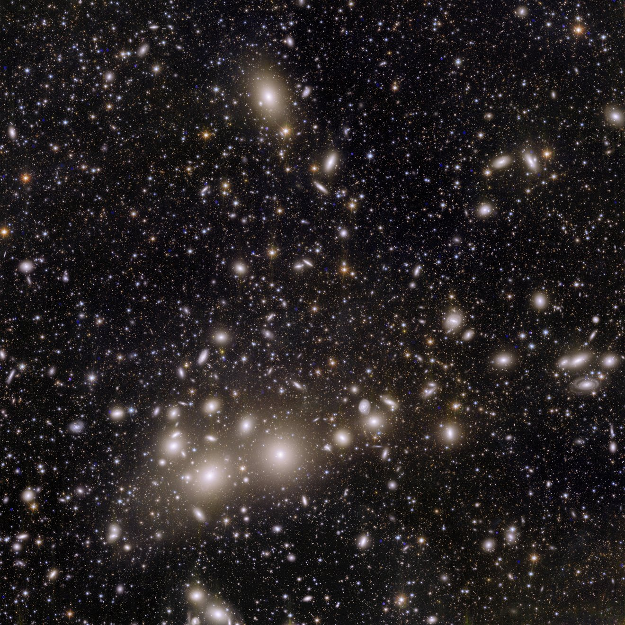
Building a Machine Learning Lab for the Physical Sciences Curriculum, Practice & Infrastructure
Tuan Do
(UCLA)
2026-06-18 CRA NAIRR Pilot Classroom Expansion Conference for Research-Emerging Institutions with Large Computing Programs

Slide 2
Outline
Why teach computation in physics and astrophysics courses?
Implementing and teaching a course on Machine Learning for Physical Sciences
Infrastructure needed for computational physics courses
The role of NAIRR Pilot
Opportunities and challenges

Slide 3
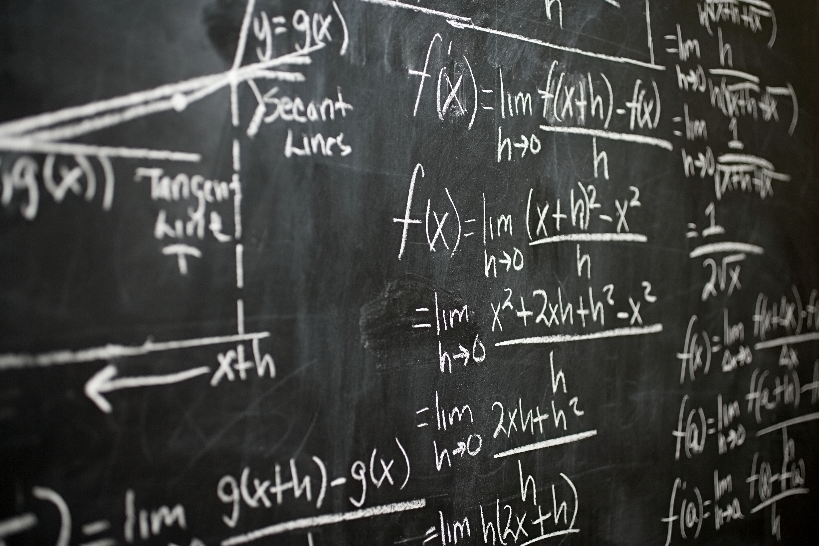
Modern physics uses computation as an integral part of research practices, but this is not the way students are taught
The way many physics courses are taught

Slide 4
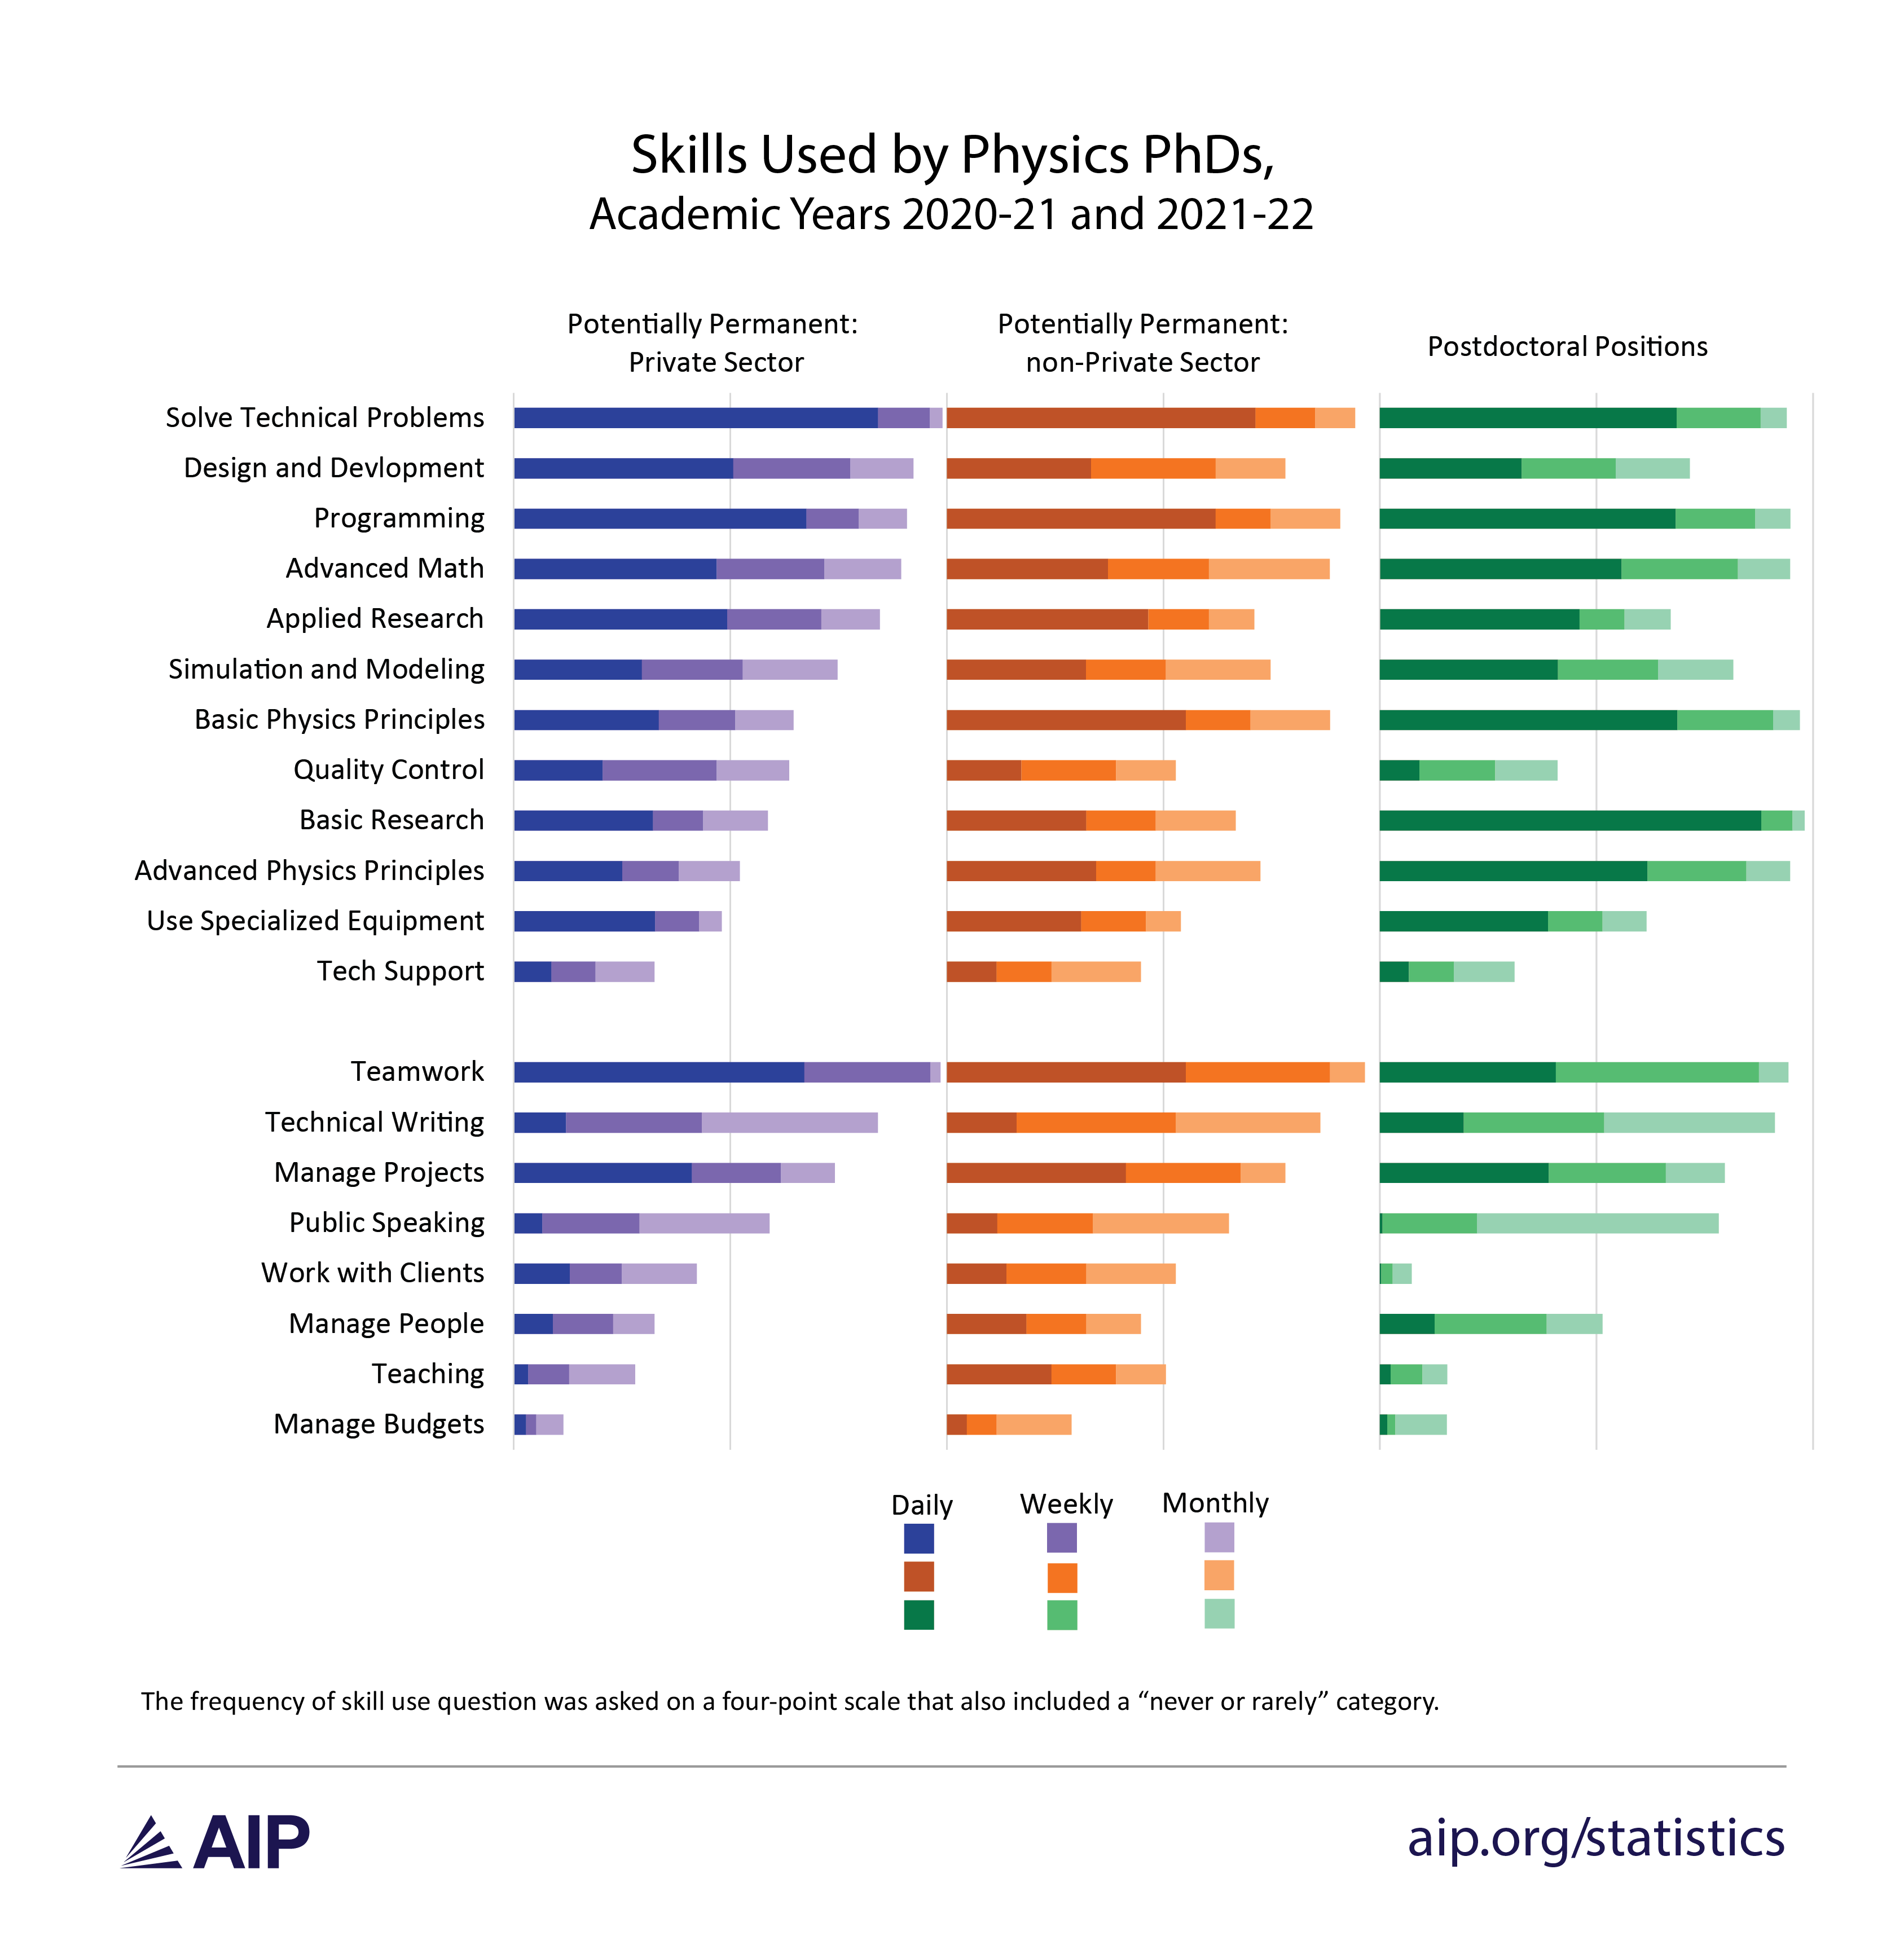
https://www.aip.org/statistics/skills-used-by-physics-phds-academic-years-2020-21-and-2021-22

Slide 5
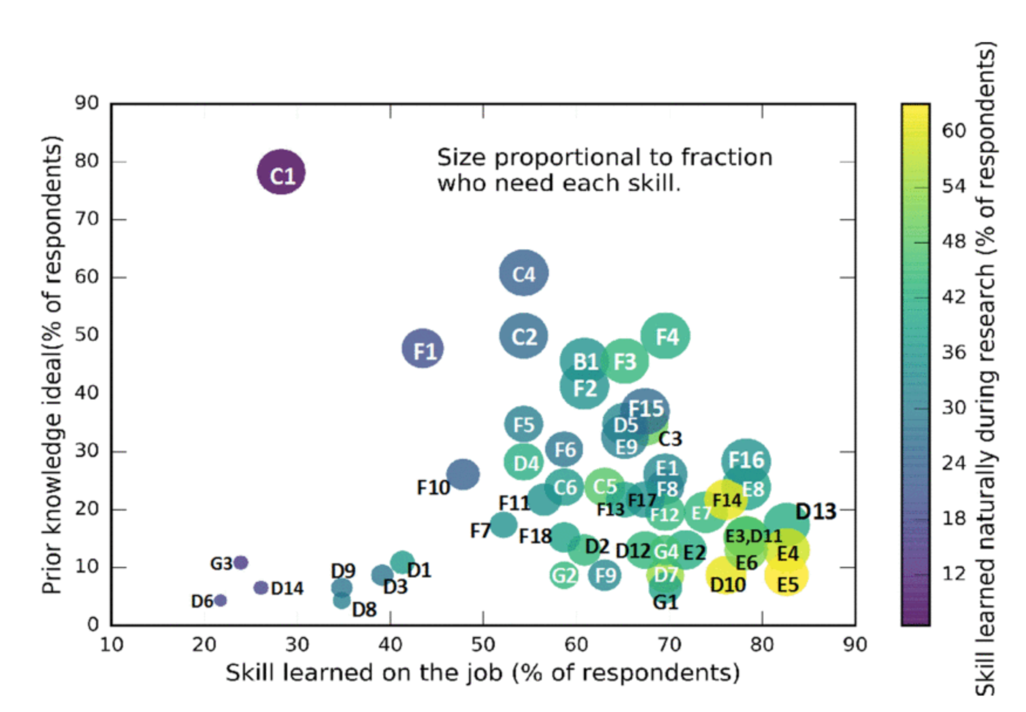
Poll of physicists suggest that additional computational background before starting undergrad research is essential
Basic coding skills and knowledge
Fundamental scientific computing skills
From Graves & Light 2020

Slide 6
Incorporating computational physics through lab courses
Lower division lab courses introduce students to python for computation and simple plots:
Physics 4AL (Mechanics), Physics 4BL (Electricity and Magnetism), Physics 18L (Modern Physics Lab)
Upper division electives specific to computational Physics and Astrophysics give students more advanced computing experience:
Physics 170E (Intro to Symbolic Computation), Physics 170M (Machine Learning for Physical Sciences Lab), Physics 170N (Computational Physics and Astrophysics), Astro 180 (Observational Astrophysics)

Slide 7
Machine Learning for Physical Sciences Lab
Audience: upper division Physical Sciences undergrads, early graduate students. Students have strong background in math but no previous ML experience, some python programming experience
Learning objectives:
Become familiar with the vocabulary of machine learning (can read machine learning papers in physics sub-discipline)
Able to approach a problem in physics or astronomy and decide if machine learning will be useful and what type of machine learning can be used.
Develop experience in the compilation, analysis, and cleaning of data from astronomy and physics contexts
Develop and have access to a community of machine learning practitioners and learners.

Slide 8
Domain Knowledge
Computer
Science
Statistics
Machine learning is an interdisciplinary challenge!
Math

Slide 9
Labs emphasizes the workflow for science with ML
Big picture: define the problem / science question, define the metric for success
Get the data
Visualize the data
Prepare the data
Select a model
Fine tune the model
Present the solution

Slide 10
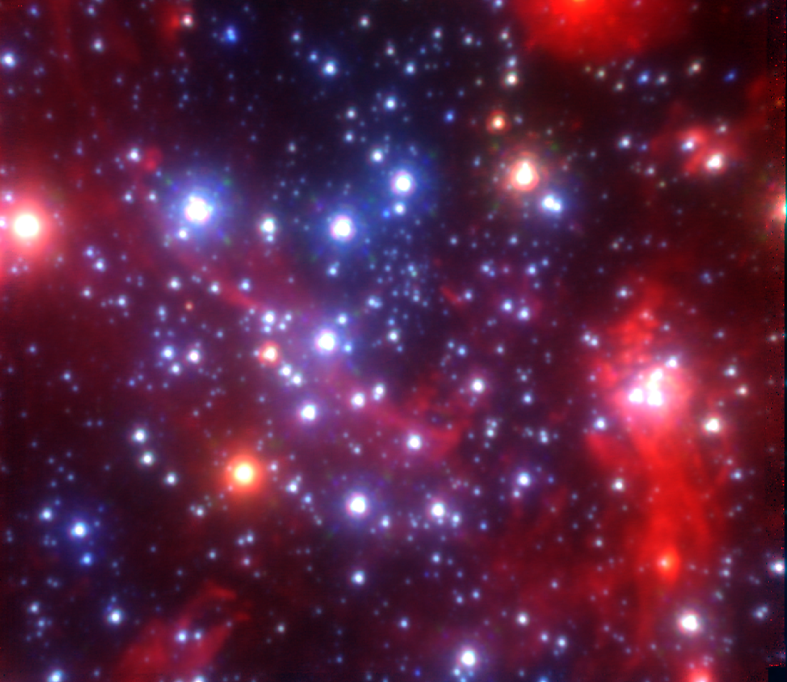
Example: Studying how stars form near the supermassive black hole at the center of our Galaxy
Big picture: How do stars form in the extreme environment around a supermassive black hole?
Goal: separate out young stars from old stars at better than 95% accuracy.
Data: spectroscopy of stars in this region
Model: Naïve Bayes classifier
Other topics include: modeling COVID19 spread, Higgs boson identification, atmospheric CO2 predictions
Credit: Tuan Do, UCLA Galactic Center Group

Slide 11
Integration of statistics, data, and ML methods around science questions
Example statistics topics:
Probability
Bayesian inference
Summary statistics, loss functions
Example data topics:
Outlier identification
Missing data
Data visualization, feature engineering
ML methods
Students typically do not know that 90% of practical ML for science applications are spent on the data and statistics phase!

Slide 12
Class Structure
Students are in groups of 3 or 4
Length: 10 weeks, 6 labs, and 1 final project
Monday
Tuesday
Wednesday
Thursday
Outside of Class
Lecture
Labs
Labs
Readings
Finish Labs
2 hr
2 hrs
2 hrs
2-5 hrs

Slide 13
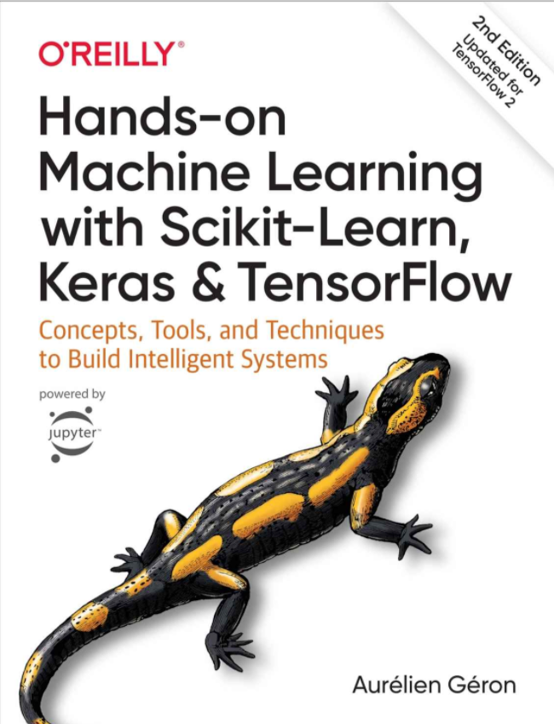
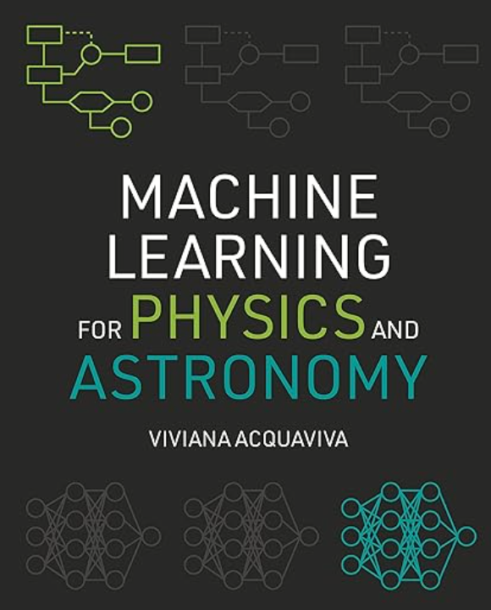
Textbooks
Available through UCLA Library digital access for free (see link in syllabus)
Machine Learning for Physics and Astronomy (2023)

Slide 14
Tension between building basic ML knowledge and more recent advances
Classical ML
Naïve Bayes
Random Forest
Support Vector Machines
Clustering
Classical Neural Networks
Perceptrons
Multi-Layer Perceptrons
Convolutional Neural Networks
Recent Deep Learning
Transformers
Physics Informed Neural Networks
Large language models

Slide 15
Final project gives students an opportunity to do an end-to-end ML project
Student groups select a science question or goal. Develop metrics for the ML model.
Discuss with instructor and refine the question and goals
Students obtain data and prepare them for modeling
Students run models and test hyperparamters
Students present project to the class and write a final report.

Slide 16
Policy for using ChatGPT & Large-Language Models (LLMs) for Code:
Large language models like ChatGPT or Gemini can be very helpful tools when you have questions about code or how to write code.
Remember to acknowledge what tool you used in your notebook if you did use it. Put the prompt you use as a comment and say if you modified the code.
Check to make sure the code it produces makes sense and works as you expect!

Slide 17
Student use of LLMs vary
Two students were found to heavily use LLMs for their lab reports (this is very easy to detect given the very computational sophisticated answers from LLMs about ML models)
Most students appear to use LLMs more sparingly to help with coding.
Example student comment: “I would also avoid leaning too heavily on ChatGPT, because even though it can be convenient, it can take away from the actual learning experience.”

Slide 18

Infrastructure requires computational backend to support multiple users
A major challenge for integrating computing into physics education is the lack of common computational infrastructure. For this lab we use:
Jupyterhub to handle multiple users
Jupyter Lab for computational interface
Custom backend for permissions and common directories
Github for distributing labs and small datasets
Use python and packages that are commonly used in industry:
numpy, scipy, pandas, matplotlib – data science related
Scikit-learn, pytorch, tensorflow – ML related
In collaboration with Ben Winjum (UCLA Office of Advance Research Computing)

Slide 19
Course computational infrastructure timeline
2020
2021
2022
2023
2024
2025
2026
Local
Compute
UCLA IDRE
Google Cloud
National Research Platform
Cloud-Based CPU
NAIRR Pilot Classroom (Jetstream 2)
Cloud-Based GPU

Slide 20
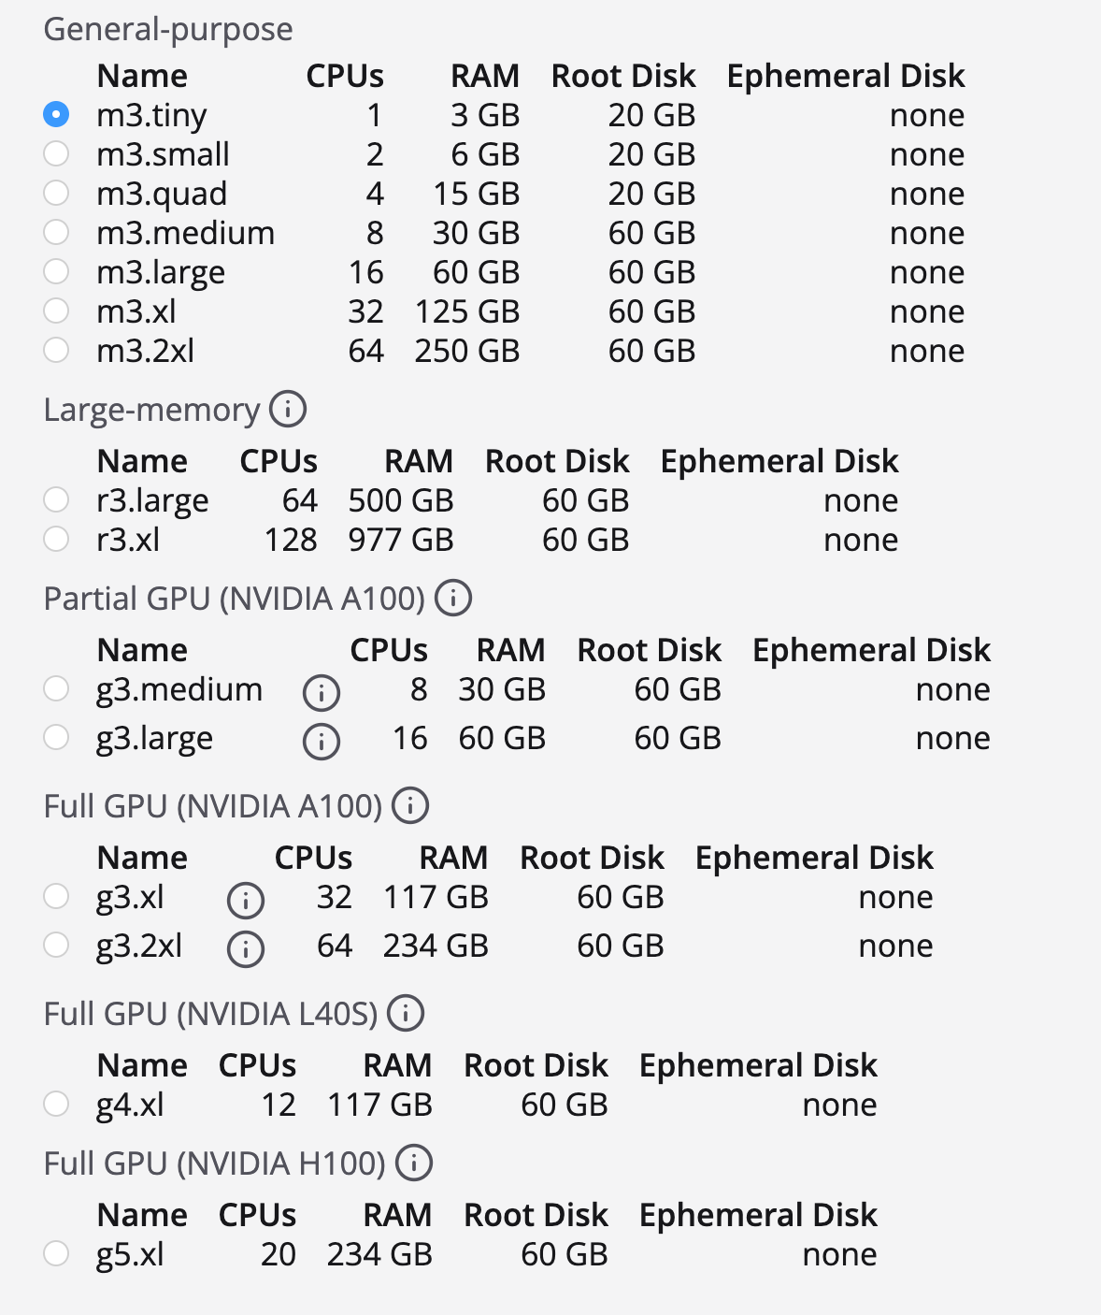
NAIRR Pilot Resource: Jetstream2
Jetstream2 is an HPC platform from Indiana University that deploys instances that work like virtual machines.
The instances have a public IP allowing hosting of different services like Jupyterhub.
Some instances have powerful GPUs, which is needed for some ML models

Slide 21
NAIRR Pilot: Opportunities and Challenges
Opportunities:
Provide computing access for students to use models requiring more powerful compute
Many resources with a range of options
Gives students more realistic preparation for industry
Challenges
Short proposal periods makes continuity difficult
No consistent GPU implementation for different resource providers
Need additional expertise to setup and maintain resources

