Slide 1


Slide 2

Building Generative AI Applications Using NAIRR Classroom Resources: Jetstream2
Steven Fernandes, Erika Germinario, Sara Avila, Izzie Nielsen, Madeline Marr, Ashlyn Viereck, Yukiko Hughes, Ben Borgmeier, Cole Krudwig, Dean Magara, Adya Dhuler, Vignesh R. Anandavel, Peter Steyger Computer Science, Data Science, Physics, School of Medicine Creighton University, Omaha, NE

Slide 3
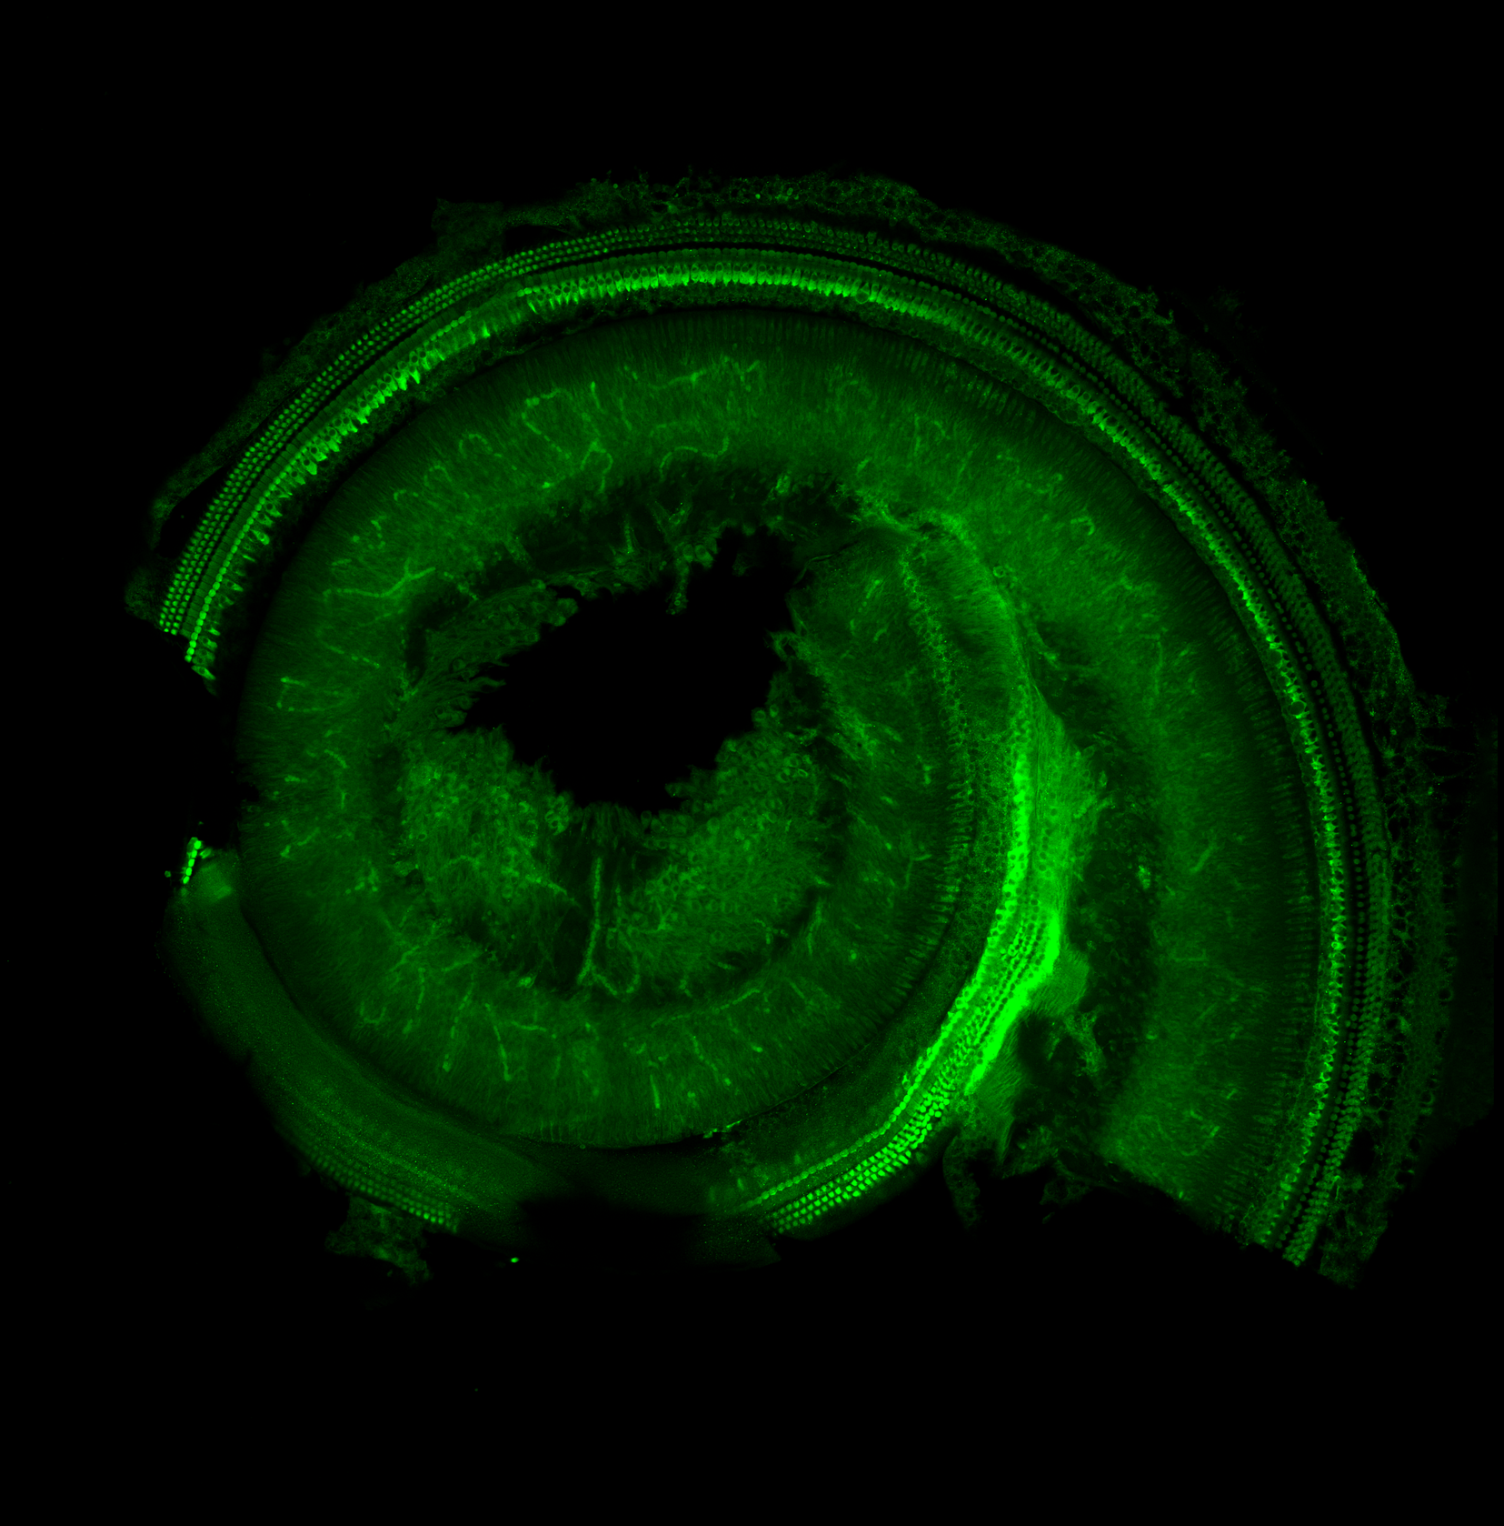
Introduction
Over 1.5 billion people worldwide are affected by hearing loss, with cases rising due to aging populations and noise exposure.
By 2050, nearly 900 million people may suffer from disabling hearing loss.
Unaddressed hearing loss carries an estimated global cost of about US $980 billion, spanning healthcare, productivity, and societal impacts.
Research objective: fine-tune the You Only Look Once (YOLO) version 26 deep learning model for precise detection of cochlear hair cells (HCs).
Figure 1: Confocal image of a mouse cochlea from Bellucci Translational Hearing Center at Creighton University

Slide 4

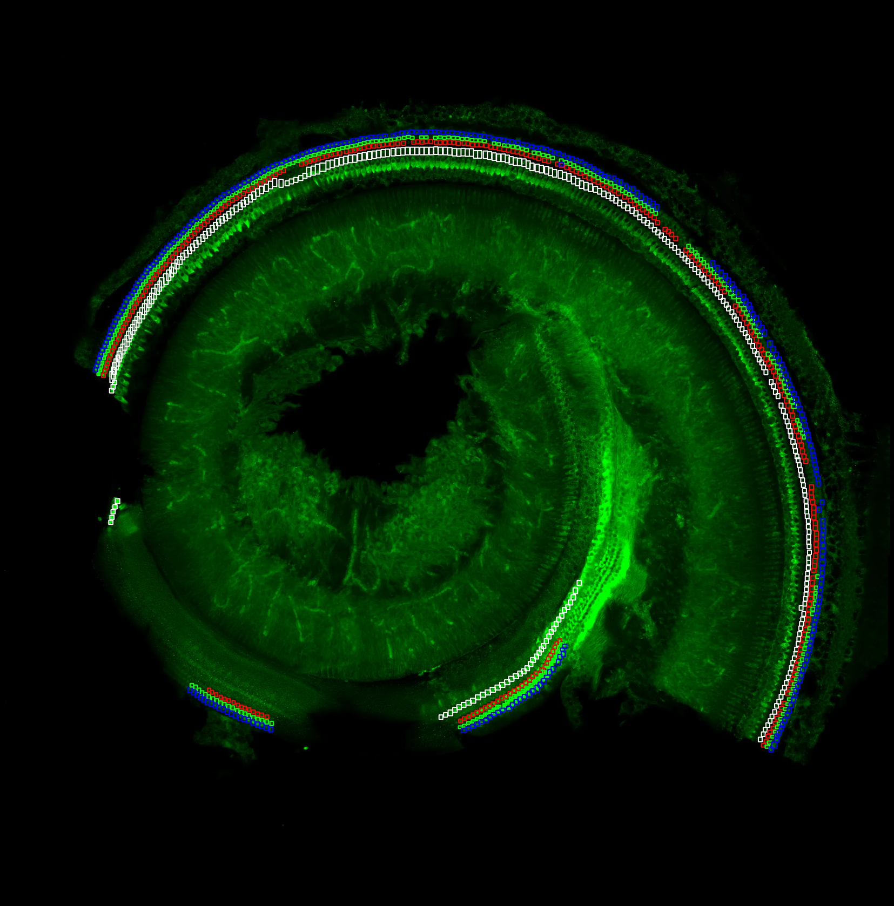
Why Cochlear Hair Cells Matter
Hair cells convert sound vibrations into the neural signals that the brain interprets as sound.
Each cochlea holds roughly 3,000 hair cells: one row of inner hair cells (IHCs) and three rows of outer hair cells (OHCs).
IHCs are the primary sensory receptors; OHCs act as a cochlear amplifier driven by molecular motors.
Loss of hair cells from aging and ototoxicity is a major cause of hearing loss, and lost cells cannot currently be restored.
Counting OHCs row by row matters: Row 3 (OHC-3) is often lost first, signaling early damage.
Figure 2: Manual annotation of IHC, OHC-1, OHC-2, and OHC-3

Slide 5
Fine-Tune YOLO26 for Cochlear Hair Cell Detection
Model overview
Fine-tuned YOLO26 on a manually annotated cochlear dataset for cochlear hair cell detection.
Small targets and small data
Small-Target-Aware Label Assignment (STAL) gives higher weight to small objects during matching, prioritizing tiny hair cells.
Non-Maximum Suppression(NMS) free inference and class balance
End-to-end NMS-free inference avoids suppressing valid detections of adjacent cells in densely packed rows.
Progressive Loss Balancing (ProgLoss) reweights loss components to limit overfitting toward frequent classes; the Distribution Focal Loss is removed.

Slide 6
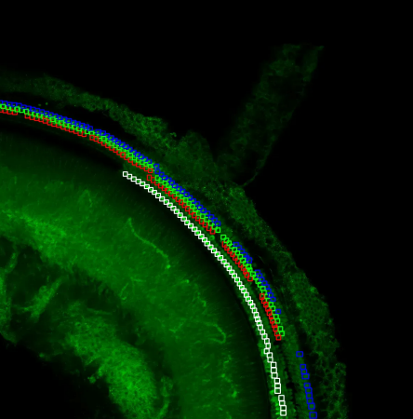
Training & Inference
Training setup
All models fine-tuned for 2,000 epochs at 1024 × 1024 resolution (Ultralytics pipeline).
YOLO26 is trained with the extra-large (x) variant and the Momentum-Unified Stochastic Gradient Descent (MuSGD) optimizer.
Dataset
28 high-resolution mouse cochlear images (confocal, 20× / 40×), manually annotated in CVAT across four classes.
Each image is split into four regions for training and inference; validation uses 14,289 annotated hair cell instances.
NMS-free inference
Each region passes through a one-to-one detection head producing one prediction per object.
Figure 3: Fine-tuned YOLO26 for cochlear hair cell detection output

Slide 7

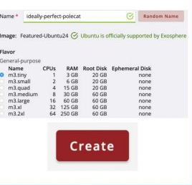
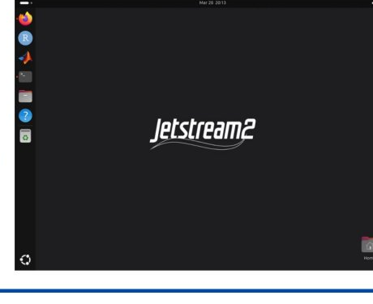
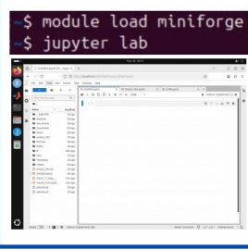
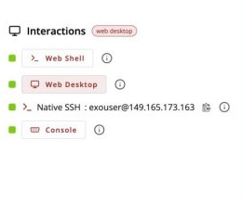
Compute Infrastructure: NAIRR Jetstream2
Jetstream2 Access Workflow
Browser-based, four steps
Add Allocation
Create Instance
Add an allocation, then create an instance (Ubuntu 24, m3 flavors from 1 to 64 CPUs).
Open the web desktop, load miniforge, and launch JupyterLab to run the detection models.
Jetstream2 Web Desktop
Run Jupyter
Open Web Desktop
Students access a cloud-based Jetstream2 environment through a browser.

Slide 8
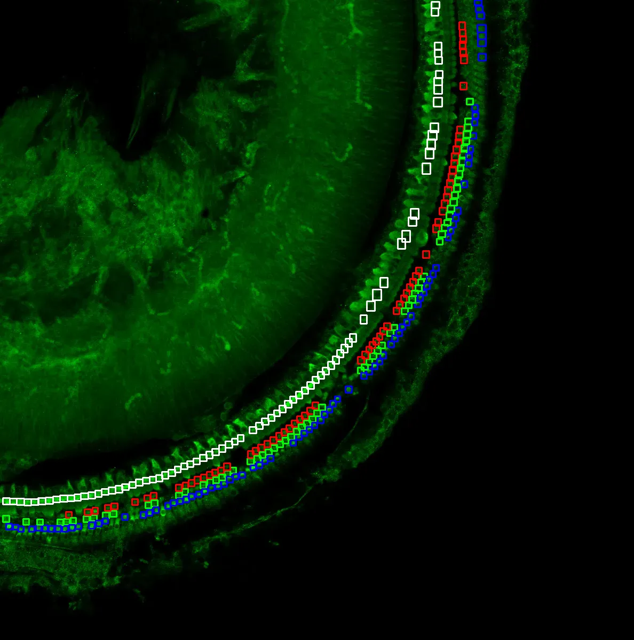
Steps to Fine-Tuned YOLO26 Prediction
Step 1. Raw confocal image
Step 2. Manual annotation
Step 3. YOLO26 prediction

Slide 9
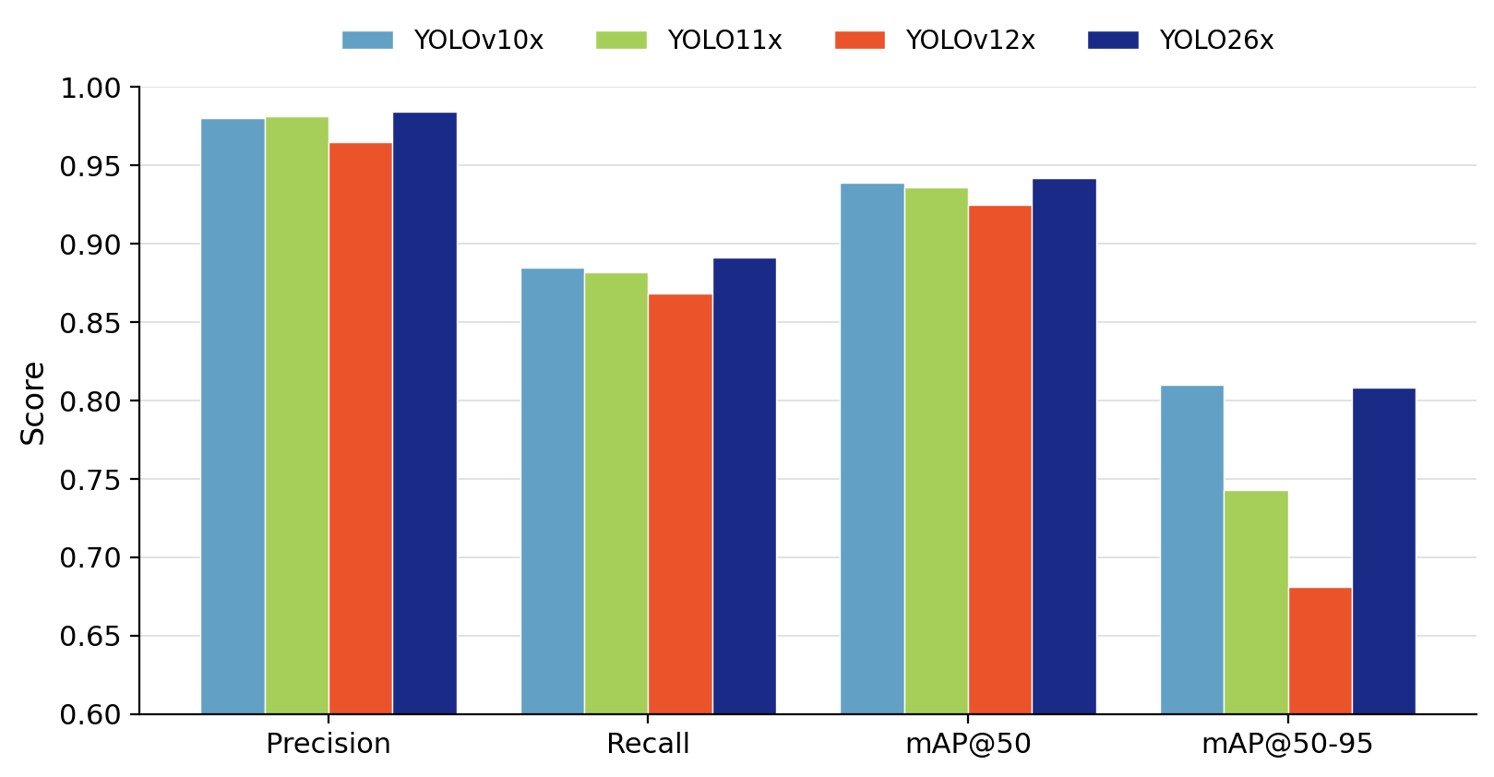
Results: Overall Performance
YOLO26x leads on overall detection
Precision 0.984
Recall 0.891
mAP@50 0.942
mAP@50-95 0.808 (≈ YOLOv10x 0.810)
7.1 ms total inference per image.
~10× faster than YOLOv12x (71.1 ms), which spends 47.5 ms on NMS alone.
Trains in 2.62 hours, 53% faster than YOLOv12x.
OHC-2 is the hardest class for every model; YOLO26x still leads its recall (0.862) and mAP@50-95 (0.770).
Figure 4: Overall cochlear hair cell detection metrics across four YOLO models

Slide 10
Conclusion
The fine-tuned YOLO26x model enables precise, automated detection of inner and outer cochlear hair cells.
It achieves the best overall accuracy (precision 0.984, recall 0.891, mAP@50 0.942) among four YOLO architectures.
Its NMS-free design and STAL module are well suited to small, densely packed targets, delivering the fastest inference (7.1 ms).
This is the first known application of YOLO26 to cochlear hair cell detection, with potential to extend to other cell-counting tasks.

Slide 11
Acknowledgements
This work was supported by the Bellucci Translational Hearing Center at Creighton University with CoBRE Award GM139762 from the National Institute of General Medical Sciences, a component of the National Institutes of Health (SF, PSS), and by The Bellucci Depaoli Family Foundation (PSS). This work is solely the responsibility of the authors and does not necessarily represent the official views of any supporting institution.
Thanks to Dr. David He, School of Medicine, Creighton University, for providing the cochlear hair cell images.
The Authors acknowledge the National Artificial Intelligence Research Resource (NAIRR) Pilot and JetStream2 for contributing to this research result.

Slide 12
References
Emmett, S. D., & Francis, H. W. (2015). The socioeconomic impact of hearing loss in U.S. adults. Otology & Neurotology, 36(3), 545–550.
Goutman, J. D., Elgoyhen, A. B., & Gomez-Casati, M. E. (2015). Cochlear hair cells: The sound-sensing machines. FEBS Letters, 589(22), 3354–3361.
Buswinka, C. J., Osgood, R. T., Simikyan, R. G., Rosenberg, D. B., & Indzhykulian, A. A. (2023). The hair cell analysis toolbox is a precise and fully automated pipeline for whole cochlea hair cell quantification. PLOS Biology, 21(3), e3002041.
Jocher, G., Qiu, J., Liu, M., Lyu, S., Akyon, F. C., & Kalfaoglu, M. E. (2026). Ultralytics YOLO26: Unified Real-Time End-to-End Vision Models. arXiv preprint arXiv:2606.03748.

Slide 13

Thank You
Steven Fernandes, Ph.D.
Associate Professor of Computer Science
Creighton University, Omaha, NE
stevenfernandes@creighton.edu

