Slide 1

Scaling AI Education Without Large-Scale Local HPC: Shared Models for Emerging Institutional Capacity
Xiaolei Huang
University of Memphis
xiaolei.huang@memphis.edu
CRA NAIRR Pilot Classroom Expansion Conference Research-Emerging Institutions with Large Computing Programs Orlando, FL | June 18-19, 2026
Sharif, M., Han, G., Liu, W., & Huang, X. Cultivating Multidisciplinary AI Workforce Development on iTiger GPU Cluster: Practices and Challenges. PEARC 2026.

Slide 2

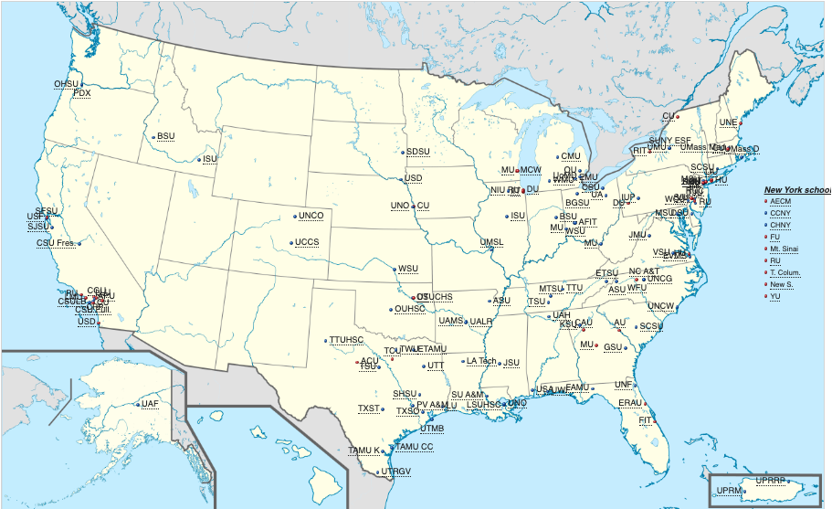
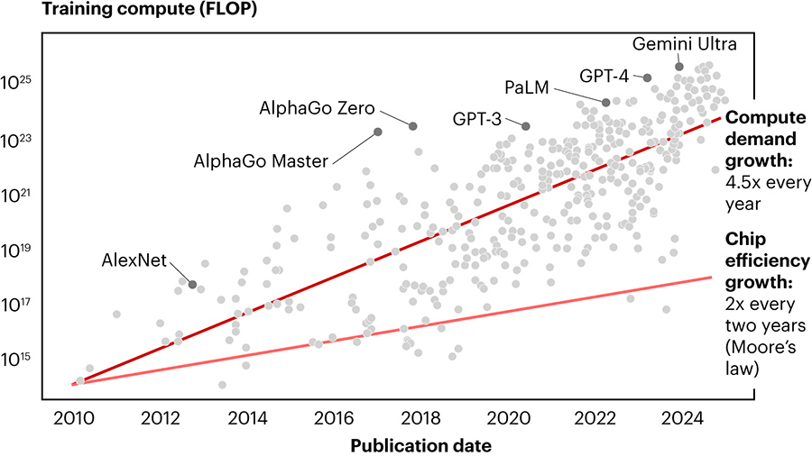
Computing Paradox and Dilemma
Research-Emerging Universities
~300
Increasing Demand + Capital Shortfall
$10B - $20B
Notes:
* Universities classified as R2, D/PU, or M1/M2 often host massive computing student bases—frequently exceeding 1,000 enrolled undergraduate and master's students.
* Unlike R1 institutions with dedicated, multi-million dollar institutional clusters, emerging institutions face steep financial and operational barriers to procuring local GPU-intensive infrastructure.

Slide 3


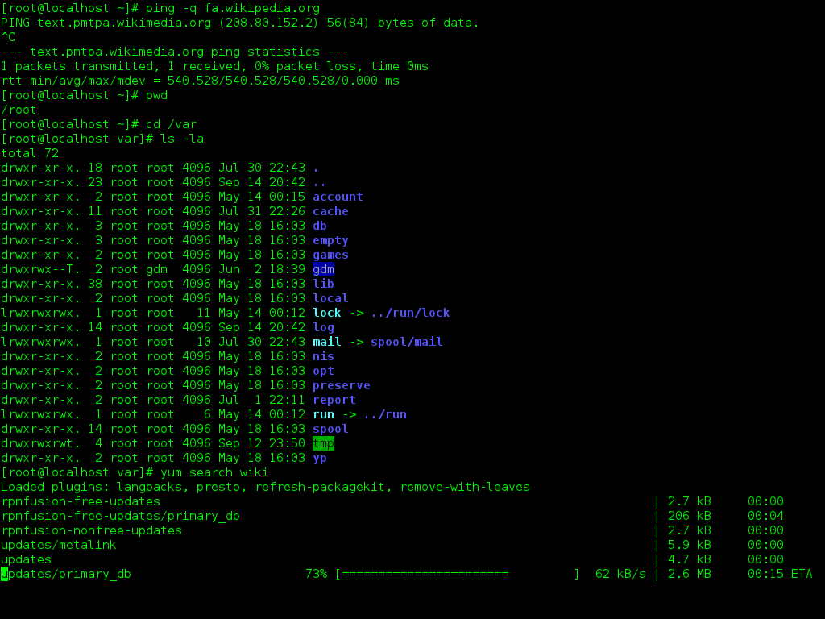
Practical Capacity Issues in HPC Adoption
Cost and access
Instructor readiness
Student readiness
Local GPU clusters are expensive to acquire, operate, secure, and refresh.
Faculty may want to teach AI but lack examples that run reliably on shared systems.
Many students have limited experience with command line tools, schedulers, containers, or debugging GPU jobs.
Question: How do we make shared AI infrastructure accessible, usable, and sustainable?
Notes:
AI education scales unevenly. Students with access to research groups and local compute gain authentic experience; others may only see small demos or conceptual material.

Slide 4

Lessons from iTiger, a GPU Cluster Computing Adoption and Challenges 2023 - 2026
CNS-2318210
NSF-MRI

Slide 5
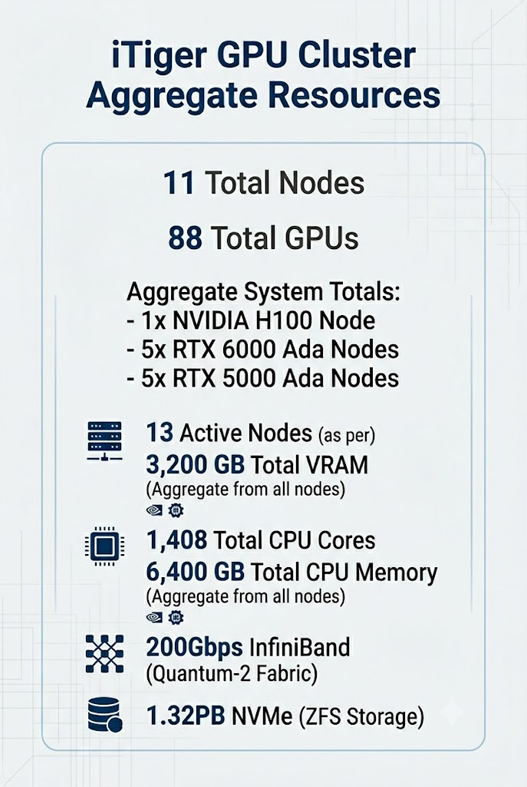
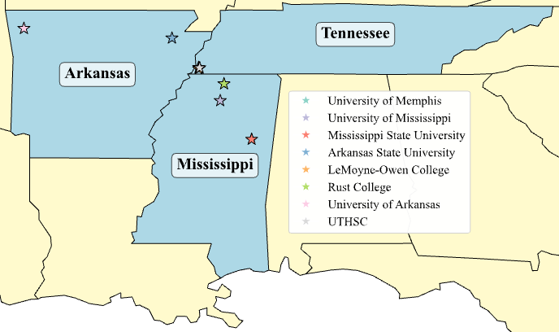
iTiger Cluster for Research & Education
>300 users
226 active users
203 internal; 19 external
181 students; 45 faculty

Slide 6
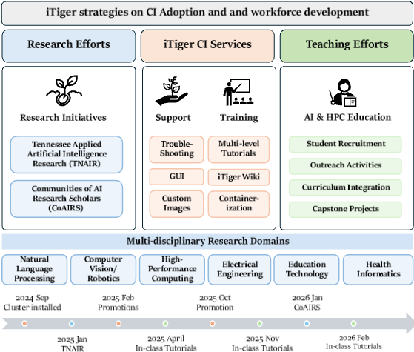
Computing Adoption Strategies
Research Initiatives
CI Services
Education Efforts

Slide 7
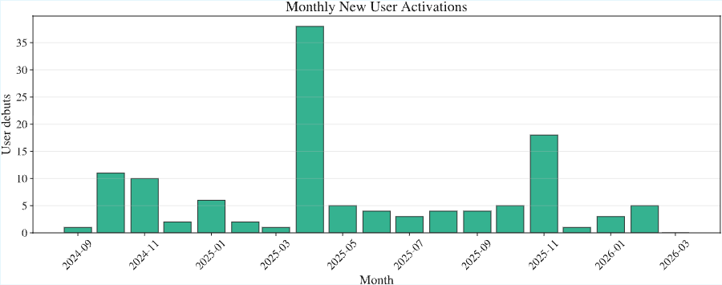
New User Registrations
New users clustered around in-class tutorials and course-related training activities.
Notes:
First-use activity was not evenly distributed. Peaks align with April and November course-integrated tutorials.
Structured exposure is a mechanism for lowering the initial barrier to CI adoption.

Slide 8
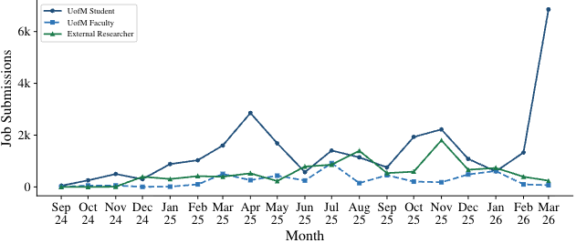
Job Submissions
Student use
Faculty and external use
Regional model
UofM students account for most submissions, with peaks aligned to course activity.
Faculty and external researchers show lower but steadily increasing submission volumes.
External users were a small share of accounts but contributed meaningful job submissions.
Job submissions show strong course-driven student demand and growing regional research use.

Slide 9
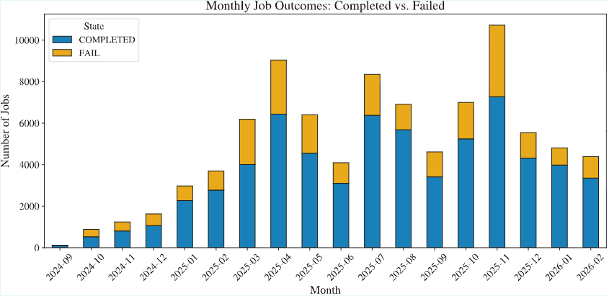
Job Outcomes
Completed jobs increased, but failed jobs also rose during intensive training and project periods. Temporary spikes in failures reflected experimentation, debugging, and workflow learning.

Slide 10
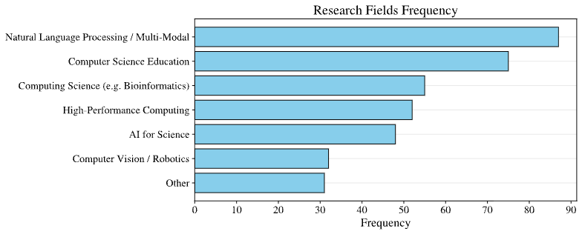
HPC Adoption in AI+X
Implication for NAIRR: Shared AI education capacity should support both computing and non-computing disciplines.

Slide 11
Takeaways for Teaching Support
Resource layer
What instructors need
What shared programs can provide
Compute
Reliable access for assignments
Small allocations, class queues, starter accounts
Software
Stable environments
Containers, notebooks, tested model recipes
Curriculum
Plug-in AI modules
Assignments, rubrics, domain datasets, socio-technical prompts
Support
Fast help during course peaks
Office hours, FAQs, instructor Slack/Discord, escalation paths
Assessment
Evidence of capacity growth
Activation, job outcomes, project artifacts, confidence surveys

Slide 12
Takeaways for Broadening HPC Adoption
Shared AI infrastructure per regional hub is necessary to motivate emerging institutions full participants in AI education and research.
Shared compute
Course integration
Human support
Regional community

Slide 13
Takeaways for Emerging Institutional Capacity
Curriculum integration is fastest to AI literacy and HPC adoption.
Access alone is not enough. Adoption requires support systems.
Sustainable capacity requires people, not only machines.
Shared GPU infrastructure can substitute for local ownership.

Slide 14
Takeaways for Sustainable Capacity
National Resource + regional Resource Hubs + local support = Sustainable AI education capacity.
National shared resources
Large-scale models, compute allocations resources (NAIRR)
Regional hubs
Local/regional support, community, and sharing network
Institutional
implementation
Research, instructors, courses, capstone projects

Slide 15

Thanks!
xiaolei.huang@memphis.edu
itiger-cluster.github.io
Sharif, M., Han, G., Liu, W., & Huang, X. Cultivating Multidisciplinary AI Workforce Development on iTiger GPU Cluster: Practices and Challenges. PEARC 2026.
Acknowledgement: The presenter wants to thank the NSF and CRA for generous support!

