Slide 1


Slide 2

Rethinking Education in the Age of AI --Preparing Students for the Classroom and Workforce
Dr. Chenchutta Jackson
Tennessee State University

Slide 3
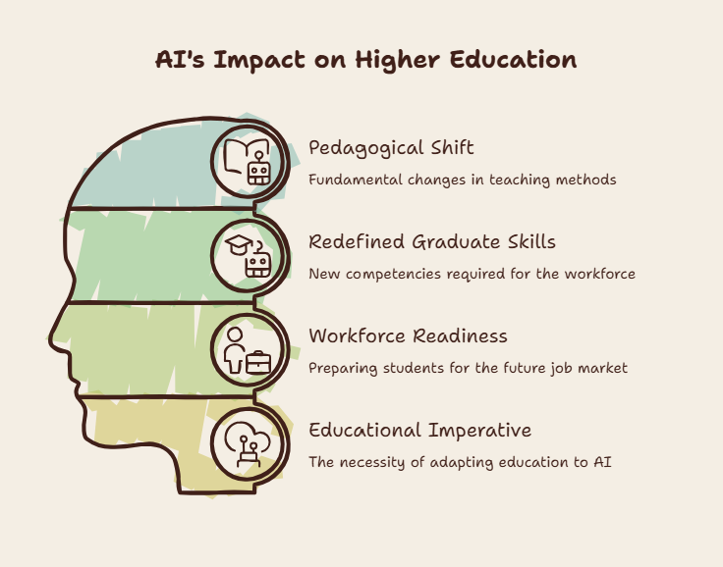
The Big Idea
Higher Education is at a historic transformation point
AI is redefining what it means to be educated
AI Fluency must become a core educational outcome
Critical thinking + AI Collaboration = Future Workforce Readiness

Slide 4
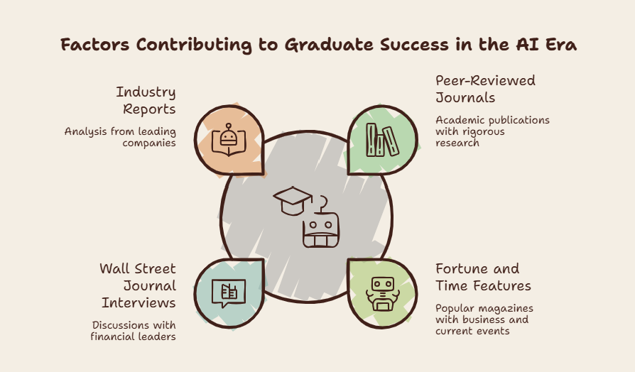
AI Fluency:

Slide 5
Ohio State University Definition
AI fluency as a graduation requirement
Emphasis on:
Explaining AI concepts
Evaluating AI outputs
Using AI for discipline-specific goals
Ethical and legal awareness
Fluency must be embedded across all majors

Slide 6
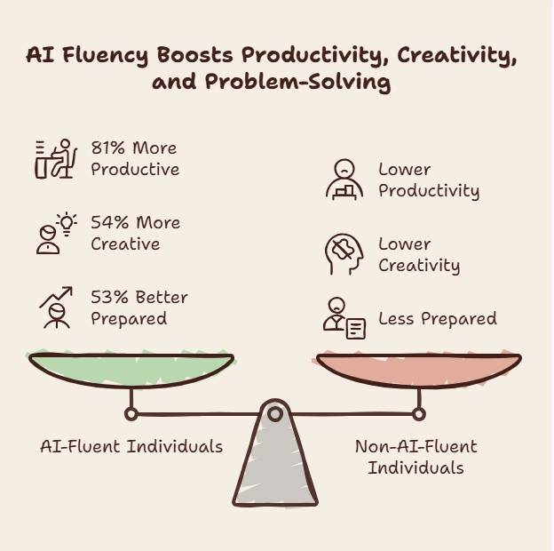
The 4D Framework (Feller and Dakan)/Anthropic
AI Fluency
Delegation
Description
Discernment
Diligence

Slide 7
Workforce Definition
AI Fluency
Frequent, confident use of AI in daily work
Understanding AI’s capabilities and limits
Ethical, adaptive, collaborative use
Organizations need a shared AI language

Slide 8
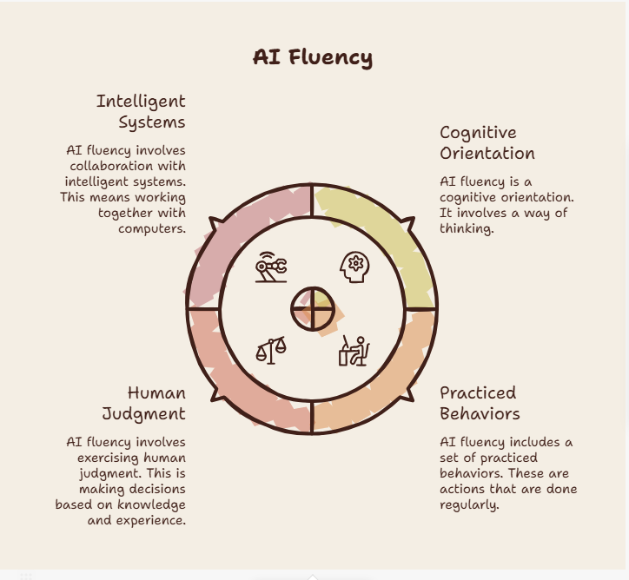
Convergence
AI fluency is not a technical certification.
Cognitive orientation
Practice Behaviors
Human Judgement with Intelligent Systems

Slide 9
Why We Teach: The Enduring Mission
Education trains the mind, not just skills
Intellectual humility
Self-direction and curiosity
Lifelong learning as a core outcome

Slide 10
What AI Can and Cannot Do
AI can generate, summarize, optimize
AI cannot assume or take responsibility
AI cannot exercise consciences or character
AI cannot frame problems
AI cannot make value-based decisions
AI cannot understand context
Humans must supply judgement; AI supplies scale

Slide 11
Cognitive Orientation: Character is not a soft skill.
“The function of education, therefore, is to teach one to think intensively and to think critically. Intelligence plus character—that is the goal of true education.” -Martin Luther King Jr., 1947
Character is the disciplined habit of using intelligence with honesty, responsibility, courage, humility, and care for consequences.
Be Transparent | Use Evidence Base Claims | Avoid Shortcut thinking
Resist “fake mastery” | Practice responsible use | Verify and reflect
Maintain academic integrity | Respect tools | Reiterate and Evaluate

Slide 12
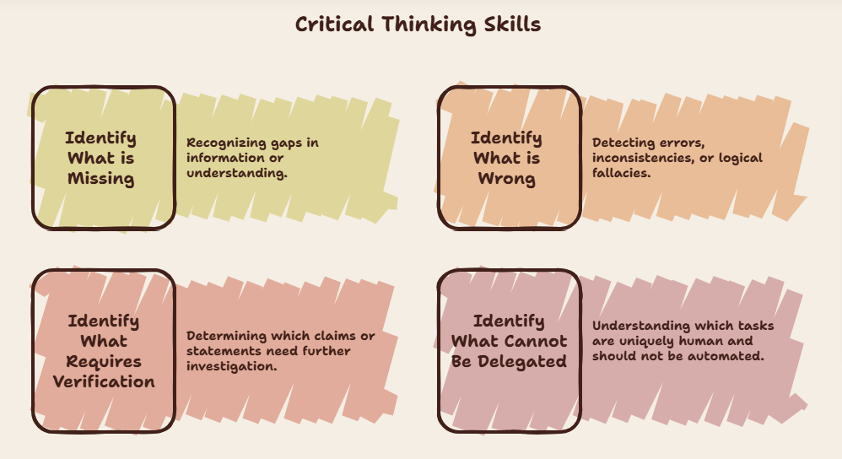

Slide 13
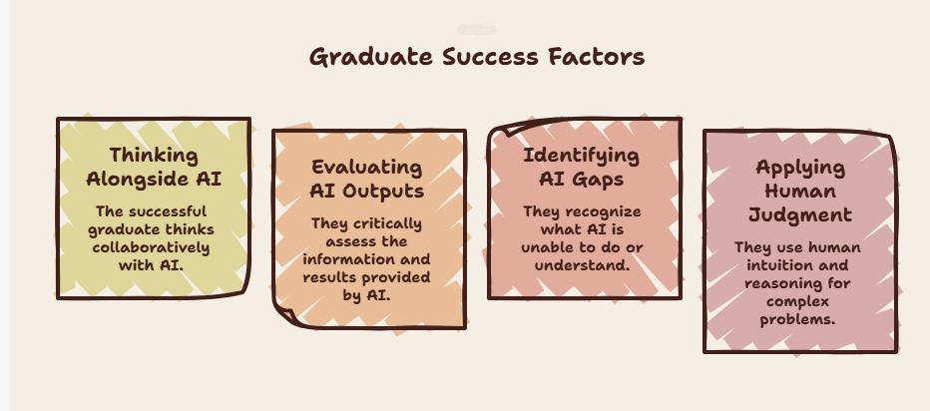
Education and Workforce
Key Skills and Key Takeaway

Slide 14
New Educational Imperative
AI fluency must be a core educational outcome
Critical thinking remains the foundation
Human + AI collaboration defines future work
Lifelong learning is the condition for career longevity
Higher education must redesign curricula accordingly

Slide 15
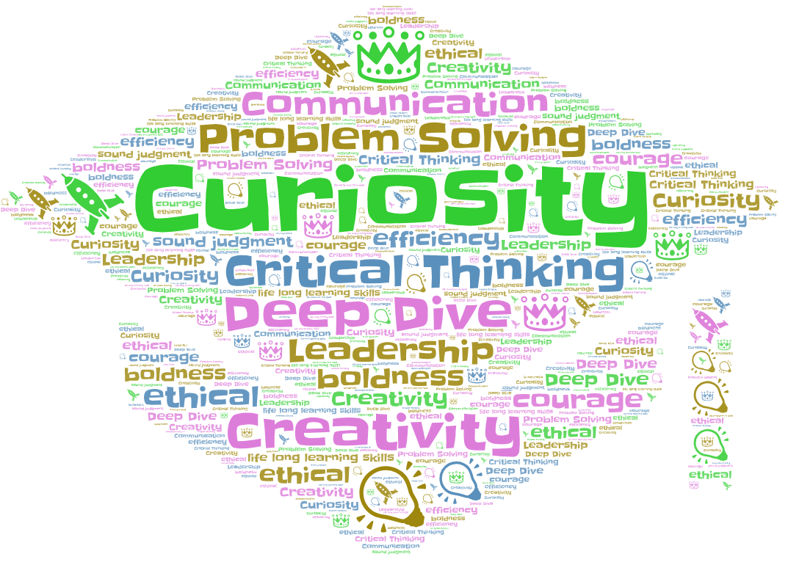
Workforce Expectations

Slide 16


Slide 17

Stay Connected!
Follow CRA on social media

Slide 18
References Attribution: AI-supported editing and content integration by Anthropic Poe and Copilot; image creation by Napkin.
Chau, C. W., Holstein, K., & Madaio, M. (2022). Part of the Conversation: Workforce Professionals' Perspectives on the Roles and Impacts of Workforce Technologies. ACM on Human-Computer Interaction (PACMHCI), 1-22.
Cramer, J. (2026). AI's impact on cognitive ability: MIT study reveals more troubling data . Fast Company.
Fischer, M. (2026). When Did White-Collar Work Start to Look so Bleak? New Yorker.
Lichtenberg, N. (2025). Can't get a job? Blame AI? IMB exec says: 'You can't hire a college student now to just come in and create spreadsheet'. Fortune.
Mahaney, R. C., & Benamati, J. S. (2007). Current and Future Entry-Level IT Workforce Needs in Organizations. SIGMIS CPR '07, (pp. 101-104).
Mills, K., Ruiz, P., Lee, K.-w., Coenraad, M., Fusco, J., Roschelle, J., & Weisgrau, J. (2024). AI Literacy: A Framework to Understand, Evaluate, and Use Emerging Technology. Digital Promise, 1-40.
Surjadi, M. (2024). Colleges Race to Ready Students for the AI Workforce. The Wall Street Journal.
Talagala, N. (2024). How AI will (or Should) Change Computer Science Education. Forbes.
Todd, B. (2026). These 5 skills are AI-proof and likely to become more valuable 'over the next 5 years,' says Oxford-trained career expert. CNBC.
Weening, M., & Crawford, K. (2026, June). How AI is reshaping education and the workforce. (E. Javers, Interviewer

