Slide 1


NAIRR Pilot Resources for High-Performance Machine Learning Education
Lessons from a Graduate Course at UT San Antonio
Buddhi Ashan Mallika Kankanamalage Sushil K. Prasad
NAIRR Pilot Classroom Expansion Conferences | Friday, June 19, 2026 @Embassy Suites Eola 2, Downtown Orlando

Slide 2
Motivation
Rapid growth of AI/ML demands advanced HPC skills for students
Need for both theoretical understanding and practical experience in high-performance ML workloads
National AI research infrastructure (NAIRR) offers unique opportunities for education

Slide 3
Course Overview
Graduate-level Special topics: High Performance Machine Learning course at UTSA
Supported by NAIRR Pilot classroom allocation
DNN foundations + HPC
Hands-on coding
Technical paper presentations and individual term projects

Slide 4
Course Curriculum
Foundations
Introduction to DNN models: model architectures, gradient descent, back propagation, training
Parallel and distributed computing: OpenMP, CUDA, MPI
Distributed deep learning network traning
Data, Model, Pipeline (TensorFlow)
Frameworks: Horovod, AxoNN
Paper discussion
Communication
Memory optimizations
Recent trends: at the edge, federated learning, Architecture search etc

Slide 5
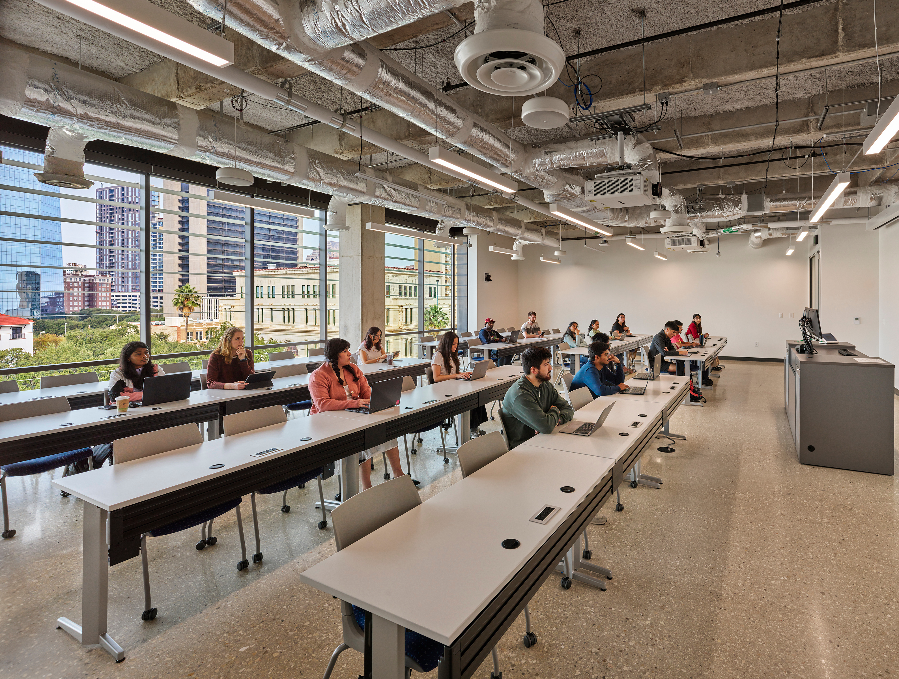
Student Assessment
Assignments
Paper presentations
Paper critique
Term project:
survey project
implementation

Slide 6
Securing and Using NAIRR Resources
UTSA Arc cluster: GPU node availability was low. Not a teaching-dedicated resource
Applied for NAIRR Pilot classroom allocation for computing resources
Initial preference: Indiana Jetstream2 GPU resources.
Jetstream2's VM-per-student model: good for isolation, but limited for distributed/multi-GPU experiments
Applied for NCSA Delta: SLURM compute cluster

Slide 7
Resource Integration & Onboarding
Students access resources via SSH and Jupyter Notebooks.
Onboarding included login, SLURM job scheduling, interactive sessions, and batch scripts.
Lowered barriers for students with limited HPC experience.
Hands-on demonstrations: SSH, Jupyter Notebooks, and standard ML datasets (ImageNet, CIFAR-10/100, Sentinel-2, IceSat-2).

Slide 8
Project analysis slide 8
Course Overview
2025 Spring
2026 Spring
Participation
Participation
5 undergraduate students by permission
13 graduate students
4 undergraduate students by permission
16 graduate students
Assessment
Assessment
Coding assignments, paper critique
3 paper presentations by each student
8 implementation projects
10 survey projects
Coding assignments, paper critique
3 paper presentations by each student
20 implementation projects
20 survey projects
Compute Resources
Compute Resources
UTSA Arc
NCSA Delta
Jetstream2 was not a good fit
2-node small cluster
NCSA Delta
UTSA Arc (optional)

Slide 9
Student Experience & Outcomes
Strongly positive overall feedback
2025 Spring: 8 students completed implementation projects; 4 continued research (including 1 undergraduate)
Strong undergraduate interest led to proposing a dedicated undergraduate section

Slide 10
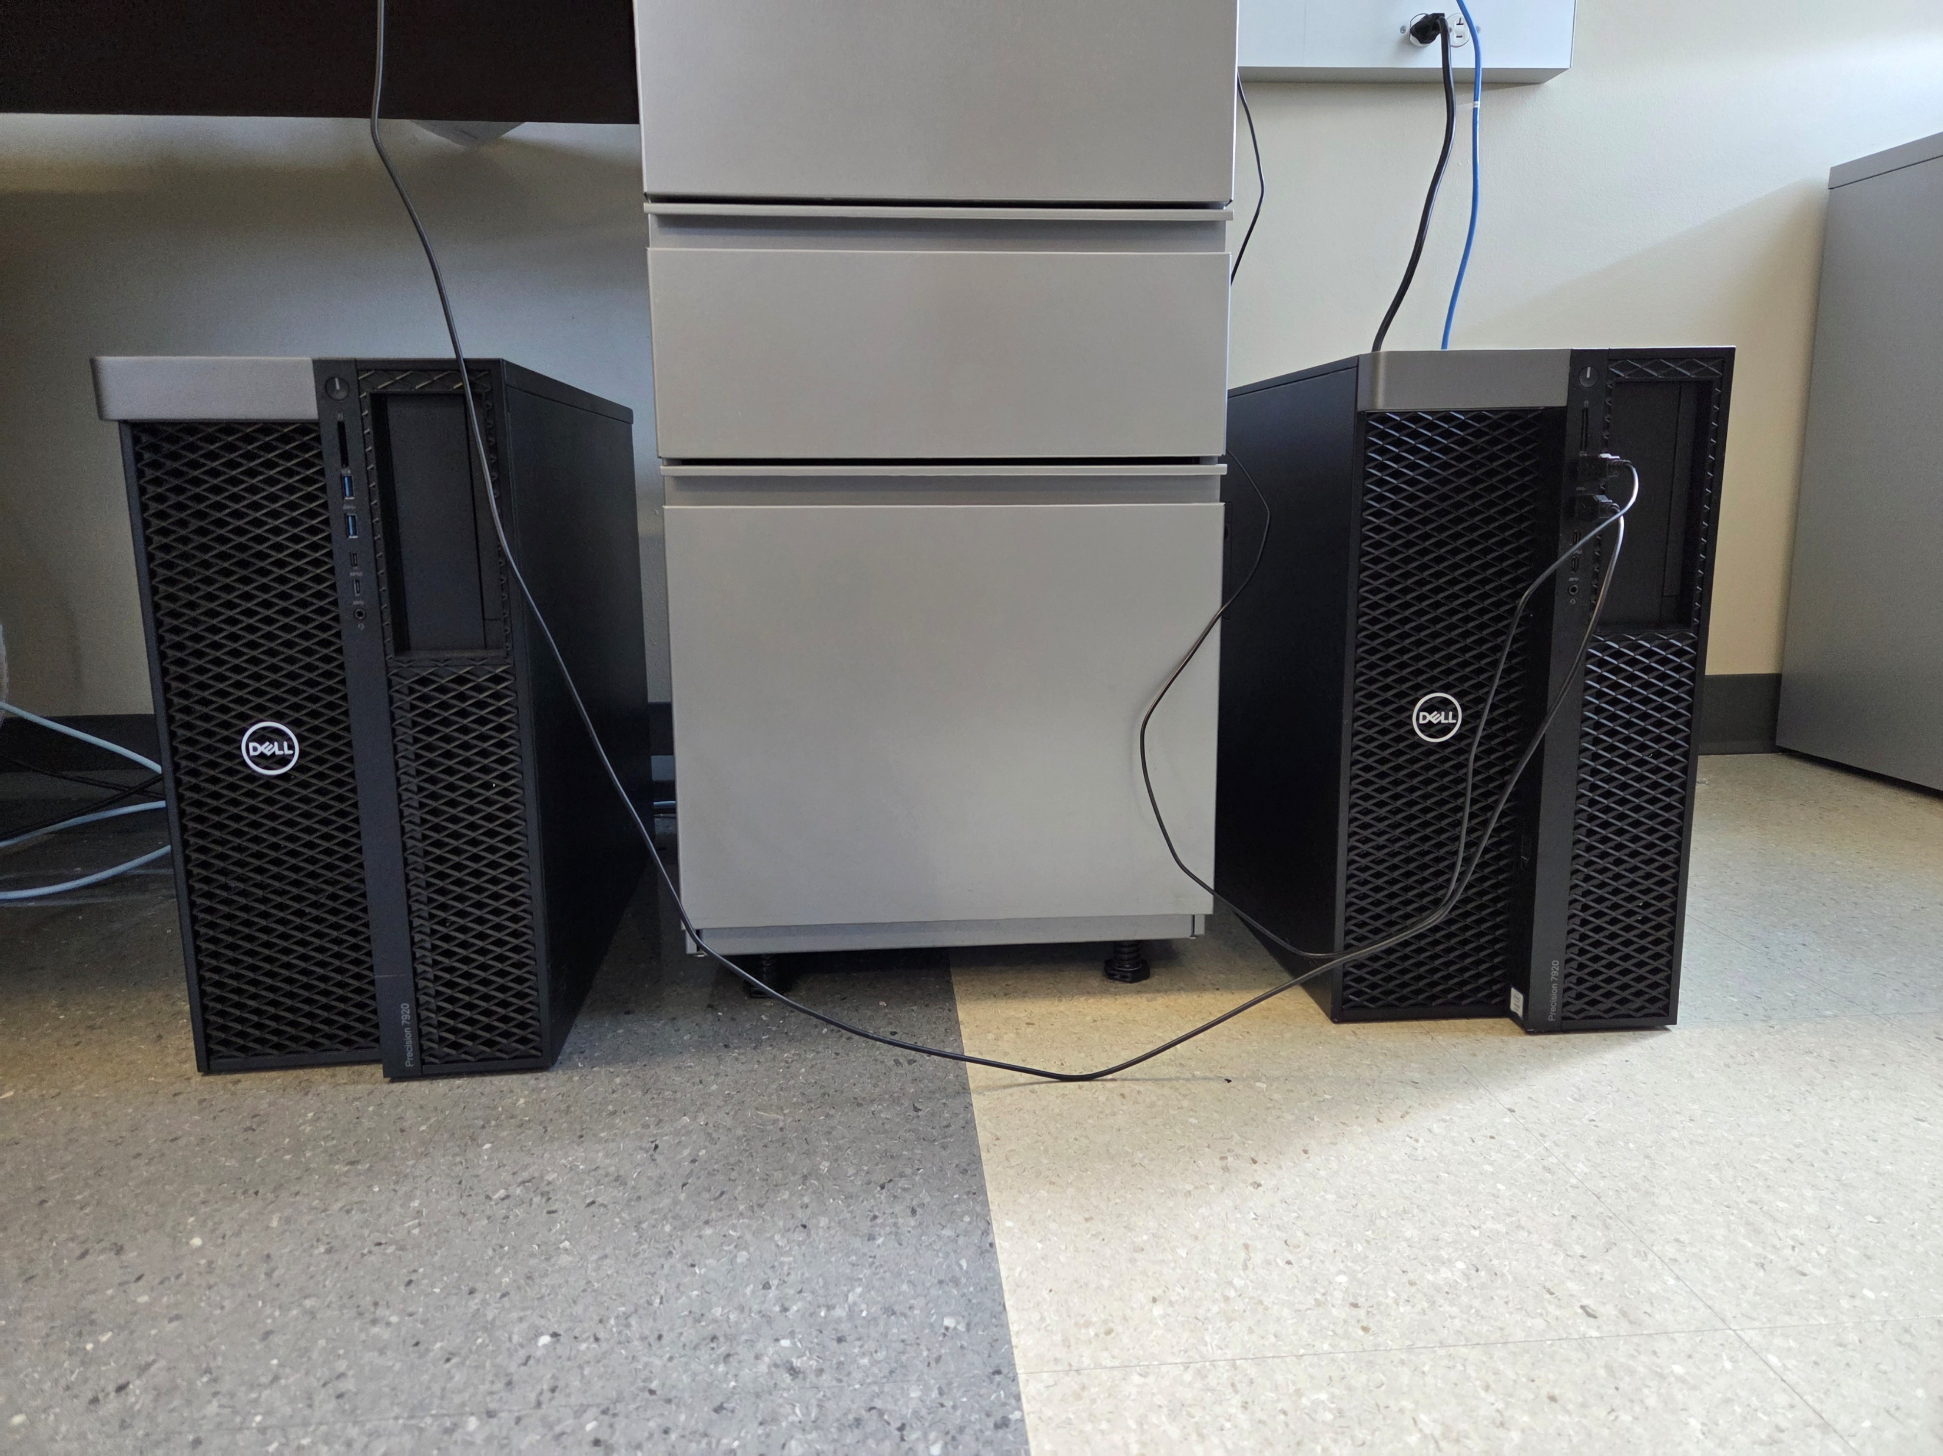
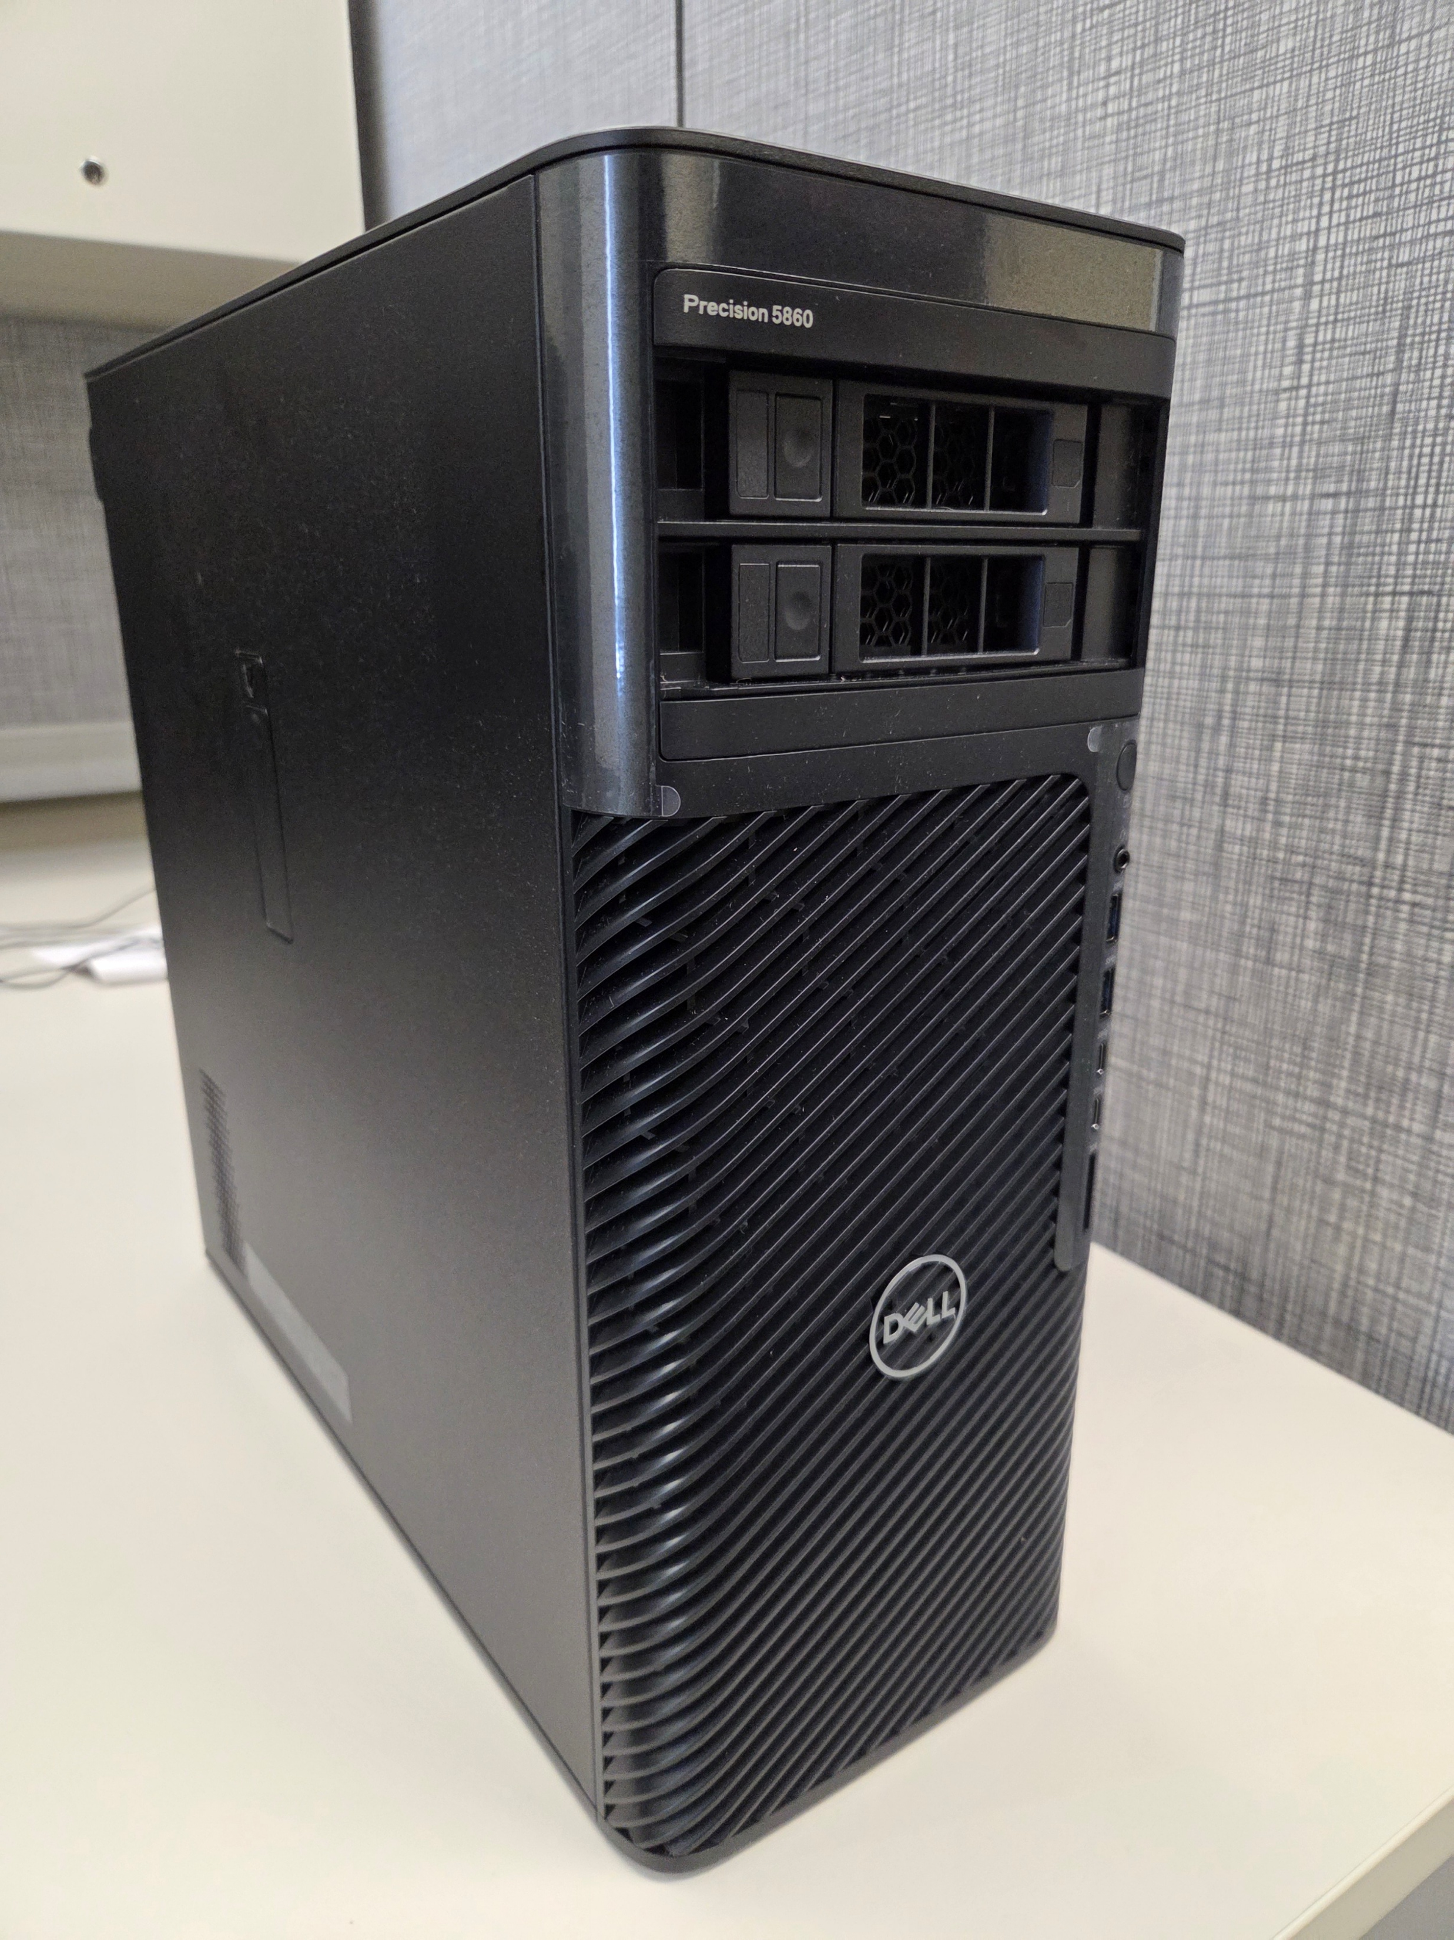
Updated: Resource Integration & Onboarding
Small cluster of 2 nodes each equipped with 2 Nvidia Quadro 5000 cards
Setup for distributed TensorFlow, PyTorch, and MPI
NCSA Delta
SLURM job scheduling related instructions
Access to better GPUs and configurations
Large-scale experiments

Slide 11
Lessons Learned & Course Redesign
Early demonstrations on DNN parallel methods improved project outcomes
Choosing the right resource. Jetstream2 was not a good fit for this type of course
Resource availability timing is critical (late access to Delta limited utility)
Added local cluster (two-node, four-GPU; later expanded with NVIDIA Blackwell GPUs) for instruction and local prototyping

Slide 12
Future Directions & Collaboration
Adapting course for undergraduates: less research-intensive, but hands-on HPC/ML focus retained.
Open to collaboration with peer institutions on curriculum and resource strategies.

Slide 13
Thank You

