Slide 1

www.clark.center
Building AI Education Resources at Scale:
Lessons from CLARK and the Need for a National Knowledge Infrastructure
Sidd Kaza, Blair Taylor
The CLARK System is partially supported by California State University through HQ0034251E002 under the DoW Cyber Academic Engagement Office, the NSF NCyTE Center, NSA NCAE-C program (H98230-21-1-0175), NCCP program (H9830-17-1-0405) and Towson University.

Slide 2

CLARK
HOW DO WE EXPAND AI EDUCATION WHEN
FACULTY, CURRICULUM AND INFRASTRUCTURE
ARE IN SHORT SUPPLY?

Slide 3
The Challenge Facing AI Education
CLARK
Exploding Demand
Faculty Capacity Gap
Resource Fragmentation
AI programs growing rapidly
Industry demand accelerating
Institutions racing to add AI coursework
Limited AI expertise
Faculty overloaded
Difficulty keeping pace with advances
Excellent curriculum exists
Difficult to discover
Difficult to adopt
Difficult to maintain

Slide 4
CLARK
CYBERSECURITY FACED THE SAME PROBLEM!
Workforce shortage
Faculty shortage
Rapidly changing discipline
Lack of accessible curriculum

Slide 5
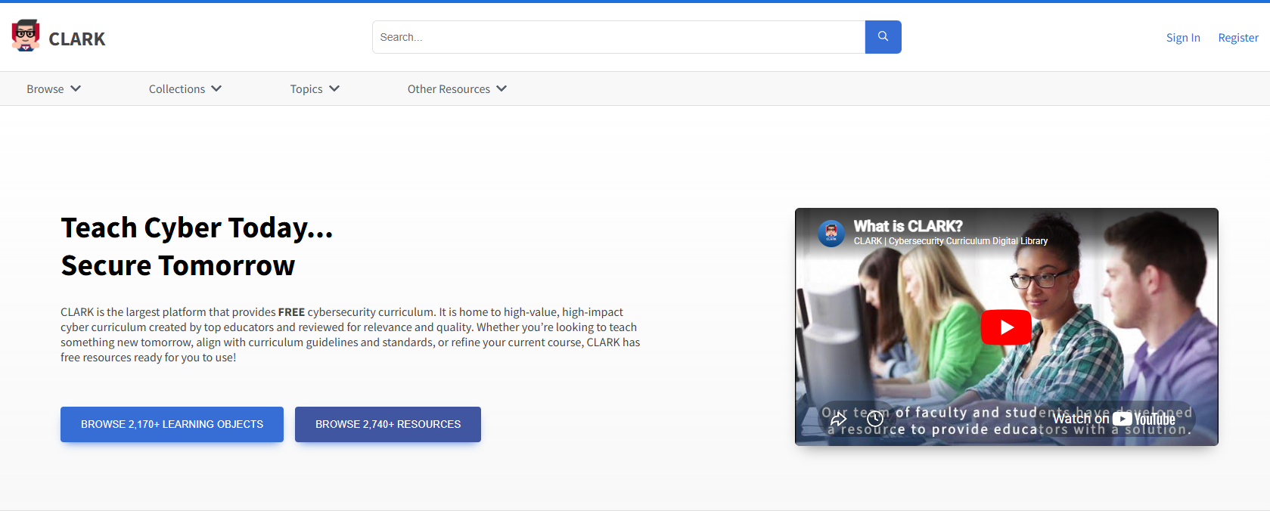
Cybersecurity is a common good that requires a common pool of educational resources.
CLARK
Notes:
The original vision was to create:
A living curriculum library
Community contribution
Standards mapping
Faculty support
Infrastructure support

Slide 6
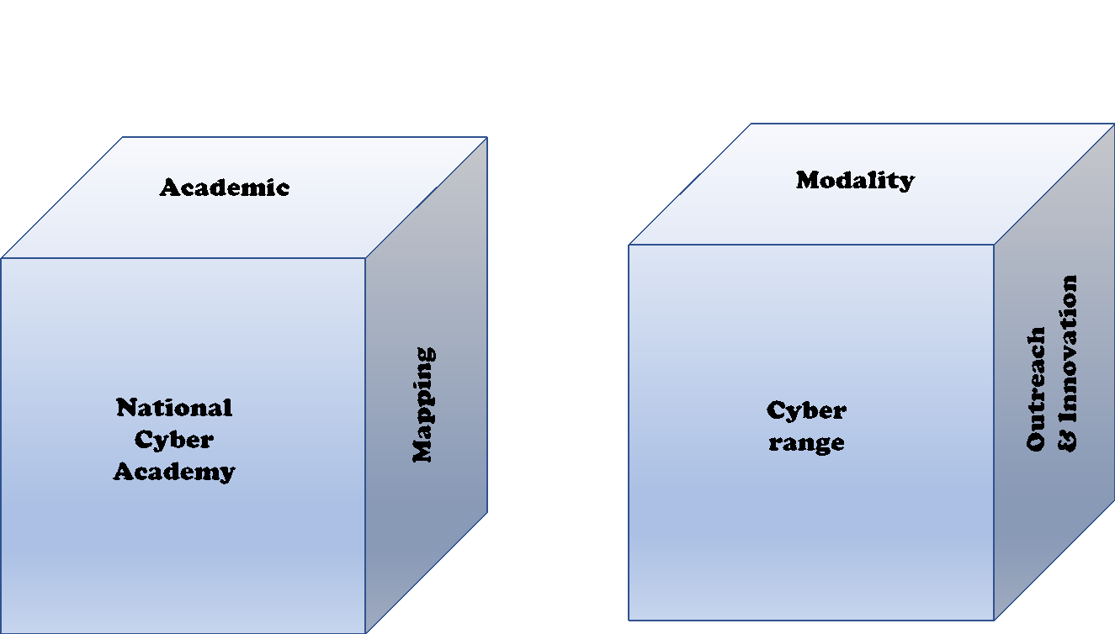
CLARK
The Cyber Cube
Figure 3. The Cyber Cube. Source: Dark, Kaza, LaFountain, & Taylor (2018).
Notes:
Curriculum is not enough.
Need:
Content
Community
Standards
Infrastructure
Professional development

Slide 7
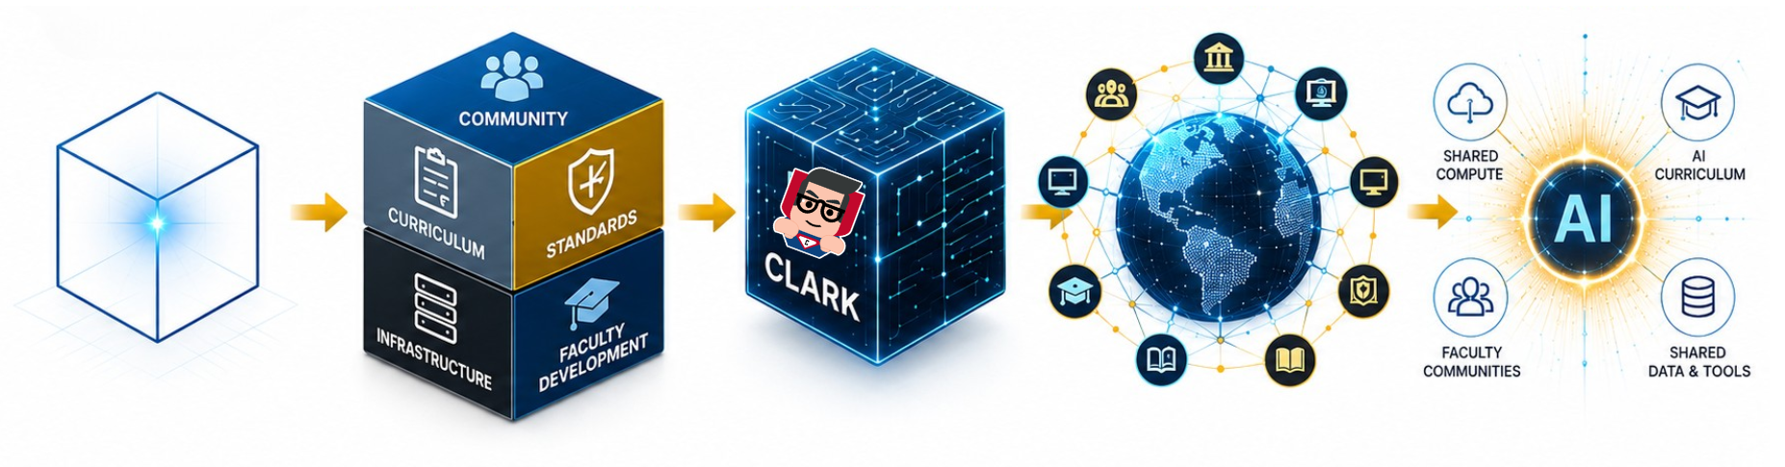
From Cube to Community
CLARK
Building a National Knowledge Infrastructure
2017
2018
2019-23
2024-26
The Future
Cyber Digital Library
The Cyber Cube
CLARK Growth
National Community
AI Knowledge Commons
Initial Vision
A Multifaceted Framework
From Concept to Platform
A Shared Resource
Building What’s Next
One Vision
Many Contributors
Stronger Together
Empowering Educators. Preparing the Workforce. Securing our Future

Slide 8
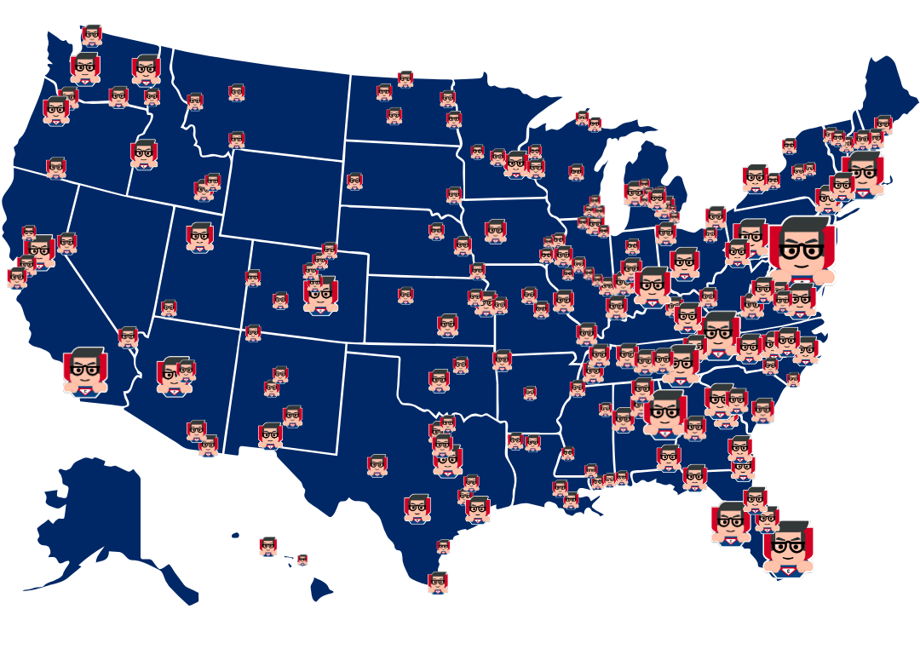
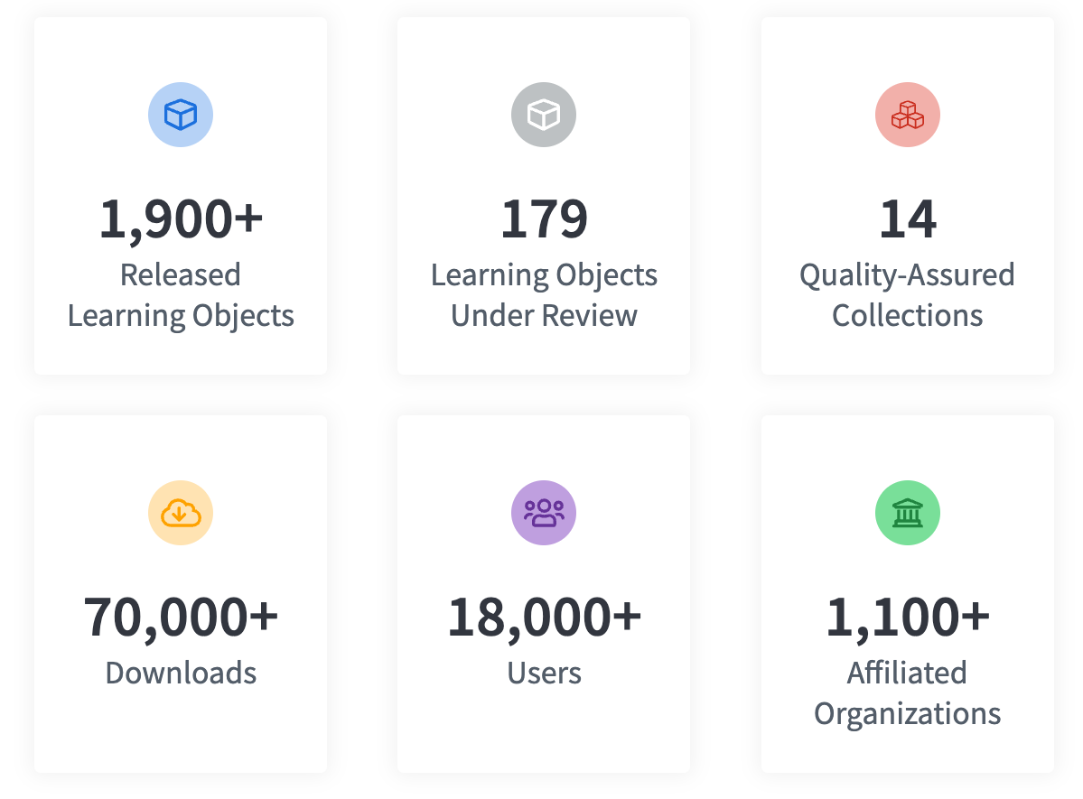
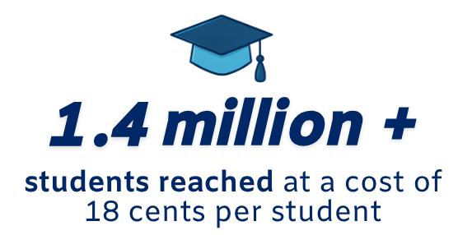
CLARK By the Numbers
CLARK
2,170+
188
13
89,780+
19,140+
1,100+
Notes:
Today:
Largest cybersecurity curriculum repository
Thousands of contributors
Global users
Community-driven model

Slide 9
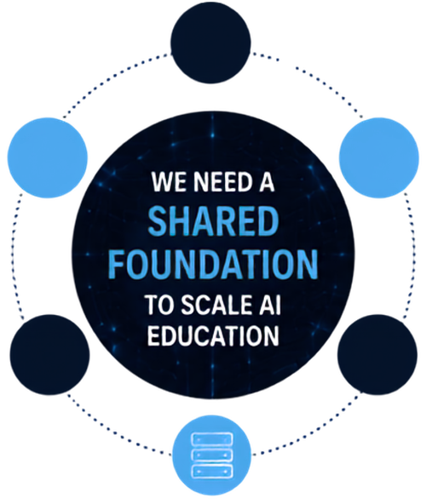













WHY AI NEEDS THIS NOW
CLARK
AI education is experiencing the same inflection point cybersecurity faced a decade ago.
DISCOVERABLE CURRICULUM
CURRICULUM EXPLOSION
AI topics, tools, and frameworks are growing at an unprecedented pace.
CONTINUOUS IMPROVEMENT TOGETHER
FACULTY COMMUNITY SUPPORT
WE NEED A
FACULTY CAPACITY GAP
SHARED RESOURCE
Limited AI expertise and bandwidth make it hard to keep up.
TOOL & MODEL PROLIFERATION
TO SCALE AI EDUCATION
New models, platforms, and tools emerge constantly.
STANDARDS & WORKFORCE ALIGNMENT
SHARED LABS & DATASETS
NEW PROGRAMS & INTERDISCIPLINARITY
Institutions are launching AI programs across every discipline.
GLOBAL COMPETITION
ACCESS TO COMPUTE & INFRASTRUCTURE
Nations are investing heavily in AI education and workforce development.
Notes:
Curriculum is not enough.
Need:
Content
Community
Standards
Infrastructure
Professional development

Slide 10
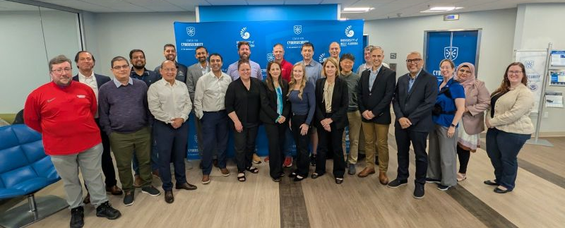



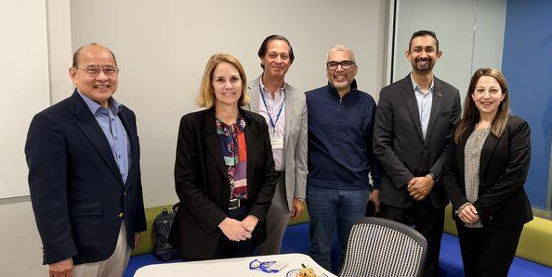


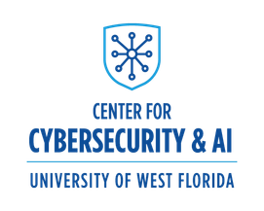


AI AND ML FUNDAMENTALS
Course Development Workshop
February 26–27, 2026 | University of West Florida Center for Cybersecurity
WHAT WE ACCOMPLISHED
A community of AI experts and cybersecurity educators came together to develop a complete AI and ML Fundamentals course aligned with the NCAE-C Cyber AI Knowledge Units (KUs) and the DoW Cyberworkforce Framework (DCWF).
DEVELOPED
A comprehensive Introduction to AI course including syllabus, outline, slides, labs, and assessments.
12+
ALIGNED
INSTITUTIONS
All materials map to Cyber AI KUs, DCWF, and NCAE-C Cybersecurity Curriculum Task Force templates.
21
COLLABORATED
Faculty facilitators and subject matter experts collaborated in small groups and plenary sessions to create high-quality, reusable resources.
PARTICIPANTS
COMMITTED
All course materials will be submitted to the CLARK repository within 45 days for review and distribution to the broader community.
Notes:
Curriculum is not enough.
Need:
Content
Community
Standards
Infrastructure
Professional development

Slide 11
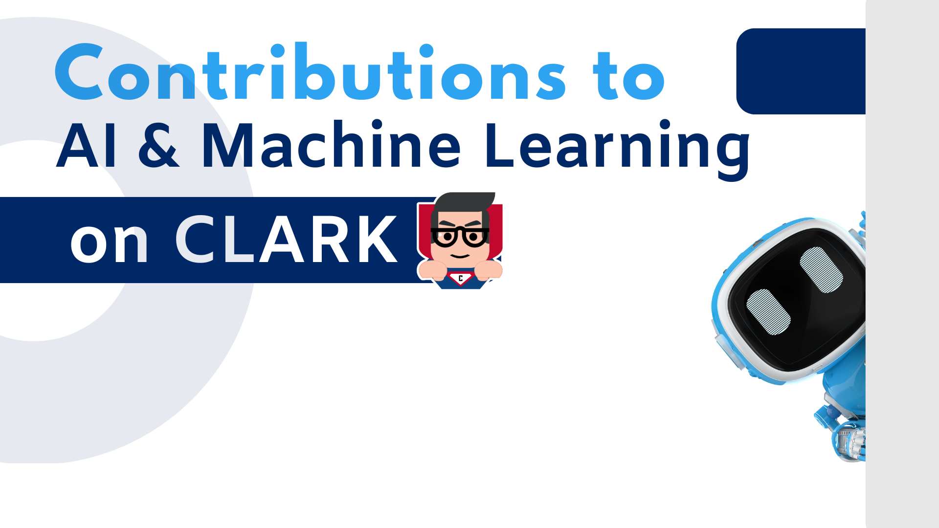
170+ AI & ML Learning Objects
7,010+ AI Curriculum Downloads

Slide 12
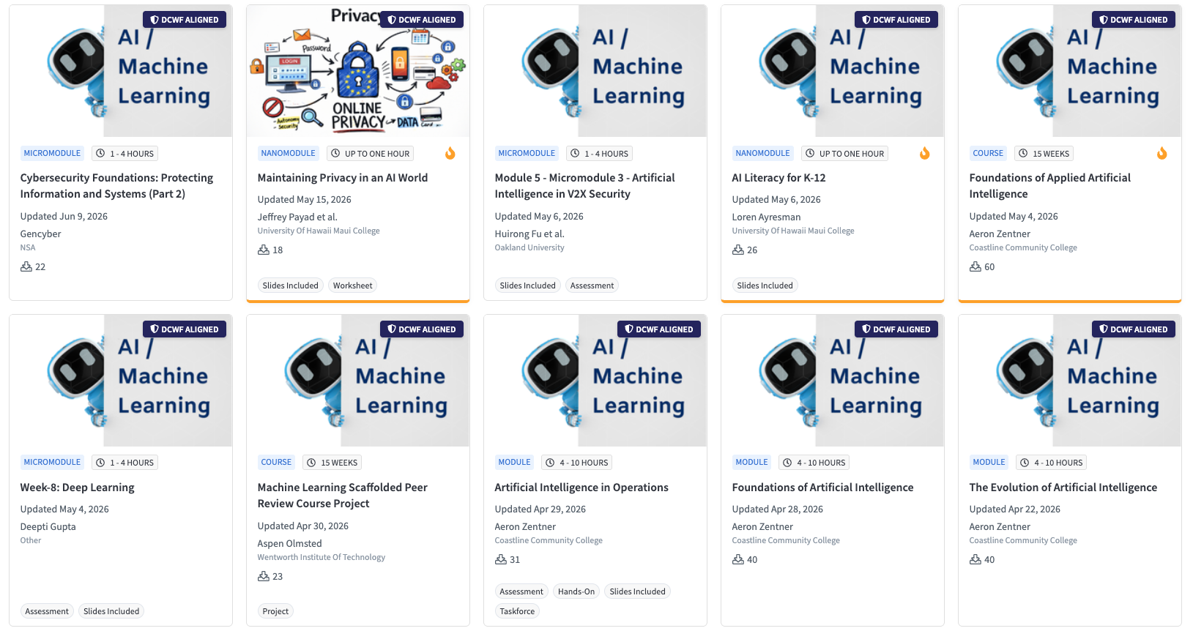
CLARK
AI Curriculum

Slide 13


CLARK + NAIRR: Infrastructure for AI Education at Scale
Together, we can empower every institution to teach AI with confidence.
What We Learned Through CLARK
NAIRR’s
Opportunity
Community Drives Adoption
Expand Compute Capacity
Shared Curriculum Accelerates Innovation
Build AI Communities of Practice
Standards & Workforce Alignment Matter
Increase Access to AI Resources
Faculty Curriculum and Support
Support AI + X Pathways
Curriculum + Compute is needed for AI
Enable Institutions to Scale AI Education

Slide 14
CLARK
www.clark.center
Questions?

Slide 15

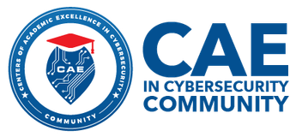



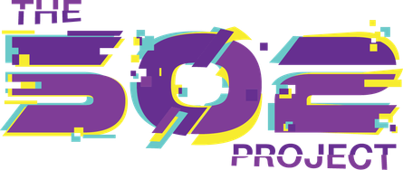
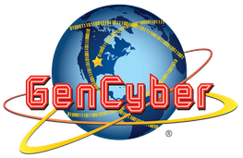
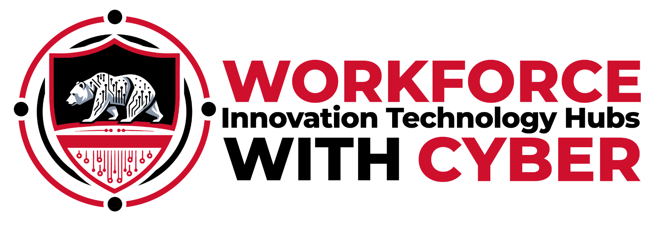





CLARK PARTNERS:

