Slide 1





NSF/NSA CyberAI as a model for the NAIRR Community
Sidd Kaza, Blair Taylor Towson University
This project is partially funded by NSF through the CyberCorps program DGE#1663184 and National Centers of Academic Excellence in Cybersecurity grant HQ0034251E002 (CAE Community) at California State San Bernardino under the DoW Cyber Academic Engagement Office

Slide 2

Bottom line up front (BLUF)
National Security Agency Centers of Academic Excellence (NSA CAE)
Cyber Defense (CAE-CD)
Cyber Operations (CAE-CO)
Cyber Research (CAE-R)
CyberAI (CAE-CAI)
National Science Foundation (NSF)
Was: CyberCorps Scholarship for Service
Now: Scholarship for Service (CyberAI SFS)
Cyber+AI is a good model for AI+X and X+AI

Slide 3



NSF CyberAICorps Program
The 2022 CHIPS and Science Act required the National Science Foundation (NSF) to determine the workforce needs for the US government.
school
lightbulb
history_edu
CyberAI Scholarships
Modeled after Cybercorps "Scholarship for Service" program to build government workforce.
AI Innovation Grants
Multidisciplinary programs covering:
Social & Economic topics
Legal & Ethical frameworks
Graduate Fellowships
Support for master's and doctoral research in AI and AI-related fields.
NSF/NSA Cyber AI Project
Notes:
Provide a report to Congress including:
A. Recent statistical data on the size, composition, and educational requirements of the Federal AI workforce, including an assessment of current and future demand for additional AI professionals across the Federal Government.
B. An assessment of the capacity of institutions of higher education to produce graduates with degrees, certifications, and relevant skills related to artificial intelligence that meet the current and future needs of the Federal workforce.
C. Evaluation of the need, feasibility, and if appropriate, plans to establish an AI-SFS program.

Slide 4
CyberAI Program of Study (PoS)
In February 2024, NSF, in collaboration with the NCAE-C program, launched an initiative to outline AI content for cybersecurity academic programs.
PoS Development
Key Challenges
Collaborative process between educators, government, and industry
Labor-intensive and iterative process
Can take years to fully mature
Aggressive Timeline: Completion in only 6 months
Rapid Evolution: AI field evolving faster than development cycle
NSF CyberAICorps Scholarship for Service (CyberAI SFS)

Slide 5
NSA CyberAI Steering Commitee
Eman El-Sheikh - University of West Florida
Greg Gogolin - Ferris State University
Maanak Gupta - Tennessee Tech University
Seth Hamman - Cedarville University, CAE-CO liaison
Thomas Hill - Montreat College
Yair Levy - Nova Southeastern University, CAE-CD liaison
Vincent Nestler - California State University, San Bernardino
Alexander Perez-Pons - Florida International University
Ariel Pinto - University at Albany, the State University of New York
Md Sajid - Towson University
Mark Spanier - Dakota State University
Daniel Takabi - Old Dominion University
Cara Tang - Portland Community College
Tommy Morris - University of Alabama, Huntsville, CAE-R liaison
Paul Wagner - University of Arizona
Tobi West - Coastline Community College
Blair Taylor, Sidd Kaza - co-leads, CyberAI

Slide 6
CyberAI Programs of Study (PoS)
Security of AI (SecureAI)
securing AI systems and infrastructure throughout their lifecycle
AI for Cybersecurity (AICyber)
leveraging AI to implement traditional cybersecurity

Slide 7
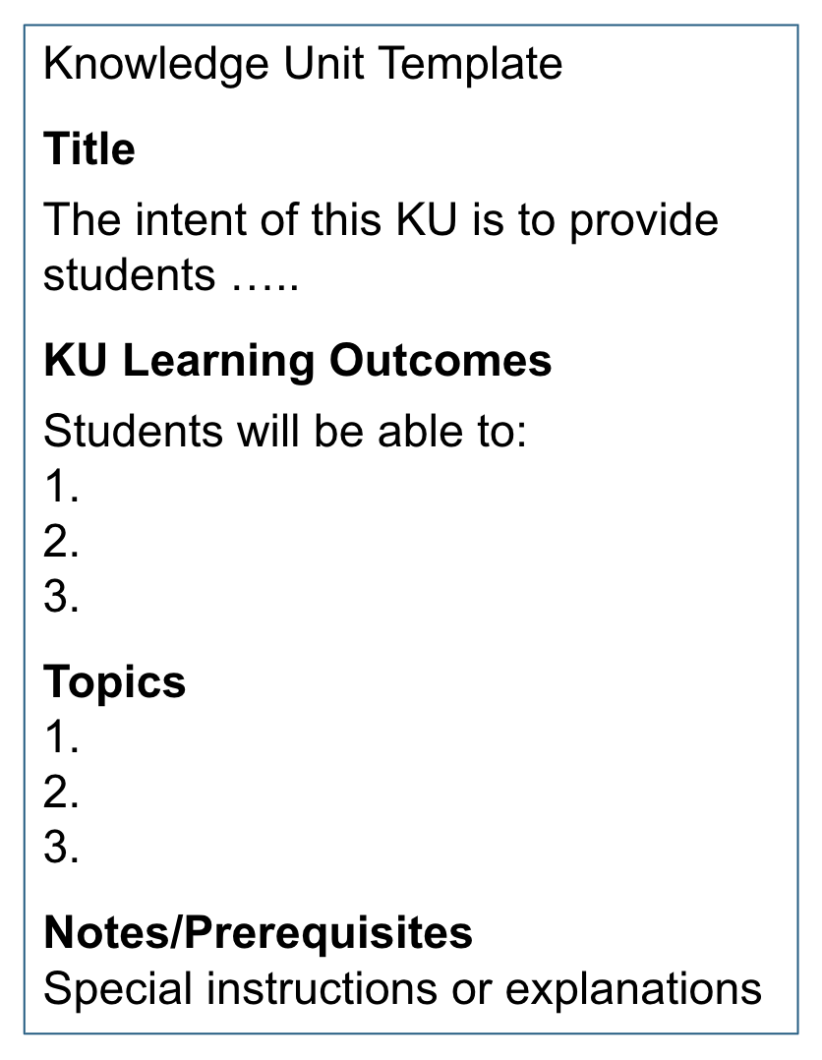
NSA NCAE-C Program of Study
A PoS is a series of courses and experiences that students can realistically complete while working towards a degree or certificate [16]
Academic institutions document their fulfillment of requirements for a PoS through the process of Knowledge Unit (KU) alignment
A KU is a thematic grouping of learning outcomes and topics
Alignment is a continuous process that must be completed every 5 years [18]

Slide 8
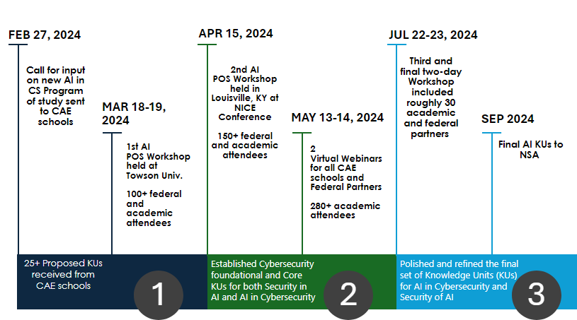
Short timeline
More details: towson.edu/cyberai

Slide 9
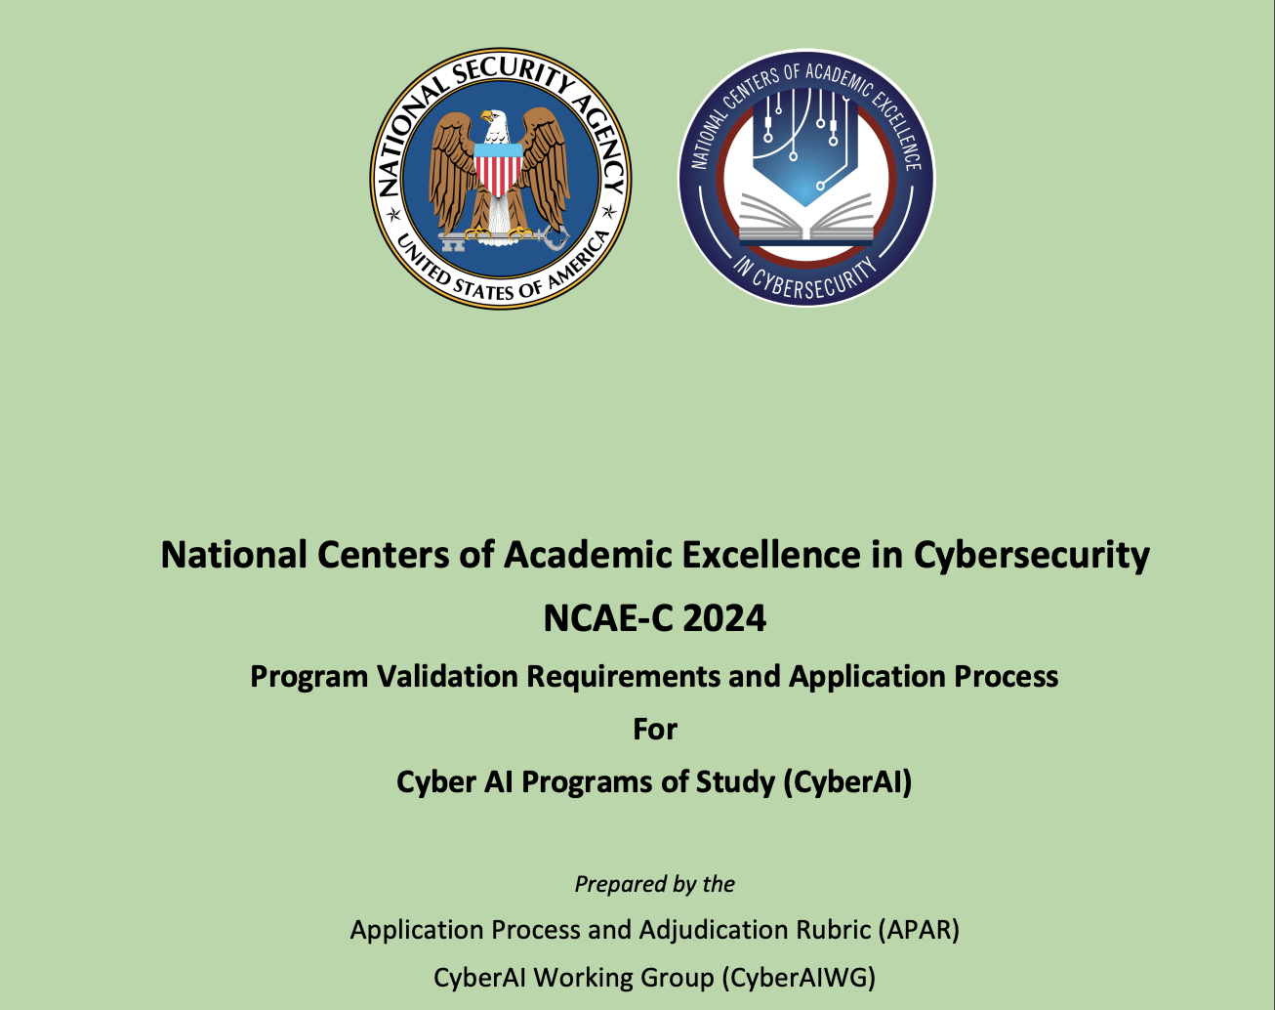
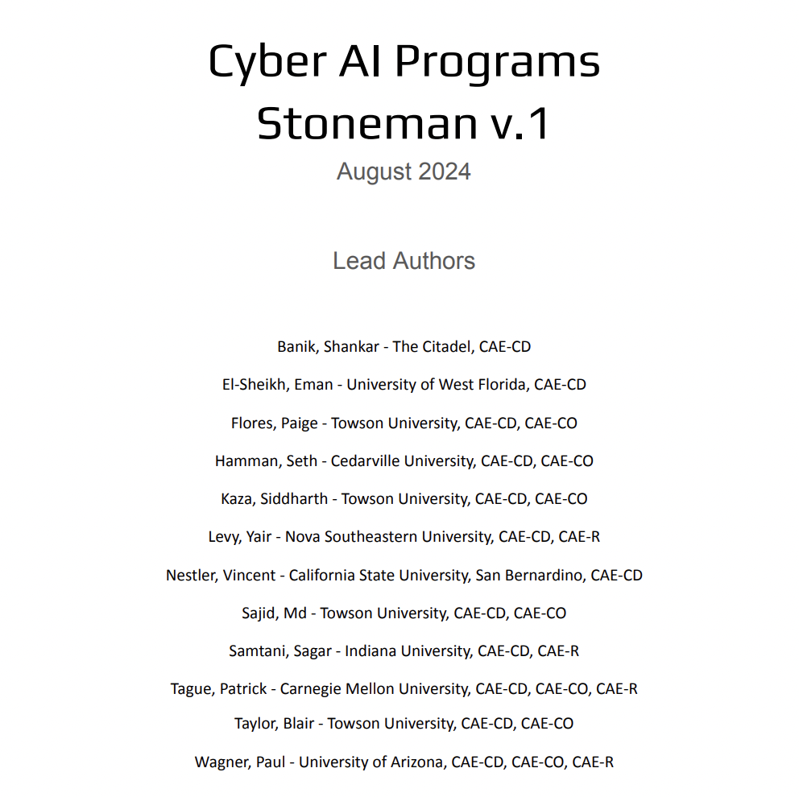
CyberAI Knowledge Units found at:
https://www.caecommunity.org/cop-cyber-ai
CyberAI Program of Study Validation Requirements CAE POS-CyberAI KUs

Slide 10
CyberAI Knowledge Units
Defense Cyber Workforce Framework
ABET Accreditation (?), ACM Guidelines (?)
Artificial Intelligence in Cybersecurity Work Role Definitions (NSF Draft)
ALIGNED to Outcomes
SecureAI
Program of Study
Must be CAE - CD or CO Designated
Program rigor will dictate which PoS students choose
SecureAI PoS
AICyber PoS
AICyber
Program of Study
Must be CAE - CD or CO Designated
Will compliment CD or CO PoS – could be Minor or Electives
Secure AI
Optional KUs
AI Cyber
Optional KUs
Security of AI
(SecureAI)
Core KUs
AI for Cybersecurity
(AICyber)
Core KUs
AI Foundational KUs
Cyber Foundational KUs
Notes:
Sidd & Blair
KUs

Slide 11
CyberAI KU document
Secure AI PoS
AICyber PoS
Optional KUs (1): Model Selection, Evaluation & Specification; Risk Management of AI
Optional KUs (1): Defensive Applications of AI; Offensive Applications of AI
Secure AI Core KUs (6): Computer Science Foundations (~CO); Advanced Math for AI; Securing the AI Lifecycle; Machine Learning Algorithms; Deep Learning; Adversarial Learning
AICyber Core KUs (3): Basic Networking (~CD); Network Defense (~CD); AI for Security Assessment
AI Foundational KUs (4): AI Governance, Law, & Ethics; AI Fundamentals; Machine Learning Fundamentals, Math Fundamentals
Cyber Foundational KUs (3): Cybersecurity Fundamentals; IT Systems Components, Basic Scripting and Programming

Slide 12

AI Companion to build guidelines
Iteration | Publication Date | AI Assistant
Strawman 1 | May 14, 2024 | None (human creation only)
Strawman 2 | July 11, 2024 | Custom GPT
Strawman 3 | July 19, 2024 | Custom GPT
Strawman 4 | July 22, 2024 | None
Strawman 5 | July 23, 2024 | None
Strawman 6 | July 23, 2024 | None
Stoneman | August 29, 2024 | Custom GPT
AI Assistants were utilized in several iterations to refine the KUs
Paige Zaleppa, Siddharth Kaza, Blair Taylor, and Md Sajid. (2024) Using AI Assistants in the Creation of an Academic Program of Study (PoS) in CyberAI. Proceedings of the 28th Colloquium for Information Systems Security Education (CISSE), Tampa, FL

Slide 13
Update on NSA CyberAI Program
v
01
3 SecureAI, 8 CyberAI
3 applying for both. List includes community colleges
02
Alignment with National Standards
ACM, DCWF, ABET
03
Industry Input
Minnesota workshop, Frontier AI workshop

Slide 14
KU Evaluation and Revision
01. NSA SMEs
Feedback Received
Review and map NSA SMEs feedback; identify common themes, trends, and valid points to suggest updates/deletions.
Aug - Sept 2025
02. Pilot Schools
Comparison Analysis
Map SME feedback against pilot school data to find trends and suggest Knowledge Unit (KU) revisions.
Spring 2026
03. Cyber/AI Experts
Expert Workshop
Focus groups for invited pilot schools and experts to finalize the updated KU draft.
March 2026
04. Framework Alignment
Alignment to DOD Cyber Workforce Framework (DCWF).
05. Final Revised KUs
Version 2026
10

Slide 15
SWOT
A separate guideline for AI
STRENGTHS
Aligns with National AI and cyber priorities
Enhances academic and program visibility
Builds AI-cybersecurity workforce pipeline
Spurs curriculum and research innovation at speed of relevance
Replicate the cyber ed community model - faster
WEAKNESSES
High resource demands for institutions
Too many curricular guidelines? Is separate accreditation needed?
Potential overlap with other designations
SWOT
OPPORTUNITY
THREATS
Access to AI-focused federal and state funding
Drives interdisciplinary collaboration
Shapes national AI standards
Attracts industry partnerships
Do it differently - skills forward, curriculum forward, resource forward
Small schools may struggle when AI is integrated
AI evolution may outpace program scope
Complex accreditation and evaluation

Slide 16
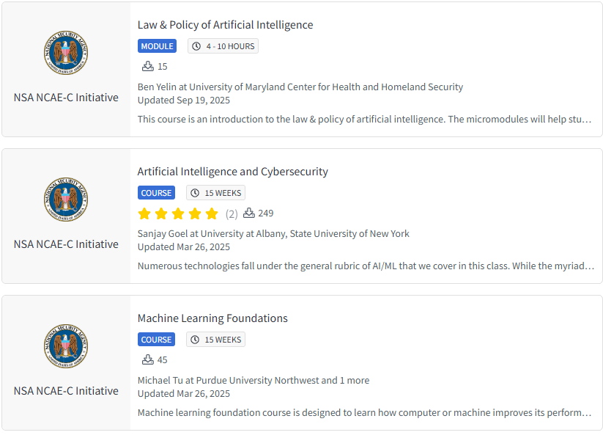

CyberAI Curriculum (www.clark.center)
CyberAI Curriculum
Now on CLARK
Modules Cover:
AI Security
Privacy
Ethics
Governance
DOWNLOAD TODAY!

Slide 17

QUESTIONS?

